Slide 1
COPE: An accurate k-mer based pair-end reads connection tool to facilitate genome assembly
Binghang Liu, Jianying Yuan, Siu-Ming Yiu, Zhenyu Li, Yinlong Xie, Yanxiang, Chen, Yujian Shi, Hao Zhang, Yingrui Li, Tak-Wah Lam, and Ruibang Luo
Bioinformatics , Vol. 28, No. 22, 2012, pp. 2870-2874
周展億
2013-08-20

Slide 2
ABSTRACT
Motivation: The boost of next-generation sequencing technologies provides
us with an unprecedented opportunity for elucidating genetic mysteries,
yet the short read length hinders us from better assembling the genome
from scratch. New protocols now exist that can generate overlapping pair-end
reads. By joining the 3’-ends of each read pair, one is able to construct
longer reads for assembling. However, effectively joining two overlapped
pair-end reads remains a challenging task.
Result: In this paper, we present an efficient tool called COPE (Connecting
Overlapped Pair-End reads), to connect overlapping pair-end reads
using k-mer frequencies. We evaluated our tool on 30x simulated pair-end
reads from Arabidopsis thaliana with 1% base error. COPE connected over
99% of reads with 98.8% accuracy, which is respectively 10% and 2%
higher than the most recently published tool FLASH. When COPE is applied
to real reads for genome assembly, the resulting contigs are found to
have fewer errors and give a 14 fold improvement in the N50 measurement
when compared to the contigs produced using unconnected reads.
Availability and Implementation: COPE is implemented in C++ and is
freely available as open-source code at ftp://ftp.genomics.org.cn/pub/cope.

Slide 3
舊有工具的缺點
1. 比對需要一個最小的重疊範圍限制
2. 重複出現的模式，或較簡單的序列會導致重疊的範圍不一
3. 舊有的工具只比較兩個base的質，若一樣就直接比對並輸出結果，容易造成錯誤

Slide 4
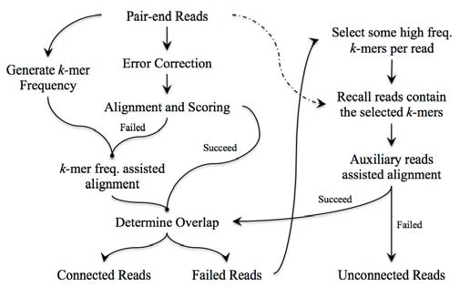
COPE流程

Slide 5
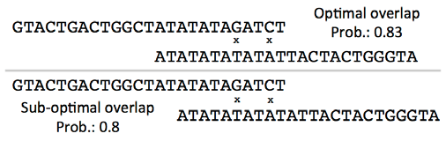
Alignment-based connection algorithm
對齊兩條read，其重疊長度必須大於k，若小於k則在下個階段進行檢驗（k為k-mer長度）
Matching Rate:
Rate(loverlap ) = (loverlap − nmismatch ) / loverlap
loverlap = 重疊長度
nmismatch = 沒有對應到的核酸個數
12
R(l) = (12 - 2) / 12 = 0.83
R(l) = (10 - 2) / 10 = 0.8
10

Slide 6
Alignment-based connection algorithm
Base: b0 and b1
Error probability: e0 and e1
Combination score: R(l) * (1 - e0)
若有任何一組配對分數相同，則定義為dilemma read

Slide 7
K-mer frequency assisted connection
K-mer frequency table：假設上一個步驟一開始就選了不好的base
Combination score: R(l) * (1 – e) → R(l) * η(1 – e)
η：k-mer展開base後產生mismatch的頻率
藉由帶有k-mer frequency的combination score可處理大部分的dilemma read，同時也使得較短長度的重疊得以被發現
展開所有k-mer會耗費大量的時間，COPE用了一點技巧來減少展開時間：若k-mer出現的頻率很低(通常是1)，就不繼續展開其他k-mer，並判定此read是假的overlap。
一般會繼續展開的情形是2~3。
超過3則直接將此read pair丟到下個階段。

Slide 8
COPE流程

Slide 9
Auxiliary reads and cross connection
剩下的read中，有著正常出現頻率的k-mer，會被抓出來，包含著這些k-mer的read會被叫回來，這些read就稱作Auxiliary read。
這些read會再次確認是否有任何的overlap

Slide 10
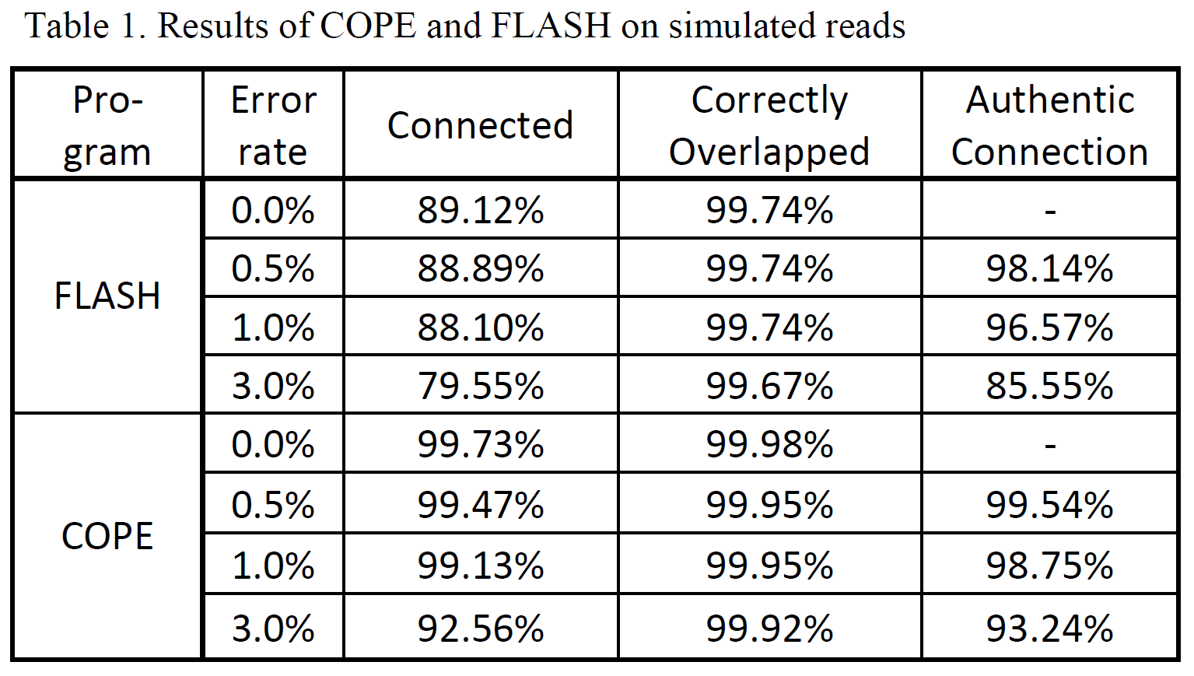

Slide 11
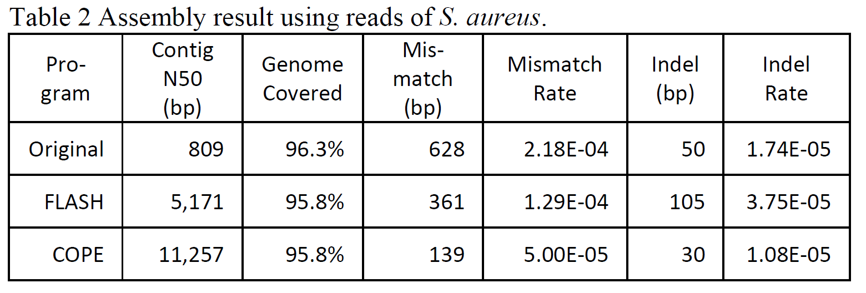

Slide 12
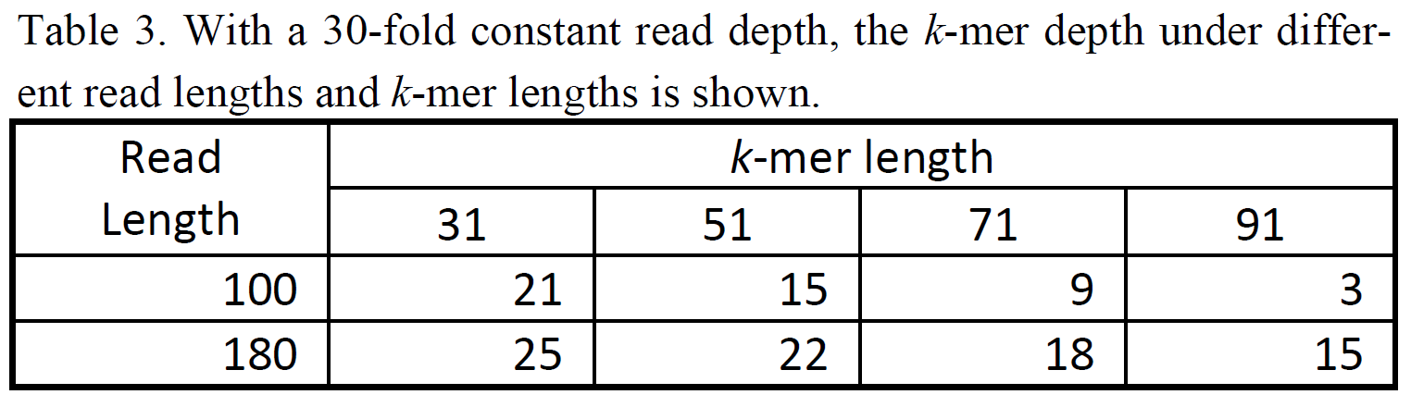
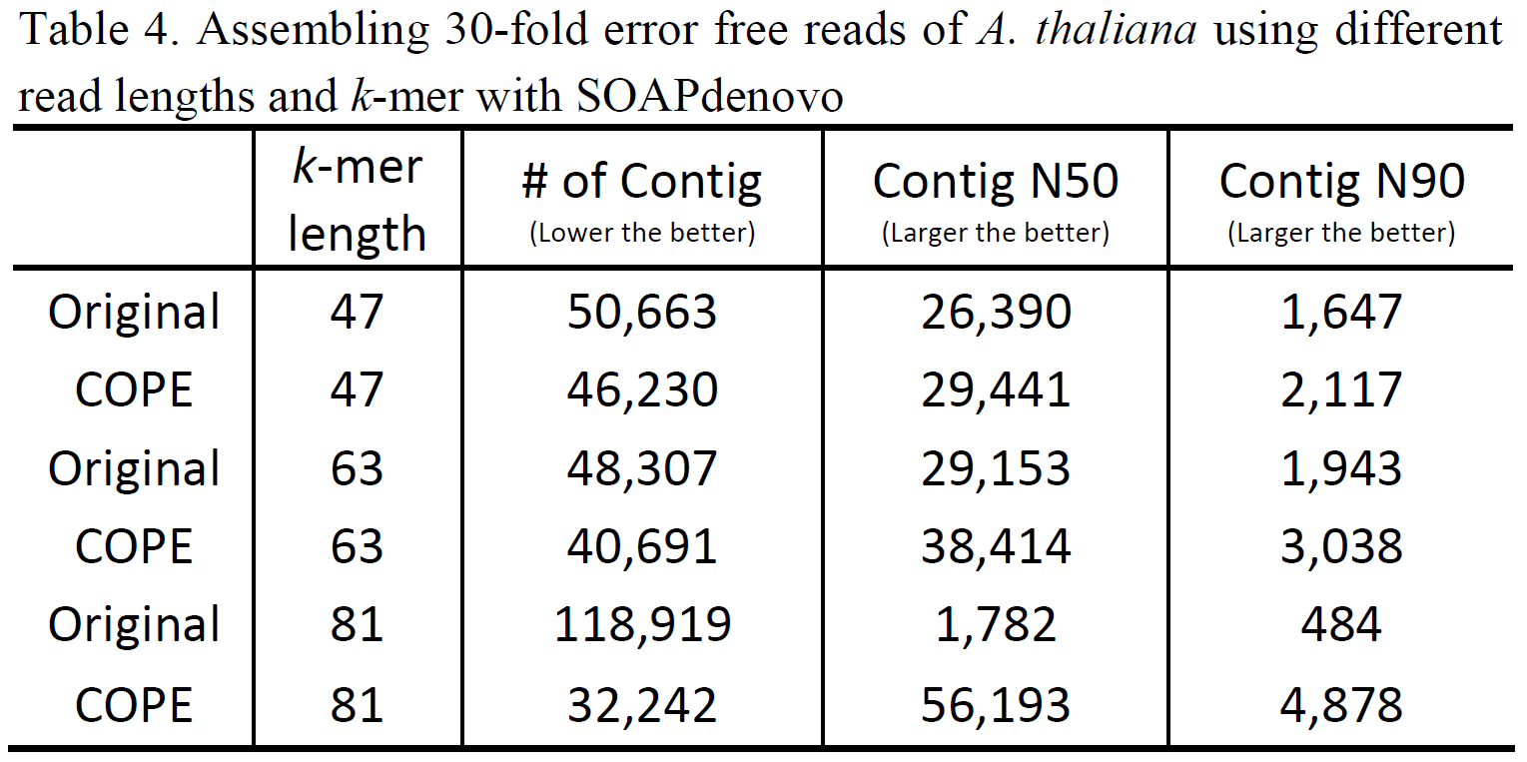

Slide 13
