Slide 1
Fast Randomized Model Generation for Shapelet-Based Time Series Classification
Daniel Gordon, Danny Hendler, Lior Rokach
arXiv:1209.5038v1 [cs.LG] 23 Sep 2012, CoRR. 2012.
Presenter: Che-Jui Hsu (許哲睿)
Date: 2013/8/20
Notes:
http://arxiv.org/abs/1209.5038

Slide 2
Abstract (1/3)
Time series classification is a field which has drawn much attention over the past decade. A new approach for classification of time series uses classification trees based on shapelets. A shapelet is a subsequence extracted from one of the time series in the dataset. A disadvantage of this approach is the time required for building the shapelet-based classification tree. The search for the best shapelet requires examining all subsequences of all lengths from all time series in the training set.

Slide 3
Abstract (2/3)
A key goal of this work was to find an evaluation order of the shapelets space which enables fast convergence to an accurate model. The comparative analysis we conducted clearly indicates that a random evaluation order yields the best results. Our empirical analysis of the distribution of high-quality shapelets within the shapelets space provides insights into why randomized shapelets sampling is superior to alternative evaluation orders.

Slide 4
Abstract (3/3)
We present an algorithm for randomized model generation for shapelet-based classification that converges extremely quickly to a model with surprisingly high accuracy after evaluating only an exceedingly small fraction of the shapelets space.

Slide 5
Shapelet
A shapelet is a subsequence extracted from one of the time series in the dataset.

Slide 6
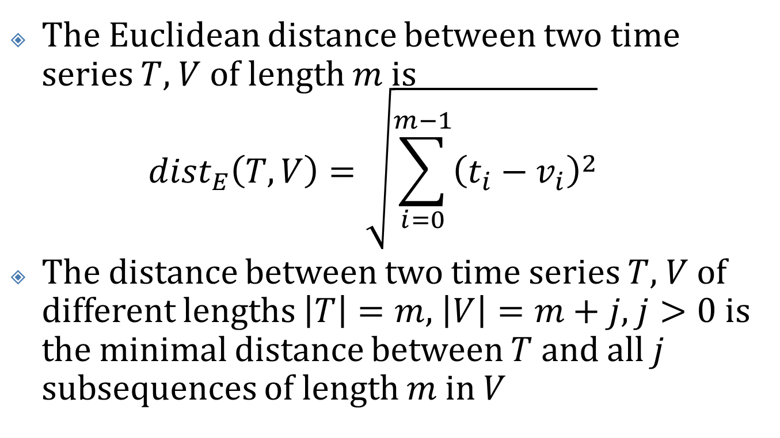
Distance
The Euclidean distance between two time series $T$, $V$ of length $m$is ${dist}_{E}\left(T, V\right)=\sqrt{\sum_{i=0}^{m−1}{{\left(t_{i}−v_{i}\right)}^{2}}}$
The distance between two time series $T$, $V$of different lengths $\left|T\right|=m$, $\left|V\right|=m+j$, $j>0$ is the minimal distance between $T$ and all $j$ subsequences of length $m$in $V$

Slide 7
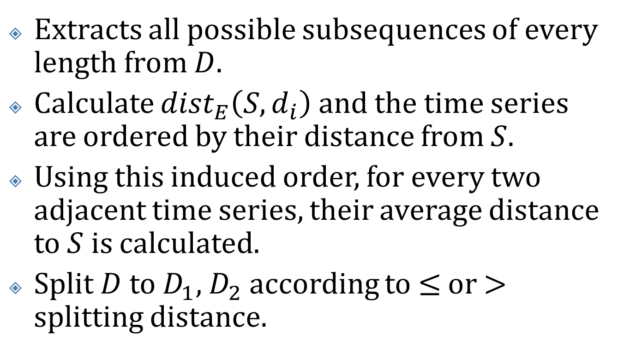
The YK Shapelet Extraction Algorithm (1/3)
Extracts all possible subsequences of every length from $D$.
Calculate ${dist}_{E}\left(S, d_{i}\right)$and the time series are ordered by their distance from $S$.
Using this induced order, for every two adjacent time series, their average distance to $S$ is calculated.
Split $D$to $D_{1}$, $D_{2}$according to $≤$ or $>$ splitting distance.

Slide 8
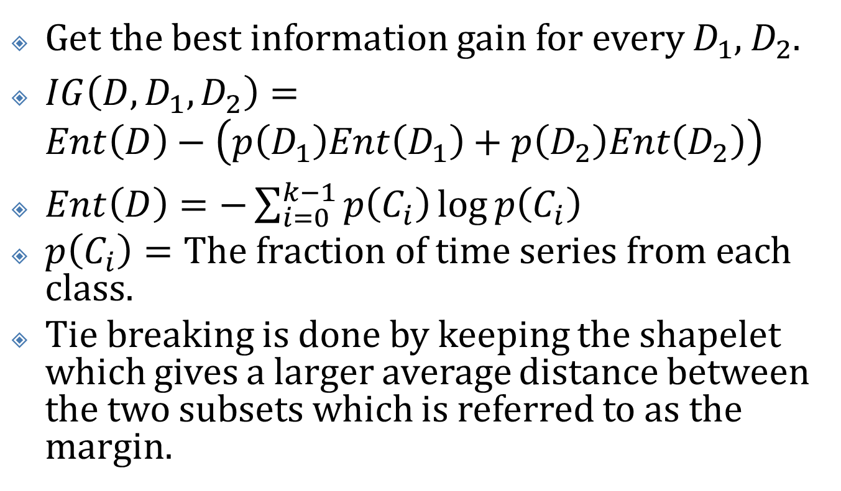
The YK Shapelet Extraction Algorithm (2/3)
Get the best information gain for every $D_{1}$, $D_{2}$.
$IG\left(D, D_{1}, D_{2}\right)=Ent\left(D\right)−\left(p\left(D_{1}\right)Ent\left(D_{1}\right)+p\left(D_{2}\right)Ent\left(D_{2}\right)\right)$
$Ent\left(D\right)=−\sum_{i=0}^{k−1}{p\left(C_{i}\right)\log{p\left(C_{i}\right)}}$
$p\left(C_{i}\right)=\text{The} \text{fraction} \text{of} \text{time} \text{series} \text{from} \text{each} \text{class}\text{.}$
Tie breaking is done by keeping the shapelet which gives a larger average distance between the two subsets which is referred to as the margin.

Slide 9















The YK Shapelet Extraction Algorithm (3/3)
$$D$$
$$D_{1}$$
$$D_{2}$$
$$D_{1_1}$$
$$D_{1_2}$$
$$D_{2_1}$$
$$D_{2_2}$$
$$D_{1_1_1}$$
$$D_{1_1_2}$$
$$D_{1_2_1}$$
$$D_{1_2_2}$$
$$D_{2_1_1}$$
$$D_{2_1_2}$$
$$D_{2_2_1}$$
$$D_{2_2_2}$$
Until all the time series in the subset are from one class.

Slide 10
The Shaplet Sampling (SALSA) Algorithm (1/2)
Four different from YK algorithm
Change the order in which shapelets are examined, to allow fast sampling of the entire shapelet domain.
Samples and examines only a small subset of all possible shapelets, ceasing analysis of new shapelets once the quality of shapelets stabilizes.
Stable: new shapelets improve the IG and margin of the current best shapelet by a significant amount or not.

Slide 11
The Shaplet Sampling (SALSA) Algorithm (2/2)
Four different from YK algorithm
While examining shapelets in the root node, the distances of each shapelet to all time series are saved.
While building the rest of the classification tree, only those shapelets already examined by the root, with distances to time series already precalculated, are considered as candidates.

Slide 12
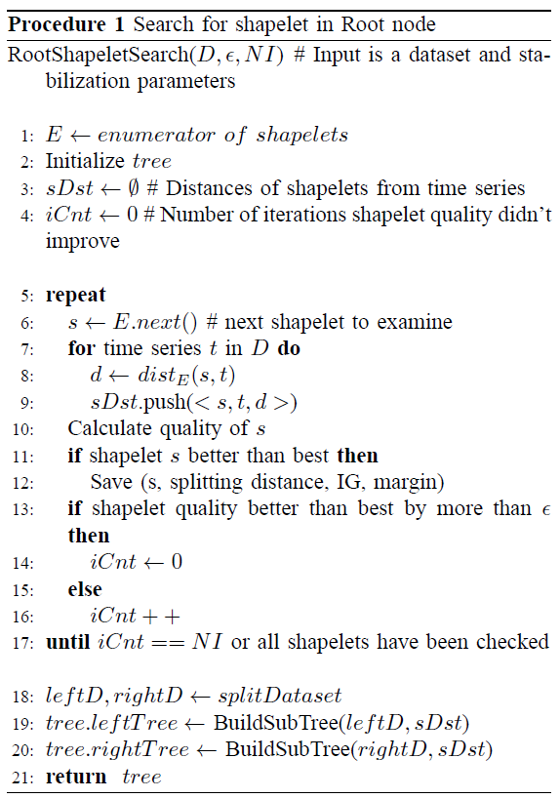
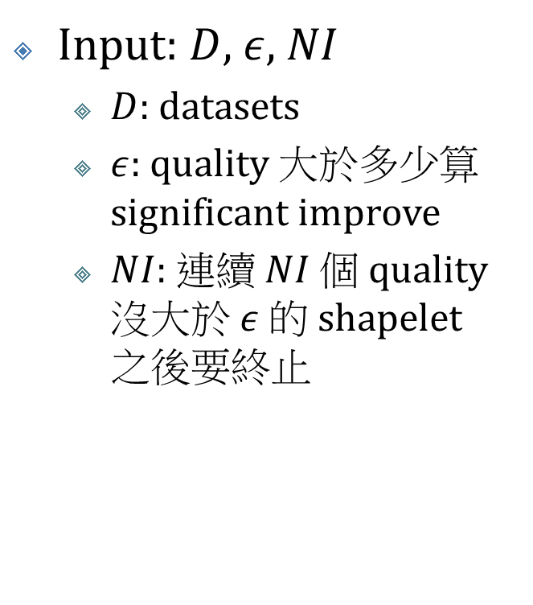
Search for Shapelet in Root Node (1/2)
Input: $D$, $ε$, $NI$
$D$: datasets
$ε$: quality 大於多少算 significantimprove
$NI$: 連續 $NI$ 個 quality 沒大於 $ε$ 的 shapelet 之後要終止

Slide 13
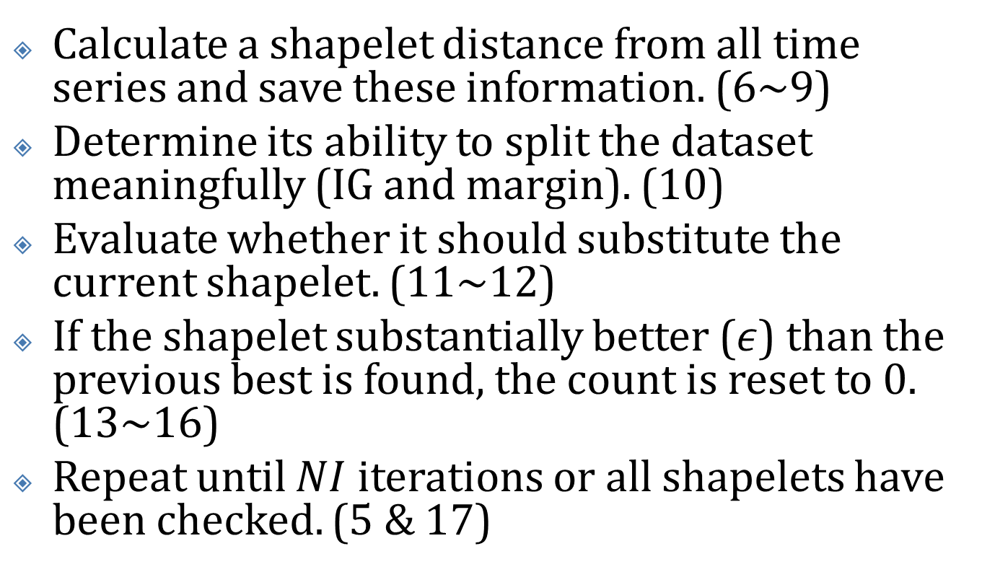
Search for Shapelet in Root Node (2/2)
Calculate a shapeletdistance from all time series and save these information. (6~9)
Determine its ability to split the dataset meaningfully (IG and margin). (10)
Evaluate whether it should substitute the current shapelet. (11~12)
If the shapelet substantially better ($ε$) than the previous best is found, the count is reset to 0. (13~16)
Repeat until $NI$ iterations or all shapelets have been checked. (5 & 17)

Slide 14
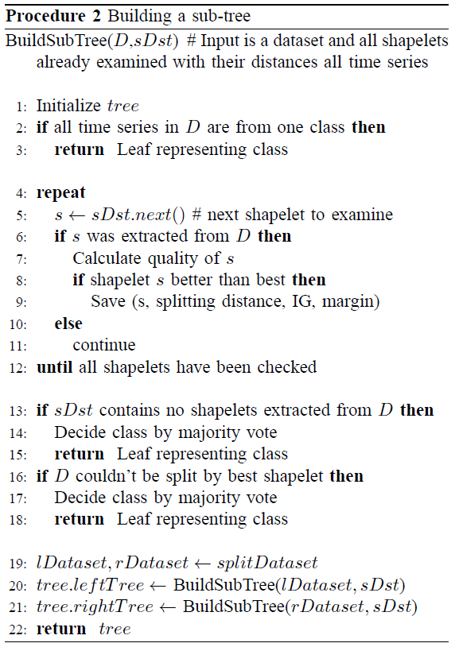
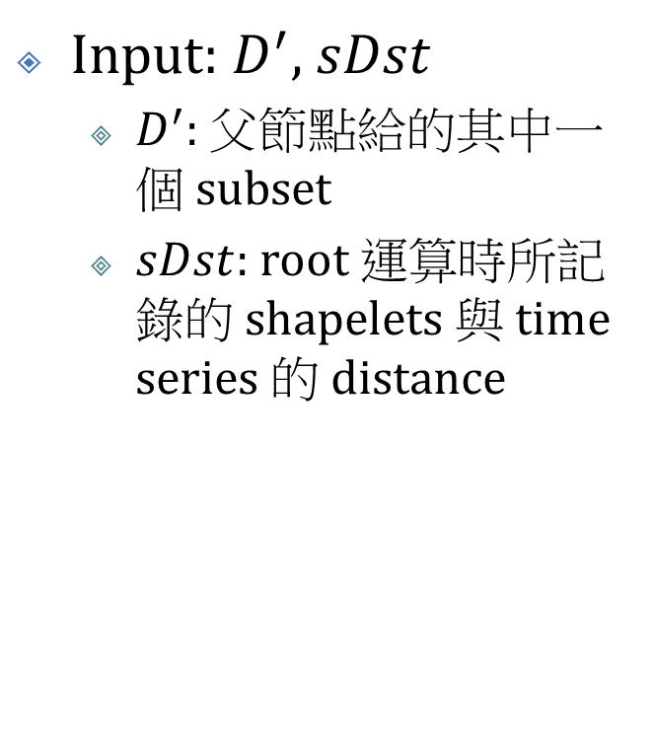
Building a Sub-tree (1/3)
Input: $D^{′}$, $sDst$
$D^{′}$: 父節點給的其中一個 subset
$sDst$: root 運算時所記錄的 shapelets與 time series 的 distance

Slide 15
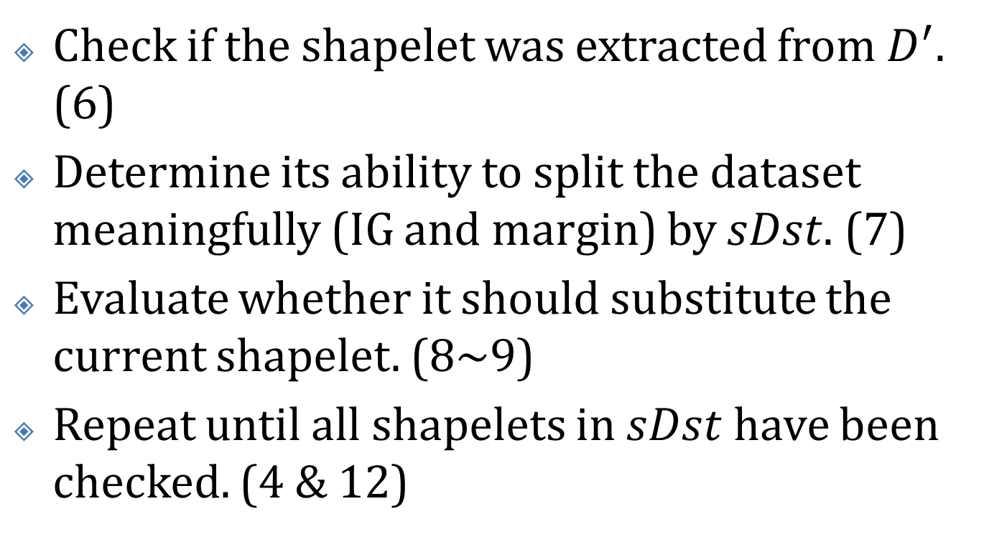
Building a Sub-tree (2/3)
Check if the shapeletwas extracted from $D^{′}$. (6)
Determine its ability to split the dataset meaningfully (IG and margin) by $sDst$. (7)
Evaluate whether it should substitute the current shapelet. (8~9)
Repeat until all shapelets in $sDst$have been checked. (4 &12)

Slide 16
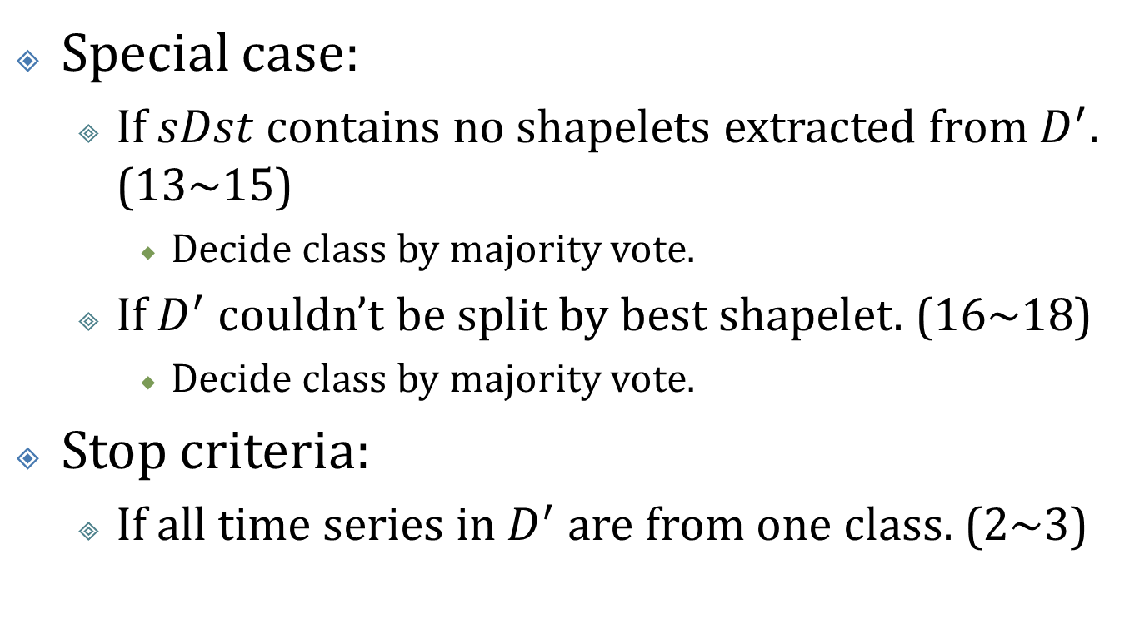
Building a Sub-tree (3/3)
Special case:
If $sDst$ contains no shapelets extracted from $D^{′}$. (13~15)
Decide class by majority vote.
If $D^{′}$ couldn’t be split by best shapelet. (16~18)
Decide class by majority vote.
Stop criteria:
If all time series in $D^{′}$ are from one class. (2~3)

Slide 17
Shapelets Sampling Order
Simple enumeration of shapelets domain
Fast-coverage enumeration of shapelets domain
Random enumeration of shapelets domain

Slide 18
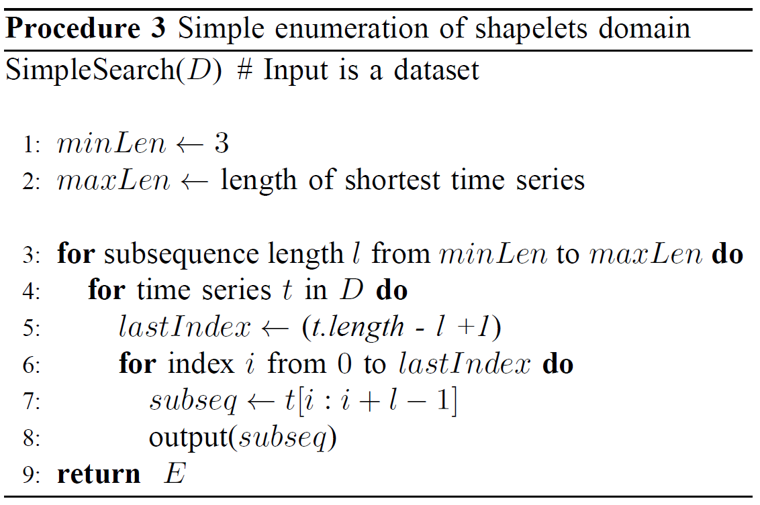
Simple Enumeration of Shapelets Domain

Slide 19
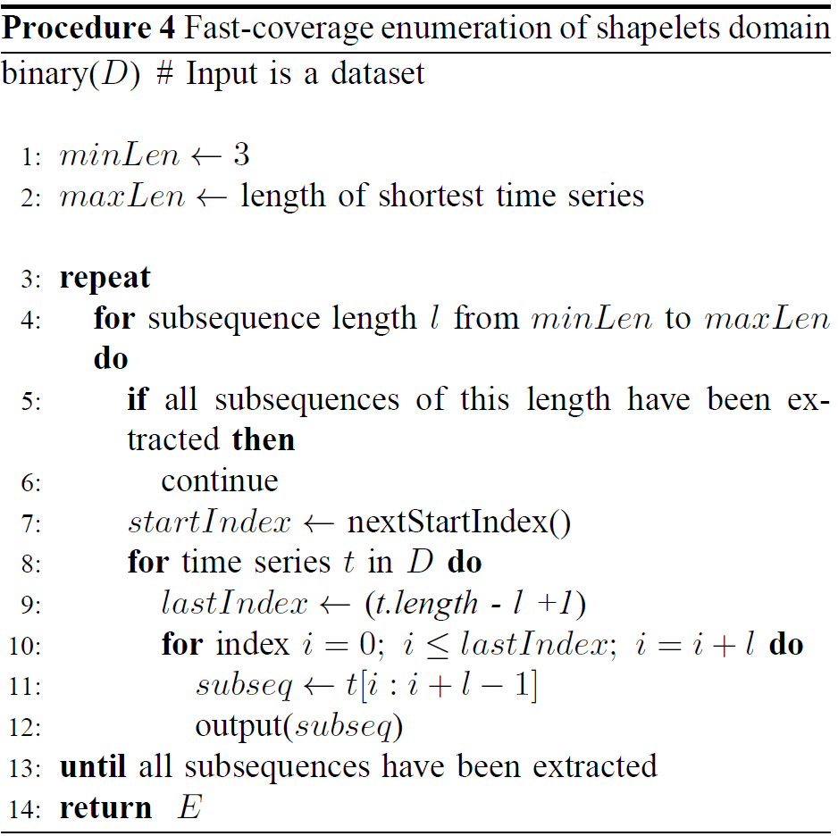
Fast-coverage Enumeration of Shapelets Domain (1/3)

Slide 20
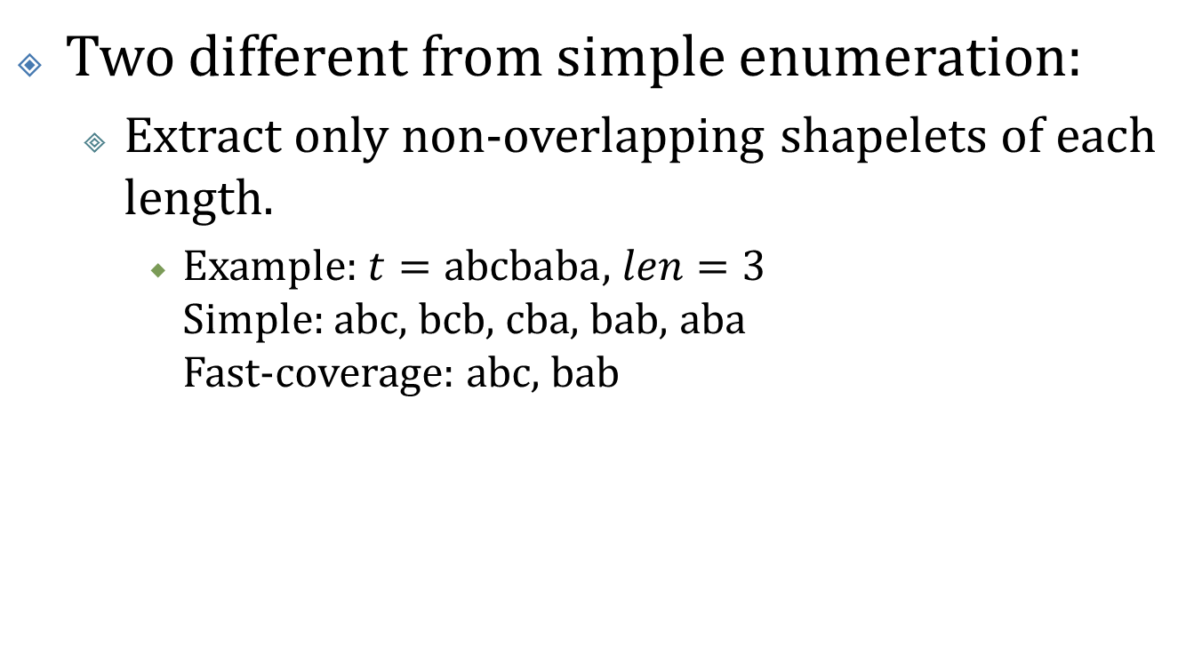
Fast-coverage Enumeration of Shapelets Domain (2/3)
Two different from simple enumeration:
Extract only non-overlapping shapeletsof each length.
Example: $t=\text{abcbaba}$, $len=\text{3}$ Simple: abc, bcb, cba, bab, aba Fast-coverage: abc, bab

Slide 21
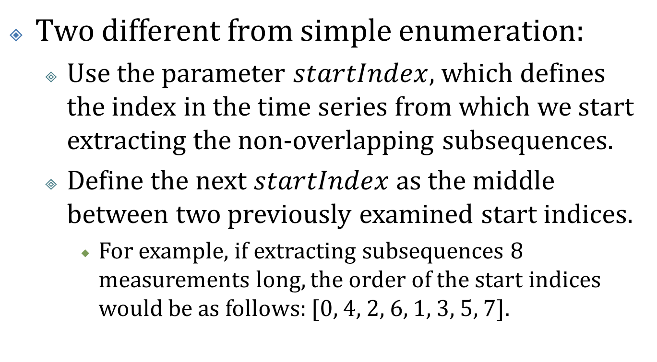
Fast-coverage Enumeration of Shapelets Domain (3/3)
Two different from simple enumeration:
Use the parameter $startIndex$, which defines the index in the time series from which we start extracting the non-overlapping subsequences.
Define the next $startIndex$as the middle between two previously examined start indices.
For example, if extracting subsequences 8 measurements long, the order of the start indices would be as follows: [0, 4, 2, 6, 1, 3, 5, 7].

Slide 22
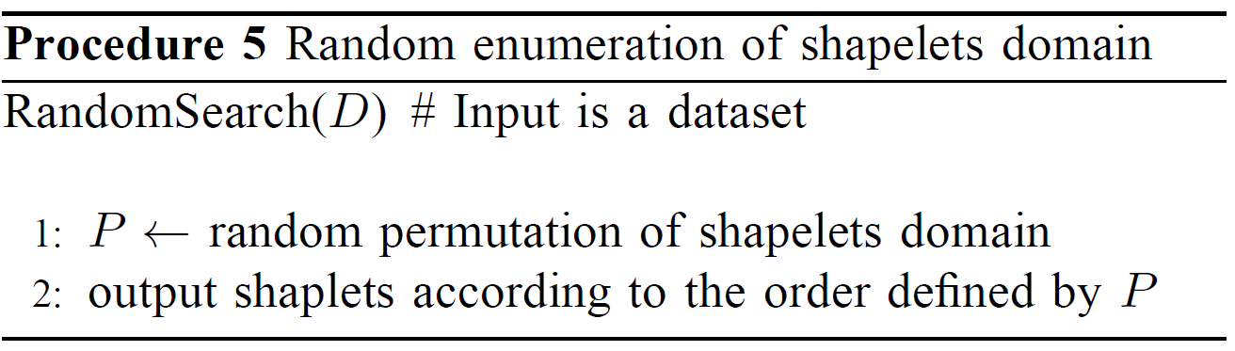
Random Enumeration of Shapelets Domain

Slide 23
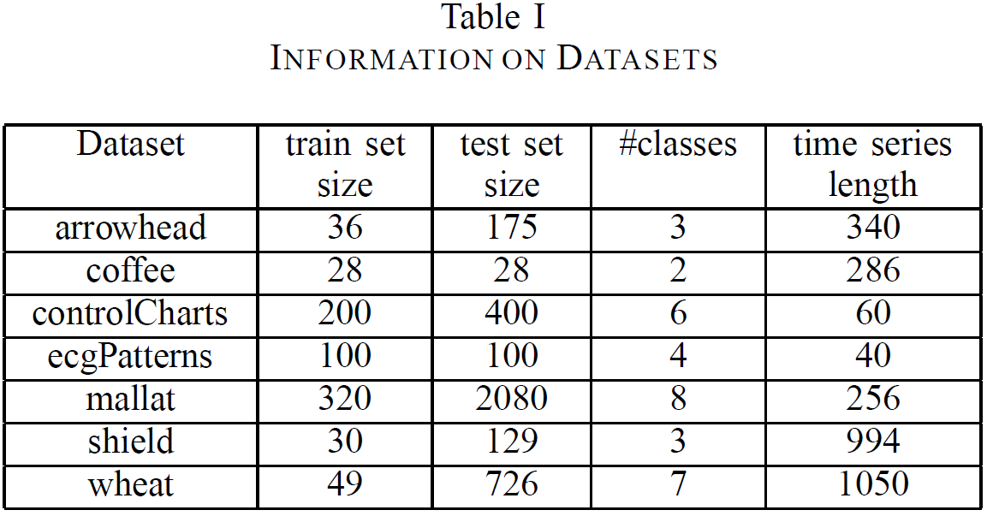
Experiment
Notes:
http://alumni.cs.ucr.edu/~lexiangy/shapelet.html

Slide 24
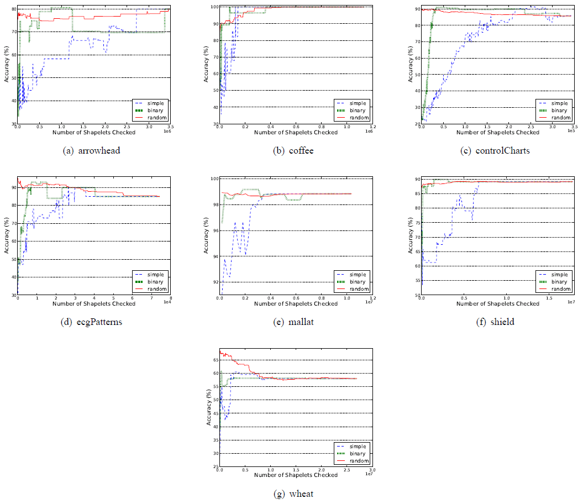

Slide 25
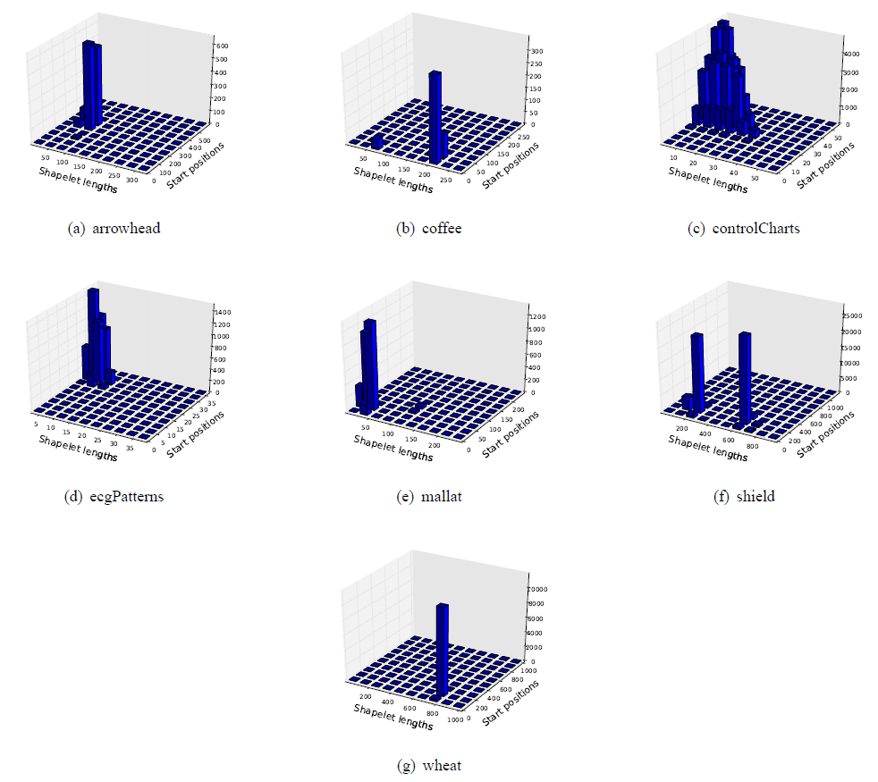
IG: 10%
Margin: 40%

Slide 26
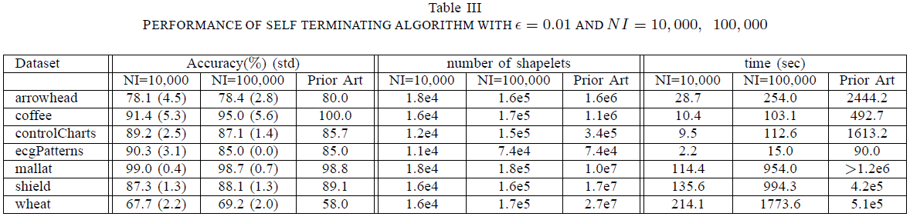
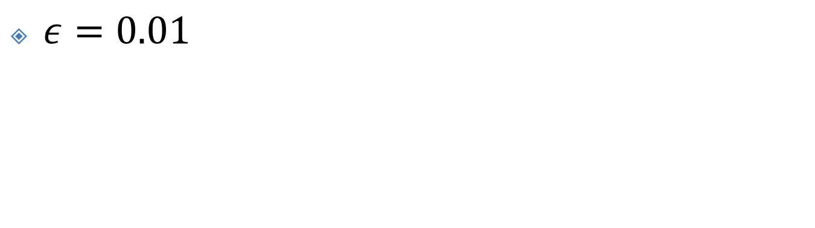
Performance of the SALSA-R Algorithm
$ε=0.01$

