Slide 1
Function Matching: Algorithms, Applications and a Lower Bound
A. Amir, Y. Aumann, R. Cole,
M. Lewenstein and E. Porat
In Proceedings of the 30th International Colloquium on Automata, Languages and Programming (ICALP),
pp. 929-942, 2003
Date: Sept. 26, 2007
Introducer: Hsing-Yen Ann
From: Moshe Lewenstein

Slide 2
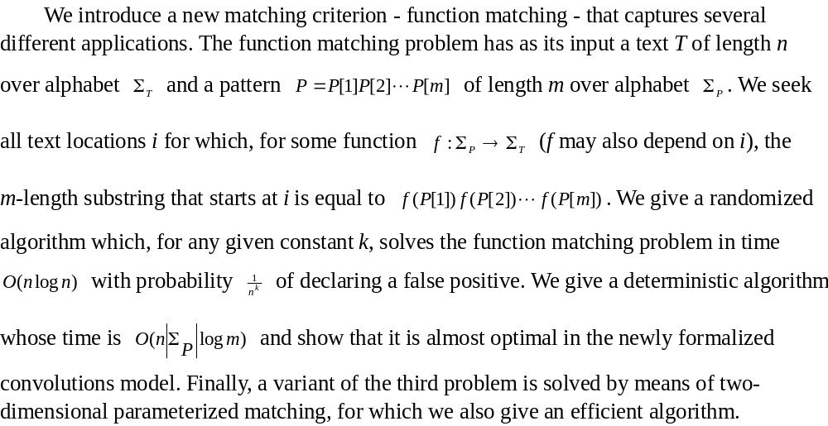
Abstract

Slide 3
Parameterized Matching
Prog.c
int a,b;
a=1;
a = g(a)*5+f(a);
b=2;
a = func(a,b);
a = a*g(b);
b=1;
b = g(b)*5+f(b);
….
c=1;
c = g(c)*5+f(c);
Pattern

Slide 4





2-D Parameterized Matching
pattern

Slide 5
Problem Definition – Function Matching (1/5)
Input:
  A text T = t₁ t₂ … t_{n} , over alphabet Σ_{T}
  A pattern P = p₁ p₂ … p_{m}, over alphabet Σ_{P}
Output:
  Locations i of T, where function f :Σ_{P} →Σ_{T} exists s.t.
  f(P) = f(p₁) f(p₂) … f(p_{m}) = t_{i} t_{i+1} … t_{i+m-1}
P = h e h a e h
T = a b c b a c b a d a b d a d d a d

Slide 6
Problem Definition – Function Matching (2/5)
Input:
  A text T = t₁ t₂ … t_{n} , over alphabet Σ_{T}
  A pattern P = p₁ p₂ … p_{m}, over alphabet Σ_{P}
Output:
  Locations i of T, where function f :Σ_{P} →Σ_{T} exists s.t.
  f(P) = f(p₁) f(p₂) … f(p_{m}) = t_{i} t_{i+1} … t_{i+m-1}
f(h) = b
f(e) = c
f(a) = a
P = h e h a e h
T = a b c b a c b a d a b d a d d a d

Slide 7
Problem Definition – Function Matching (3/5)
Input:
  A text T = t₁ t₂ … t_{n} , over alphabet Σ_{T}
  A pattern P = p₁ p₂ … p_{m}, over alphabet Σ_{P}
Output:
  Locations i of T, where function f :Σ_{P} →Σ_{T} exists s.t.
  f(P) = f(p₁) f(p₂) … f(p_{m}) = t_{i} t_{i+1} … t_{i+m-1}
f(h) = a
f(e) = d
f(a) = b
P = h e h a e h
T = a b c b a c b a d a b d a d d a d

Slide 8
Problem Definition – Function Matching (4/5)
Input:
  A text T = t₁ t₂ … t_{n} , over alphabet Σ_{T}
  A pattern P = p₁ p₂ … p_{m}, over alphabet Σ_{P}
Output:
  Locations i of T, where function f :Σ_{P} →Σ_{T} exists s.t.
  f(P) = f(p₁) f(p₂) … f(p_{m}) = t_{i} t_{i+1} … t_{i+m-1}
f(h) = d
f(e) = a
f(a) = d
P = h e h a e h
T = a b c b a c b a d a b d a d d a d

Slide 9
Problem Definition – Function Matching (5/5)
Input:
  A text T = t₁ t₂ … t_{n} , over alphabet Σ_{T}
  A pattern P = p₁ p₂ … p_{m}, over alphabet Σ_{P}
Output:
  Locations i of T, where function f :Σ_{P} →Σ_{T} exists s.t.
  f(P) = f(p₁) f(p₂) … f(p_{m}) = t_{i} t_{i+1} … t_{i+m-1}
no match !
f(h) = ??
P = h e h a e h
T = a b c b a c b a d a b d a d d a d

Slide 10
Function Matching vs.
Parameterized Matching
P p-matches t_{i} t_{i+1} … t_{i+m-1} iff
1. P f-matches t_{i} t_{i+1} … t_{i+m-1} and
2. # of symbols in t_{i} t_{i+1} … t_{i+m-1} = # of symbols in P
(the function f is a bijection)
f(h) = b
f(e) = c
f(a) = a
f(h) = d
f(e) = a
f(a) = d
P = h e h a e h h e h a e h
T = a b c b a c b a d a b d a d d a d

Slide 11
Function Matching with Don’t Cares
Input:
  A text T = t₁ t₂ … t_{n} , over alphabet Σ_{T} ∪ {?}
  A pattern P = p₁ p₂ … p_{m}, over alphabet Σ_{P}
Output:
  Locations i of T, where function f :Σ_{P} →Σ_{T} exists s.t.
  f(P) = f(p₁) f(p₂) … f(p_{m}) = t_{i} t_{i+1} … t_{i+m-1}
  f(?) - wildcard
P = h e ? ? e h
T = a b c b a c b c d b c d a d d a d

Slide 12
Polynomial Multiplication - Convolutions (1/3)
t₁ t₂ t₃ t₄ . . . t_{n-2} t_{n-1} t_{n}
p_{m} p_{m-1} . . . p₂ p₁
p₁t₁ p₁t₂ . . . p₁t_{n-2} p₁t_{n-1} p₁t_{n}
p₂t₁ p₂t₂ p₂t₃ . . . p₂t_{n-2} p₂t_{n-1} p₂t_{n}
p₃t₁ p₃t₂ p₃t₃ p₃t₃ . . . p₃t_{n-1} p₃t_{n}
. . .
..
. . .
p_{m}t₁ . . . p_{m}t_{m} p_{m}t_{m+1} . . p_{m}t_{n-1} p_{m}t_{n}
. . .
. . .
Running time: O(n log m)

Slide 13
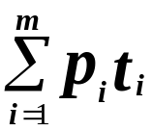
Polynomial Multiplication - Convolutions (2/3)
p₁ p₂ p₃ p₄ . . . p_{m}
t₁ t₂ t₃ t₄ . . . t_{n-2} t_{n-1} t_{n}
p_{m} p_{m-1} . . . p₂ p₁
p₁t₁ p₁t₂ . . . p₁t_{n-2} p₁t_{n-1} p₁t_{n}
p₂t₁ p₂t₂ p₂t₃ . . . p₂t_{n-2} p₂t_{n-1} p₂t_{n}
p₃t₁ p₃t₂ p₃t₃ p₃t₄ . . . p₃t_{n-1} p₃t_{n}
. . .
..
. . .
p_{m}t₁ . . . p_{m}t_{m} p_{m}t_{m+1} . . p_{m}t_{n-1} p_{m}t_{n}
. . .
. . .

Slide 14
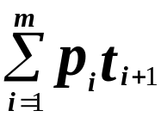
Polynomial Multiplication - Convolutions (3/3)
p₁ p₂ p₃ p₄ . . . p_{m}
t₁ t₂ t₃ t₄ . . . t_{n-2} t_{n-1} t_{n}
p_{m} p_{m-1} . . . p₂ p₁
p₁t₁ p₁t₂ . . . p₁t_{n-2} p₁t_{n-1} p₁t_{n}
p₂t₁ p₂t₂ p₂t₃ . . . p₂t_{n-2} p₂t_{n-1} p₂t_{n}
p₃t₁ p₃t₂ p₃t₃ p₃t₄ . . . p₃t_{n-1} p₃t_{n}
. . .
..
. . .
p_{m}t₁ . . . p_{m}t_{m} p_{m}t_{m+1} . . p_{m}t_{n-1} p_{m}t_{n}
. . .
. . .

Slide 15
T = a b c b a c b a c a b d a d d a d e a
P = h e h a e h ? e P^{R} = e ? h e a h e h
h in P vs.
a in T
T_{a} = 1 0 0 0 1 0 0 1 0 1 0 0 1 0 0 1 0 0 1
P^{R}_{h} = 0 0 1 0 0 1 0 1
Choose a symbol in P and a symbol in T.
Using convolution to check all occurrences of the symbol in P are mapping to the same symbol in T.

Slide 16
h e h a e h ? e
T = a b c b a c b a c a b d a d d a d e a
P = h e h a e h ? e P^{R} = e ? h e a h e h
h - a
T_{a} = 1 0 0 0 1 0 0 1 0 1 0 0 1 0 0 1 0 0 1
P^{R}_{h} = 0 0 1 0 0 1 0 1
1 0 0 0 1 0 0 1 0 1 0 0 1 0 0 1 0 0 1
0 0 0 0 0 0 0 0 0 0 0 0 0 0 0 0 0 0 0
1 0 0 0 1 0 0 1 0 1 0 0 1 0 0 1 0 0 1
0 0 0 0 0 0 0 0 0 0 0 0 0 0 0 0 0 0 0
0 0 0 0 0 0 0 0 0 0 0 0 0 0 0 0 0 0 0
1 0 0 0 1 0 0 1 0 1 0 0 1 0 0 1 0 0 1
0 0 0 0 0 0 0 0 0 0 0 0 0 0 0 0 0 0 0
0 0 0 0 0 0 0 0 0 0 0 0 0 0 0 0 0 0 0
0 0 1 0 0 1 1 1 0 2 0 2 1 0 3 0 1 2 0 1 2 0 1 1 0 1

Slide 17
T = a b c b a c b a c a b d a d d a d e a
P = h e h a e h ? e P^{R} = e ? h e a h e h
h - a
1 0 2 0 2 1 0 3 0 1 2 0
h - b
0 3 0 1 1 1 1 0 1 0 1 0
h - c
2 0 1 2 0 1 1 0 1 0 0 0
h - d
0 0 0 0 0 0 1 0 1 2 0 3
Match(h)
0 1 0 0 0 0 0 1 0 0 0 1
There are |Σ_{P}| |Σ_{T}| pairs
➔ in O(|Σ_{P}| |Σ_{T}| n log m) time!!

Slide 18

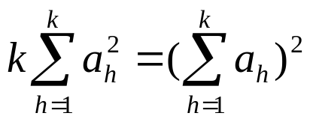
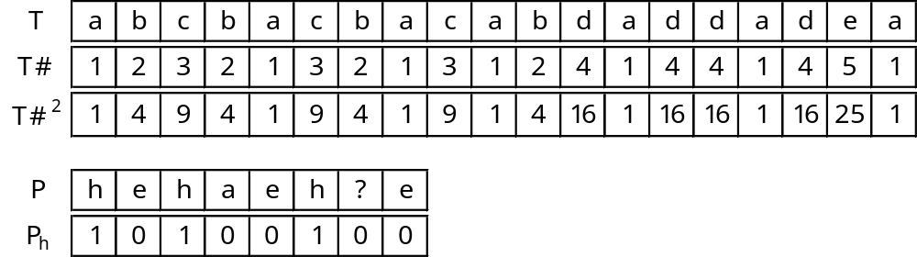
Improvement (1/3)
Lemma: Let , then
iff for all i,j, a_{i} = a_{j}

Slide 19
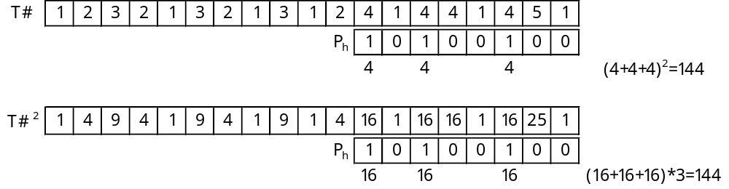
Improvement (2/3)
Lemma: Let , then
iff for all i,j, a_{i} = a_{j}

Slide 20
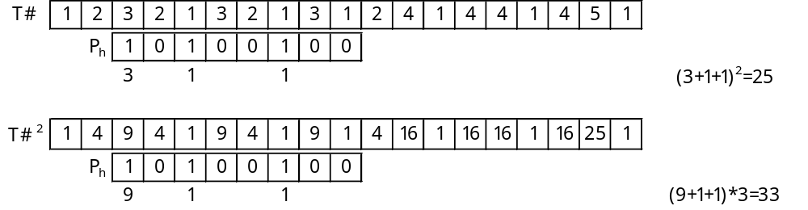
Improvement (3/3)
Lemma: Let , then
iff for all i,j, a_{i} = a_{j}
no match !
In O(|Σ_{P}| n log m) time!!

Slide 21
For Large Alphabets?
O(|Σ_{P}| n log m) time is not good enough for large alphabets !!
Can be solved by an O(n log²m) randomized convolutions based algorithm

Slide 22

Paired Function Matching
Def: A pattern is paired string if every character
appears at most twice in the pattern.
Lemma: Let P be a pattern and T a text.
paired string patterns P₁ and P₂ s.t. at loc. i of T
P f-matches iff P₁ and P₂ f-match.
Example:
P = a b c b c c b b
P₁ = a₁ b₁ c₁ b₁ c₁ c₂ b₂ b₂ (even pairs)
P₂ = a₁ b₁ c₁ b₂ c₂ c₂ b₂ b₃ (odd pairs)

Slide 23
New Randomized Algorithm (1/3)
For each symbol σ in T, replaced by an integer v_{σ} randomly chosen from [0, 2n^{k+1}], then forms T’.
For each symbol σ in P₁ and P₂, choose a random integer u_{σ} from [0, 2n^{k+1}], then forms P₁’ and P₂’.
  If σ occurs once, replaced by 0.
  The first occurrence of σ is replaced by u_{σ}.
  The second occurrence of σ is replaced by -u_{σ}.
If there is a function matching of P with T, both the convolution of P₁’ with T’ and P₂’ with T’ will be 0.

Slide 24
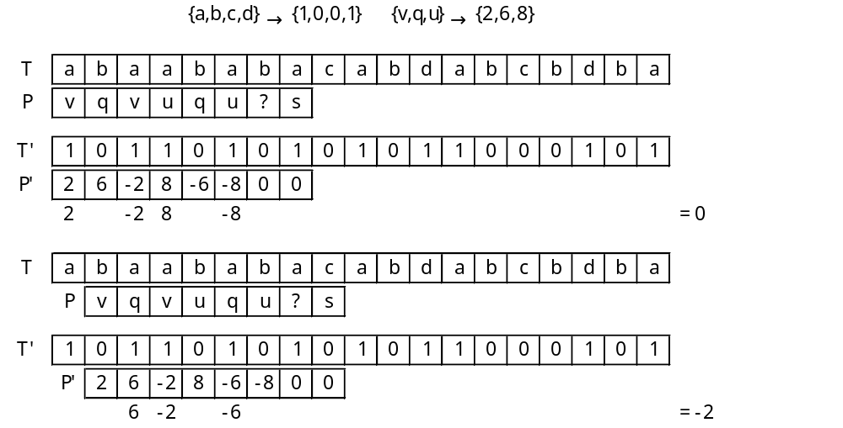
New Randomized Algorithm (2/3)

Slide 25
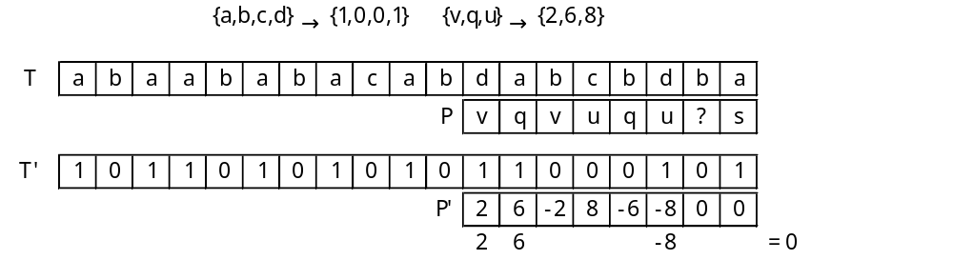
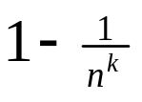
New Randomized Algorithm (3/3)
false positive !
Theorem 3
There is a randomized algorithm for function matching that, given a constant k, runs in time O(kn log m); it reports all function matches and, with probability at least
reports no mismatches as matches.

