Slide 1
Near-optimal Block Alignments
Author：Kuo-Tsung Tseng (曾國尊)
Co-Author：Chang-Biau Yang (楊昌彪)
Co-Author: Kuo-Si Huang (黃國璽)
Co-Author: Yung-Hsing Peng(彭永興)
Dec. 4, 2006
Department of Computer Science and Engineering
National Sun Yet-sen University
Notes:
Good morning, ladies and gentlemen.
My name is 國尊 曾.
I come from national 孫逸仙 university.
The title of my paper is near-optimal block alignments.

Slide 2
Outline
Near-optimal Block Alignments
Tracings in the Alignment Lattice
An Algorithm for Near-optimal Block Alignment
Conclusion
Notes:
The outline of my presentation is as follows.
First, I would like to talk about the motivation and the goal of our paper.
Then, I shall explain how we use the tracing marking method to find all
alignments which are within acceptable range (i.e. d in our paper) when compared to the optimum.
And the concept of tau-blocks is explained.
Third, our algorithm to solve the near-optimal block alignment problems is introduced.
Finally, I’ll give some conclusions and future works.

Slide 3
Near-optimal Block Alignments
Motivation
  The near-optimal alignments increase the possibilities of finding the correct alignment, but too many of them may confuse the biologists.
Idea
  There should be the best one in those near-optimal alignments if we take some other criteria into consideration.
Goal
  Find reasonable criteria in judging goodness of the near-optimal alignments and solve the problems without increasing the time complexity of the original problem.
Notes:
In fact, sometimes the biosequences with optimal scores using existent scoring function does not
work out the reasonable biological experiments but those biosequences which are near to optimum does.
According to this, we should check not only the optimal alignments but also near-optimal ones.
It is time-consuming if we use all those near-optimal alignments in experiments.
Thus we need some other criteria to help us to judge the goodness of the near-optimal alignments.
And we hope this will not increase the time complexity of the original problem.
(The near is defined by a parameter d in our paper.)

Slide 4
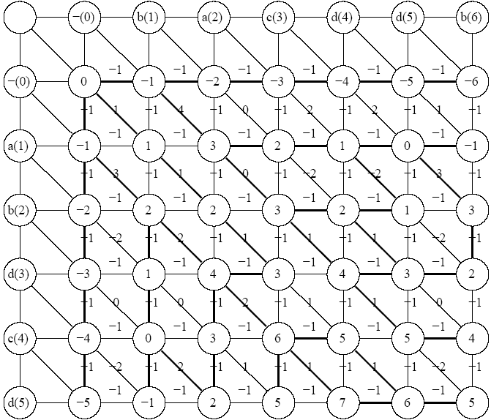
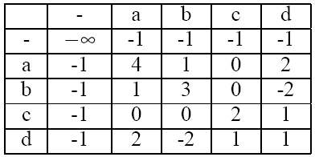
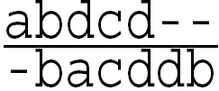
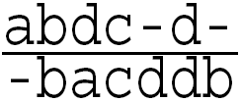
Traditional Sequence Alignments
Optimal Alignments of abdcd & bacdb using score matrix above:
Notes:
Using abdcd & bacdb as our example, with score matrix at upper right,
We can get the alignment lattice like this one in traditional sequence alignment.
If we trace back from the (5,6) to (0,0) according these blue lines,
we have two optimal alignments at lower-right.
How will the score be affected by choosing the black lines?
I shall discuss this later.

Slide 5
A Method for Tracing Marking
Input: Alignment lattice AL with threshold d.
Output: Tracing queue R and tracings (possible alignments) TR that construct near-optimal alignments within d score compared to the optimal alignment.
Notes:
The threshold d is a parameter that we use to define the word “near”.

Slide 6
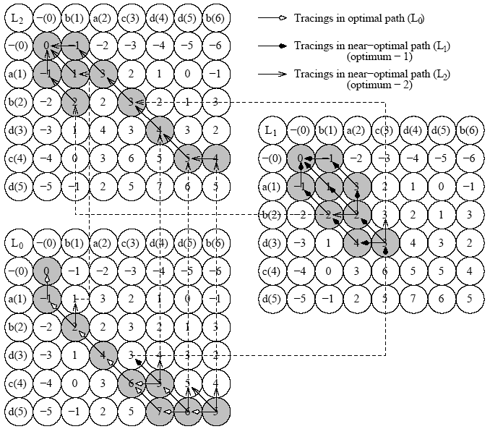
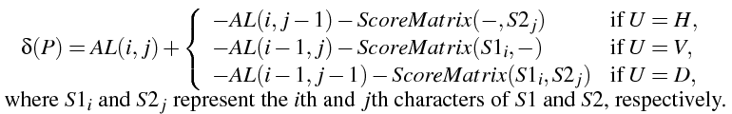
Tracings in the Alignment Lattice
Let P =(i, j,U) denote the alignment from position (i, j) to the U direction, where 0≤i≤m, 0≤ j ≤n, and U ∈ {H,V,D}.
The U direction of {H,V,D} means the Horizontal, Vertical, or Diagonal direction. We define the δ function to calculate the effect when the alignment P, with respect to AL(i, j), is chosen as follows.
Notes:
Let P = (i,j,U) denote the alignment from position (i,j) to the U direction.
The function delta of P is the bias if P is chosen as one of our alignment.
It is clear that all blue lines in previous page are with bias 0 since they are belonged to the optimal alignments set.
The rough idea of tracing marking method is
Start from (i,j), then check three directions H-horizontal, V-vertical, D-diagonal
meet our acceptable range by function delta. If yes, put the node in queue to wait to be checked.
2.Pop up then elements in queue and check the three directions of them.
Keep doing this until the queue is empty.

Slide 7
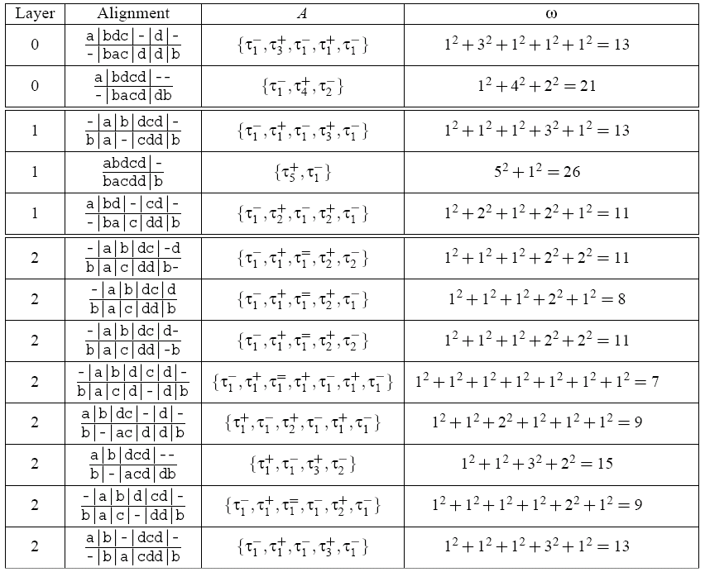
The Concept of τ-Blocks
Notes:
An alignment A can be regarded as a list of tau-blocks.
If we use 0 as the threshold of tau-blocks, we may part all
near-optimal alignments as shown in this table.
Tau-plus means the continuous block that is greater than our threshold.
Tau-equal is equal to and tau-minus is less than.
Longer block means longer structurally conserved region.
It is more biological meaningful.
Thus, we use omega to measure if an alignment is conserved.
Omega is the square sum of length of all tau-blocks of an alignment.

Slide 8
An Algorithms for Near-optimal Block Alignment (NBA)
Input: alignment lattice AL, tracings of possible alignments TR and tracing queue R.
Output: maximum ω among all near-optimal alignments.
Notes:
Here I shall introduce the algorithm to find the maximum omega among
all near-optimal alignments.

Slide 9
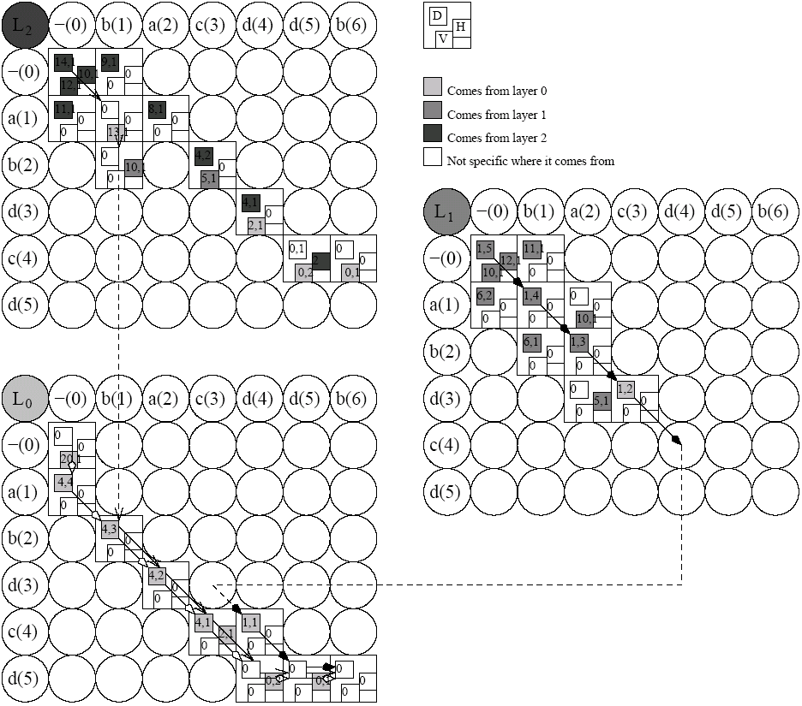
Near-optimal Block Alignments II
Notes:
In this figure, the numbers in three little square box mean the current omega in respective directions.

Slide 10
Conclusion
Proposed algorithms refine the traditional optimal sequence alignments in different criteria without increasing the time complexity of the original algorithm.
The refined near-optimal alignments helps any methods based on homology modeling in predicting protein 3D structure to find a better template, then to get a better predicting result.
Notes:
解釋…

Slide 11
Conclusion (Cont’d)
The criteria that we use to find the better alignments among those near-optimal alignments can be open to discuss. It is noteworthy that the criteria to measure if an near-optimal alignment is better than the other one may be meaningless in traditional sequence alignment technique.
  e.g.
  a₁a₂…a_{m}-----------
  -----------b₁b₂…b_{n}
Notes:
解釋…
(最後我們未來的工作是-下頁提詞)

Slide 12
Future Works
Other criteria (may increase time complexity. e.g. LCS in constraint)
Two or more criteria in the same time
Experiments
Multiple sequence alignment
Thanks for Your Listening
Notes:
汪…
謝謝您的聆聽…

