Slide 1
A time-efficient pattern reduction algorithm for k-means clustering Ming-Chao Chiang, Chun-Wei Tsai, Chu-Sing Yang Information Sciences, Vol. 181, pp. 716-731, 2011.
Presenter: Hong-Yu Chen
Date: April 19, 2011

Slide 2
Abstract (1/3)
This paper presents an efficient algorithm, called pattern reduction (PR), for reducing the computation time of k-means and k-means-based clustering algorithms. The proposed algorithm works by compressing and removing at each iteration patterns that are unlikely to change their membership thereafter.

Slide 3
Abstract (2/3)
Not only is the proposed algorithm simple and easy to implement, but it can also be applied to many other iterative clustering algorithms such as kernel-based and population-based clustering algorithms.

Slide 4
Abstract (3/3)
Our experiments—from 2 to 1000 dimensions and 150 to 10,000,000 patterns—indicate that with a small loss of quality, the proposed algorithm can significantly reduce the computation time of all state-of-the-art clustering algorithms evaluated in this paper, especially for large and high-dimensional data sets.

Slide 5
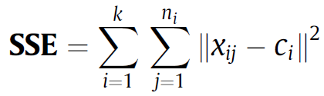
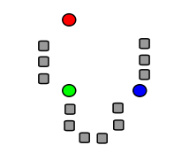
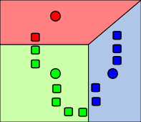
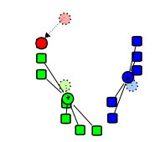
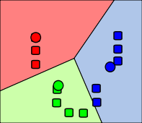
K-means clustering

Slide 6
Limitations of k-means
Scalability – relational k-means
Initial means – random sampling
Noise – detection
Number of clusters – X-means
Local minima – GKA
Inability of cluster non-linearly separable data set – kernel k-means

Slide 7
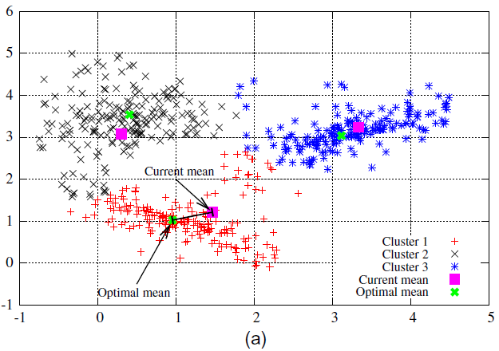
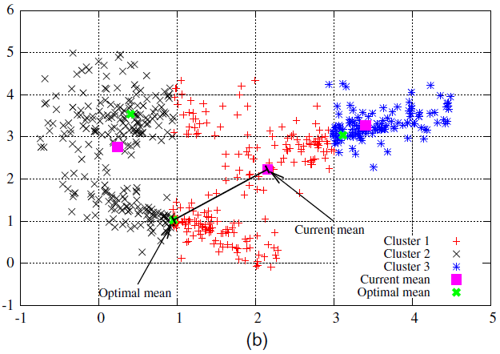
Initial means

Slide 8
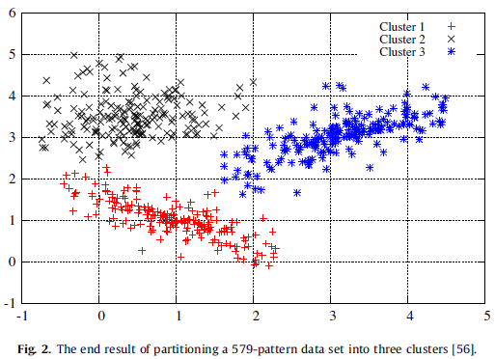
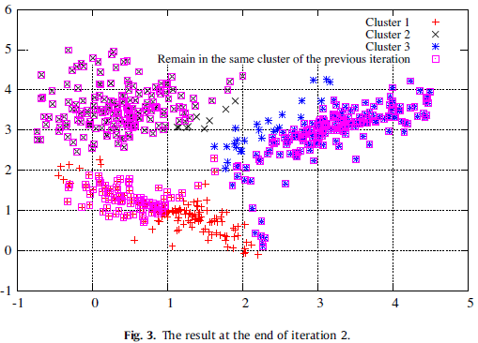
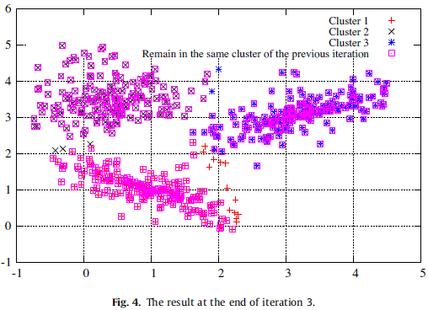

Slide 9
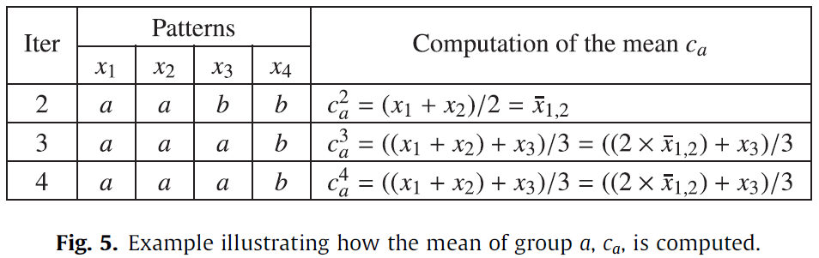
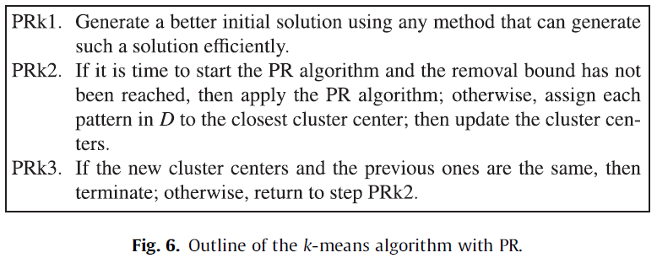
Pattern reduction (PR) algorithm (1/2)

Slide 10
Pattern reduction (PR) algorithm (2/2)
Generation of a better initial solution
Random sampling
Pattern compression and removal (PCR)
Removal bound: 80%
Pattern assignment and mean update (PAMU)
Applying PR to k-means-based algorithms
Notes:
1. Find a longest almost-increasing subsequence whose largest element is $x_{i}$.

Slide 11
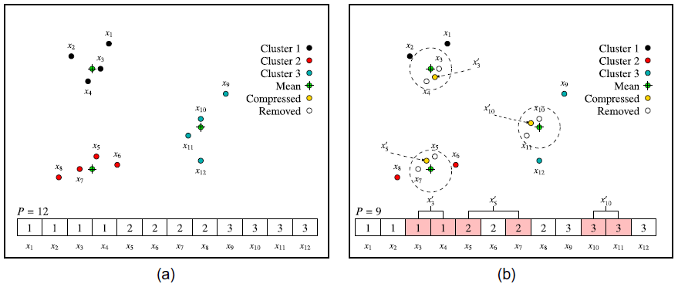
Example

Slide 12
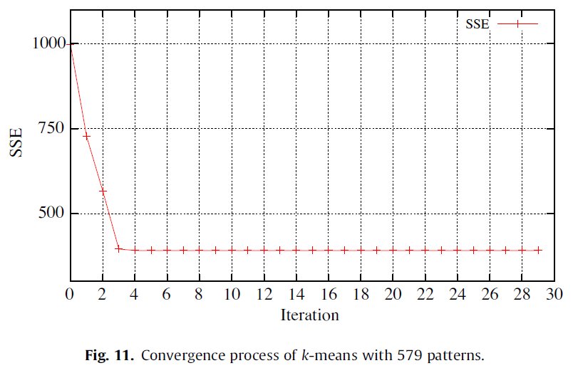
Convergence process of k-means with 579 patterns

Slide 13
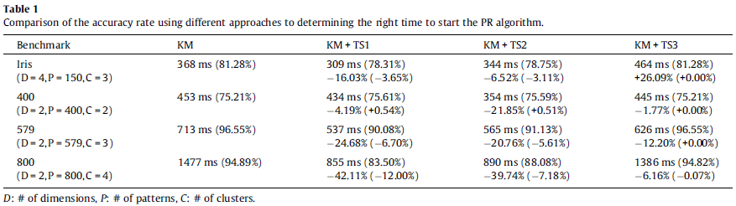
Time to start
Start the PR algorithm at iteration 2. (faster)
Compare the current SSE with the previous one. (ex. threshold = 0.3)
When a large number of patterns remain in the same group. (ex. threshold = n/2, # of iterations = 3)

Slide 14
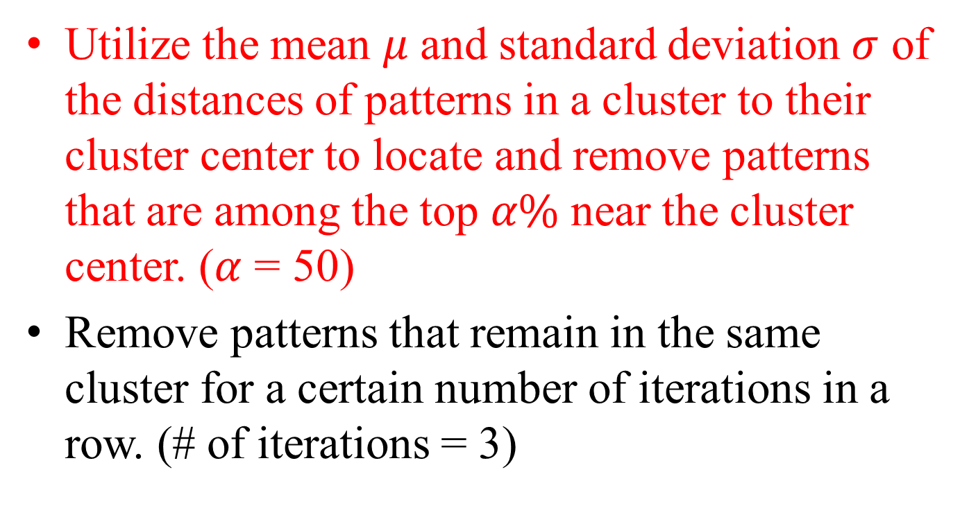
Removal strategy (1/2)
Utilize the mean $μ$ and standard deviation $σ$ of the distances of patterns in a cluster to their cluster center to locate and remove patterns that are among the top $α\%$ near the cluster center. ($α$ = 50)
Remove patterns that remain in the same cluster for a certain number of iterations in a row. (# of iterations = 3)

Slide 15
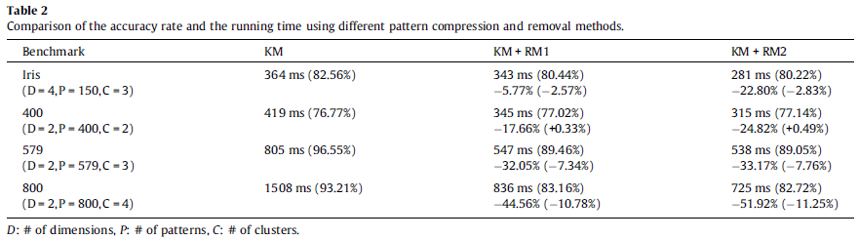
Removal strategy (2/2)

Slide 16
Experiment
Apply PR to
Standard k-means
Relation k-means
Triangle inequality k-means
Kernel k-means
Genetic k-means
Notes:
先講動機
1.
2. There are applications where the data items have a small amount of noise.

Slide 17
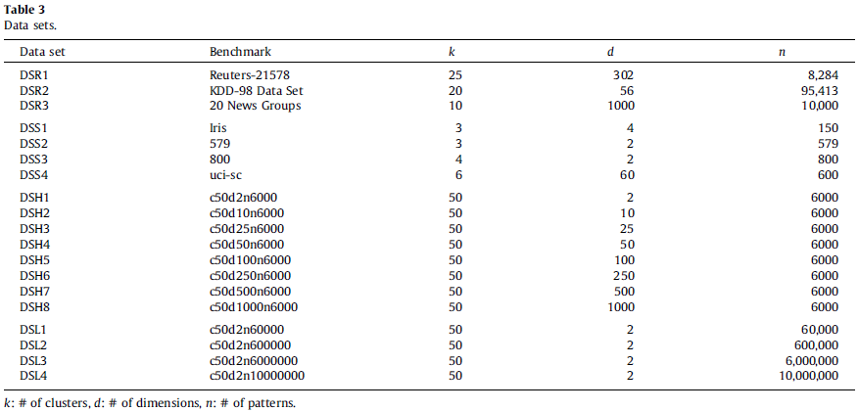
Data sets

Slide 18

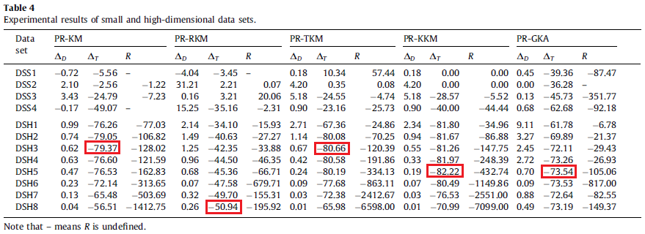
Experimental results of small and high-dimensional data sets

Slide 19
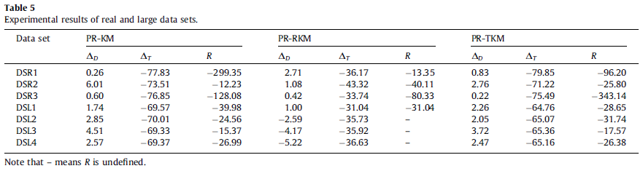
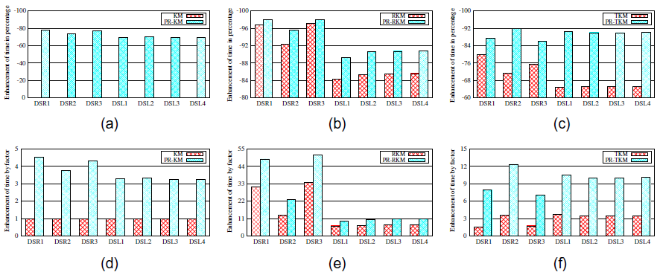
Experimental results of real and large data sets

Slide 20

Conclusion
Time complexity:
somewhere between O($nkd$) and O($nkdl$)
Underway to apply the proposed algorithm to other clustering algorithms.

