Slide 1
Output-Sensitive Algorithms for Finding the Nested Common Intervals of Two General Sequences
Biing-Feng Wang(王炳豐), Jhih-Hong Ye(葉志鴻) and Song-Hsuan Lin(林嵩軒 )
Presenter: Chiou-Ting Tseng
Date: Apr. 19, 2011

Slide 2
Abstract
The focus of this paper is the problem of finding all nested common intervals of two general sequences. Blin, Faye, and Stoye introduced three models to define nested common intervals of two sequences: the uniqueness, the free-inclusion, and the bijection models. We consider all the three models. For the uniqueness and the bijection models, we give O(n + N_{out})-time algorithms, where N_{out} denotes the size of

Slide 3
Abstract
the output. For the free-inclusion model, we give an O(n^{1+ε} + N_{out})-time algorithm, where ε > 0 is an arbitrarily small constant. We also present an upper bound on the size of the output for each model. For the uniqueness and the free-inclusion models, we show that N_{out} = O(n²). Consequently, our algorithms for the uniqueness and the free-inclusion models improve the previous O(n³)-time algorithms by Blin, Faye, and Stoye.

Slide 4
Abstract
Let C = Σ_{α∈Σ}o1(α)o2(α), where Σ is the set of distinct genes, and o1(α) and o2(α) are, respectively, the numbers of copies of α in the two given sequences. For the bijection model, we show that N_{out} = O(Cn). As compared with Blin, Faye, and Stoye's O(n³)-time algorithm, our new algorithm is more practical, as C is likely to be much smaller than n² in practice.

Slide 5
Common Interval
A pair of intervals ([i₁, j₁], [i₂, j₂]), where 1 ≤ i₁ < j₁ ≤ n and 1 ≤ i₂ < j₂ ≤ n, is a common interval of S1 and S2 if Σ(S1[i₁, j₁]) = Σ(S2[i₂, j₂]).
S1=(a₁, b₂, c₃, d₄, e₅, f₆, g₇, h₈)
S2=(e₁, g₂, f₃, h₄, b₅, d₆, a₇, c₈)
([6, 7], [2,3]), ([5,7], [1,3]), ([5, 8], [1, 4]), ([1, 4], [5, 8]) are common intervals

Slide 6
Nested Common Interval
A common interval ([i₁, j₁], [i₂, j₂]) of S1 and S2 is called a nested common interval if either (1) |[i₁, j₁]| = |[i₂, j₂]| = 2, or (2) [i₁, j₁] contains a sub-interval X₁ and [i₂, j₂] contains a sub-interval X₂ such that (X₁, X₂) is a nested common interval of size |X₁| = |[i₁, j₁]| - 1.

Slide 7
Example
S1=(a₁, b₂, c₃, d₄, e₅, f₆, g₇, h₈)
S2=(e₁, g₂, f₃, h₄, b₅, d₆, a₇, c₈)
([6, 7], [2,3]), ([5,7], [1,3]), ([5, 8], [1, 4]), are nested common intervals
But ([1, 4], [5, 8]) is not a nested common interval.

Slide 8
Models for Nested Common Interval
Uniqueness model
Free-inclusion model
Bijection model

Slide 9
Uniqueness Model
It is forbidden to include a second copy of a gene in a nested common interval.
S1 = (a₁, b₂, a₃, e₄, a₅, a₆, d₇, c₈)
S2 = (d₁, a₂, c₃, b₄, a₅, a₆, b₇, e₈)
([2, 3], [6, 7]) and ([2, 4], [6, 8]) are
([2, 5], [5, 8]) is not

Slide 10
Free-inclusion Model
We can extend a nested common interval to include a gene that is already inside it "for free", caring about only the "innermost occurrence".
S1 = (a₁, b₂, a₃, e₄, a₅, a₆, d₇, c₈)
S2 = (d₁, a₂, c₃, b₄, a₅, a₆, b₇, e₈)
([2, 3], [6, 7]), ([2, 5], [5, 8]) and ([1, 6], [4, 8]) are

Slide 11
Bijection Model
A common interval ([i₁, j₁], [i₂, j₂]) is a nested common interval if either (1) |[i₁, j₁]| = |[i₂,j₂]| = 2, or (2) there exist x ∈ {i₁, j₁} and y ∈ {i₂, j₂} such that S1[x] = S2[y] and ([i₁, j₁] \ {x}, [i₂, j₂] \ {y}) is a nested common interval.
字的集合一樣且個數一樣。

Slide 12
Example
S1 = (a₁, b₂, a₃, e₄, a₅, a₆, d₇, c₈)
S2 = (d₁, a₂, c₃, b₄, a₅, a₆, b₇, e₈)
([2, 5], [5, 8]) is
([1, 6], [4, 8]) is not

Slide 13
Blin, Faye and Stoye's Algorithm on Bijection Model
First, a directed acyclic graph G is constructed.
The vertex set of G represents all possible candidates of nested common intervals.
A directed edge is drawn from a vertex v = (i₁, j₁, i₂, j₂) to a vertex v' = (i'₁, j'₁, i'₂, j'₂) if and only if there exist x∈ {i₁ - 1, j₁ + 1} and y ∈ {i₂ - 1, j₂ + 1} such that S1[x] = S2[y] and ([i'₁, j'₁], [i'₂, j'₂]) = ([i₁, j₁] ∪ {x}, [i₂, j₂] ∪ {y}).

Slide 14
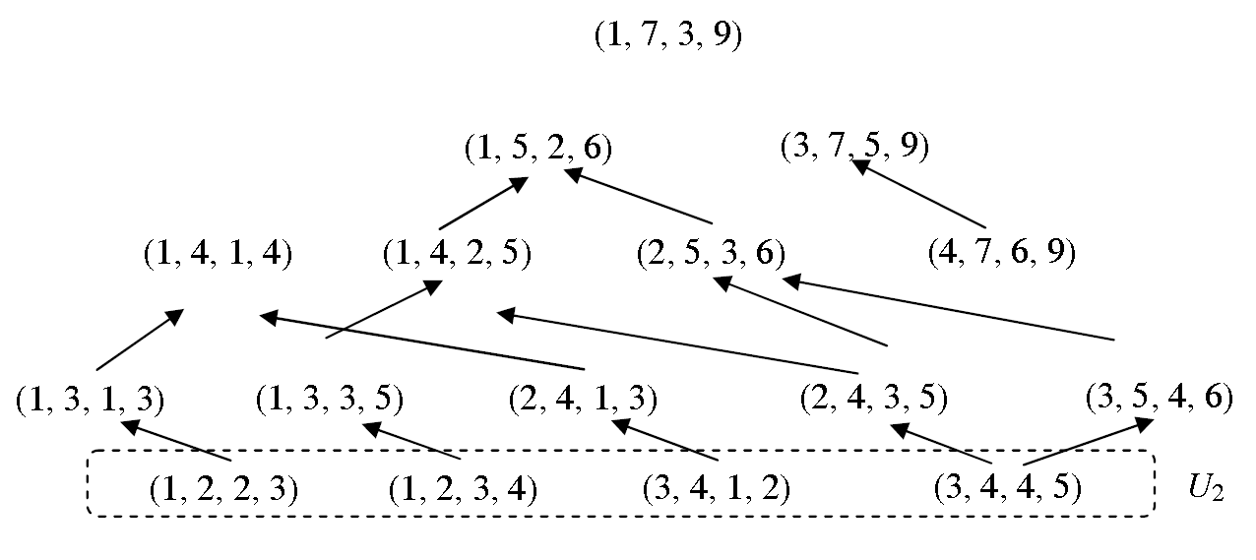
Blin, Faye and Stoye's Algorithm on Bijection Model
S1=(c₁, a₂, b₃, c₄, d₅, e₆, f₇)
S2=(b₁, c₂, a₃, c₄, b₅, d₆, f₇, c₈, e₉)

Slide 15
Proposed Algorithm
Find the set U₂.
Iteratively, we find the set U_{s} by using the vertices in U_{s-1} for each s > 2.

Slide 16
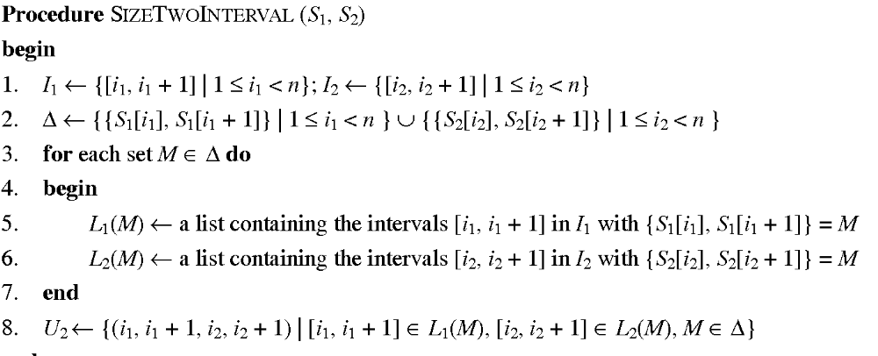
Finding U₂

Slide 17
Example
S1=(c₁, a₂, b₃, c₄, d₅, e₆, f₇)
S2=(b₁, c₂, a₃, c₄, b₅, d₆, f₇, c₈, e₉)
Δ={{a, c}, {a, b}, {b, c}, {c, d}, {d, e}, {e, f}} ∪ {{b, c}, {a, c}, {a, c}, {b, c}, {b, d}, {d, f}, {c, f}, {c, e}}={{a, b}, {a, c}, {b, c}, {b, d}, {c, d}, {c, f}, {d, e}, {d, f}, {e, f}}
L₁({b, c})={[3, 4]}
L₂({b, c})={[1, 2], [4, 5]}
Δ, L₁, L₂ can be obtained in O(n) by radix sort.

Slide 18
Extension
S1=(c₁, a₂, b₃, c₄, d₅, e₆, f₇)
S2=(b₁, c₂, a₃, c₄, b₅, d₆, f₇, c₈, e₉)
(3, 4, 4, 5) → (3, 5, 4, 6) and (2, 4, 3, 5)
(3, 4, 1, 2) → (2, 4, 1, 3) →(1, 4, 1, 4)
(1, 2, 2, 3) → (1, 3, 1, 3) →(1, 4, 1, 4)

Slide 19
Extension Algorithm
We generate all feasible extensions of the vertices in U_{s-1} and store them in an array E.
Since each vertex has at most four feasible extensions, |E| ≤ 4|U_{s-1}| and thus this step takes O(|U_{s-1}|) time.
Each vertex in U_{s} is contained in E.

Slide 20
Remove Duplicate
All vertices in U_{s} are nested common intervals of the same size s. Therefore, two elements (i₁, j₁, i₂, j₂) and (i'₁, j'₁, i'₂, j'₂) in E are the same vertex if and only if (i₁, i₂) = (i'₁, i'₂).
To remove duplicates, we sort the elements (i₁, j₁, i₂, j₂) in E according to the lexicographic order of (i₁, i₂) and then delete duplicates by a simple scan on the sorted sequence.
After the removal, E stores the set of vertices of U_{s}.

Slide 21
Sorting
We sort the elements two times with a stable sort: first on i₂ and next on i₁. Since all indices i₁ and i₂ are integers in the range 1 to n, by counting sort, this step can be done in O(n + |U_{s-1}|) time.
In the following, we show that the time can be reduced to O(|U_{s-1}|), so that the overall time complexity is O(n + N_{out}).

Slide 22
7.2 Counting Sort
Counting Sort (記數排序法) 不需要藉由比較來做排序。
必須依賴一些對於待排序集合中元素性質的假設。(如：所有待排序元素均為整數，介於1到k之間)
時間複雜度：O(n+k)
主要的關鍵在於，統計1到k之間每個數值出現過幾次，然後想辦法將排序好的數列輸出。
Notes:
將k視為常數時，此是一個線性時間的排序演算法。

Slide 23
Input: A[1..n], where A[j]∈{1,2,…,k}
Output:B[1..n], sorted
CountingSort(A,B,k)
{ for i = 0 to k
do C[i]⬅0
for j = 1 to length[A]
do C[A[j]]⬅C[A[j]]+1
for i = 1 to k
do C[i]⬅C[i]+C[i-1]
for j = length[A] downto 1
do B[C[A[j]]]⬅A[j]
C[A[j]]⬅C[A[j]]-1
}
Notes:
第一個迴圈將C[0..k]初始化為全0陣列。
第二個迴圈將C[j]變成j在A裡面出現的次數。
第三個迴圈將C[j]變成1..j在A裡面出現的次數。
第四個迴圈作輸出的動作。
詳細的例子請參考下一頁。

Slide 24
k=6
1
2
3
4
5
6
7
8
A:
3
6
4
1
3
4
1
4
1
2
3
4
5
6
2nd loop
C:
2
0
2
3
0
1
1
2
3
4
5
6
3rd loop
2
2
4
7
7
8

Slide 25
1
2
3
4
5
6
7
8
A:
3
6
4
1
3
4
1
4
4th loop
1
2
3
4
5
6
7
8
1
2
3
4
5
6
1st iteration
B:
4
C:
2
2
4
6
7
8
1
2
3
4
5
6
7
8
1
2
3
4
5
6
2nd iteration
B:
1
4
C:
1
2
4
6
7
8
1
2
3
4
5
6
7
8
1
2
3
4
5
6
3rd iteration
B:
1
4
4
C:
1
2
4
5
7
8
……
1
2
3
4
5
6
7
8
1
2
3
4
5
6
8th iteration
B:
1
1
3
3
4
4
4
6
C:
0
2
2
4
7
7

Slide 26
Lemma 1
Let K be a set of integers in the range 1 to n, where |K| < n, and let K* be the sorted sequence of the integers in K. Let A be a sequence of integers drawn from K. Given K*, we can stably sort the integers in A in O(|K| + |A|) time.

Slide 27
Lemma 1
C[1..n] is used to count the occurrences of numbers
First, we set C[K*[i]] = 0 for each i, 1 ≤ i ≤ |K*|. Next, we increase C[A[i]] by one for each i, 1 ≤ i ≤ |A|.
Then, we compute C[K*[i]] = C[K*[i]] + C[K*[i - 1]] for i = 2, 3, ..., |A|.

Slide 28
Sorting i₁
S1=(c₁, a₂, b₃, c₄, d₅, e₆, f₇)
S2=(b₁, c₂, a₃, c₄, b₅, d₆, f₇, c₈, e₉)
U₃={[1, 3, 1, 3], [1, 3, 3, 5], [2, 4, 1, 3], [2, 4, 3, 5], [3, 5, 4, 6]}
U₄={[1, 4, 1, 4], [1, 4, 2, 5], [1, 4, 1, 4], [1, 4, 2, 5], [2, 5, 3, 6], [2, 5, 3, 6]}
I₁(1)={1, 2, 3}, I₁⁻(1)={1, 2}, I*={1, 2, 3}

Slide 29
Sorting i₁
Let I₁⁻(s - 1) be the sequence obtained from I₁(s - 1) by decreasing each number by one. Since each element in E is an extension of a vertex in U_{s-1}, all i₁ indices of the elements in E are integers in I₁(s - 1) or I₁⁻(s - 1). Let I* be an array that stores the set of distinct integers in I₁(s - 1) and I₁⁻(s - 1) in increasing order.

Slide 30
Extension
I₁(2) can be computed in O(n) time
By Lemma 1, given I*, we can do the sorting for i₁ in O(|I₁(s)| + |E|) = O(|U_{s-1}|) time. The array I* can be built in O(|I₁(s - 1)|) time by merging I₁(s - 1) and I₁⁻(s - 1) and then removing duplicates. Therefore, given U_{s-1} and I₁(s - 1), U_{s} can be computed in O(|U_{s-1}|)

Slide 31
Time Complexity
U₂ can be computed in O(n + |U₂|) time, and for s > 2 each set U_{s} can computed in O(|U_{s-1}|) time. Therefore, all nested common intervals of two sequences of length n on the bijection model can be found in O(n + N_{out}) time.

Slide 32
Uniqueness Model
We add the following constraint on each vertex (i₁, j₁, i₂, j₂) in U_{s}: |Σ(S₁[i₁, j₁])| = |[i₁, j₁]| = |Σ(S₂[i₂, j₂])| = |[i₂, j₂]|.
To check whether the LL-extension of a vertex (i₁, j₁, i₂, j₂) is feasible, we add the following constraint: S₁[i₁ - 1] ∉Σ(S₁[i₁, j₁]). The feasibilities of LR-, RL-, and RR-extensions are redefined similarly.

