Slide 1
Compressed indexing and local alignment of DNA
T. W. Lam, W. K. Sung, S. L. Tam, C. K. Wong and S. M. Yiu
Vol. 24, No. 6, 2008, pages 791–797
doi:10.1093/bioinformatics/btn032
Speaker: Kai-Yuan Cheng
Date: May. 10, 2011

Slide 2
Abstract
Motivation: Recent experimental studies on compressed indexes (BWT, CSA, FM-index) have confirmed their practicality for indexing very long strings such as the human genome in the main memory. For example, a BWT index for the human genome (with about 3 billion characters) occupies just around 1G bytes. However, these indexes are designed for exact pattern matching, which is too stringent for biological applications. The demand is often on finding local alignments (pairs of similar substrings with gaps allowed). Without indexing, one can use dynamic programming to find all the local alignments between a text T and a pattern P in O(|T| |P|) time, but this would be too slow when the text is of genome scale (e.g. aligning a gene with the human genome would take tens to hundreds of hours). In practice, biologists use heuristic-based software such as BLAST, which is very efficient but does not guarantee to find all local alignments.

Slide 3
Abstract
Results: In this article, we show how to build a software called BWT-SW that exploits a BWT index of a text T to speed up the dynamic programming for finding all local alignments. Experiments reveal that BWT-SW is very efficient (e.g. aligning a pattern of length 3000 with the human genome takes less than a minute). We have also analyzed BWT-SW mathematically for a simpler similarity model (with gaps disallowed), and we show that the expected running time is O(|T|^{0.628}|P|) for random strings. As far as we know, BWT-SW is the first practical tool that can find all local alignments. Yet BWT-SW is not meant to be a replacement of BLAST, as BLAST is still several times faster than BWT-SW for long patterns and BLAST is indeed accurate enough in most cases (we have used BWT-SW to check against the accuracy of BLAST and found that only rarely BLAST would miss some significant alignments).

Slide 4
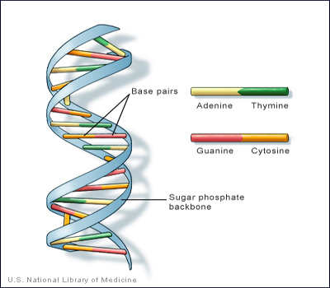
Base Pairs_{(bp)}
S₁ = TAGTCACG
S₁’ = ATCAGTGC

Slide 5
Sequence Alignment
S₁ = TAGTCACG
S₂ = AGACTGTC
⇒
----TAGTCACG TAGTCAC-G--
AGACT-GTC--- -AG--ACTGTC
Which one is better?
We can set different gap penalties as parameters for different purposes.

Slide 6
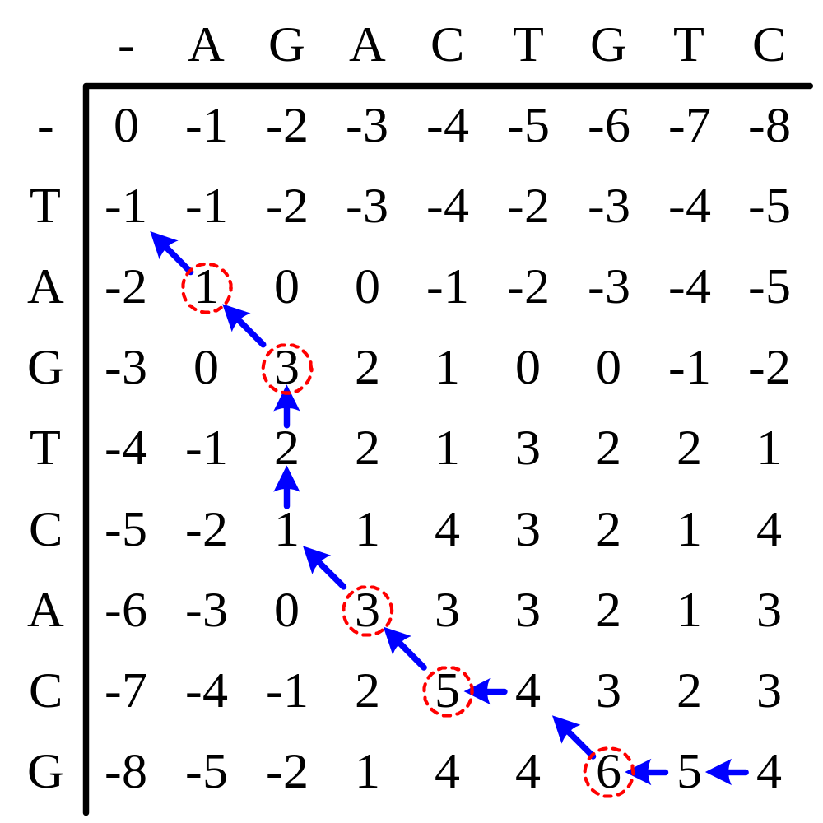
Example for Sequence Alignment
TAGTCAC-G--
-AG--ACTGTC

Slide 7
The Local Alignment Problem
Input: Two (or more) sequences S₁, S₂, …, S_{n}, and a scoring function f.
Output: Substrings S_{i}’of S_{i} such that the score obtained by aligning S_{i}’ is the highest, among all possible substrings of S_{i}. (1≤ i ≤ n)
S₁= abbbcc
S₂= adddcc
Score=3×2+3×(–1)=3
S₁’= cc
S₂’= cc
Score=2×2=4

Slide 8
Gap Penalty
An alignment A is composed of three kinds of regions.
  (i) Matched pair: x’[i]=y’[i];
  (ii) Mismatched pair: x’[i] ≠ y’[i] and both are not spaces;
  (iii) Gap: either x[i..j] or y’[i..j] is a gap. Only a matched pair has a positive score a, a mismatched pair has a negative score b and a gap of length r also has a negative score g+rs where g, s<0.
For DNA, the most common scoring scheme (e.g. used by BLAST) makes a = 1, b = -3, g = -5 and s = -2.

Slide 9
All Local Alignment
T:
 |  | h |  |  |  |  | i
P:
 |  |  |  | j
Suppose A[h, i, j] equal the largest alignment score of T[h…i] and any substring of P end at position j
For all h, find the max alignment score in A[h, I, j]

Slide 10
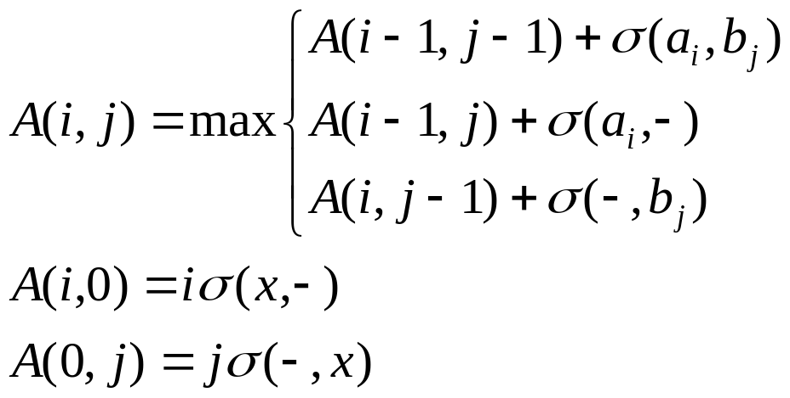

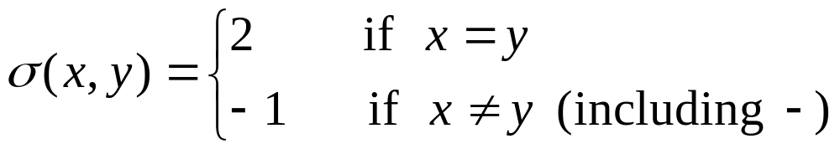
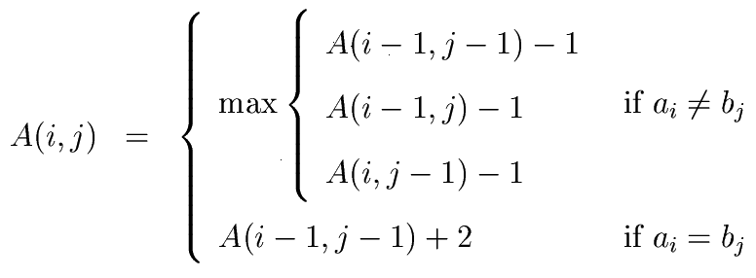
Gap Penalty
is the gap penalty.
Suppose
4 -<number>

Slide 11
Local Alignment

Slide 12
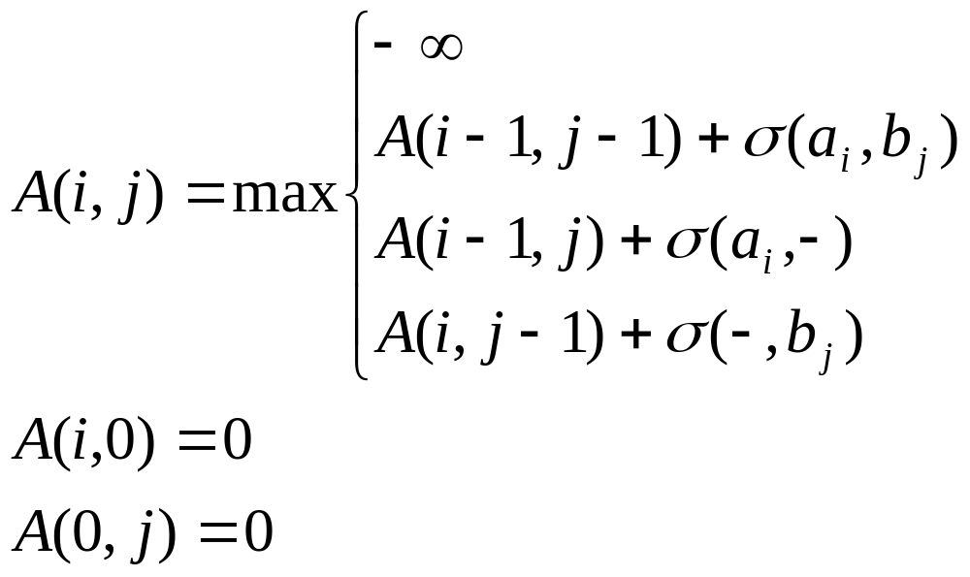
Dynamic Programming for Local Alignment
Once the score becomes negative, we reset it to 0.

Slide 13
Example for Local Alignment
-
A
G
A
C
T
G
T
C
-
-5
0
0
0
0
0
0
0
0
T
0
0
0
0
0
2
1
2
1
A
0
2
1
2
1
1
1
1
1
Two solutions:
G
0
1
4
3
2
1
3
2
1
TAGTC
T-GTC
T
0
0
3
3
2
4
3
5
4
C
0
0
2
2
5
4
3
4
7
A
0
2
1
4
4
4
3
3
6
AGTCAC-G
AG--ACTG
C
0
1
1
3
6
5
4
3
5
G
0
0
3
2
5
5
7
6
5

Slide 14
Sequence Alignment Software
BLAST
  http://www.ncbi.nlm.nih.gov/BLAST/
SSAHA2
  http://www.sanger.ac.uk/resources/software/ssaha2/
BWT-SW
  http://i.cs.hku.hk/~ckwong3/bwtsw/
BWA-SW:
  http://bio-bwa.sourceforge.net/

Slide 15
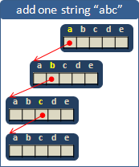
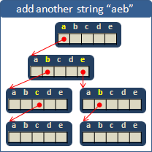
Suffix Trie

Slide 16
T = tgctatgc
root
P = ctag
a
c
g
t
$
t
$
t
c
a
g
g
a
$
t
t
c
c
t
a
g
$
t
$
g
t
c
a
c
g
$
t
$
c
g
$
c
$

Slide 17
Suffix Array
S₁ = TAGTCACG
SA[i] | i | suf_{SA[i]}
8 | 0 | $
5 | 1 | ACG$
1 | 2 | AGTCACG$
4 | 3 | CACG$
6 | 4 | CG$
7 | 5 | G$
2 | 6 | GTCACG$
0 | 7 | TAGTCACG$
3 | 8 | TCACG$

Slide 18
BWT_{(Burrow-Wheeler transform)}
BWT[i] = S[ SA[i] - 1]
S₁ = TAGTCACG$
BWT=GCTTACA$G
i | SA[i] | suf_{SA[i]}
0 | 8 | $
1 | 5 | ACG$
2 | 1 | AGTCACG$
3 | 4 | CACG$
4 | 6 | CG$
5 | 7 | G$
6 | 2 | GTCACG$
7 | 0 | TAGTCACG$
8 | 3 | TCACG$
7 | 2 | 6 | 8 | 3 | 1 | 4 | 5 | 0
T | A | G | T | C | A | C | G | $

Slide 19
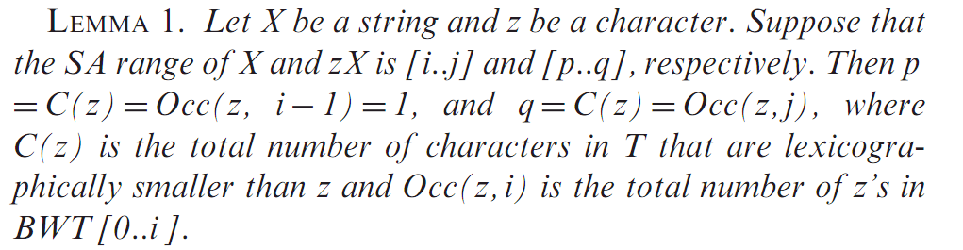

Slide 20
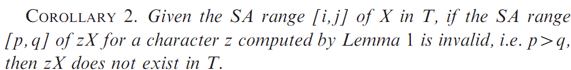
Simulating suffix trie traversal using BWT
We can make use of the backward search technique on BWT to simulate the pre-order traversal of a suffix trie to numerate the substrings. Based on Lemma 1, we have the following corollary.

Slide 21
BWT-SW
M^{u}(i, j) be the best alignment score of X[1..i] and any substring of pattern P ending at position j.
M (i, j) mean X[i] aligned with P[j]
M (i, j) mean X[i] aligned with space.
M (i, j) mean P[j] aligned with space.
u
1
u
2
u
3

Slide 22
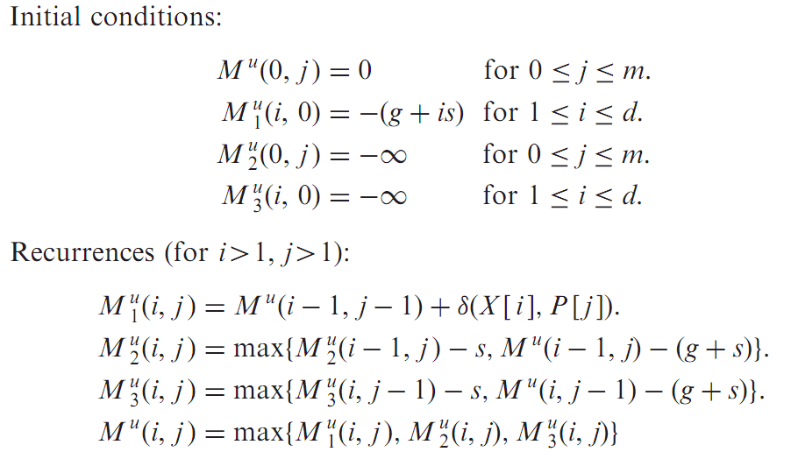
BWT-SW Dynamic Programming

Slide 23
T = tgctatgc
root
P = ctag
a
c
g
t
$
t
$
t
c
a
g
g
a
$
t
t
c
c
t
a
g
$
t
$
g
t
c
a
c
g
$
t
$
c
g
$
c
$

Slide 24
T = tgctatgc
root
P = ctag
a
c
g
t
$
t
$
t
c
a
g
g
a
$
t
t
c
c
t
a
g
$
t
$
g
t
c
a
c
g
$
t
$
c
g
each node represented a substring of T.
X = ‘ctat’
$
c
$

Slide 25
T = tgctatgc
root
P = ctag
c | t | a | g
c | t | a | g
c
1 | -3 | -3 | -3
t
-3 | 1 | -3 | -3
c | ct | cta | ctag
c | t | ta | tag
t
-6 | 2 | -5 | -7
a
-10 | -6 | 2 | -5
c | ct | cta | ctag
c | t | ta | tag
a
-8 | -5 | 3 | -4
t
-12 | -8 | -5 | -1
c | ct | cta | ctag
t
-10 | -7 | -4 | 0
g
c
1 | -3 | -3 | -3
-6 | 2 | -5 | -7
-8 | -5 | 3 | -4
-10 | -7 | -4 | 0
$
This traversal can be implemented by 2D-array

Slide 26
Meaningless alignment
Let A be an alignment of a substring X=T[h..i ]of T and a substring Y=P[k..j]of P. If A aligns a prefix X'=T[h..h']of X with a prefix Y'=P[k..k']of Y such that the alignment score of X' and Y' is less than or equal to zero, A is said to be a meaningless alignment. Otherwise, A is said to be meaningful.

Slide 27
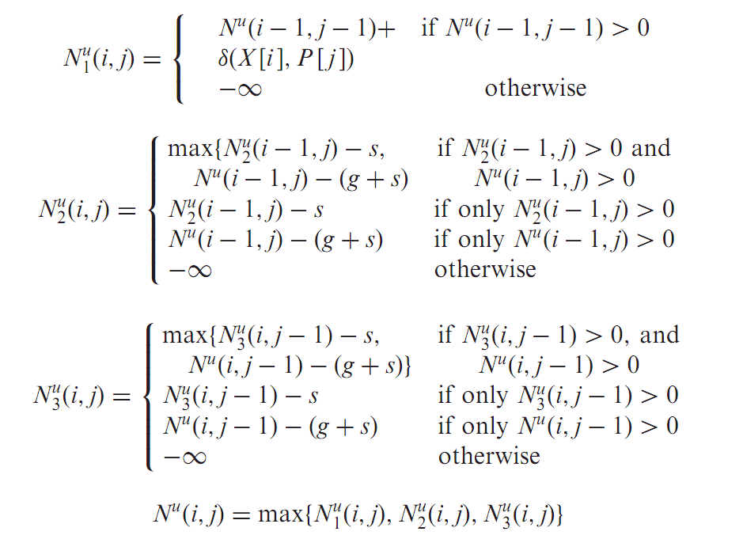
Modified dynamic programming and pruning

Slide 28
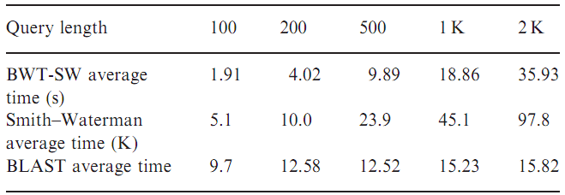
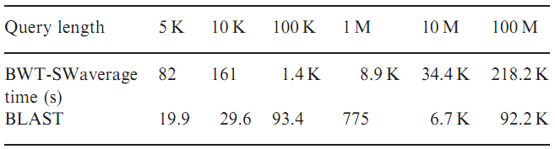
Result

Slide 29
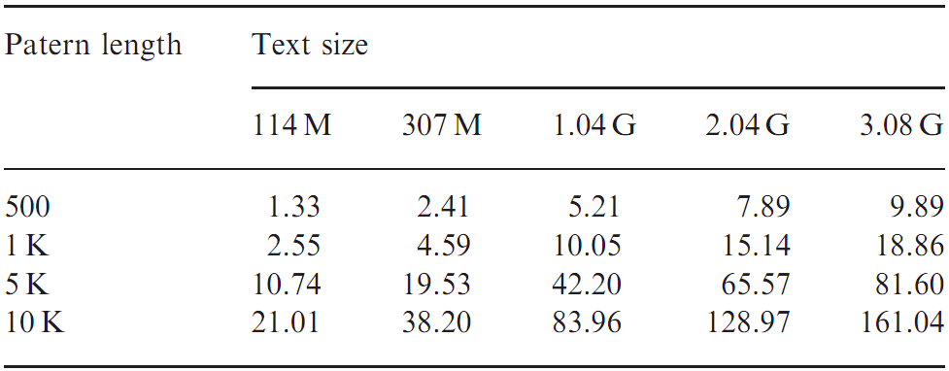
Result
Using the above figures, we roughly estimate that the time complexity of BWT-SW is in the order of n^{0.628}m.

Slide 30
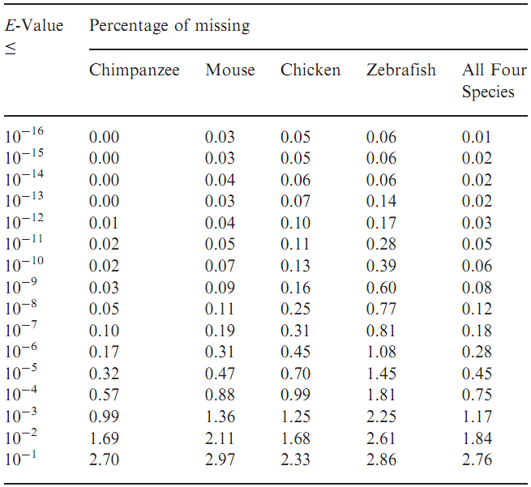
Missing Rate of BLAST

Slide 31
Thank you!!!

