Slide 1
Independent Component Analysis: Algorithm and Applications
Aapo Hyvärinen and Erkki Oja
Neural Networks Research Centre
Helsinki University of Technology
Neural Networks, Vol. 13 (2000), pp. 411-430
Presenter: Hung-Hsin Chen
Date: May 10, 2011

Slide 2
Abstract (1/2)
A fundamental problem in neural network research, as well as in many other disciplines, is finding a suitable representation of multivariate data, i.e. random vectors.
For reasons of computational and conceptual simplicity, the representation is often sought as a linear transformation of the original data. In other words, each component of the representation is a linear combination of the original variables. Well-known linear transformation methods include principal component analysis, factor analysis, and projection pursuit.

Slide 3
Abstract (2/2)
Independent component analysis (ICA) is a recently developed method in which the goal is to find a linear representation of nongaussian data so that the components are statistically independent, or as independent as possible. Such a representation seems to capture the essential structure of the data in many applications, including feature extraction and signal separation. In this paper, we present the basic theory and applications of ICA, and our recent work on the subject.

Slide 4
ICA
Blind Signal Separation (BSS) or Independent Component Analysis (ICA) is the identification & separation of mixtures of sources with little prior information.
Applications include:
Audio Processing
Medical data
Finance
Array processing (beamforming)
… and most applications where Factor Analysis and PCA is currently used.
ICA seeks such directions that are most independent from each other.

Slide 5
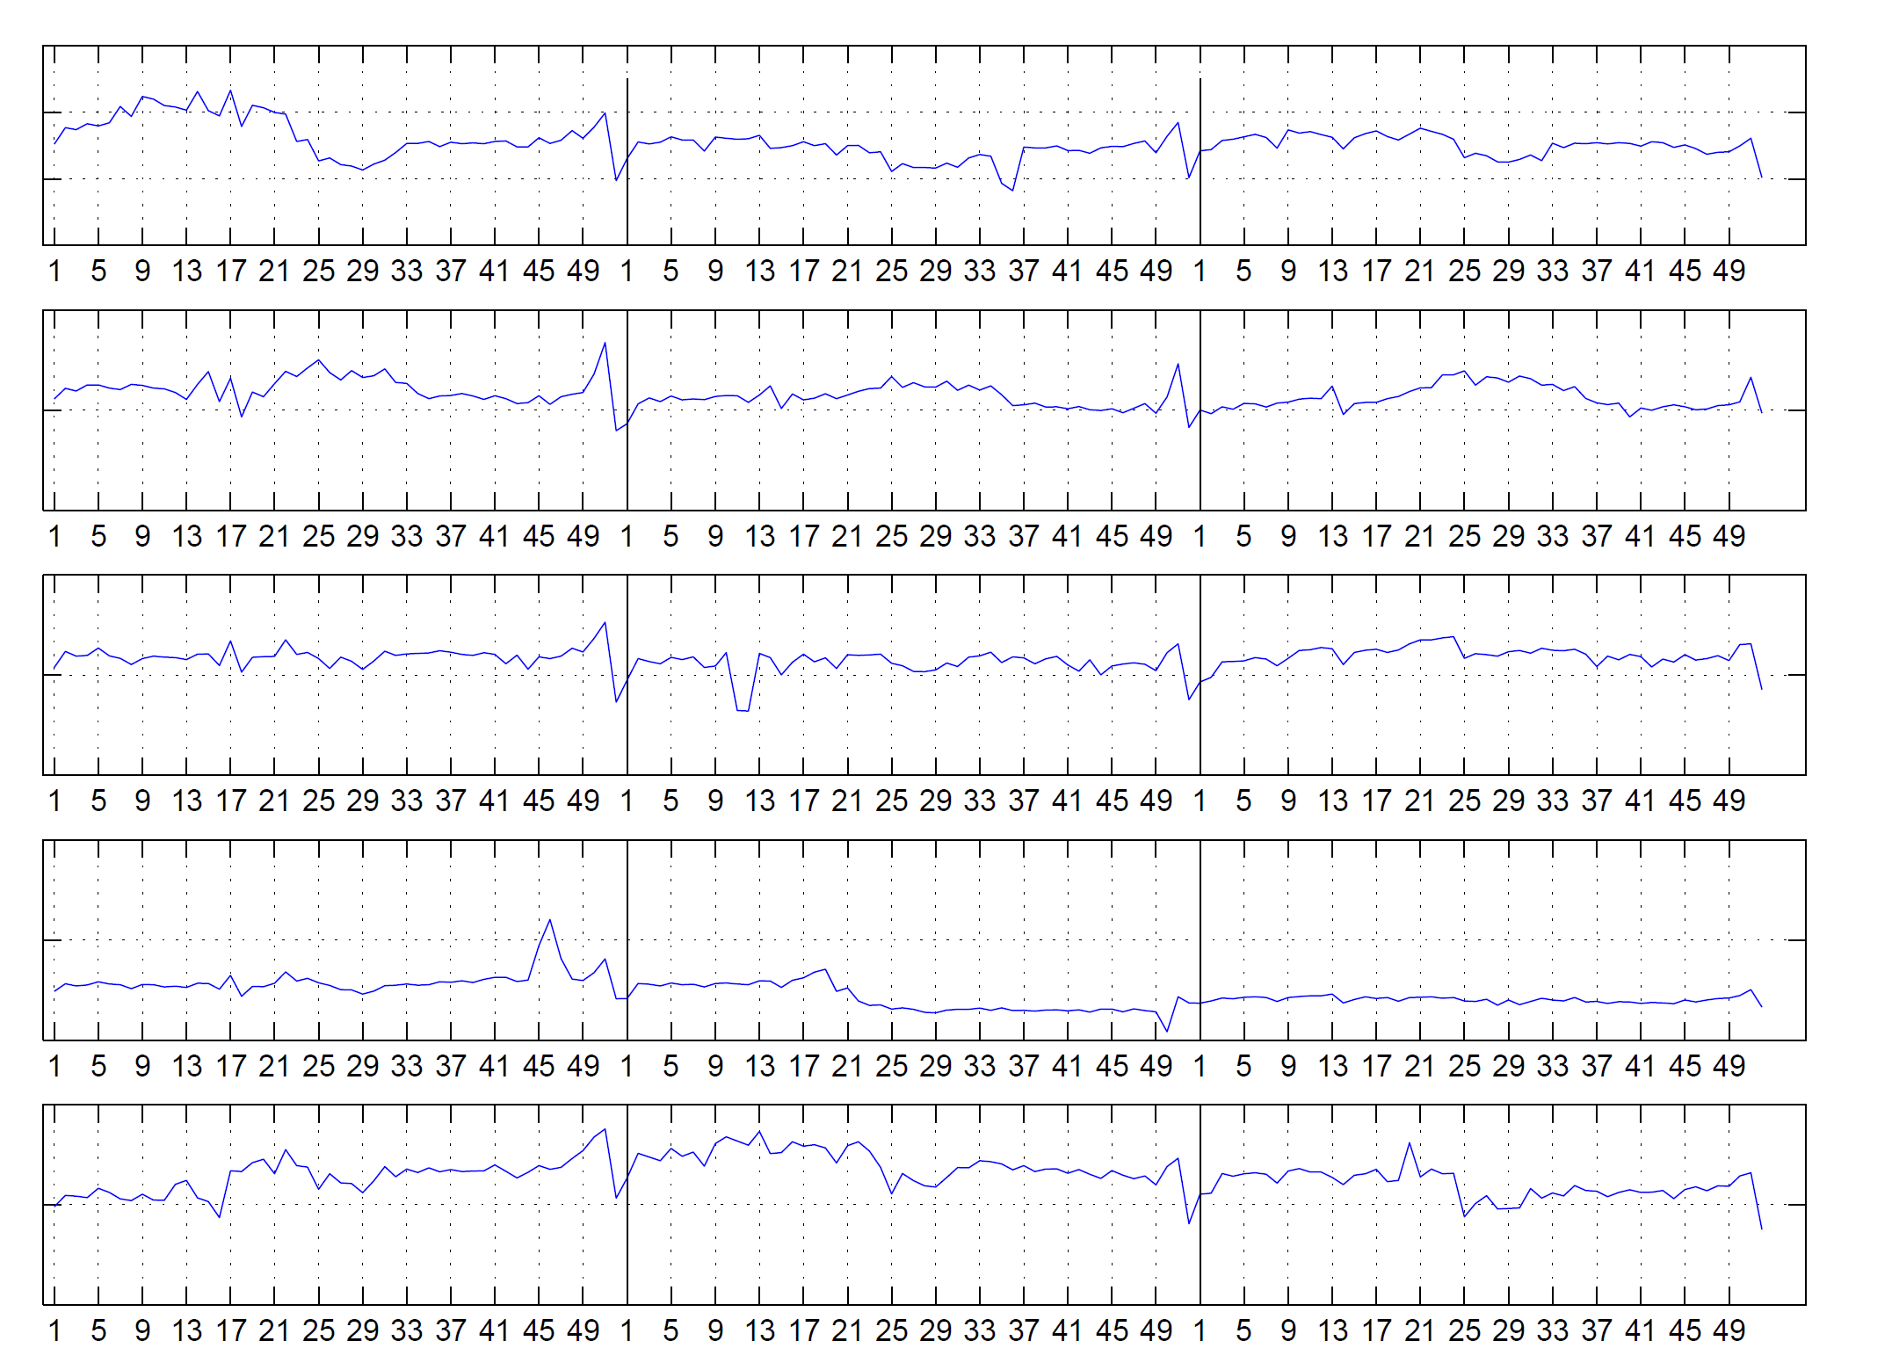
Application-finance
Original weekly cash flow

Slide 6
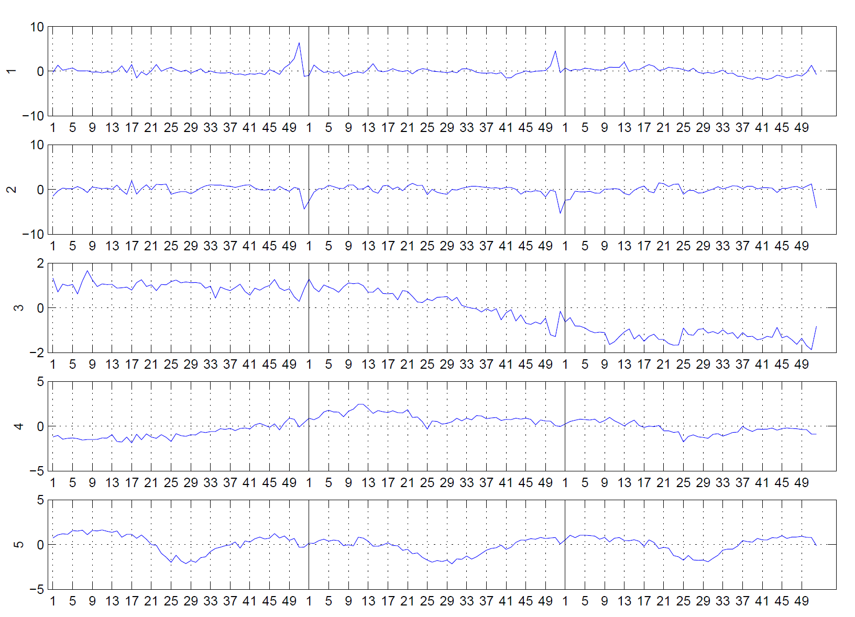
Independent components of factors of cash flow

Slide 7
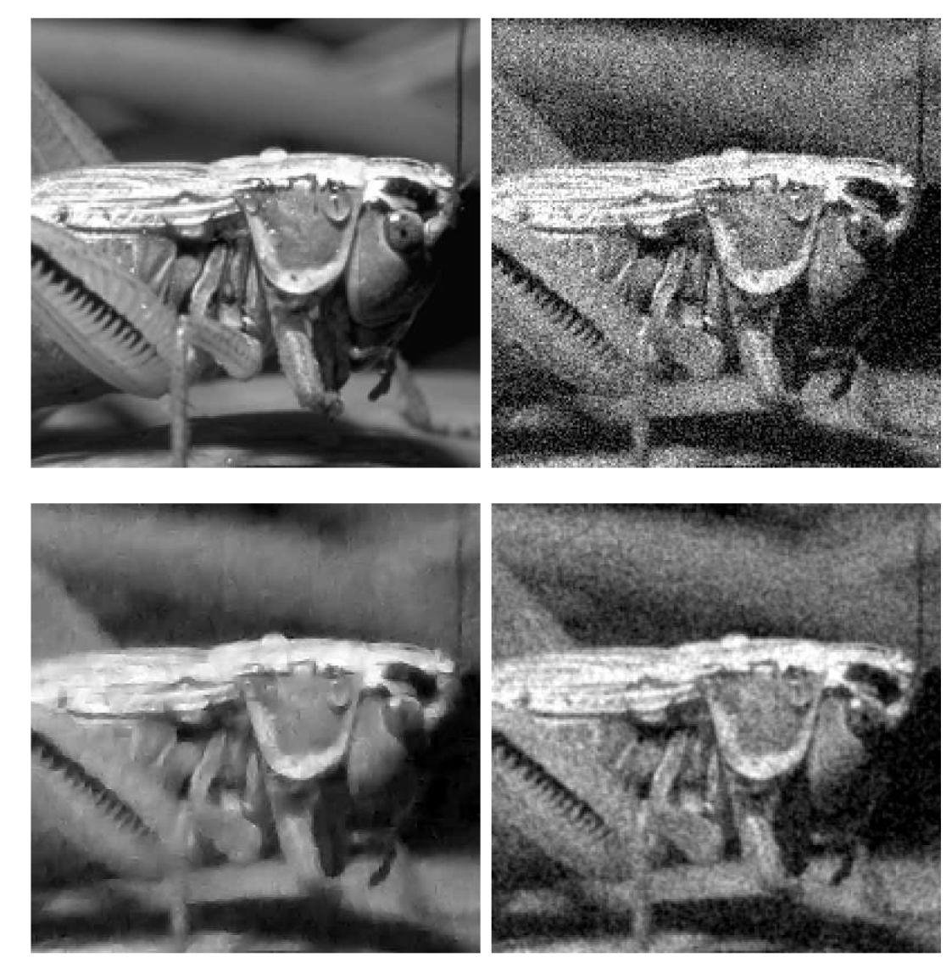
Application-denoising
Original
With 50% noise
ICA
Wiener filter

Slide 8
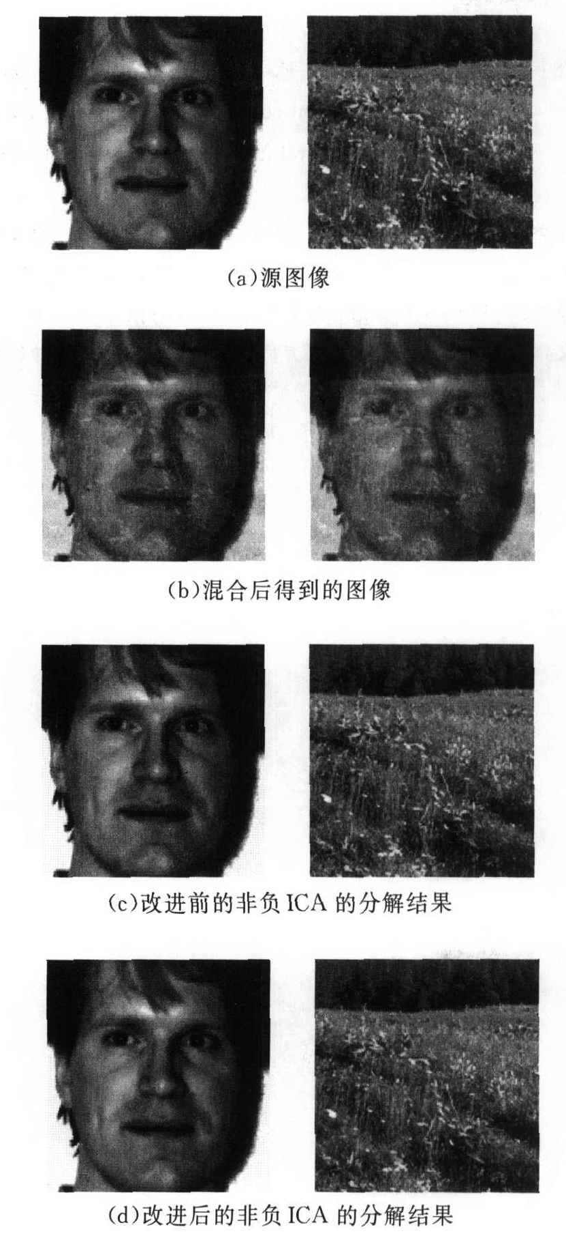
Application-image separation

Slide 9

The Principle of ICA: a cocktail-party problem
x₁(t)=a₁₁ s₁(t) +a₁₂ s₂(t) +a₁₃ s₃(t)
x₂(t)=a₂₁ s₁(t) +a₂₂ s₂(t) +a₁₂ s₃(t)
x₃(t)=a₃₁ s₁(t) +a₃₂ s₂(t) +a₃₃ s₃(t)
Matrix form:
X = AS
X: 合成訊號
S: 獨立訊號
a_{ij}: 合成矩陣

Slide 10
Goal of ICA
Observing signals (known)
Original source signal (unknown)
ICA
0.10
0.05
V4
0.00
-0.05
-0.10
0
50
100
150
200
250

Slide 11
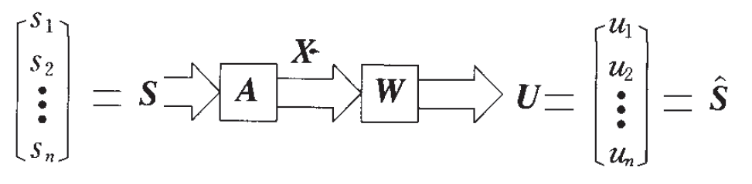
Mathematical representation
Observed vector: X=(x₁, x₂,…,x_{n})^{T}
Signal vector(unknown): S =(s₁, s₂,…,s_{m})^{T}, E(s_{i})=0, var(s_{i}) = 1
Assume n >= m (prevent A is a singular matrix)
X = AS
A is hybrid matrix (unknown)
Assume the signals are independent and nongaussian
Y = WX = W AS
Y: estimation of S
W: separation matrix (we want to get)

Slide 12

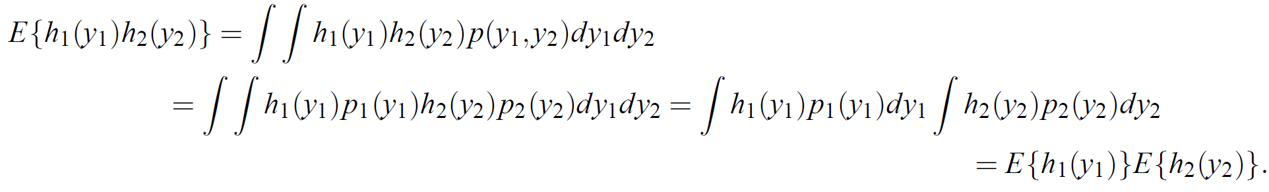
Statistical independent
y₁, y₂ is independent iff P(y₁, y₂) = P₁(y₁)*P₂(y₂)
Extension:
Given functions h₁, h₂:
E{h₁(y₁), h₂(y₂)} = E{h₁(y₁)}*E{h₂(y₂)}

Slide 13
Uncorrelated
Independent ＝> Uncorrelated
But Uncorrelated ≠> Independent
y₁, y₂ is uncorrelated if cov(y₁, y₂) = E{y₁y₂} - E{y₁}*E{y₂} = 0
Since independence implies uncorrelatedness, many ICA methods constrain the estimation procedure so that it always given uncorrelated estimates of the independent components. (for simplifying the problem)

Slide 14
Central limit theorem
The distribution of a sum of independent random variables tends toward a Gaussian distribution
Observed signal
=
IC_{n}
a₁
IC₁
+ a₂
IC₂
….+ a_{n}
toward Gaussian
Non-Gaussian
Non-Gaussian
Non-Gaussian
If the independent random variables are Gaussian distribution, we can not separate them!!

Slide 15
How to estimate ICA model
Principle for estimating the model of ICA
Maximization of Non-Gaussianity
Non-Gaussianity is independent!!
Notes:
評估ICA model的基本原則就是將component非高斯性最大化

Slide 16
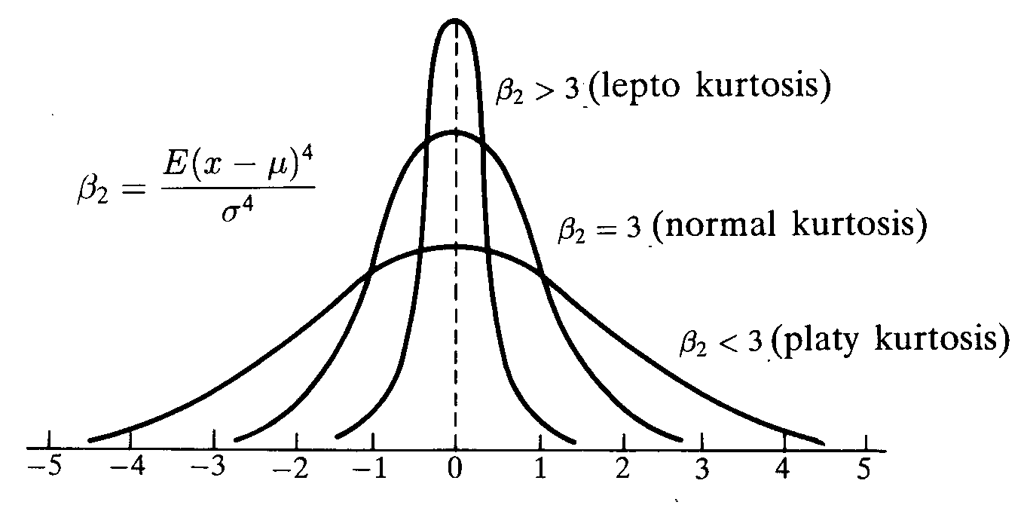
Measures of Non-Gaussianity (1) Kurtosis (峰態)
Kurtosis : E{(x-μ_{x})⁴}-3*[E{(x-μ_{x})²}]²
=> E{x⁴}-3*E({x²})²=> E{x⁴} - 3
Super-Gaussian kurtosis > 0
Gaussian kurtosis = 0
Sub-Gaussian kurtosis < 0
Non-Gaussian random variable, kurotosis is nonzero.
kurt(x₁+x₂)= kurt(x₁) + kurt(x₂)
kurt(αx₁) =α⁴kurt(x₁)
If x₁, x₂ is independent

Slide 17
X = AS
Assume independent components s₁, s₂
kurt(s₁), kurt(s₂) ≠0, and var(s₁) = var(s₂) = 1
E(Y) = 0, COV(Y) = I
We want to get independent component Y = U^{T}X
Let Z = AU^{T}=[z₁, z₂]
Y = U^{T}X = Y = (U^{T}A )S = Z^{T} S = z₁*s₁+z₂*s₂
Maximize
Kurt(Y) = kurt(z₁*s₁) + kurt(z₂*s₂) = z₁⁴*kurt(s₁) + z₂⁴*kurt(s₂)
Subject to
Var(Y) = Var(z₁*s₁+z₂*s₂) = z₁²*Var(s₁)+z₂²*var(s₂) = z₁²+z₂²=1
Drawback: kurtosis is very sensitive to outliers, not robust

Slide 18
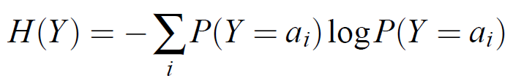
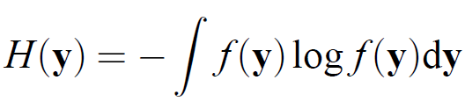
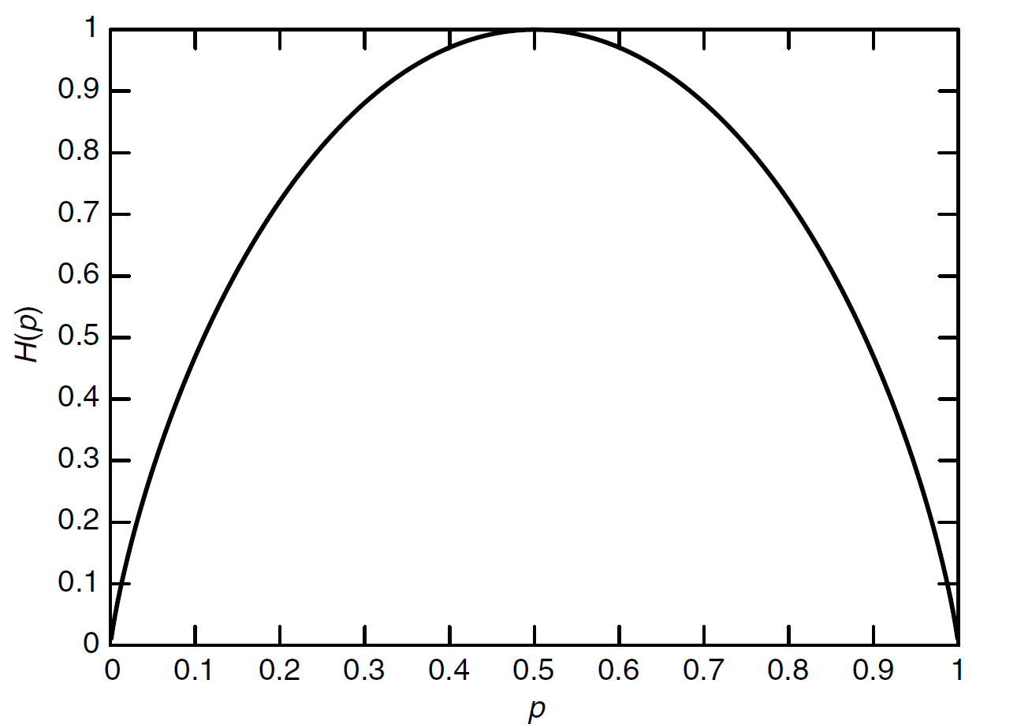
Measures of Non-Gaussianity (2) Neg-entropy
Entropy:
資料混亂程度
資料平均編碼長度
Discrete:
Continuous:
P(Y=a) or P(Y≠a)

Slide 19
A Gaussian variable has the largest entropy among all random variables of equal variables!! [proof]
Neg-entropy:
J(y) = H(y_{Gauss}) – H(y)
y_{Gauss}: Gaussian r.v. of the same covariance matrix as y
Neg-entropy is the optimal estimator of non-Gaussianity.
But it is hard to compute the neg-entropy (need to estimate the p.d.f)

Slide 20
Approximation of the neg-entropy
Classical method (nonrobustness, because of kurtosis):
Based on the maximum-entropy principle:
The following choices of G is good:
1 ≦ a ≦ 2

Slide 21
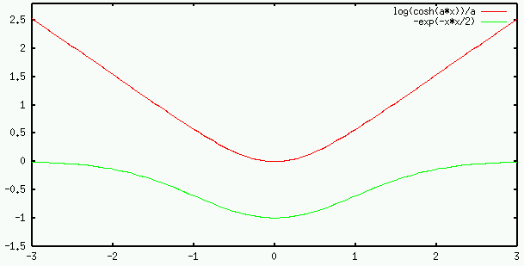
The following choices of G is good:
1 ≦ a ≦ 2

Slide 22
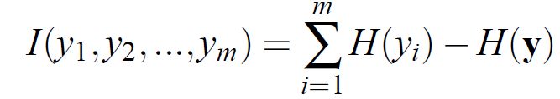
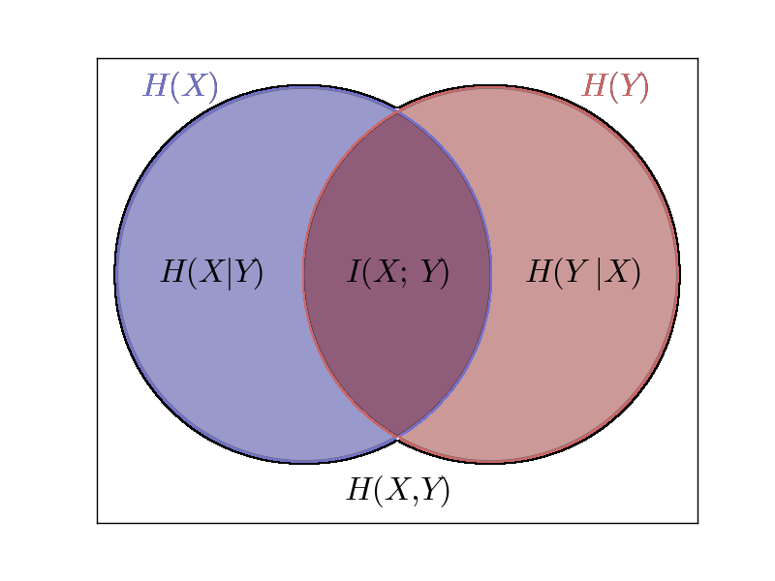
Measures of Non-Gaussianity (3) Mutual information
I(y₁, y₂,…,y_{m}) = 0 iff y₁, y₂,…, y_{m} independent

Slide 23
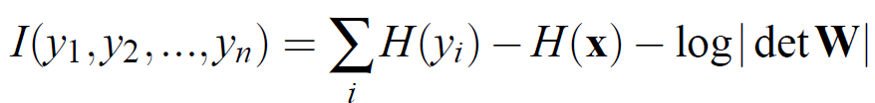
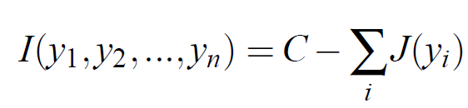
If Y=WX then:
[Proof]
Assume COV(y_{i}, y_{j}) = 0, i ≠ j, Var(y_{i})=1
then
E{YY^{T}}=E{WX(WX)^{T}}=WE{XX^{T}}W^{T}=I
det(I)=1=det(WE{XX^{T}}W^{T)}=(detW)(detE{XX^{T}})(detW^{T})
It implies detW must be constant
Moreover, H(y_{i})- J(y_{i}) = C₁ (constant)

Slide 24
ICA and mutual information
Finding W that minimize the mutual information ⬄ finding direction in which the neg-entropy is maximized.
Minimize the mutual information ⬄ maximizing the sum of non-Gaussianities of the estimates if these estimates are uncorrelated.

Slide 25
Preprocess the data-whitening
Centering: X <= X – E{X}
X=[[2, 6, 4] => X = [[-2, 2 ,0] [4, 5, 6]] [-1, 0 ,1]]
將X做線性轉換得到X*，使得各訊號uncorrelated且變異數為1
i.e. COV(X*) = E{X*(X*)^{T}} = I

Slide 26
To get X*
Step:
1. Use the eigen-value decomposition (EVD) of E{XX^{T}} = EDE^{T}
X = [[-2, 2 ,0] [-1, 0 ,1]]
COV(X) = [[4 ,1]
[1, 1]]
D=[0.69722, 0]
[0, 4.30278]]
E=[[0.28978 -0.95709
[-0.95709 -0.28978]]
2. X* = ED^{-1/2}E^{T}X
D^{-1/2}=[[1.1976, 0]
[0, 0.48209]]
X*=[[-0.88590 1.08435 -0.19845]
[-0.74062 -0.39690 1.13752]]
E{X*(X*)^{T}} = I

Slide 27
Substituting X to X*:
X = AS
X* = ED^{-1/2}E^{T}X = ED^{-1/2}E^{T}AS = (A*)S
E{X*(X*)^{T}} = E{(A*)S((A*)S)^{T}}=(A*)E{SS^{T}}(A*)^{T}=(A*)(A*)^{T}=I
We can get A* is orthogonal matrix
It reducing then number of parameters to be estimated!!
A: n² parameters
A*: n(n-1)/2 degrees of freedom
以下均假設X已經經過whitening處理

Slide 28
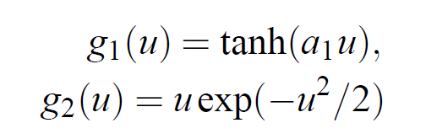
The FastICA algorithm for one unit
Assume W is vector of R^{n*1} (one independent source)
Maximize the neg-entropy J(W^{T}X)
According to Karush–Kuhn–Tucker (K.K.T.) conditions:
The optima of E{G(W^{T}X)}
under constraint E{Y²} = E{(W^{T}X)²}=||W||²=1 is
F(W) = E{Xg(W^{T}X)}-βW = 0,
g is differential of G

Slide 29

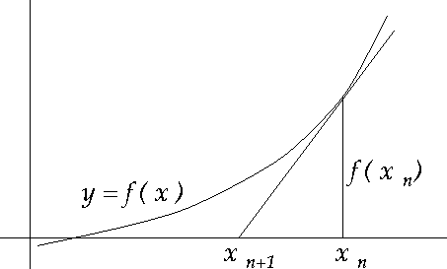
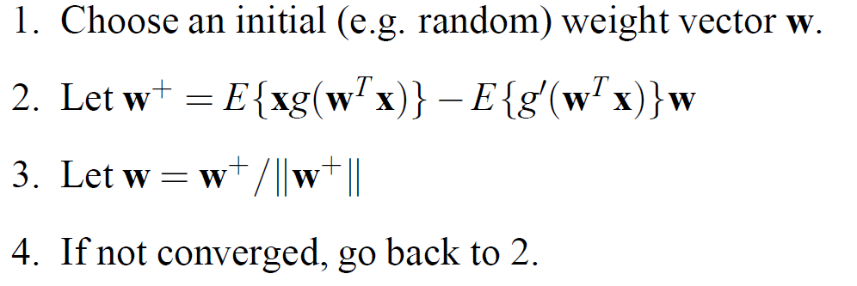
Jacobian matrix JF(W):
JF(W) = E{XX^{T}g’(W^{T}X)}- βI
E{XX^{T}g’(W^{T}X)} ≒ E{XX^{T}} E{g’(W^{T}X)}= E{g’(W^{T}X)}I
Newton iteration (to find max value):
W⁺= W – [E{Xg(W^{T}X)}- βW]/[E{g’(W^{T}X)}- β]
We get the FastICA for one unit:

Slide 30
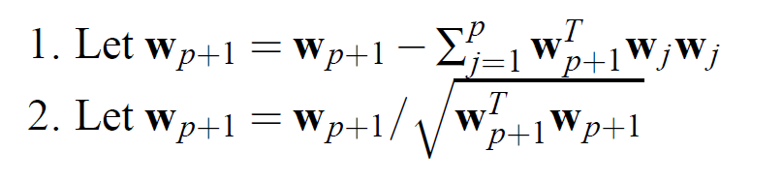
FastICA for several units
Assume several units W₁,W₂…,W_{n}
Because W₁X,…,W_{n}X are correlated
We have to decorrelate them after each iteration
Method 1 (as Gram–Schmidt process):
Assuming there are p independent components
w₁, w₂,…,w_{p}, run previous one units method to get w_{p+1}.

Slide 31

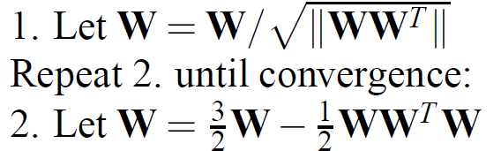
Method 2 (to generate symmetric matrix W):
W =(w₁,w₂,…,w_{n})^{T}
EVD of WW^{T} = FDF^{T}, hence (WW^{T})^{-1/2}= FD^{-1/2}F^{T}
Classical method:
Alternative method:

Slide 32
FastICA

Slide 33
Property of FastICA
Convergence of FastICA is cubic (at least quadratic), convergence of gradient-based method is only linear.
Unlike gradient-based method, no step size parameters
Using function g to finds independent component
Implementation (Matlab, R, C++, Python):
http://research.ics.tkk.fi/ica/fastica/

Slide 34
Hot issues
ICA model with noise
The number of source signals are not equal to the number of observed signals
Non-linear ICA, Kernel ICA
Complex number dataset
Blind deconvolution, Blind equalization
Independent measures

Slide 35
Thank you!!

