Slide 1
Next-generation sequencing technologies and their implications for crop genetics and breeding
Rajeev K. Varshney, Spurthi N. Nayak, Gregory D. May and Scott A. Jackson
Trends in Biotechnology, Vol. 27, Issue 9, pp. 522-530, 12 August 2009
Presenter: Hsin-Fang Wu
Date: May 10, 2011

Slide 2
Abstract (1/2)
Using next-generation sequencing technologies it is possible to resequence entire plant genomes or sample entire transcriptomes(轉錄組) more efficiently and economically and in greater depth than ever before. Rather than sequencing individual genomes, we envision the sequencing of hundreds or even thousands of related genomes to sample genetic diversity(差異性) within and between germplasm(種原) pools. Identification and tracking of genetic variation are now so efficient and precise that thousands of variants can be tracked within large populations.

Slide 3
Abstract (2/2)
In this review, we outline some important areas such as the large-scale development of molecular markers for linkage mapping, association mapping, wide crosses and alien introgression(基因滲入), epigenetic (表觀遺傳學) modifications, transcript profiling, population genetics and de novo genome/organellar(細胞器) genome assembly for which these technologies are expected to advance crop genetics and breeding, leading to crop improvement.

Slide 4
Sanger sequencing methodology
Once a piece of DNA has been amplified(擴增), it can be sequenced. In this process, four reaction mixtures are set up, each one including:
1. DNA to be sequenced
2. DNA polymerase(聚合酶)
3. A supply of nucleotides (核苷酸)(A, C, G and T)
4. A small amount of a labelled chain-terminating variant of one of the four nucleotides.
The enzyme(酶) DNA polymerase incorporates(結合) a chain- terminating variant at random, eventually ending the chain at every possible nucleotide position over a few hundred bases.
The products of the reaction mixtures are run on an electrophoresis gel(凝膠電泳), where the sequence can be deduced by reading from the smallest to the largest piece.
http://www.youtube.com/watch?v=oYpllbI0qF8

Slide 5
Sanger sequencing methodology
If different fluorescent(熒光) labels are used for the variant bases, sequencing can all be done in one single reaction, the bands can be detected and the sequence read out automatically. The entire process of DNA sample preparation and sequencing is now highly automated, a development that has been essential for the timely and cost-effective completion of the human genome project.

Slide 6
The Origin of NGS
Sanger法測序依賴於電泳，而電泳設備（僅管現在使用的已經是毛細管陣列）的體積又限制了Sanger法測序向更高通量的發展，Sanger法對測序樣品的前期準備要求較高，並且這個準備過程步驟繁雜，難以自動化，費時、費錢、費人力。因此有了次世代測序技術(NGS)，這種新的測序方法應該有以下幾個特點：高通量、高自動化、高精確度、低成本並且測序片段長度盡可能長。
主要的方法有：Roche 454、Illumina Solexa、ABI SOLiD

Slide 7
NGS
雖然在長度上優於其他兩個但成本較高
 | 454 | Solexa | SOLiD
Company | Roche | Illumina | ABI
Sequencing Method | Pyrosequencing | Reversible Terminator | Supported Oligo Ligation
Read Length | 300~400 base | 36~2×75 base | 36 base
Error Rate | ~1% | >1% | ~0.1%
Data/Run (Gb) | 0.1 | 1~3 | 2~3
Time/Run | 7.5 hrs | 3~5 days | Up to 8 days
Cost/Gb | $84,000 | $6,000 | $6,000
PCR | Emulsion PCR | Bridge PCR | Emulsion PCR

Slide 8
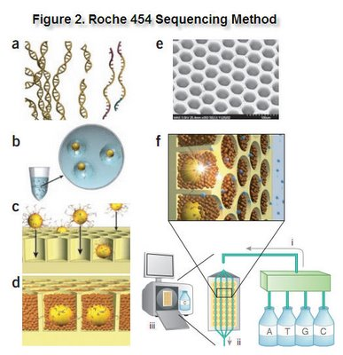
Roche 454
(a)將待測基因組序列打斷成較短的DNA片段，片段兩端分別連接特定接頭，並使雙鏈熔解拆分為單鏈DNA分子。
(b)利用直徑為28µm的DNA吸附珠與單鏈DNA分子特定端接頭的吸附作用吸附固定單鏈DNA分子，然後利用乳化PCR擴增每個珠子上的DNA分子拷貝數，以備下一步測序使用。
(c)-(e)將每個珠子置於隔離反應井中。
(f) Roche 454使用焦磷酸法測序，其反應原理是在DNA聚合酶、ATP硫酸化酶、螢光素酶和三磷酸腺苷雙磷酸酶4種酶的協同作用下，將每一個dNTP的聚合與一次螢光信號的釋放偶聯起來。記錄並分析這些螢光信號，就可以獲得高品質的DNA序列。

Slide 9
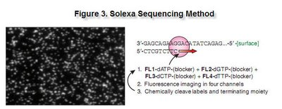
Solexa
(a) 將待測基因組序列打斷成較短的DNA片段，片段兩端分別連接特定接頭，並使雙鏈熔解拆分為單鏈DNA分子。
(b) 通過接頭將單鏈DNA分子隨機吸附在反應板表面，然後利用橋式 PCR擴增每個單鏈DNA分子拷貝數。通過這一步，同種單鏈DNA將成簇分佈在反應板表面。
(c) 加入改造過的DNA聚合酶和帶有4種螢光標記和可變粘性3'端的dNTP。對任何一條範本序列，它在聚合1bp的核苷酸後由於聚合上去的dNTP粘性末端被 封閉，將無法再聚合第二個核苷酸。此時，用鐳射掃描反應板表面，讀取每條範本序列第一輪反應所聚合上去的核苷酸種類。加入試劑去除被聚合上去的dNTP的 螢光基團，然後恢復3'端粘性，繼續聚合第二個核苷酸。如此繼續下去，直到每條範本序列都完全被聚合為雙鏈。這樣，聯合統計每輪收集到的螢光信號結果，就 可以得知每個範本DNA片段的序列。

Slide 10
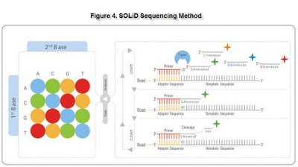
SOLiD
(a) 同上
(b) 利用直徑為1µm的DNA吸附珠與單鏈DNA分子特定端接頭的吸附作用吸附固定單鏈DNA分子然後利用乳化PCR擴增每個珠子上的DNA分子拷貝數，以備下一步測序使用。將珠子隨機吸附在反應平板上。
(c) 採用一系列用螢光標記的寡核苷酸探針，探針3'端的前2個核苷酸為測序反應提供資訊。ABI SOLiD法與以上幾種方法顯著不同的是它使用DNA連接酶而非聚合酶進行測序反應。通過連接反應，不同的寡核苷酸探針與範本序列競爭結合，只有3’端前 兩個核苷酸與範本鏈相應位置完全配對互補的探針才會被連接到範本的互補鏈上，這樣，通過多輪反應，範本鏈上位置編號為（1 or 2 +8N）的核苷酸位點的序列將被測定。然後將範本互補鏈的引物接頭延長一個核苷酸，同樣的採用連接酶進行多輪測序，則範本鏈上位置編號為（2 or 3 +8N）的核苷酸位點的序列將被測定，如此反復幾次，就可以獲得範本DNA分子的全長序列資訊。

Slide 11
Thanks for your listening !!

