Slide 1
使用表面幾何特徵於蛋白質與配體結合位置之預測 Using Geometric Features to Predict Protein-ligand Binding Regions
陳明權、林煊庭、羅英倉、白敦文 國立臺灣海洋大學資訊工程學系 2011 National Computer Symposium (NCS 2011, Dec. 2 - Dec. 3), pp. 96-107, Chiayi, Taiwan, Dec., 2011.
Presenter: Chun-Chieh Tai
Date: December 19, 2011

Slide 2
Abstract(1/2)
Protein-ligand interactions are key processes of triggering and controlling biological functions within cells. To improve the efficiencies of experimental approaches in drug discovery, a system employing geometrical features including solid angle, depth of cavity and volume of cavity is designed for protein-ligand binding region prediction. In this paper, we adopted the solid angle features to obtain the cavity depths and the scanned directions to acquire corresponding cavity volumes. Both depth and volume features were combined to rank predicted binding regions.

Slide 3
Abstract(2/2)
To verify the system performance, a testing dataset including 388 structures from LigASite was applied and compared to two well-known prediction systems, SITEHOUND and MetaPocket 2.0. The result has shown that the proposed system achieving an accuracy rate of 82.6%, and it outperforms these two existing systems. Additionally, the CUDA parallel computing architecture was designed in this prediction system to enhance the computational efficiencies. Each binding region prediction for a query protein structure only requires less than 1 second in general.

Slide 4
CUDA
Compute Unified Device Architecture
由NVIDIA所推出的一種整合技術
利用顯示核心進行高畫質視訊編碼加速
GPU(Graphics Processing Unit)通常用來加速圖形的表現，它可以簡單且快速地產生許多執行緒，將大量重複計算進行平行化的過程，可以有效降低運算所需的時間。
Notes:
NVIDIA官網
http://www.nvidia.com.tw/object/cuda_home_new_tw.html
Wiki
http://zh.wikipedia.org/wiki/CUDA

Slide 5
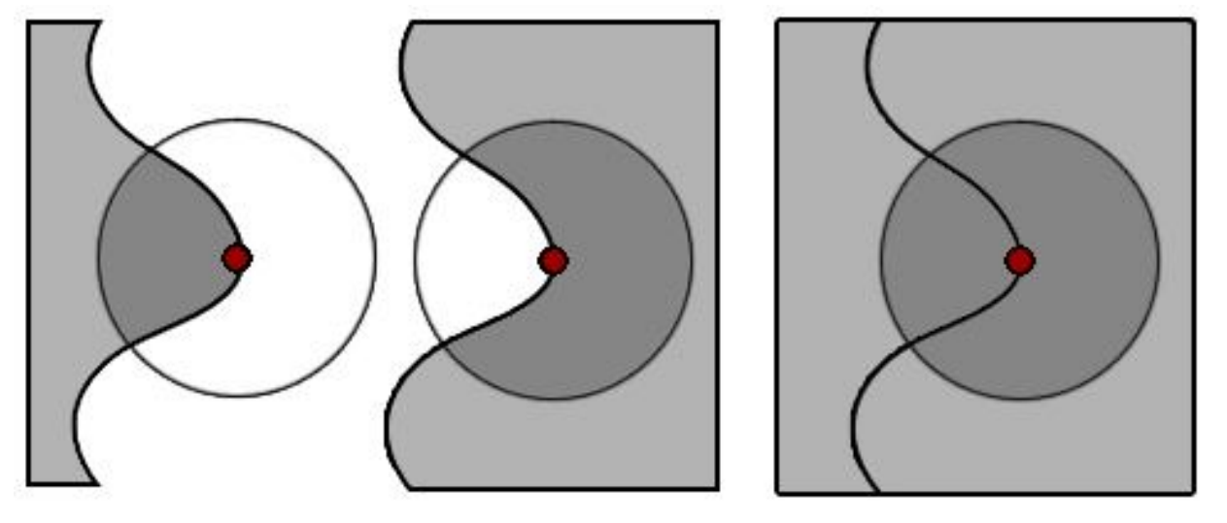
立體角特徵
Connolly於1986年提出
立體角: 從一特定點觀察或測量遠處物體的三維空間角度
定義某一物體投影在特定點的虛擬球上的面積

Slide 6
系統流程圖
三維網格技術建構蛋白質立體結構(讀取PDB檔，三維網格化，決定表面格點)
立體角計算(平行計算立體角並依立體角大小排序)
找錨點及分群(依立體角決定描點並分群)
幾何特性計算(計算深度及凹洞體積)
配體結合位置預測(將深度與凹洞體積加權後排名)

Slide 7
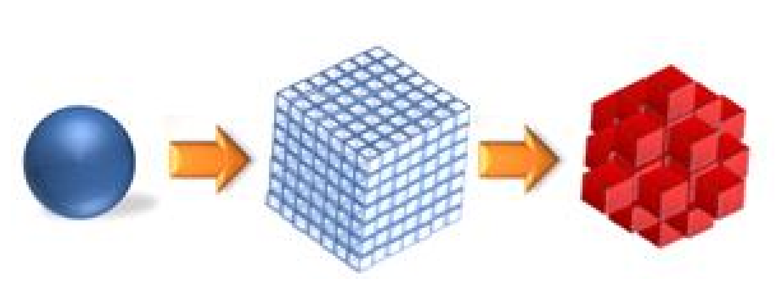
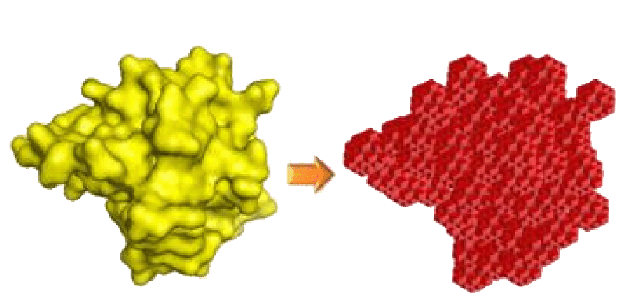
Step 1 三維網路技術建構蛋白質立體結構
讀取PDB檔
以1ACB為例
三維網格化
決定表面格點

Slide 8
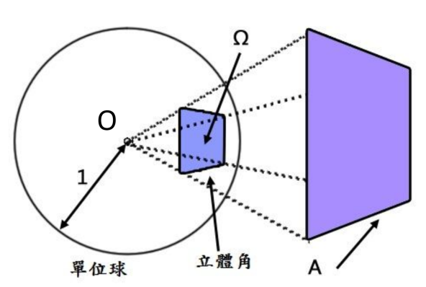
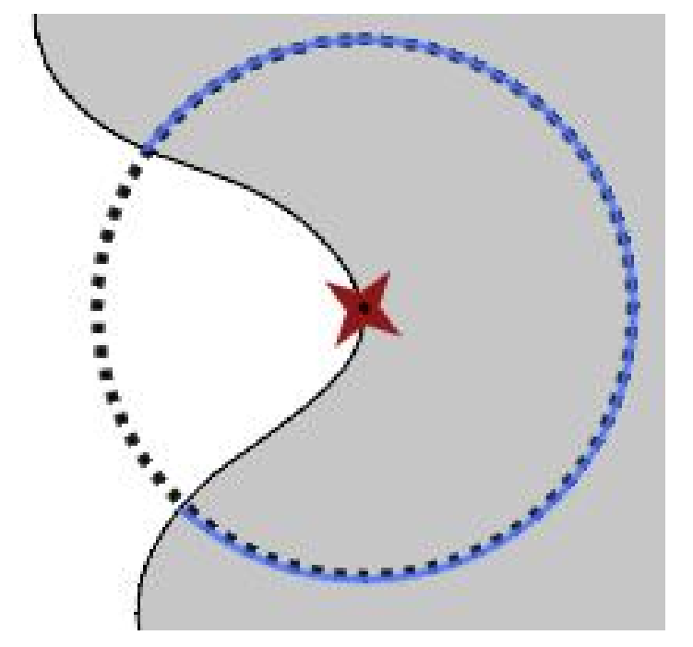
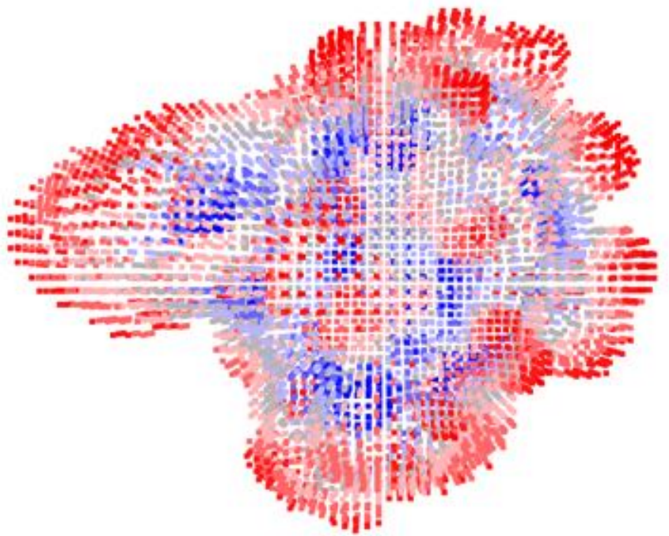
Step 2 立體角計算
平行計算立體角並依立體角大小排序
立體角計算公式:
半徑: 10Å
紅點: 0 ~ 1.5π(凸出)
灰點: 1.5 ~ 2.5π(平坦)
藍點: 2.5 ~ 4π(凹陷)

Slide 9
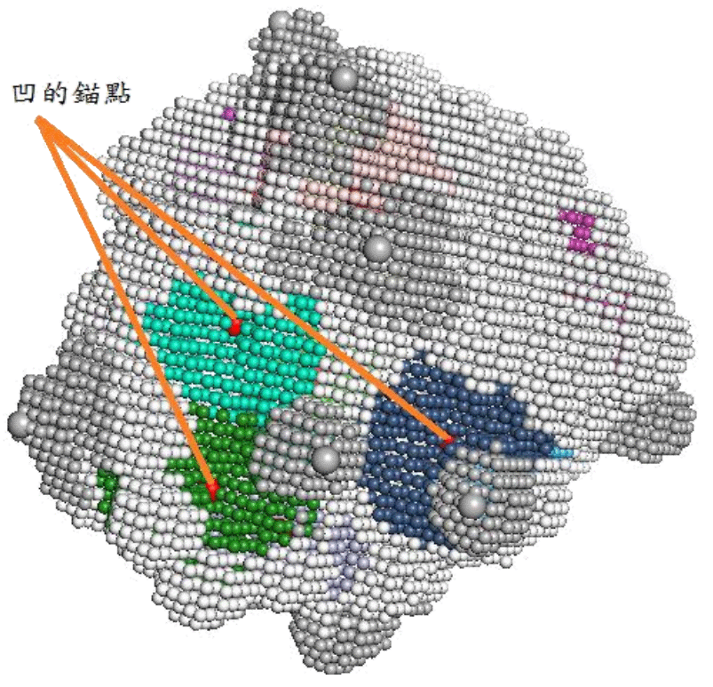
Step 3 找錨點及分群
將同性質(凹/凸/平)且分佈於限定距離(10Å)內視為同一群
只取凹洞部份的群組, 並將立體角最大的位置設為該群之代表錨點(anchor)

Slide 10
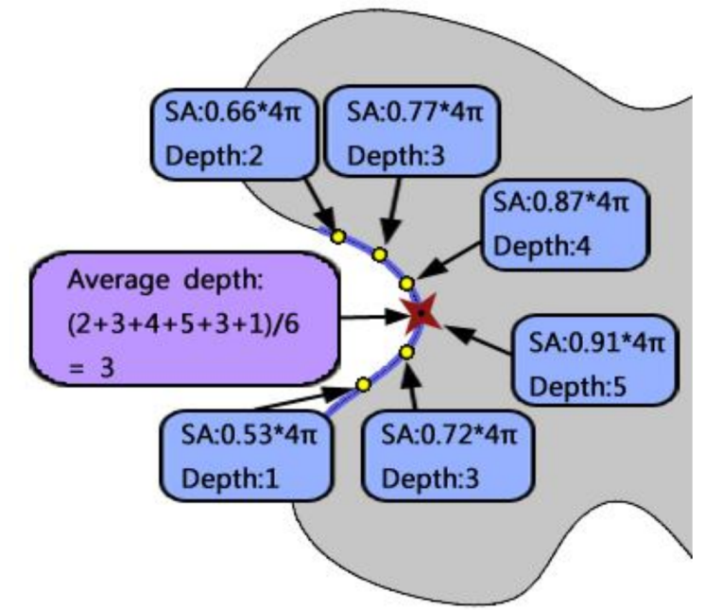
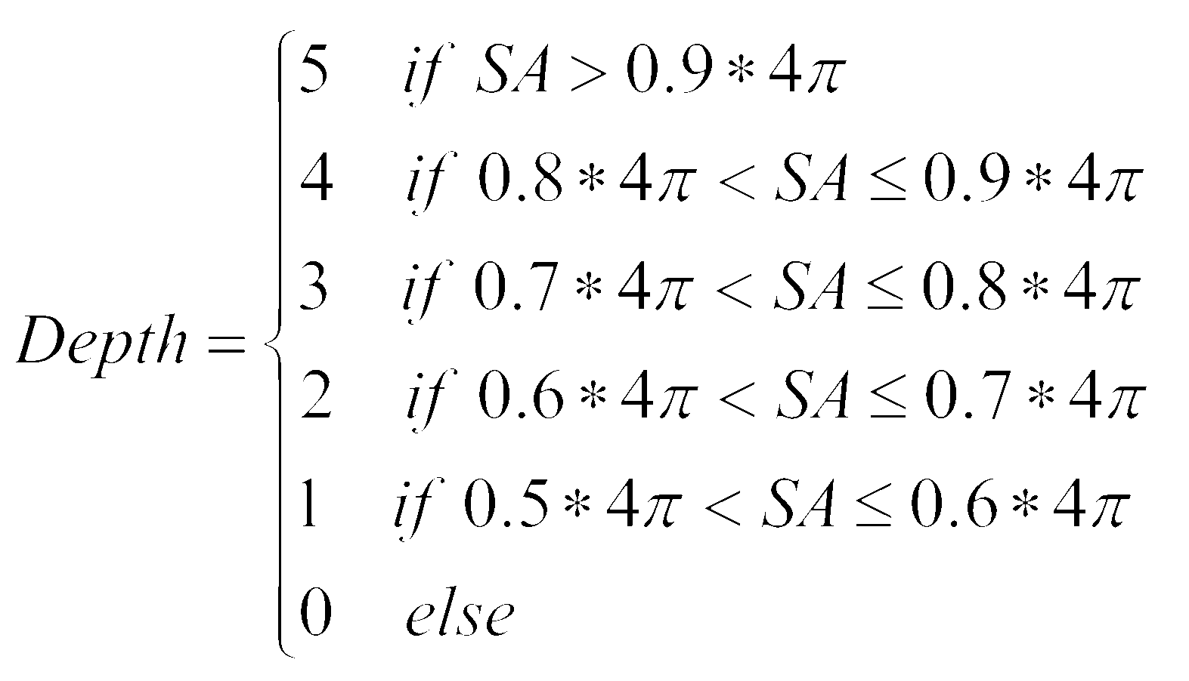
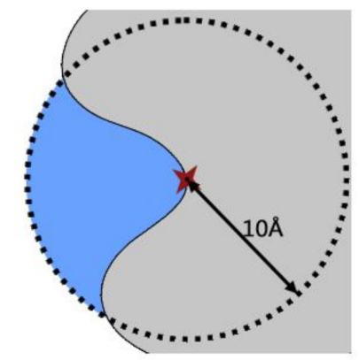
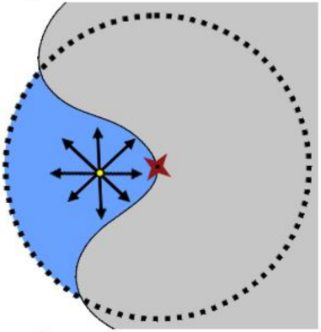
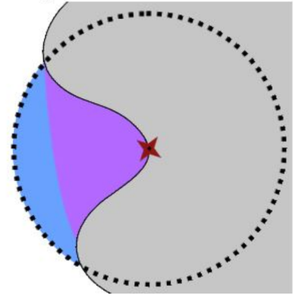
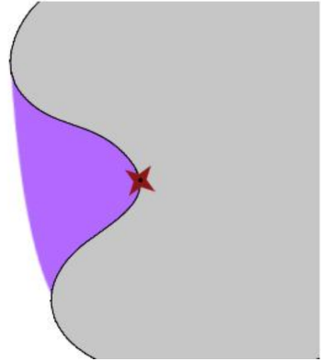
Step 4 幾何特性計算
凹洞平均深度特徵值
凹洞體積
所有凹洞內部點的個數

Slide 11
Step 5 配體結合位置預測
將凹洞深度與凹洞體積以 8:2 加權後排名
RV(p): Rank Value, p為錨點
CD(p)_{AVG}: 錨點p之凹洞深度
CV(p)_{AVG}: 錨點p之凹洞體積
CD_{MAX}: 所有錨點中最大凹洞深度
CV_{MAX}: 所有錨點中最大凹洞體積

Slide 12
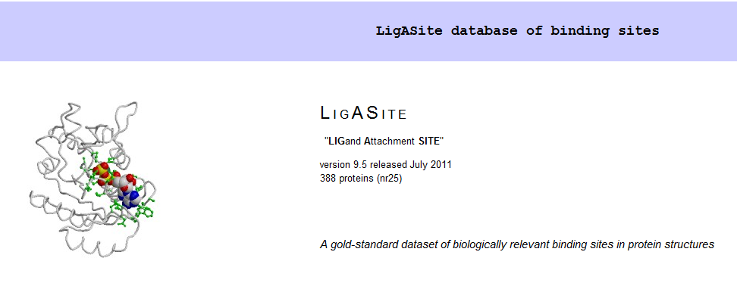
測試資料集
LigASite
全名: LIGand Attachment SITE
388條不重複之蛋白質結構
Notes:
LigASite database of binding sites
http://www.bigre.ulb.ac.be/Users/benoit/LigASite/index.php?home

Slide 13
評估效能說明(1/3)
 |  | Condition
 |  | True | False
Test Outcome | Positive | True Positive | False Positive | PPV (precision)
 | Negative | False Negative | True Negative
 |  | Sensitivity (recall) | Specificity
Notes:
http://en.wikipedia.org/wiki/Sensitivity_and_specificity

Slide 14
評估效能說明(2/3)
實際在結合位置上的胺基酸編號
10 | 11 |  | 24 | 25 | 28 |  | 33 | 53 | 107
預測為在結合位置上的胺基酸編號
10 |  | 18 | 24 |  | 28 |  | 33 | 53 | 107
 | TP |  | FP |  | FN |  | TN

Slide 15
評估效能說明(3/3)
Sensitivity:
Specificity:
Accuracy:
Positive predictive value(PPV)
Matthews Correlation Coefﬁcient(MCC)
Notes:
Sensitivity(敏感性) http://wiki.mbalib.com/zh-tw/%E6%95%8F%E6%84%9F%E6%80%A7%E5%88%86%E6%9E%90%E6%B3%95
Specificity(特異性)
http://www.wretch.cc/blog/elleryhuang/14233982

Slide 16
系統比較(1/2)
SITEHOUND
Mount Sinai School of Medicine, New York
使用方法
利用化學性質分類
判斷結合位置
用TIE(Total Interaction Energy)排名
判斷預測結合位置
Notes:
SITEHOUND
http://scbx.mssm.edu/sitehound/sitehound-web/Input_files/disclaimers.html
MetaPocket 2.0
http://projects.biotec.tu-dresden.de/metapocket/index.php

Slide 17
系統比較(2/2)
MetaPocket 2.0
Technical University of Dresden , Germany
使用方法
結合LIGSITE^{cs}, PASS, Q-SiteFinder, SURFNET, Fpocket, GHECOM, ConCavity, POCASA八種方法進行預測
依據預測結果進行投票來決定最後預測的結合位置
Notes:
SITEHOUND
http://scbx.mssm.edu/sitehound/sitehound-web/Input_files/disclaimers.html
MetaPocket 2.0
http://projects.biotec.tu-dresden.de/metapocket/index.php

Slide 18
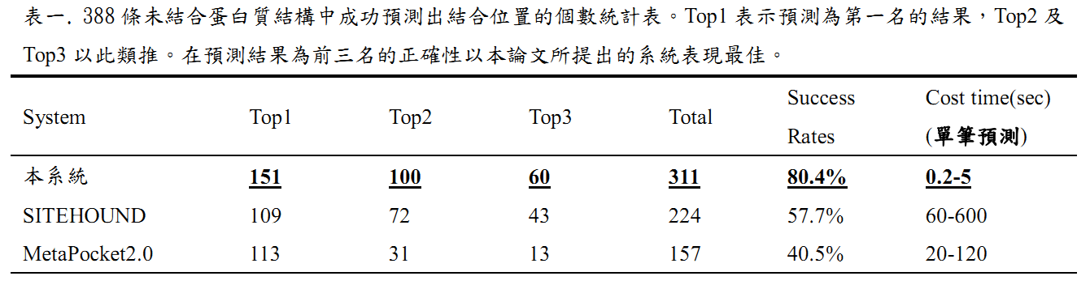
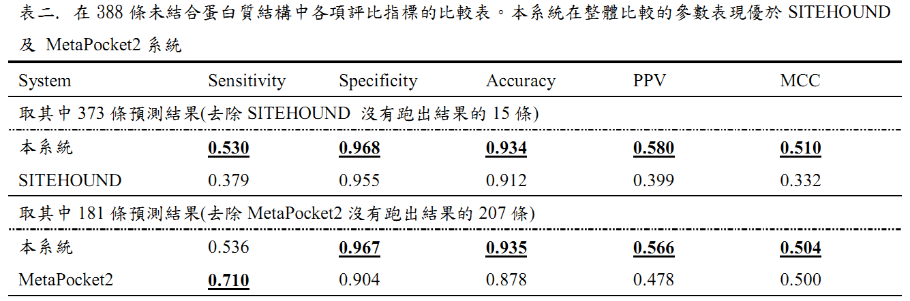

Slide 19
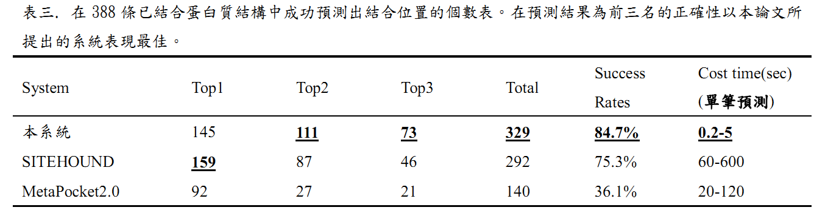
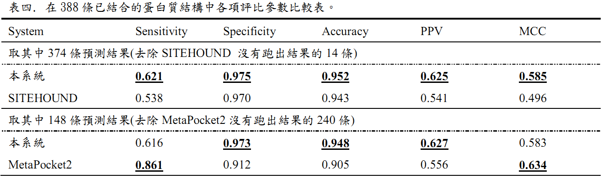

Slide 20
測試環境
Intel® Core™2 Duo Processor E8400
L2 Cache: 6MB
Clock Speed: 3.00 GHz
FSB Speed: 1333 MHz
NVIDIA Gefocre GTS450
CUDA處理器核心: 192
處理器時脈: 1566 MHz
4GB DDR2, Windows XP 32-bits
Notes:
Intel® Core™2 Duo Processor E8400
http://ark.intel.com/products/33910/Intel-Core2-Duo-Processor-E8400-(6M-Cache-3_00-GHz-1333-MHz-FSB)
NVIDIA Gefocre GTS450
http://www.nvidia.com.tw/object/product-geforce-gts-450-tw.html

Slide 21
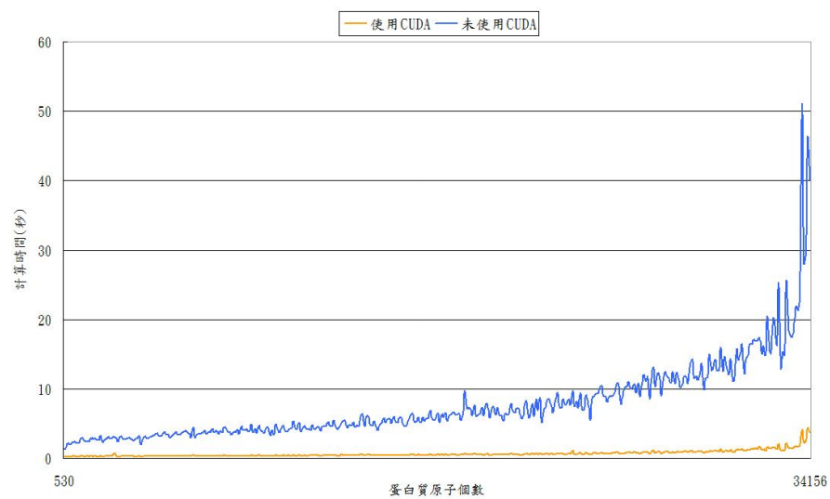
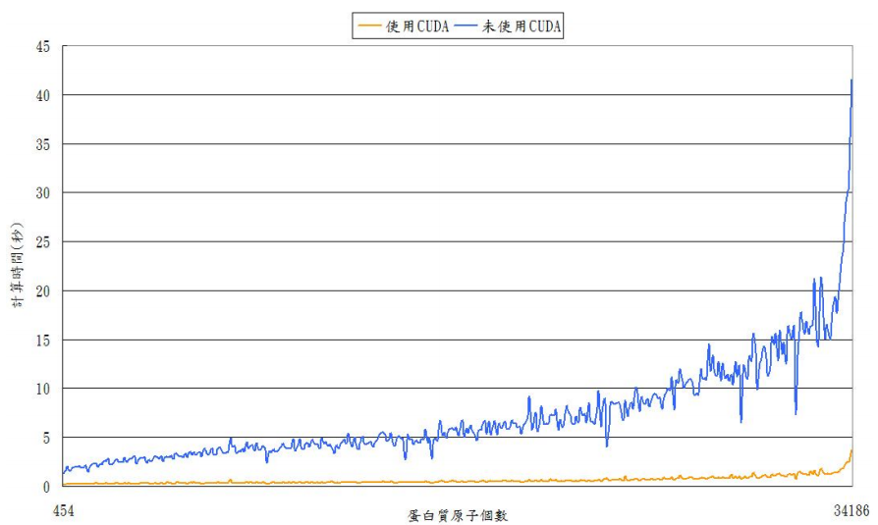
CUDA加速成果
對388個已結合蛋白質進行預測
對388個未結合蛋白質進行預測

Slide 22
Thanks for your listening.

