Slide 1
Stock time series pattern matching: Template-based vs. rule-based approaches
Tak-chung Fu, Fu-lai Chung, Robert Luk, Chak-man Ng
Engineering Applications of Artificial Intelligence 20 (2007) 347–364
Presenter : Chang-Hao Huang
Date : Dec. 19, 2011

Slide 2
Abstract(1/2)
One of the major duties of financial analysts is technical analysis. It is necessary to locate the technical patterns in the stock price movement charts to analyze the market behavior. Indeed, there are two main problems: how to define those preferred patterns (technical patterns) for query and how to match the defined pattern templates in different resolutions. As we can see, defining the similarity between time series (or time series subsequences) is of fundamental importance. By identifying the perceptually important points (PIPs) directly from the time domain, time series and templates of different lengths can be compared. Three ways of distance measure, including Euclidean distance (PIP-ED), perpendicular distance (PIP-PD) and vertical distance (PIP-VD), for PIP identification are compared in this paper.

Slide 3
Abstract(2/2)
After the PIP identification process, both template- and rule-based pattern-matching approaches are introduced. The proposed methods are distinctive in their intuitiveness, making them particularly user friendly to ordinary data analysts like stock market investors. As demonstrated by the experiments, the template- and the rule-based time series matching and subsequence searching approaches provide different directions to achieve the goal of pattern identification.

Slide 4
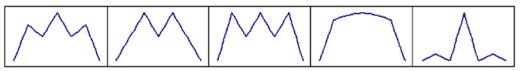
Five typical technical analysis reversal patterns
Head-and-shoulder
Double top
Triple top
Rounded top
Spike top

Slide 5
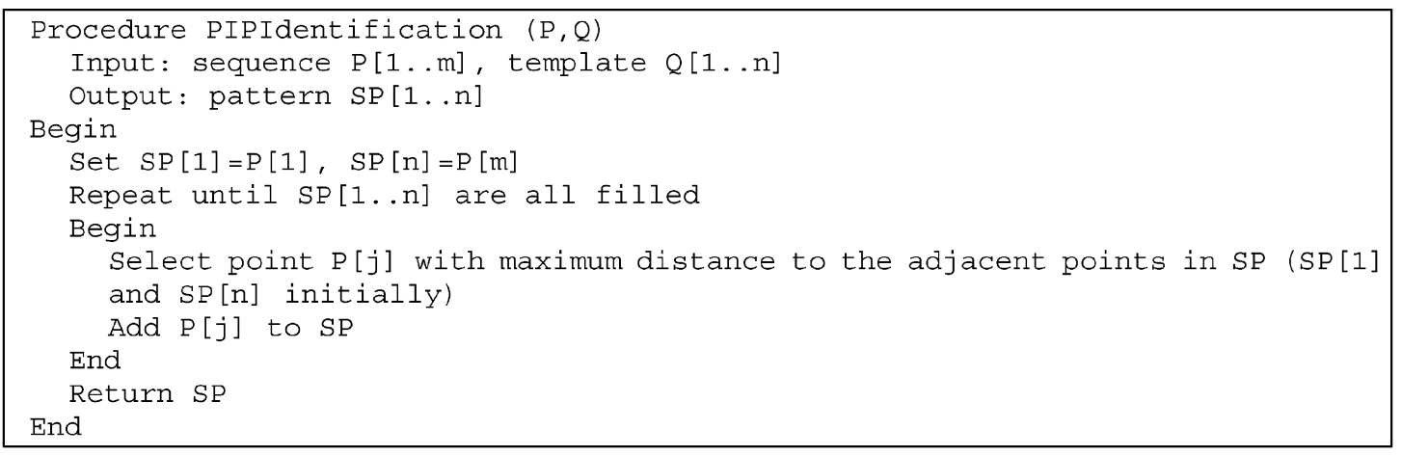
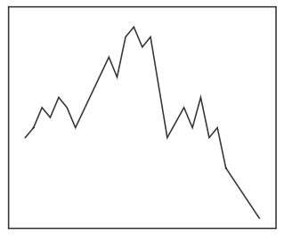
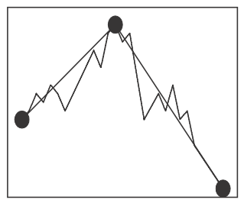
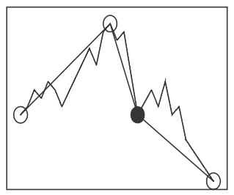
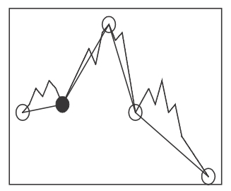
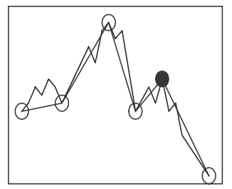
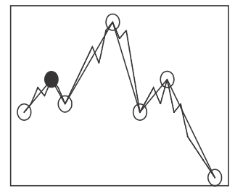
perceptually important points(PIP) identification
1
2
3
4
5
6

Slide 6
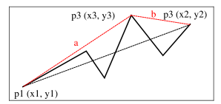
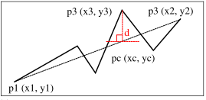
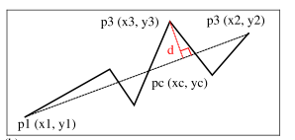
3 distance measures
Euclidean distance(ED)
perpendicular distance(PD)
vertical distance(VD)

Slide 7


Template-based pattern-matching approach
normalizing all the sequence values to a given range(e.g. 0-1)
Amplitude distance (AD)
Temporal distance (TD)
distance measure

Slide 8
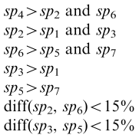


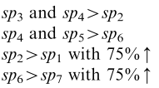
Rule-based pattern-matching approach
Rule set 1 (head-and-shoulder)
Rule set 2 (rounded top)
4
2
6
3
5
1
7

Slide 9



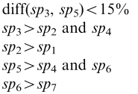

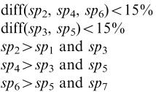
Rule set 3 (spike top)
Rule set 4 (double top)
Rule set 5 (triple top)

Slide 10
dataset
synthetic time series dataset : 135 time series with different lengths, which includes 25,43 and 61. Each of them belongs to one of the five technical patterns
Each technical pattern is generated to 27 variants by applying different levels of scaling, time wrapping and noise.
real dataset : 50 stock time series subsequences were identified by human. Each subsequence is labeled by one of the five technical patterns. Their lengths are between 22 and 592.

Slide 11
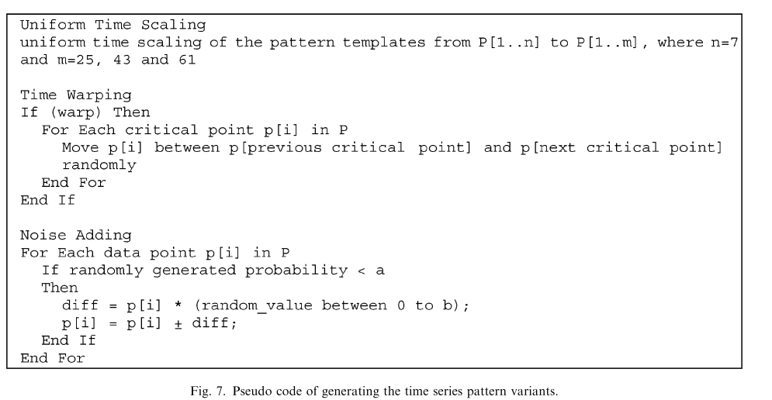
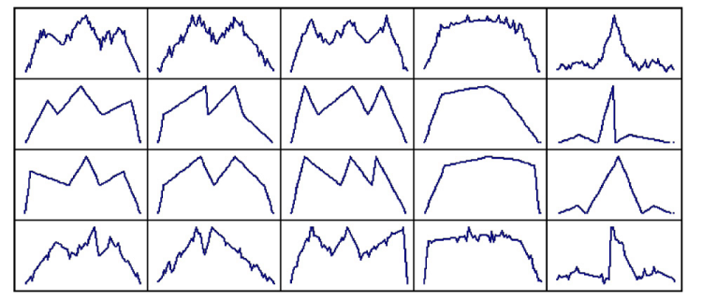

Slide 12
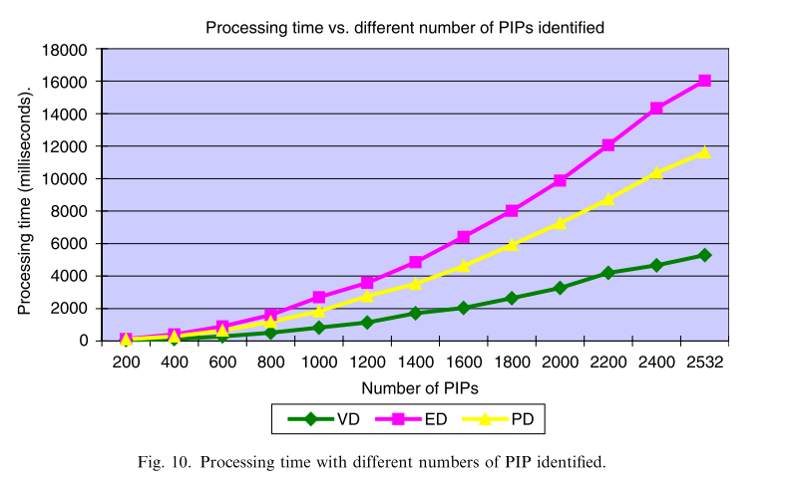
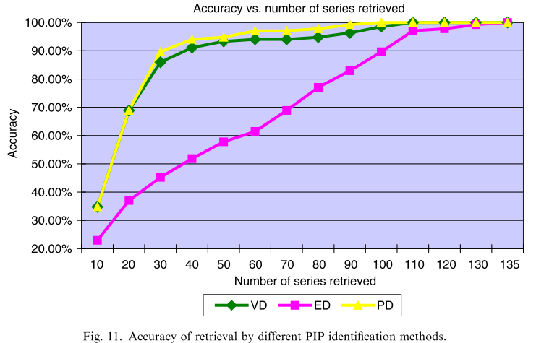

VD is the best choice

Slide 13
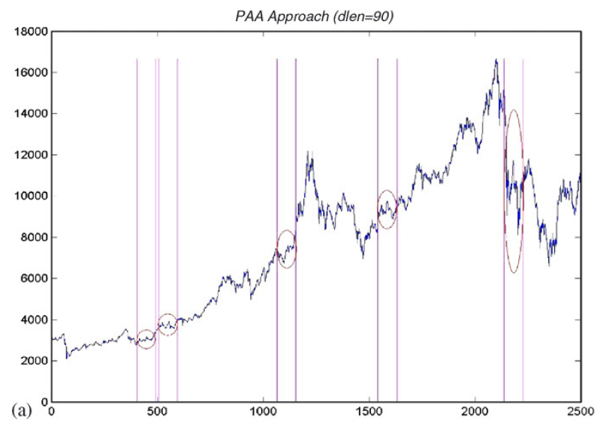
Identification of a ‘‘Triple Top’’ pattern

Slide 14
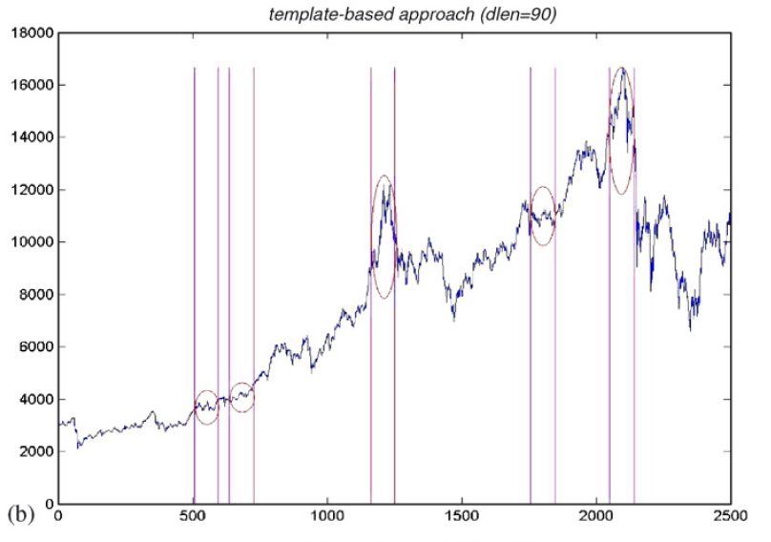

Slide 15
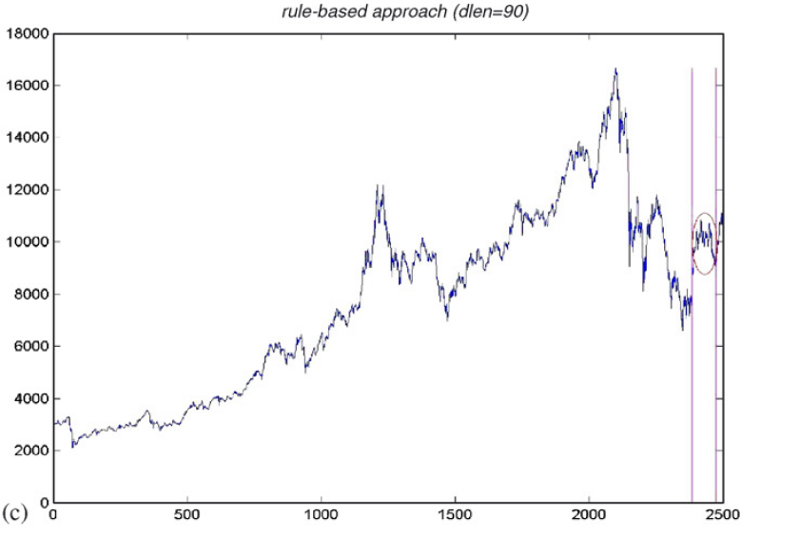

Slide 16
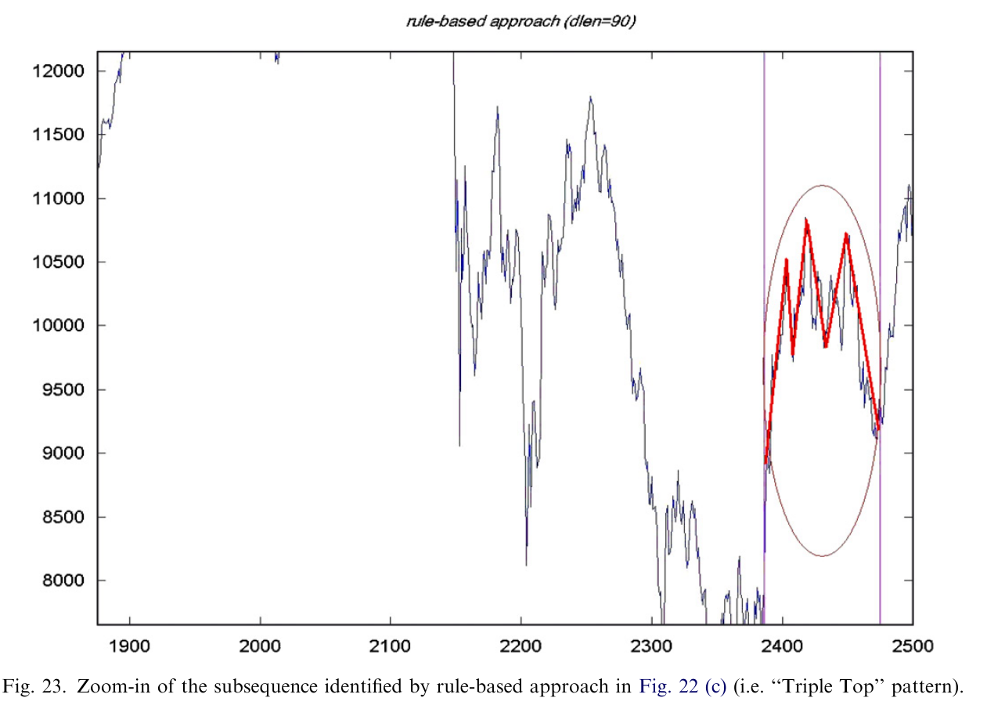

Slide 17
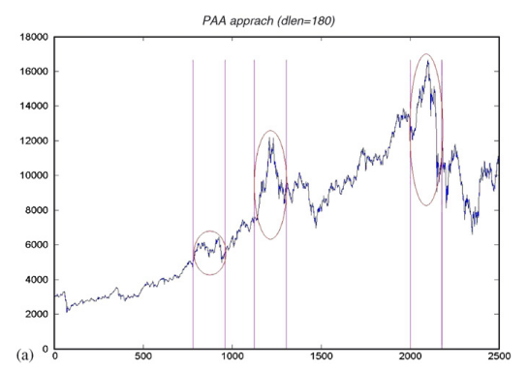
Identification of a ‘‘Spike Top’’ pattern

Slide 18
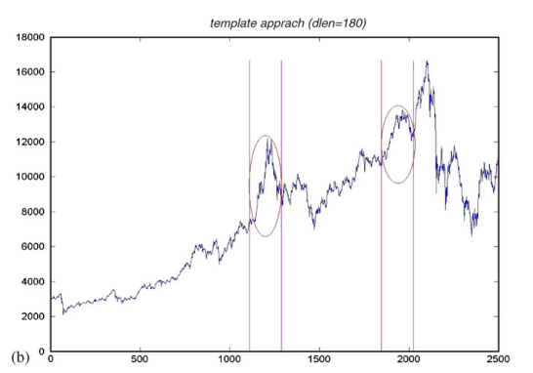

Slide 19
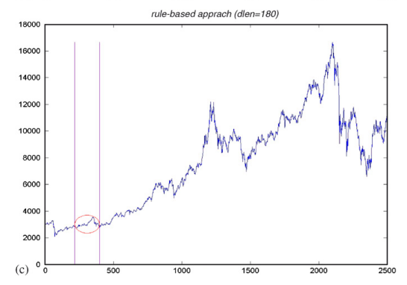

Slide 20
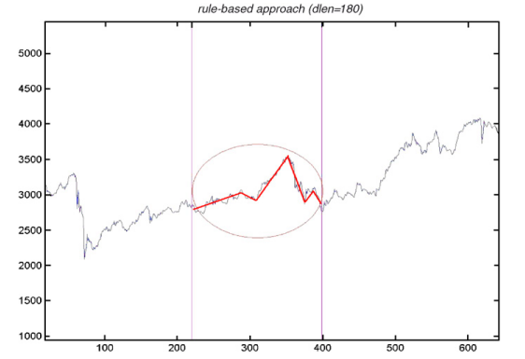

Slide 21
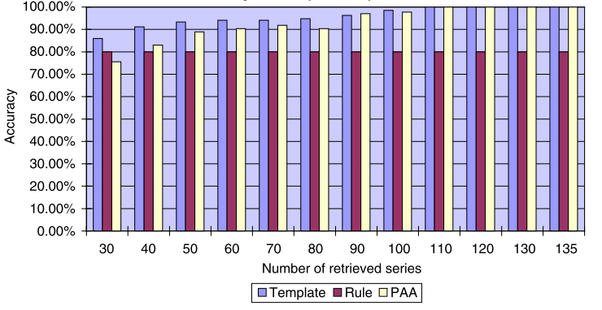
Average accuracy for the synthetic dataset

Slide 22
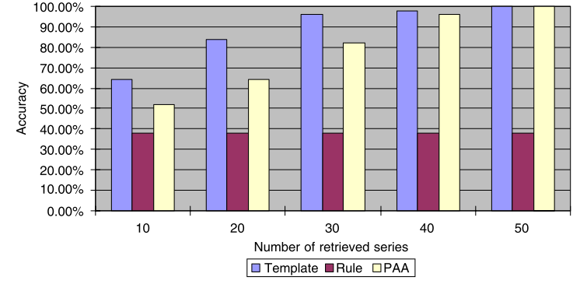
Average accuracy for the real dataset

Slide 23
Conclusion
the template-based approach provides an effective time series pattern matching tool, while the rule-based approach provides further ability for describing the query patterns and is constrainable on the shape of the query patterns.

