Slide 1
Classification of Yeast Protein Complexes Using Topological and Physicochemical Features
Szu-Yu Chou (周思瑜), Chien-Hung Huang (黃建宏),
Ka-Lok Ng (吳家樂)
National Computer Symposium, pp.10-16, 2011
Presenter: Hsin-Fang Wu
Date: Dec. 19, 2011

Slide 2
Abstract
It is known that protein complexes play important roles in many cellular processes. Many protein complex prediction methods are based on the identification of pseudo-cliques, and dense protein-protein interaction (PPI) regions. Amino acids’ physiochemical properties are not generally used in the feature representation of protein complexes. The results of the physiochemical properties study for yeast protein complexes are reported. A 10-fold cross-validation test is performed based on the features to test the classification accuracy of the Support Vector Machine (SVM). It is found that the physiochemical properties serve as additional important features besides PPI and Gene Ontology.

Slide 3
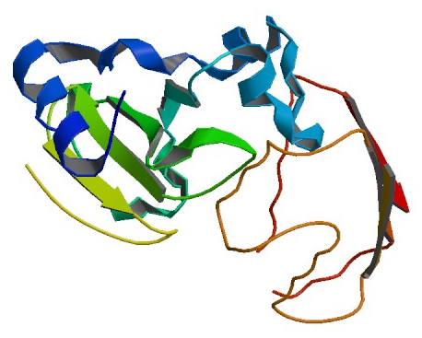
Introduction
protein complex (蛋白質複合體，又稱 multiprotein complex):
兩個以上功能相關的多肽鏈通過雙硫鍵或其他蛋白質相互作用形成的複合體；可分成結構型和功能型 蛋白質複合體。
protein-protein interaction (蛋白質-蛋白質交互作用):在生物體中，蛋白質會彼此結合在一起，形成複合體，執行特殊的功能，這就是「蛋白質的交互作用」。生化學家發現，幾乎所有的蛋白質都會與其它的蛋白質結合，或是透過不結合的方式，達到交互作用的目的。
Biological Assembly Image for 1BRS
PROTEIN-PROTEIN RECOGNITION: CRYSTAL
STRUCTURAL ANALYSIS OF A BARNASE-
BARSTAR COMPLEX AT 2.0-A RESOLUTION

Slide 4
Introduction
In the last ten years or so, we have seen many high-throughput
experimental techniques attempt to crystallize proteins (蛋白質結晶化), determine peptide sequences using mass spectrometry (質譜), three-dimensional structures, and protein-protein interaction networks (PPIN) through, such as, NMR spectroscopy (核磁共振光譜) and the genome-wide yeast two hybrid (全基因組酵母菌雙混交系統). A lot is known about how proteins interact at the cellular level.
It was reported that in the yeast organism, the protein-protein interactions (PPI) are not random but well organized. It was also found that most of the neighbors of highly connected proteins have few neighbors, that is highly connected proteins are unlikely to interact with each other.

Slide 5
Introduction
Yeast is chosen as the model system for the present study for three reasons：
The complete genome sequence has been completed since
year 1996.
The PPI are well studied.
There are many molecular tools, such as cDNA, genomic
libraries, bacterial artificial chromosomes, microarray, and ESTs
are available for the biological functions study.

Slide 6
Introduction
Recent experimental studies indicate that the protein complex can be visualized as a unit composed of the cores, modules and attachments.
Core proteins are proteins that have relatively more interactions among themselves and belong to a unique protein complex.
Attachment proteins bind to the core proteins with relative fewer
interactions among them.
Module proteins are a subset of the attachment, which are always present together, and module proteins can be present in more than one complex.
A recent study indicated that the prediction of protein complexes based on the core-attachment model can achieve better performance than graphical approaches.

Slide 7
Introduction
It is conjectured that prediction approaches based on the assumption that complexes are composed of highly PPI dense regions can predict a rather limited number of complexes.
Here we propose to consider the following physiochemical properties of a complex; i.e. hydrophobic (疏水性), hydrophilic (親水性), pI value (iso-electric point 等電點), half-life (半衰期), length distribution and amino acid compositions.
Instead of trying to classify complexes from PPI data only, one of the major objectives of the present study is to classify complexes based on physiochemical properties as well as PPI information.
A total of 1643 and 491 yeast protein complexes data were retrieved from BOND and Yeast respectively. All the subunits’ accession numbers are labeled according to gene index for protein.

Slide 8
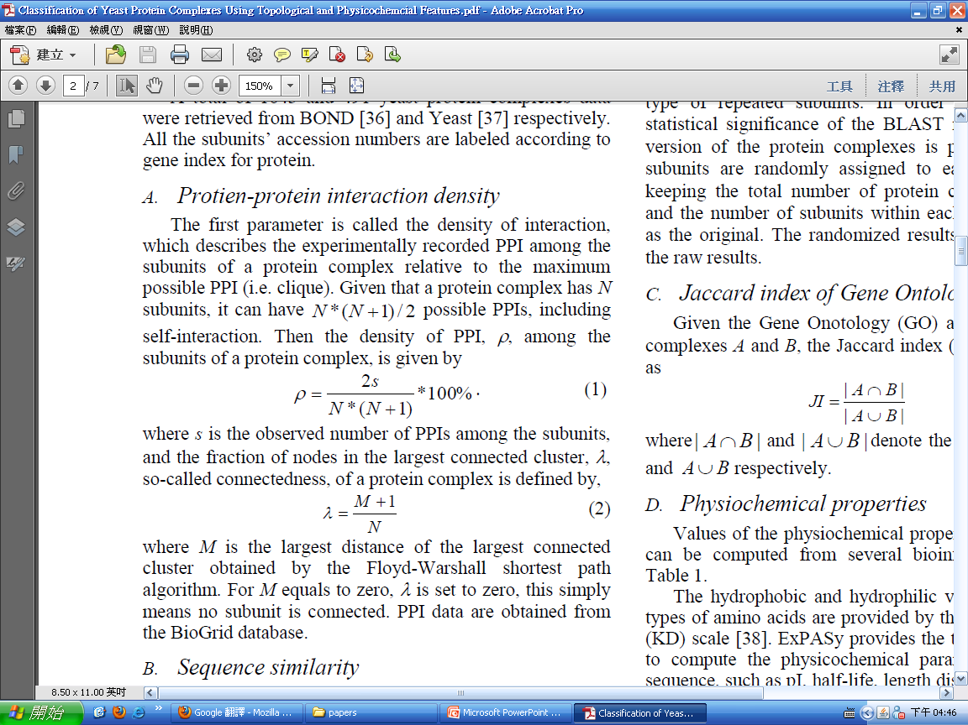
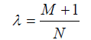
METHODS
Protein-protein interaction density:
The density of interaction, which describes the experimentally recorded PPI among the subunits of a protein complex relative to the maximum possible PPI. Given that a protein complex has N subunits, it can have N *(N 1) / 2 possible PPIs, including self-interaction.
For M equals to zero, λ is set to zero, this simply means no subunit is connected. PPI data are obtained from the BioGrid database.
the observed number of PPIs among the subunits
the density of PPI
the largest distance of the largest connected cluster obtained by the Floyd Warshall shortest path algorithm.
connectedness

Slide 9
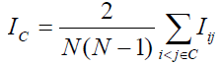
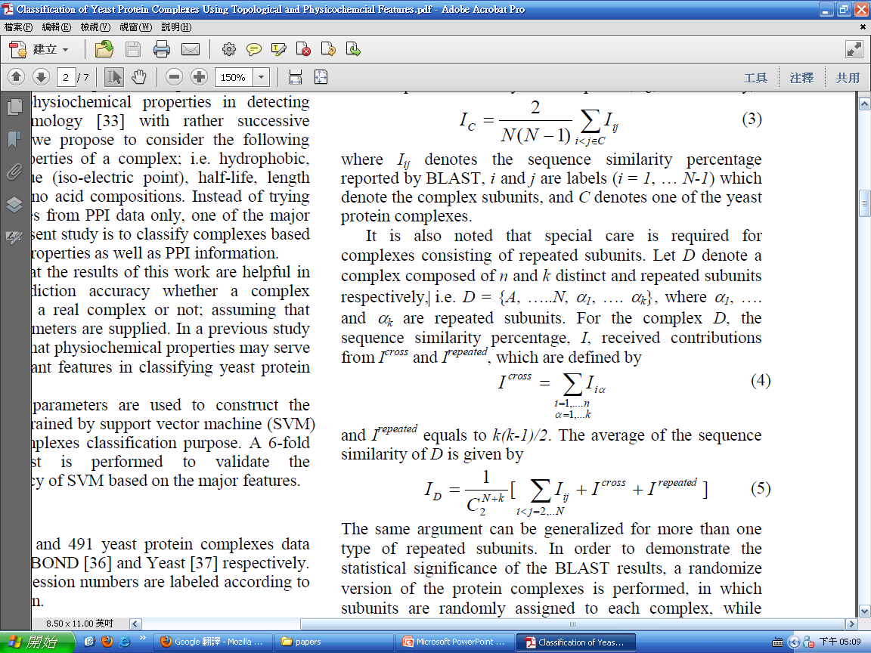
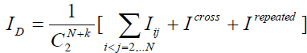
METHODS
Sequence similarity:
An all-against-all pairwise sequence alignment is performed by using the BLAST program.
Let D denote a complex composed of n and k distinct and repeated subunits respectively, I^{repeated} equals to k(k-1)/2.
the sequence similarity percentage by BLAST
The average sequence similarity of a complex C
the complex subunits
(i = 1, … N-1)
one of the yeast protein complexes
repeated subunits
The average of the sequence
similarity of D

Slide 10
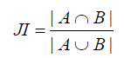
METHODS
Jaccard index of Gene Ontology (GO) :
Given the Gene Onotology annotation of protein complexes A and B, the Jaccard index (JI) of GO is defined as
where | A∩B | and | A∪B | denote the cardinality of A∩ B and A∪ B respectively.

Slide 11
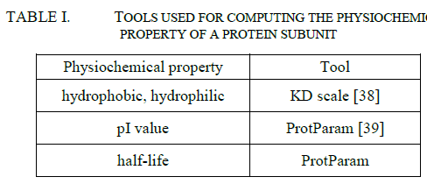
METHODS
Physiochemical properties:
The half-life is a prediction of the time it takes for half of the amount of protein in a cell to disappear after its synthesis in the cell. ProtParam relies on the "N-end rule", which relates the half-life of a protein to the identity of its Nterminal residue.
The length and amino acid compositions are obtained from the subunit’s sequence information.

Slide 12
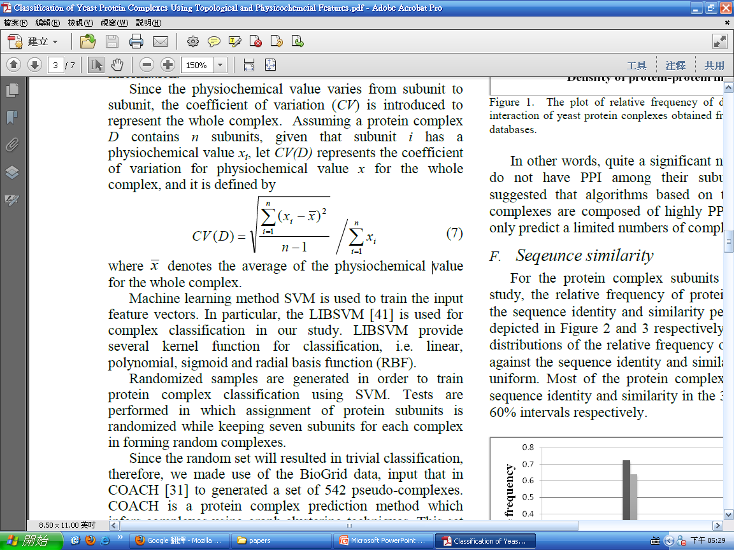
METHODS
Since the physiochemical value varies from subunit to subunit, the coefficient of variation (CV) is introduced to represent the whole complex.
Assuming a protein complex D contains n subunits, given that subunit i has a physiochemical value x_{i}, let CV(D) represents the coefficient of variation for physiochemical value x for the whole
Complex.
Tests are performed in which assignment of protein subunits is randomized while keeping seven subunits for each complex in forming random complexes. We input BioGrid data in COACH to generated a set of 542 pseudo-complexes. The results of the randomized set are taken together with the original complexes’ values to form the training set, and input into the SVM for training.
the average of the physiochemical value for the whole complex.

Slide 13
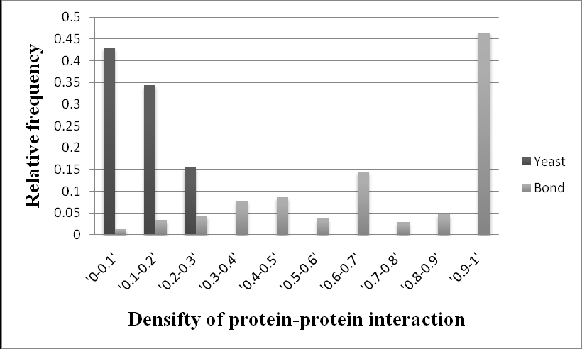
RESULTS
Protein-protein interaction density:
around 45% has a density of interaction of over 90%

Slide 14
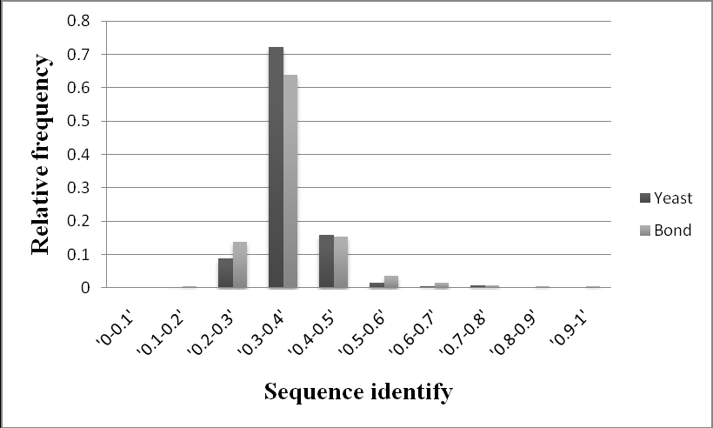
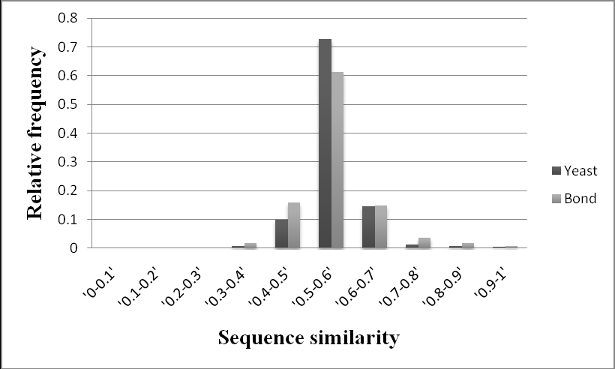
RESULTS
Seqeunce similarity:

Slide 15
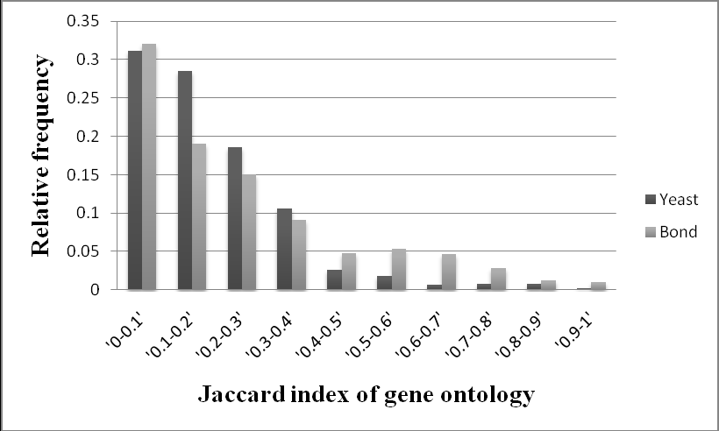
RESULTS
Gene ontology :
85.5%
71.1%

Slide 16
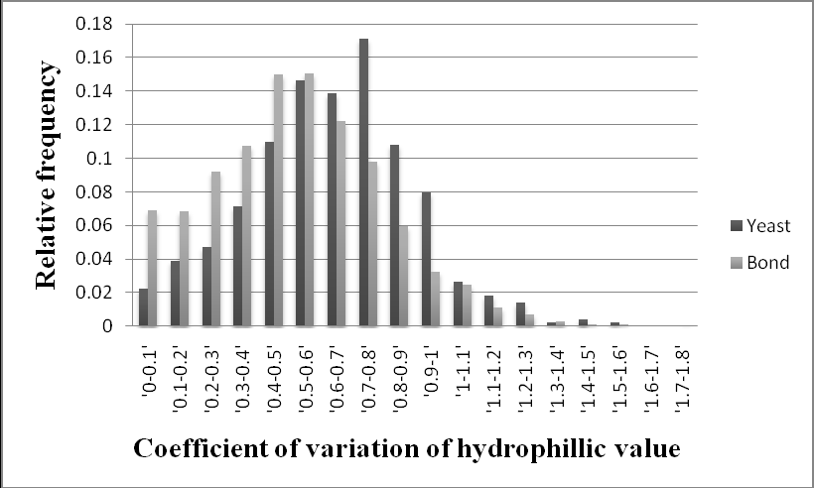
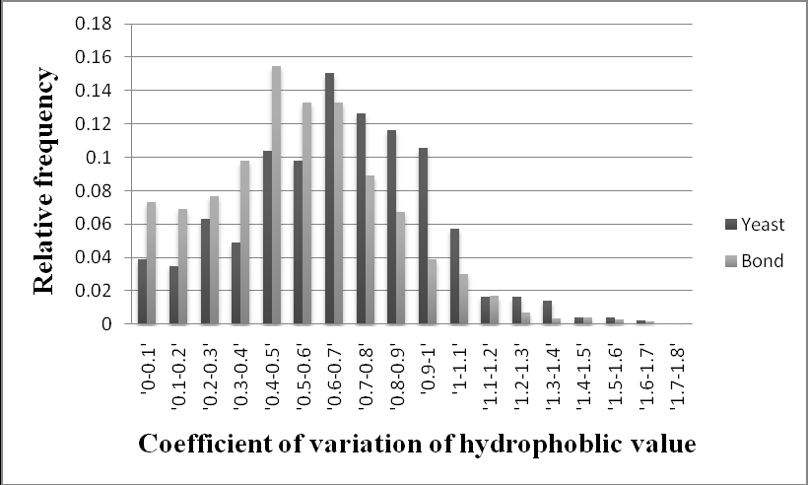
RESULTS
Hydrophobic and hydrophilic properties :
It is noted that the BOND data shows a smaller CV hydrophilic and hydrophobic value relative to the yeast database.

Slide 17
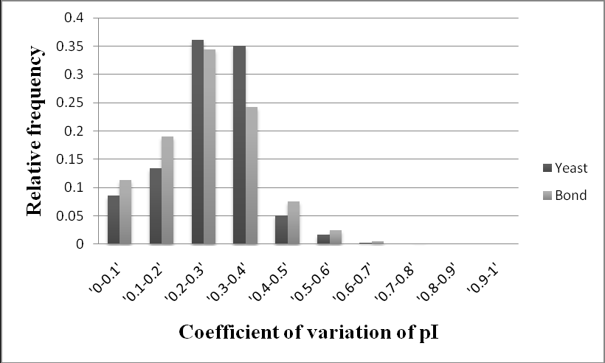
RESULTS
pI value :
For each complex, the CV for pI is computed, after that we grouped the values CV into a 10% interval.
It is noted that the BOND data shows a smaller CV pI value relative to the yeast database.

Slide 18
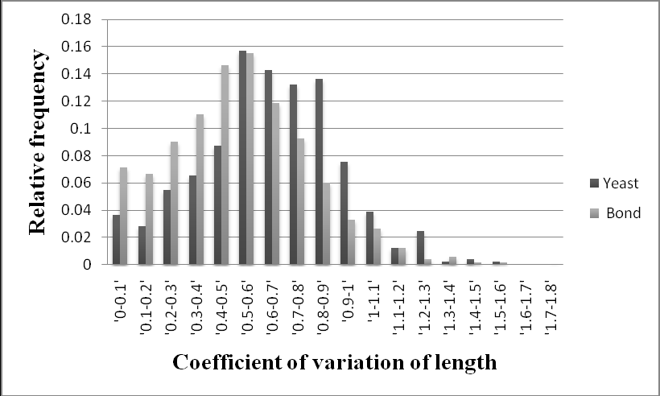
RESULTS
Length distribution of subunits within a complex :
For each complex, the CV is computed, then we
group the CV into a 10% interval.
Again, it is noted that the BOND data shows a smaller CV value relative to the yeast database.

Slide 19
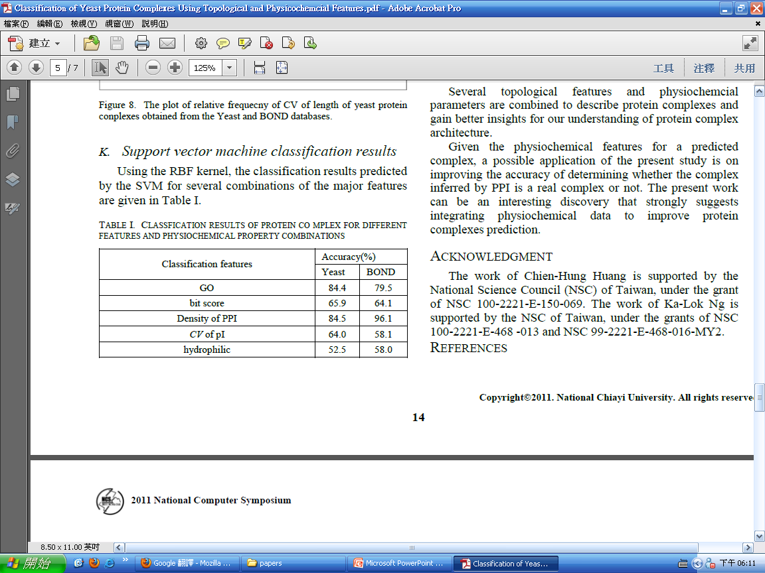
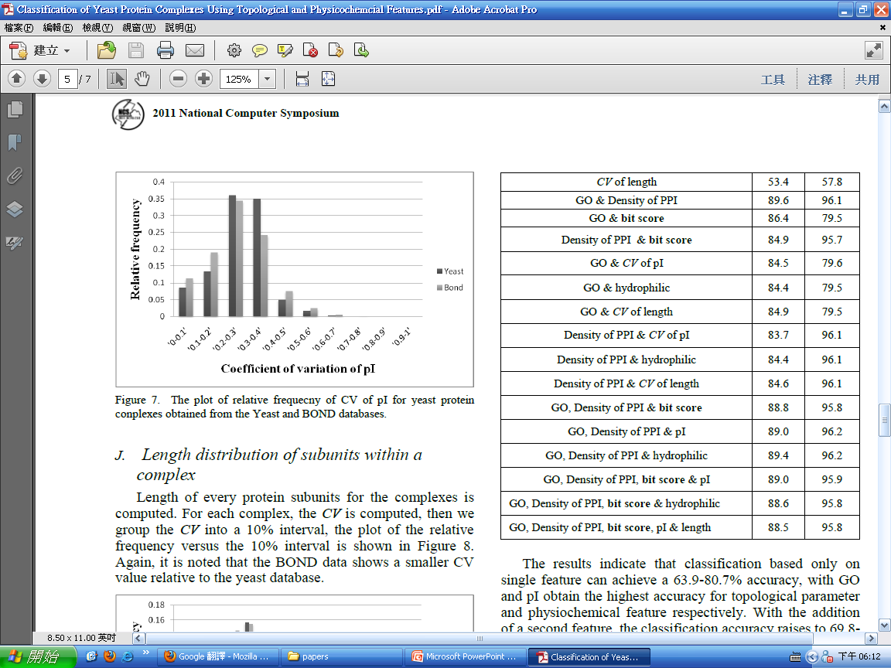
RESULTS
Support vector machine classification results :
classification based only on single feature can achieve a 63.9-80.7% accuracy.
addition
of a second feature, the classification accuracy raises to 69.8- 82.6%.
GO, density of PPI & sequence similarity achieves the highest (84.8%).

Slide 20
Thanks for your listening !!

