Slide 1
Finding Maximal 2-Dimensional Palindromes
Sara H. Geizhals, Dina Sokol Information and Computation, Vol. 266, June, 2019, pp. 161-172
Speaker: Kuan-Lin Lai
Date: Mar. 24, 2019

Slide 2
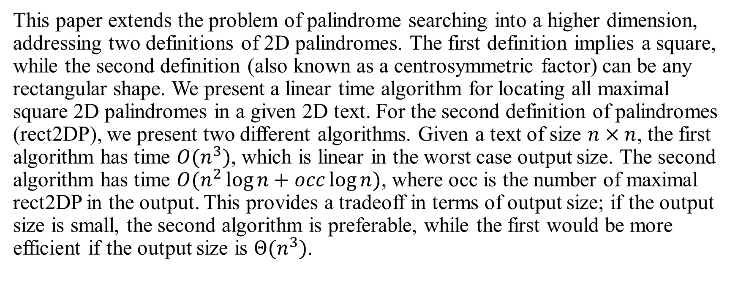
Abstract
This paper extends the problem of palindrome searching into a higher dimension, addressing two definitions of 2D palindromes. The first definition implies a square, while the second definition (also known as a centrosymmetric factor) can be any rectangular shape. We present a linear time algorithm for locating all maximal square 2D palindromes in a given 2D text. For the second definition of palindromes (rect2DP), we present two different algorithms. Given a text of size $n×n$, the first algorithm has time $O(n^{3})$, which is linear in the worst case output size. The second algorithm has time $O(n^{2}\log{n}+occ\log{n})$, where occ is the number of maximal rect2DP in the output. This provides a tradeoff in terms of output size; if the output size is small, the second algorithm is preferable, while the first would be more efficient if the output size is $Θ(n^{3})$.

Slide 3

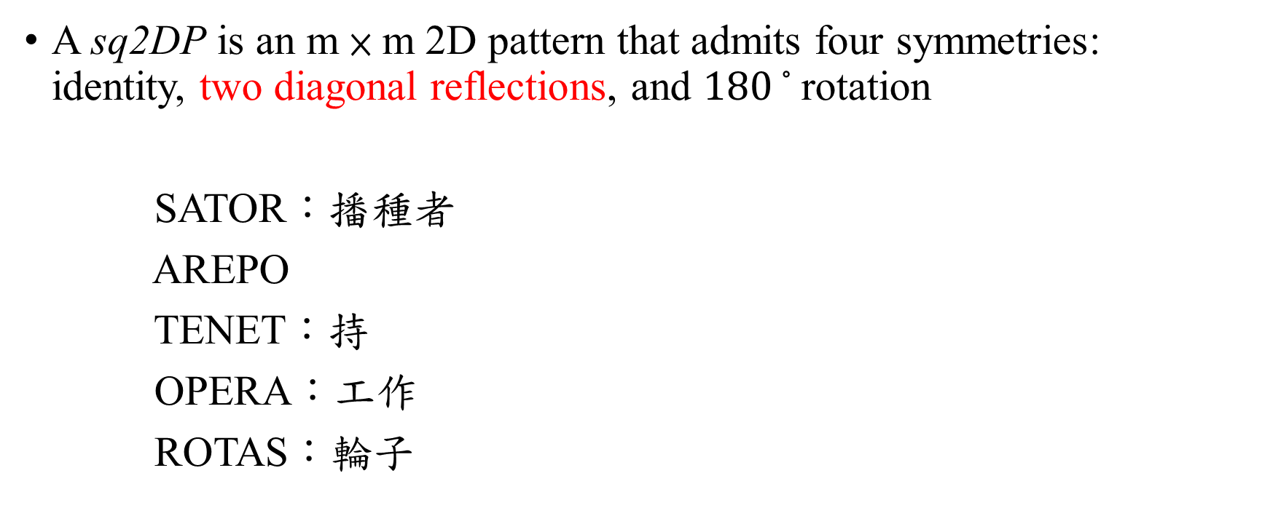
2D Palindrome
A sq2DP is an m × m 2D pattern that admits four symmetries: identity, two diagonal reflections, and ${180}^{◦}$rotation
SATOR：播種者
AREPO
TENET：持
OPERA：工作
ROTAS：輪子

Slide 4
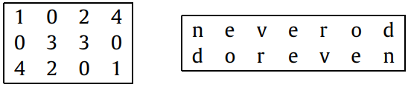

2D Palindrome
A rect2DP is a rectangular block of $m_{1}$ rows and $m_{2}$ columns that admits the two symmetries of identity and ${180}^{◦}$rotation

Slide 5
Square 2D Palindrome
R
E
P
EP$
NE$
$
$
R$
ER$
NE$
P$
$
Generalized Suffix Tree
DOV HAREL and ROBERT ENDRE TARJAN, “FAST ALGORITHMS FOR FINDING NEAREST COMMON ANCESTORS”, SIAM Journal on Computing, Vol.13, No. 2, May, 1984

Slide 6

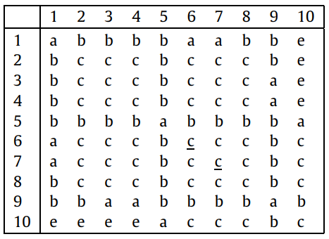
Square 2D Palindrome
pals[6, 6] = pals[4, 4] = 1
pals[7, 7] = pals[3, 3] = 3

Slide 7
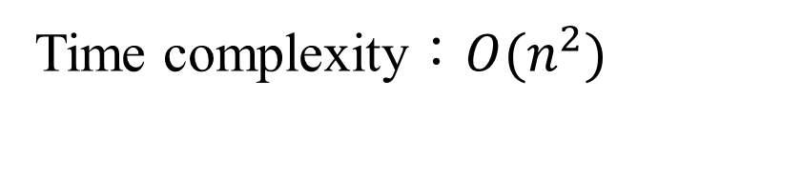
Square 2D Palindrome
pals[7, 7] = 4
Time complexity：$O(n^{2})$

Slide 8
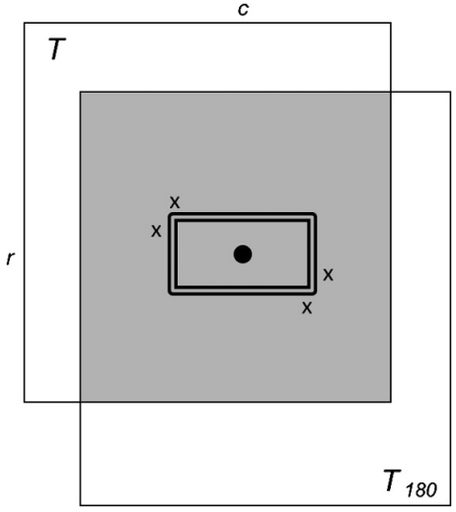
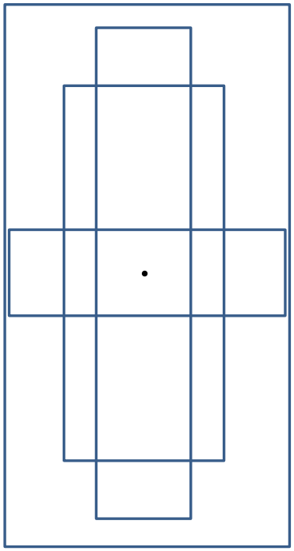
Rectangle 2D Palindrome

Slide 9
Rectangle 2D Palindrome
e | e | e | e | e | e | e | e
e | e | e | e | e | e | e | e
e | e | d | b | b | e | e | e
b | c | c | a | c | c | d | e
e | e | b | b | d | d | e | e
e | e | e | e | e | e | e | e
e | e | e | e | e | e | e | e
e | e | d | d | b | b | e | e
e | d | c | c | a | c | c | b
e | e | e | b | b | d | e | e
e | e | e | e | e | e | e | e
e | e | e | e | e | e | e | e
colLCP | 0 | 1 | 3 | 3 | 3 | 3 | 0

Slide 10
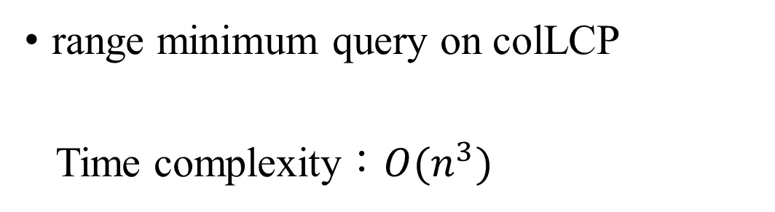
Rectangle 2D Palindrome
e | e | e | e | e | e | e | e
e | e | d | d | b | b | e | e
e | d | c | c | a | c | c | b
e | e | e | b | b | d | e | e
e | e | e | e | e | e | e | e
e | e | e | e | e | e | e | e
colLCP | 0 | 1 | 3 | 3 | 3 | 3 | 0
range minimum query on colLCP
Time complexity：$O(n^{3})$

Slide 11
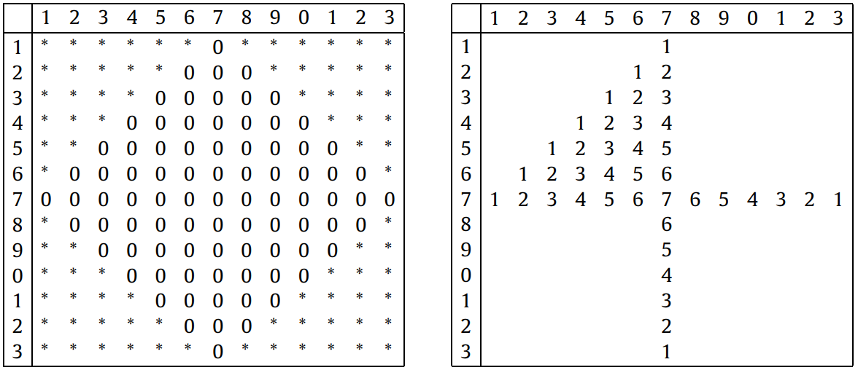
Number of rec2DP

Slide 12




KMR algorithm in 2D + Binary search
$$T^{1}$$
$$T^{2}$$
A | B | B | C | C | A | A
B | C | C | D | E | F | C
G | H | I | J | L | H | M
A | A | M | M | G | A | A
N | O | P | Q | R | S | T
U | V | W | X | Y | Z | A₁
e | e | e | e | e | e | e
e | d | d | b | b | e | e
d | c | c | a | c | c | b
e | e | b | b | d | e | e
e | e | e | e | e | e | e
$$T_{180}^{1}$$
$$T_{180}^{2}$$
A | A | C | C | B | A | A
B | F | E | D | C | F | B
G | L | L | J | I | H | M
A | G | G | M | M | A | A
N | B₁ | R | Q | P | S | T
C₁ | D₁ | Y | X | W | Z | A₁
Richard M. Karp, Raymod E. Miller and Arnold L. Roesnberg, “Rapid identification of repeated patterns in strings, trees and arrays”, Proceedings of the fourth annual ACM symposium on Theory of computing, Denver, CO, USA, May 1972, pp. 125–136

Slide 13

Time Complexity
sq2DP
$O(n^{2})$
rect2DP
original：$O(n^{3})$
improved：$O(n^{2}\log{n}+occ\log{n})$

