Slide 1
An all-substrings common subsequence algorithm
C. E. R. Alves, E. N. Ca´ceres, and S. W. Song, Electronic Notes in Discrete Mathematics, Vol. 19, pp. 133–139, 2005
Presenter: Shao-Xuan Lee
Date: Mar. 24, 2020

Slide 2
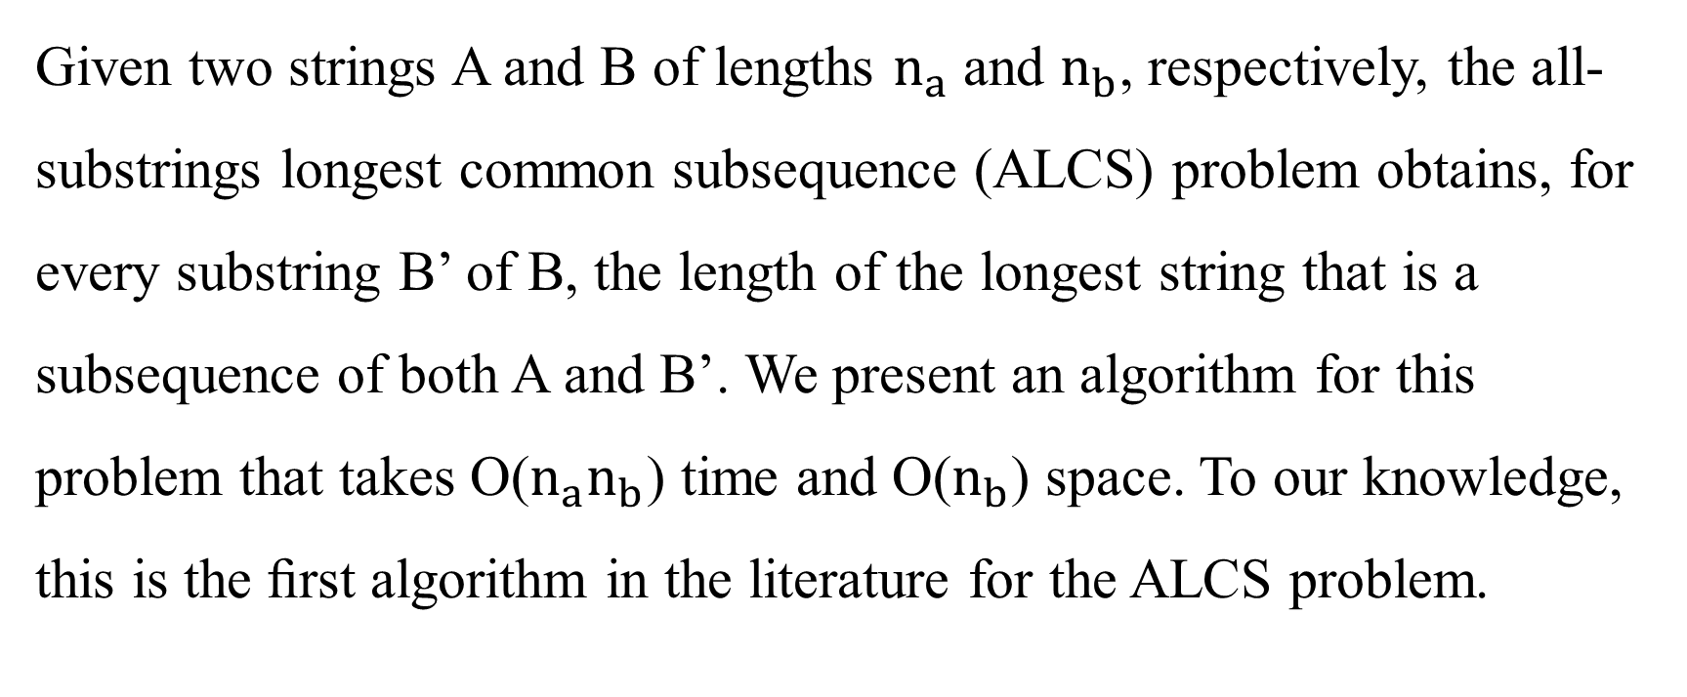
Abstract
Given two strings A and B of lengths $n_{a}$ and $n_{b}$, respectively, the all-substrings longest common subsequence (ALCS) problem obtains, for every substring B’ of B, the length of the longest string that is a subsequence of both A and B’. We present an algorithm for this problem that takes O($n_{a}n_{b}$) time and O($n_{b}$) space. To our knowledge, this is the ﬁrst algorithm in the literature for the ALCS problem.

Slide 3

All-substrings longest common subsequence (ALCS)
ALCS = solve the LCS for all pairs (A, $B_{i}^{j}$ ), where 1≤i≤j≤ $n_{b}$
|A|= $n_{a}$
|B|= $n_{b}$
$A_{3}^{6}$=$a_{3}a_{4}a_{5}a_{6}$

Slide 4
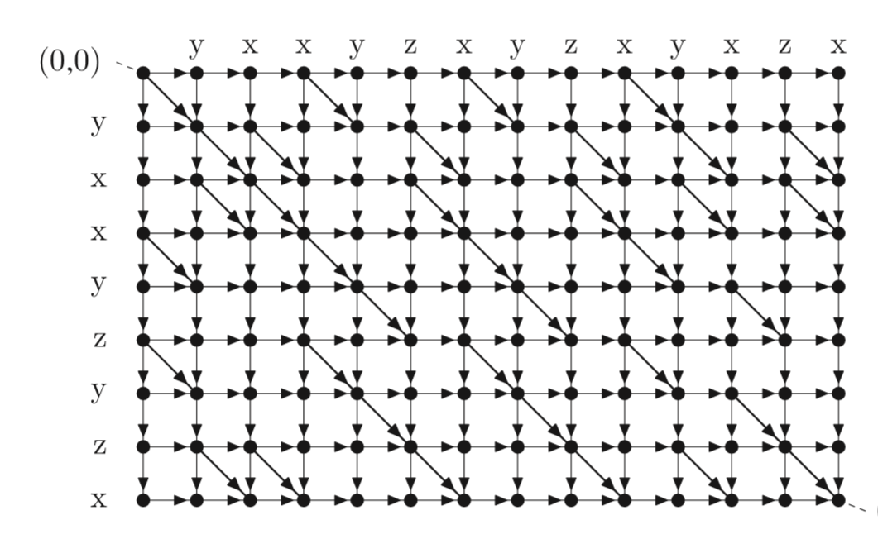
Grid directed acyclic graph (GDAG)
Weight = 0
Weight = 1

Slide 5
Grid directed acyclic graph (GDAG)

Slide 6
Grid directed acyclic graph (GDAG)

Slide 7
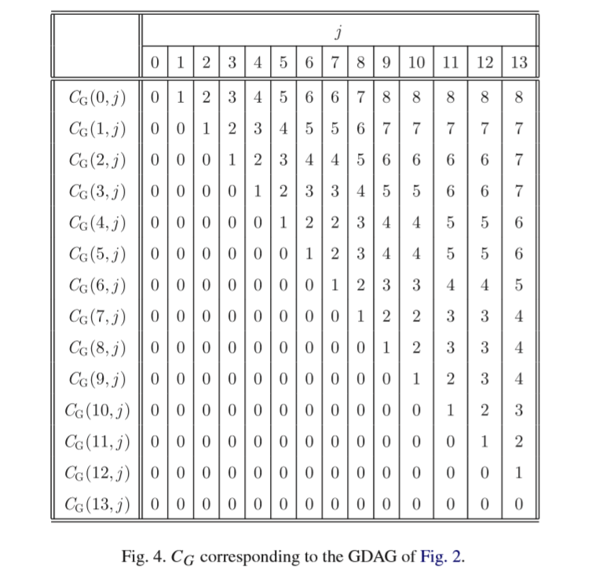
$C_{G}$(i,j) represents the length of the LCS of A and the substring $B_{i+1}^{j}$

Slide 8
i=1
j=3
$C_{G}$(i,j) represents the length of the LCS of A and the substring $B_{i+1}^{j}$

Slide 9
i=3
j=8
$C_{G}$(i,j) represents the length of the LCS of A and the substring $B_{i+1}^{j}$

Slide 10
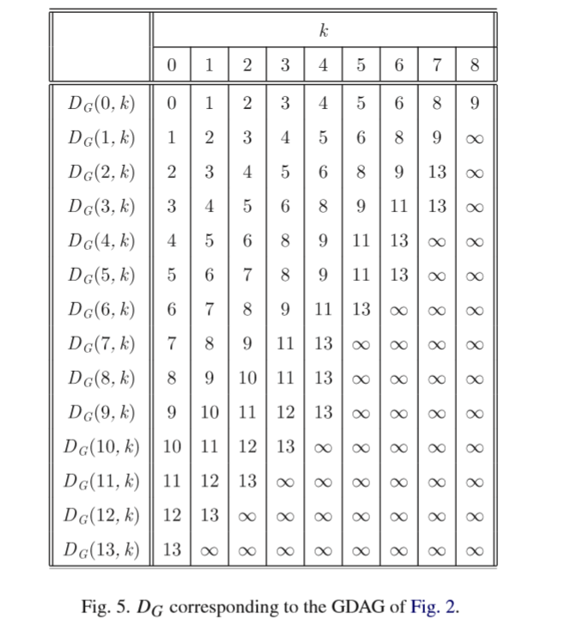
( Length)

Slide 11
( Length)

Slide 12
( Length)

Slide 13
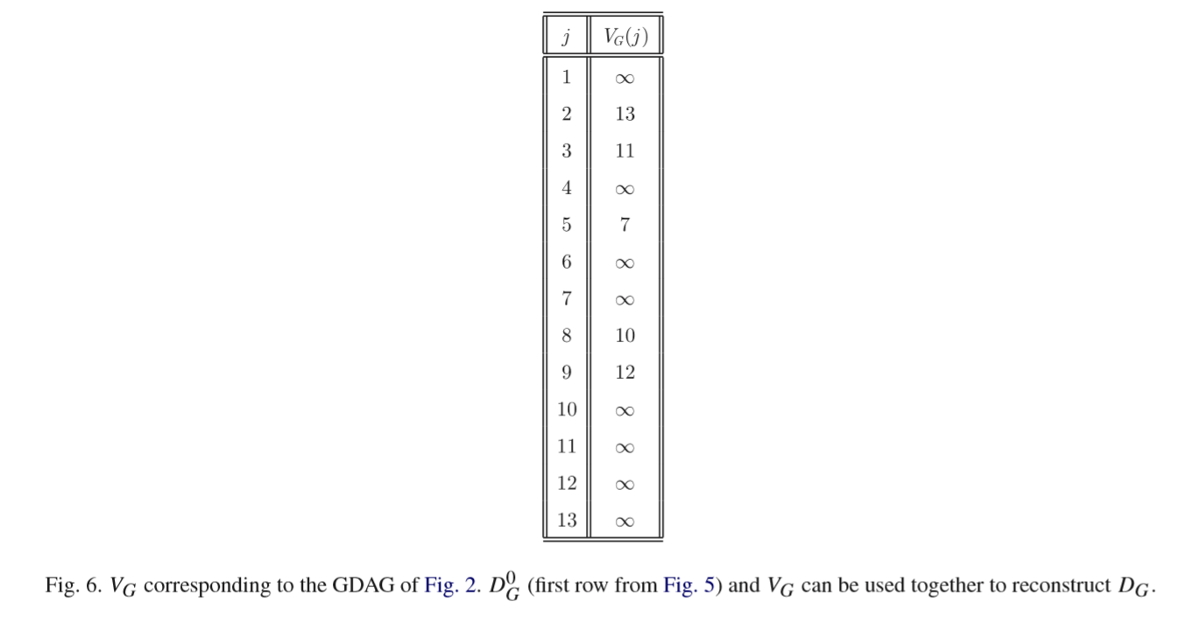

Slide 14
