Slide 1
A branch-and-cut approach to the repetition-free longest common subsequence problem
Carlos E. Ferreira and Christian Tjandraatmadja
Electronic Notes in Discrete Mathematics
Volume 36, 1 August 2010, Pages 527-534
Presenter : Tz-Hsu Lee
Date : Mar. 24, 2020.
Notes:
雄死ㄍㄟ nen na ga 黑給 虎摟

Slide 2
Abstract
We present a branch-and-cut approach to solve the following problem. Given two sequences x and y over a finite alphabet, find a repetition-free longest common subsequence of x and y. Implementation details of an efficient separation routine and several heuristics are described. We can solve medium size instances of the problem to optimality.
Notes:
敲乎李 ate 敖

Slide 3

RFLCS
X = CAADBD
Y = ABACDAD
RFLCS(X,Y) = CAD
Notes:
Aligning distance matrices for structural alignment

Slide 4
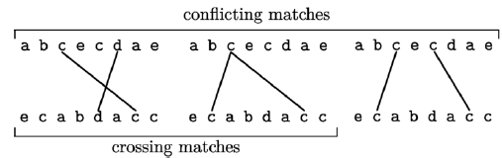
Formulation(1/2)
Let A be a set of pairwise non-crossing matches, the sequence s is a common subsequence of x and y and we say that A defines s.
A set of pairwise non-conflicting matches defines a repetition-free common subsequence.
Therefore, the RFLCS problem can be translated into finding a set of pairwise non-conflicting matches of maximum
Notes:
Aligning distance matrices for structural alignment

Slide 5
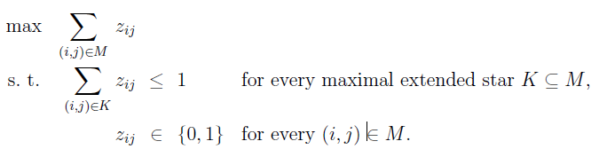

Formulation(2/2)
Let $z_{ij}$ be a binary variable for a match (i, j) in M
Notes:
Aligning distance matrices for structural alignment

Slide 6

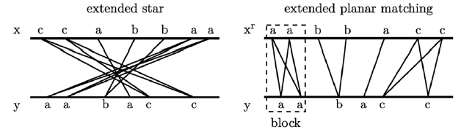
Separation algorithm(1/2)
Find a maximal extended star K such that > 1, or inform if there is no such K.
If we revert one of the sequences, say x, an original match
(i, j) turns into a match (|x|+1−i, j).
Notes:
Aligning distance matrices for structural alignment

Slide 7
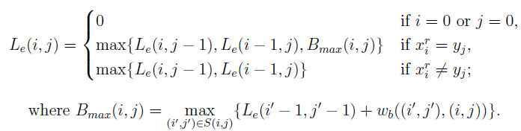
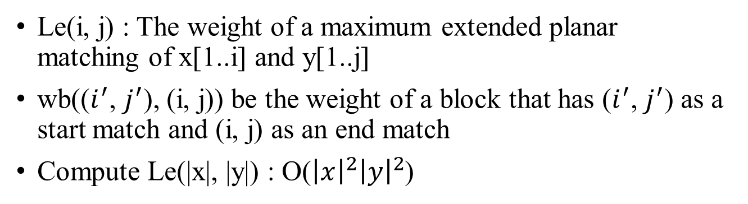
Separation algorithm(2/2)
Le(i, j) : The weight of a maximum extended planar matching of x[1..i] and y[1..j]
wb(($i^{′}$, $j^{′}$), (i, j)) be the weight of a block that has ($i^{′}$, $j^{′}$) as a start match and (i, j) as an end match
Compute Le(|x|, |y|) : O(${\left|x\right|}^{2}{\left|y\right|}^{2}$)
Notes:
Aligning distance matrices for structural alignment

Slide 8
Variable elimination
Lemma : Let (i, j) be a match and let u(i, j) be a match upper
bound for (i, j). If there is a repetition-free common
subsequence of x and y of length greater than u(i, j), then (i, j)
is not in a set that defines an RFLCS of x and y.
u(i, j) = upref(i, j)+usuff(i, j)+1
Notes:
Aligning distance matrices for structural alignment

Slide 9
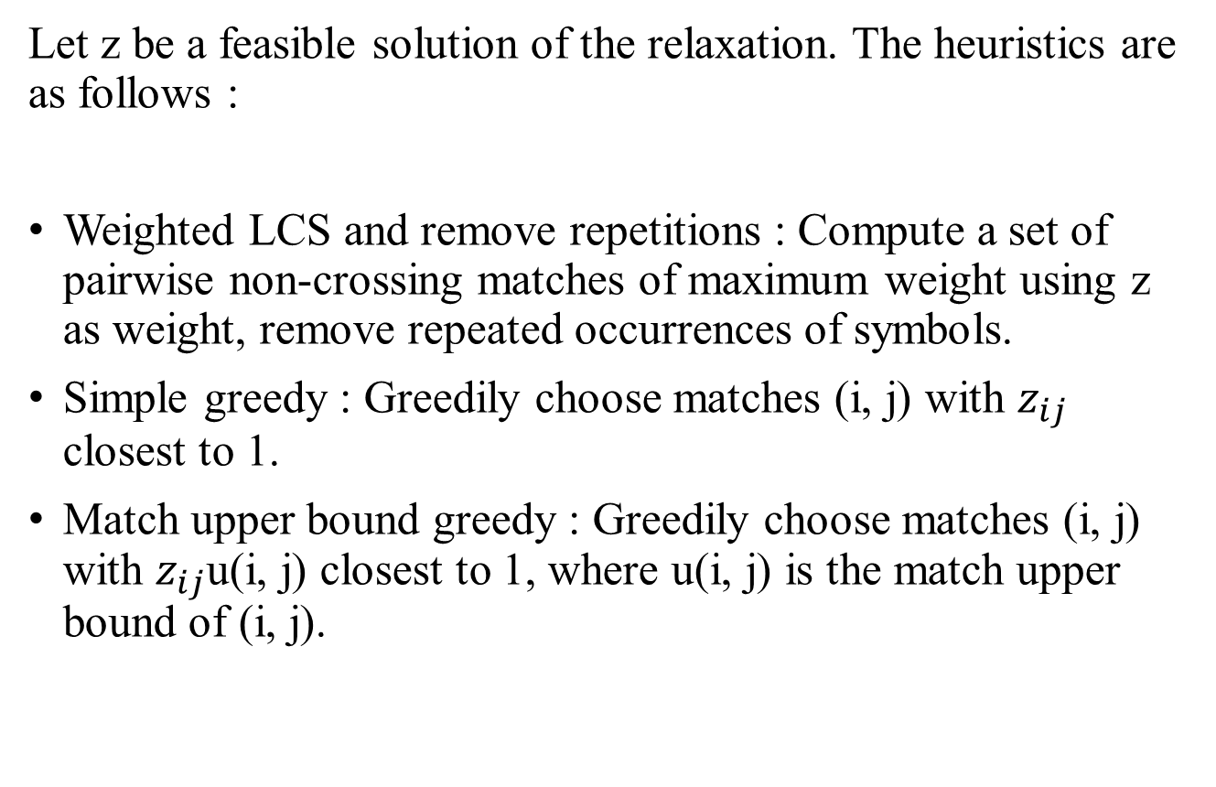
Primal heuristics
Let z be a feasible solution of the relaxation. The heuristics are as follows :
Weighted LCS and remove repetitions : Compute a set of pairwise non-crossing matches of maximum weight using z as weight, remove repeated occurrences of symbols.
Simple greedy : Greedily choose matches (i, j) with $z_{ij}$ closest to 1.
Match upper bound greedy : Greedily choose matches (i, j) with $z_{ij}$u(i, j) closest to 1, where u(i, j) is the match upper bound of (i, j).
Notes:
Aligning distance matrices for structural alignment

Slide 10
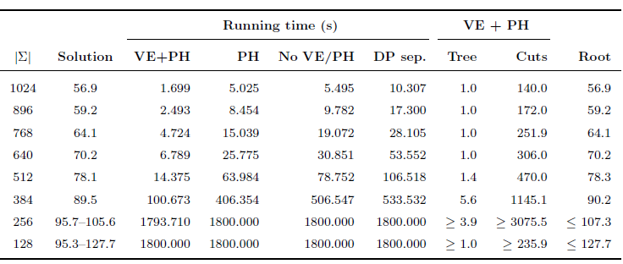
Experimental results
Notes:
Aligning distance matrices for structural alignment

