Slide 1
An Efficient Algorithm for Computing the Edit Distance with Non-overlapping Inversions
Student: Kuan-Lin Lai (賴冠霖)
Advisor: Prof. Chang-Biau Yang (楊昌彪)
Date: June 10, 2020

Slide 2
Outline
Preliminaries
Brute-force Algorithm
Lee et al. Algorithm
Our Algorithm

Slide 3


Edit (Levenshtein) Distance
A = a g c a c g a g
B = a g a t c g t g g c
$$A$$
agca-cgag--
Deletion
Insertion
Replacement
Insertion
$$B$$
ag-atcgtggc

Slide 4




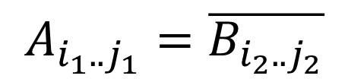






Inversion
The inversion operation is to reverse the order of elements and replace them with their complements.
$$1$$
$$i_{1}$$
$$j_{1}$$
$$m$$
$$A$$
cacga
a g g
$$1$$
$$i_{2}$$
$$j_{2}$$
$$n$$
$$B$$
tcgtg
a g a g c
$$A_{i_{1}..j_{1}}=\overline{B_{i_{2}..j_{2}}}$$

Slide 5


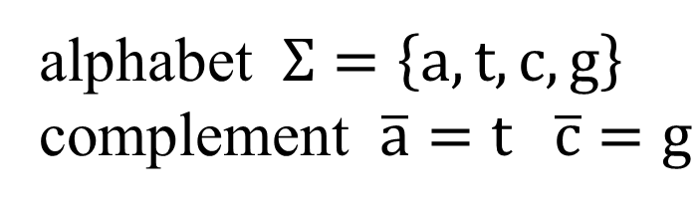
The Edit Distance with Non-overlapping Inversion (EDI) Problem
4 operations：insertion, deletion, replacement, inversion
Every operations can not overlap each other.
$$A$$
a g -
cacga
g -
$$B$$
a g a
tcgtg
g c
alphabet $Σ=\left\{a,t,c,g\right\}$
complement $\overline{a}=t \overline{c}=g$

Slide 6





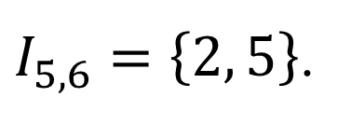


Inversion Set $I_{i,j}$
$I_{i,j}=\left\{k \right| A_{i−k+1..i}=B_{j−k+1..j} ,1≤k≤\min\left\{i,j\right\}\}$
$$A$$
aca
ac
$$A$$
acaac
$$B$$
tgtt
gt
$$B$$
t
gttgt
$$a_{4}a_{5}=\overline{b_{5}b_{6}}$$
$$A_{1..5}=\overline{B_{2..6}}$$
$I_{5,6}=\left\{2, 5\right\}$.

Slide 7



A Brute-force Algorithm
$θ\left(i,j,k\right)=1⇔k∈I_{i,j}$
Builded by $ext\left(I_{i−1,j} , A\right)$
$$A$$
acaacc
acaac
a
aca
ac
a
a
$$B$$
tgttg
t
tgt
t
gt
t
gttgt
$I_{6,6}=\left\{1, 3, 6\right\}⇔θ\left(6,6,1\right)=θ\left(6,6,3\right)=θ\left(6,6,6\right)=1$.

Slide 8
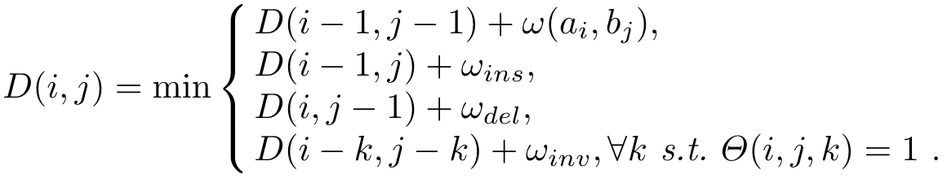

DP Formula for Distance Table D
$D(i,j)$denotes the EDI between $A_{1..i}$ and $B_{1..j}$
Time Complexity： $O(m^{2}n)$

Slide 9
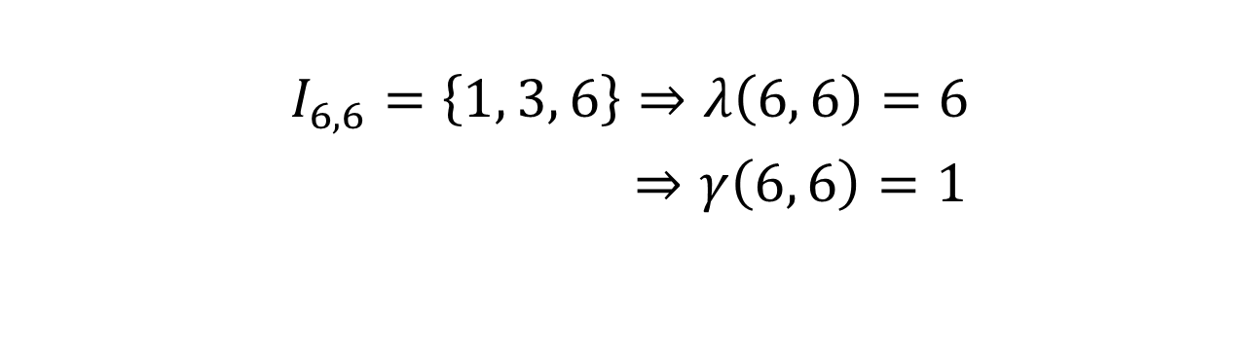



Maximal, Minimal Inversion ( $λ$, $γ$ )
$$A$$
acaac
a
aca
aca
acaaca
$$B$$
tgttg
t
tgt
tgt
tgttgt
$$I_{6,6}=\left\{1, 3, 6\right\}⇒λ\left(6, 6\right)=6$$
$⇒γ\left(6, 6\right)=1$

Slide 10
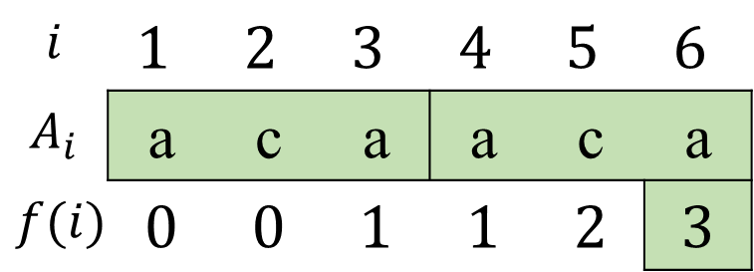
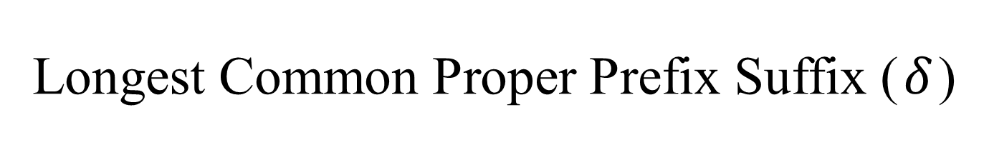
Longest Common Proper Prefix Suffix ($δ$)
CPPS(acaaca) = {a, aca}
LCPPS(acaaca) = {aca}
KMP prefix function：
a c a a c a
$$i$$ | $$1$$ | $$2$$ | $$3$$ | $$4$$ | $$5$$ | $$6$$
$$A_{i}$$ | a | c | a | a | c | a
$$f(i)$$ | $$0$$ | $$0$$ | $$1$$ | $$1$$ | $$2$$ | $$3$$

Slide 11
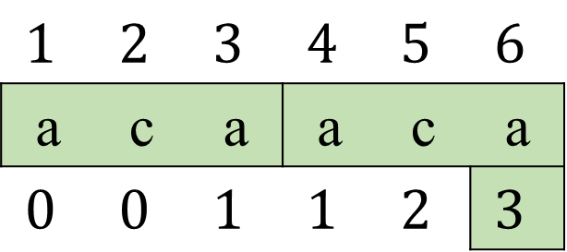

LCPPS ($δ$) Table
 | a | c | a | a | c | a
1 | 0 | 0 | 1 | 1 | 2 | 3
2 |  | 0 | 0 | 0 | 1 | 2
3 |  |  | 0 | 1 | 0 | 1
4 |  |  |  | 0 | 0 | 1
5 |  |  |  |  | 0 | 0
6 |  |  |  |  |  | 0
$$1$$ | $$2$$ | $$3$$ | $$4$$ | $$5$$ | $$6$$
a | c | a | a | c | a
$$0$$ | $$0$$ | $$1$$ | $$1$$ | $$2$$ | $$3$$

Slide 12




























Building Maximal Inversion Table
$$1$$
$$2$$
$$3$$
$$4$$
$$5$$
$$6$$
$$1$$
$$2$$
$$3$$
$$4$$
$$5$$
$$6$$
$$A$$
acaac
a
acaaca
$$B$$
t
gttgt
$$a_{6}=\overline{b_{1}}$$
tgttgt
$$1$$
$$2$$
$$3$$
$$4$$
$$5$$
$$6$$
$$4$$
$$5$$
$$6$$
$$A$$
acaac
a
aca
$$δ\left(1, 6\right)=3$$
$$B$$
c
gttgt
$$a_{6}≠\overline{b_{1}}$$
tgt

Slide 13
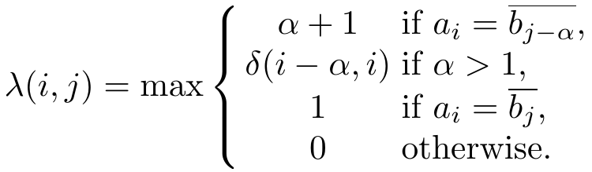
DP Formula for Maximal Inversion Table

Slide 14

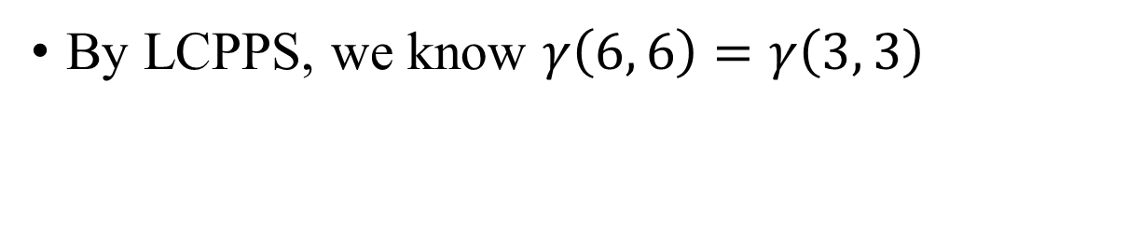


Minimal Inversion Table
$$A$$
acaaca
aca
aca
$$δ\left(6, 6\right)=3$$
$$B$$
tgttgt
tgt
tgt
By LCPPS, we know $γ\left(6, 6\right)=γ\left(3, 3\right)$

Slide 15
Minimal Inversion Table
 | t | g | t | t | g | t
a | 1 | 0 | 1 | 1 | 0 | 1
c | 0 | 1 | 2 | 0 | 1 | 2
a | 1 | 2 | 3 | 1 | 2 | 3
a | 1 | 0 | 1 | 2 | 3 | 4
c | 0 | 1 | 2 | 3 | 4 | 5
a | 1 | 2 | 3 | 4 | 5 | 6
 | t | g | t | t | g | t
a | 1 | 0 | 1 | 1 | 0 | 1
c | 0 | 1 | 2 | 0 | 1 | 2
a | 1 | 2 | 1 | 1 | 2 | 1
a | 1 | 0 | 1 | 1 | 3 | 1
c | 0 | 1 | 2 | 3 | 1 | 2
a | 1 | 2 | 1 | 1 | 2 | 1
Diagonal 2
Diagonal 0
Diagonal -2

Slide 16










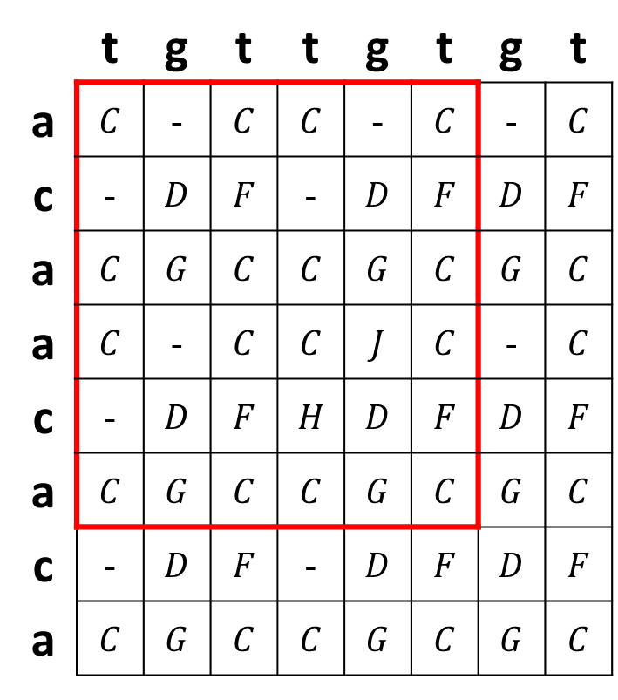














Encoding All Minimal inversions
a
c
 | t | g | t | t | g | t | g | t
a | $$C$$ | - | $$C$$ | $$C$$ | - | $$C$$ | - | $$C$$
c | - | $$D$$ | $$F$$ | - | $$D$$ | $$F$$ | $$D$$ | $$F$$
a | $$C$$ | $$G$$ | $$C$$ | $$C$$ | $$G$$ | $$C$$ | $$G$$ | $$C$$
a | $$C$$ | - | $$C$$ | $$C$$ | $$J$$ | $$C$$ | - | $$C$$
c | - | $$D$$ | $$F$$ | $$H$$ | $$D$$ | $$F$$ | $$D$$ | $$F$$
a | $$C$$ | $$G$$ | $$C$$ | $$C$$ | $$G$$ | $$C$$ | $$G$$ | $$C$$
c | - | $$D$$ | $$F$$ | - | $$D$$ | $$F$$ | $$D$$ | $$F$$
a | $$C$$ | $$G$$ | $$C$$ | $$C$$ | $$G$$ | $$C$$ | $$G$$ | $$C$$
a
$$C$$
c
$$D$$
a
$$E$$
$$F$$
$$G$$
c
c
a
a
$$H$$
$$I$$
c
$$J$$
$$K$$
a
a
a
c
c
$$L$$
$$M$$
$$N$$
a
$$O$$
a
$$P$$
c
$$Q$$
$$R$$
$$S$$
$$T$$
a
a
c
$$U$$
c
$$V$$
$$W$$
a
a
$$X$$
$$Y$$
$$Z$$

Slide 17
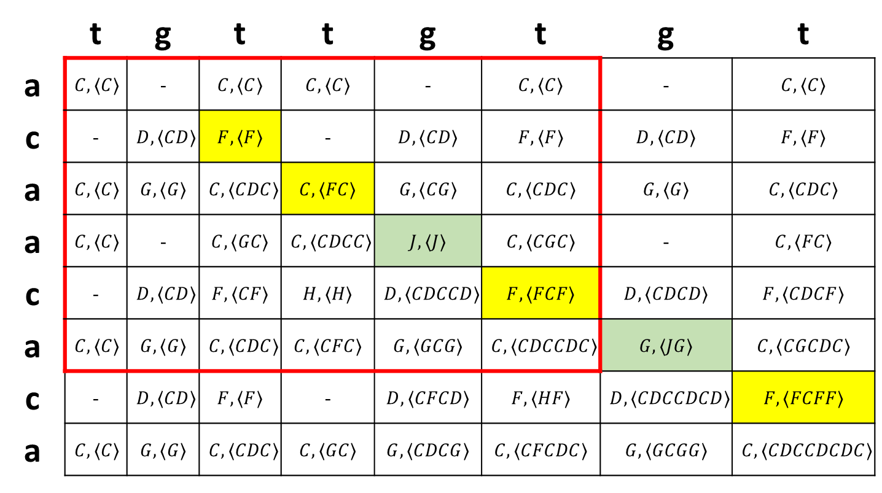
Encoded Minimal Inversion Representation (SMIR)
 | t | g | t | t | g | t | g | t
a | 1 | 0 | 1 | 1 | 0 | 1 | 0 | 1
c | 0 | 1 | 2 | 0 | 1 | 2 | 1 | 2
a | 1 | 2 | 1 | 1 | 2 | 1 | 2 | 1
a | 1 | 0 | 1 | 1 | 3 | 1 | 0 | 1
c | 0 | 1 | 2 | 3 | 1 | 2 | 1 | 2
a | 1 | 2 | 1 | 1 | 2 | 1 | 2 | 1
c | 0 | 1 | 2 | 0 | 1 | 2 | 1 | 2
a | 1 | 2 | 1 | 1 | 2 | 1 | 2 | 1
 | t | g | t | t | g | t | g | t
a | $$C, ⟨C⟩$$ | - | $$C, ⟨C⟩$$ | $$C, ⟨C⟩$$ | - | $$C, ⟨C⟩$$ | - | $$C, ⟨C⟩$$
c | - | $$D, ⟨CD⟩$$ | $$F, ⟨F⟩$$ | - | $$D, ⟨CD⟩$$ | $$F, ⟨F⟩$$ | $$D, ⟨CD⟩$$ | $$F, ⟨F⟩$$
a | $$C, ⟨C⟩$$ | $$G, ⟨G⟩$$ | $$C, ⟨CDC⟩$$ | $$C, ⟨FC⟩$$ | $$G, ⟨CG⟩$$ | $$C, ⟨CDC⟩$$ | $$G, ⟨G⟩$$ | $$C, ⟨CDC⟩$$
a | $$C, ⟨C⟩$$ | - | $$C, ⟨GC⟩$$ | $$C, ⟨CDCC⟩$$ | $$J, ⟨J⟩$$ | $$C, ⟨CGC⟩$$ | - | $$C, ⟨FC⟩$$
c | - | $$D, ⟨CD⟩$$ | $$F, ⟨CF⟩$$ | $$H, ⟨H⟩$$ | $$D, ⟨CDCCD⟩$$ | $$F, ⟨FCF⟩$$ | $$D, ⟨CDCD⟩$$ | $$F, ⟨CDCF⟩$$
a | $$C, ⟨C⟩$$ | $$G, ⟨G⟩$$ | $$C, ⟨CDC⟩$$ | $$C, ⟨CFC⟩$$ | $$G, ⟨GCG⟩$$ | $$C, ⟨CDCCDC⟩$$ | $$G, ⟨JG⟩$$ | $$C, ⟨CGCDC⟩$$
c | - | $$D, ⟨CD⟩$$ | $$F, ⟨F⟩$$ | - | $$D, ⟨CFCD⟩$$ | $$F, ⟨HF⟩$$ | $$D, ⟨CDCCDCD⟩$$ | $$F, ⟨FCFF⟩$$
a | $$C, ⟨C⟩$$ | $$G, ⟨G⟩$$ | $$C, ⟨CDC⟩$$ | $$C, ⟨GC⟩$$ | $$G, ⟨CDCG⟩$$ | $$C, ⟨CFCDC⟩$$ | $$G, ⟨GCGG⟩$$ | $$C, ⟨CDCCDCDC⟩$$

Slide 18
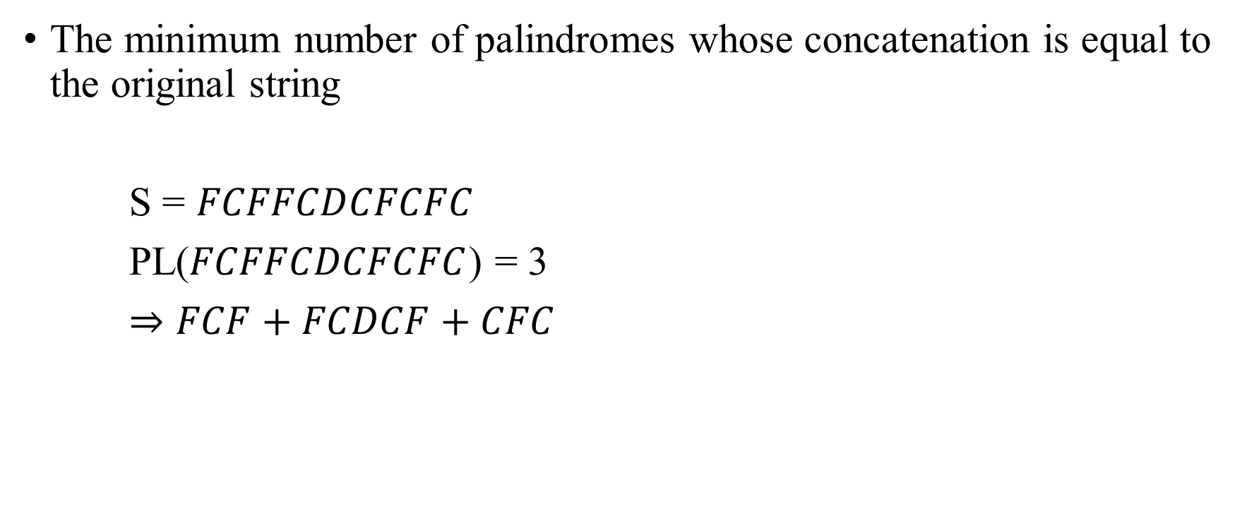
Palindromic Factor
The minimum number of palindromes whose concatenation is equal to the original string
S = $FCFFCDCFCFC$
PL($FCFFCDCFCFC$) = 3
$⇒$ $FCF+FCDCF+CFC$

Slide 19


































































Why we need palindromic factorization？
$$F$$
$$C$$
$$F$$
$$F$$
$$C$$
$$D$$
$$C$$
$$F$$
$$C$$
$$F$$
$$C$$
$$\overline{F}$$
$$\overline{C}$$
$$\overline{F}$$
$$\overline{F}$$
$$\overline{C}$$
$$\overline{D}$$
$$\overline{C}$$
$$\overline{F}$$
$$\overline{C}$$
$$\overline{F}$$
$$\overline{C}$$
$$F$$
$$C$$
$$F$$
$$F$$
$$C$$
$$D$$
$$C$$
$$F$$
$$C$$
$$F$$
$$C$$
$$\overline{F}$$
$$\overline{C}$$
$$\overline{F}$$
$$\overline{F}$$
$$\overline{C}$$
$$\overline{D}$$
$$\overline{C}$$
$$\overline{F}$$
$$\overline{C}$$
$$\overline{F}$$
$$\overline{C}$$
$$F$$
$$C$$
$$F$$
$$F$$
$$C$$
$$D$$
$$C$$
$$F$$
$$C$$
$$F$$
$$C$$
$$\overline{F}$$
$$\overline{C}$$
$$\overline{F}$$
$$\overline{F}$$
$$\overline{C}$$
$$\overline{D}$$
$$\overline{C}$$
$$\overline{F}$$
$$\overline{C}$$
$$\overline{F}$$
$$\overline{C}$$

Slide 20






Suffix string S of SMIR is inversion iff S is palindrome
$$A$$
acac
ac
ac
$$δ\left(4, 4\right)=2$$
SMIR = DD
SMIR = FCF
$$B$$
gtgt
gt
gt
$$A$$
aca
ac
a
$$δ\left(1, 3\right)=1$$
$$B$$
tgt
tg
t

Slide 21

Suffix string S of SMIR is inversion iff S is palindrome
aaaa
a
aaa
aa
aa
$$δ\left(1, 4\right)=3$$
SMIR = FFFF
tttt
t
ttt
tt
tt
aaa
aaa

Slide 22
Encoded Minimal Inversion Representation (SMIR)
 | t | g | t | t | g | t | g | t
a | 1 | 0 | 1 | 1 | 0 | 1 | 0 | 1
c | 0 | 1 | 2 | 0 | 1 | 2 | 1 | 2
a | 1 | 2 | 1 | 1 | 2 | 1 | 2 | 1
a | 1 | 0 | 1 | 1 | 3 | 1 | 0 | 1
c | 0 | 1 | 2 | 3 | 1 | 2 | 1 | 2
a | 1 | 2 | 1 | 1 | 2 | 1 | 2 | 1
c | 0 | 1 | 2 | 0 | 1 | 2 | 1 | 2
a | 1 | 2 | 1 | 1 | 2 | 1 | 2 | 1
 | t | g | t | t | g | t | g | t
a | $$C, ⟨C⟩$$ | - | $$C, ⟨C⟩$$ | $$C, ⟨C⟩$$ | - | $$C, ⟨C⟩$$ | - | $$C, ⟨C⟩$$
c | - | $$D, ⟨CD⟩$$ | $$F, ⟨F⟩$$ | - | $$D, ⟨CD⟩$$ | $$F, ⟨F⟩$$ | $$D, ⟨CD⟩$$ | $$F, ⟨F⟩$$
a | $$C, ⟨C⟩$$ | $$G, ⟨G⟩$$ | $$C, ⟨CDC⟩$$ | $$C, ⟨FC⟩$$ | $$G, ⟨CG⟩$$ | $$C, ⟨CDC⟩$$ | $$G, ⟨G⟩$$ | $$C, ⟨CDC⟩$$
a | $$C, ⟨C⟩$$ | - | $$C, ⟨GC⟩$$ | $$C, ⟨CDCC⟩$$ | $$J, ⟨J⟩$$ | $$C, ⟨CGC⟩$$ | - | $$C, ⟨FC⟩$$
c | - | $$D, ⟨CD⟩$$ | $$F, ⟨CF⟩$$ | $$H, ⟨H⟩$$ | $$D, ⟨CDCCD⟩$$ | $$F, ⟨FCF⟩$$ | $$D, ⟨CDCD⟩$$ | $$F, ⟨CDCF⟩$$
a | $$C, ⟨C⟩$$ | $$G, ⟨G⟩$$ | $$C, ⟨CDC⟩$$ | $$C, ⟨CFC⟩$$ | $$G, ⟨GCG⟩$$ | $$C, ⟨CDCCDC⟩$$ | $$G, ⟨JG⟩$$ | $$C, ⟨CGCDC⟩$$
c | - | $$D, ⟨CD⟩$$ | $$F, ⟨F⟩$$ | - | $$D, ⟨CFCD⟩$$ | $$F, ⟨HF⟩$$ | $$D, ⟨CDCCDCD⟩$$ | $$F, ⟨FCFF⟩$$
a | $$C, ⟨C⟩$$ | $$G, ⟨G⟩$$ | $$C, ⟨CDC⟩$$ | $$C, ⟨GC⟩$$ | $$G, ⟨CDCG⟩$$ | $$C, ⟨CFCDC⟩$$ | $$G, ⟨GCGG⟩$$ | $$C, ⟨CDCCDCDC⟩$$

Slide 23




Suffix Inversion
$$F$$ | $$C$$ | $$F$$ | $$F$$ | $$C$$
$$F$$ | $$C$$ | $$F$$ | $$F$$ | $$C$$ | $$D$$ | $$C$$ | $$F$$ | $$C$$ | $$F$$ | $$C$$
3
4
8 10
$$F$$ | $$C$$ | $$F$$ | $$F$$ | $$C$$
$$F$$ | $$C$$ | $$F$$ | $$F$$ | $$C$$ | $$D$$ | $$C$$ | $$F$$ | $$C$$ | $$F$$ | $$C$$
2 5
7
9 11
Ali Alatabbi, Costas S. Iliopoulos and M. Sohel Rahman, “A subquadratic algorithm for minimum palindromic factorization”, Journal of Discrete Algorithms, Vol. 28, September , 2014, pp. 41-48

Slide 24
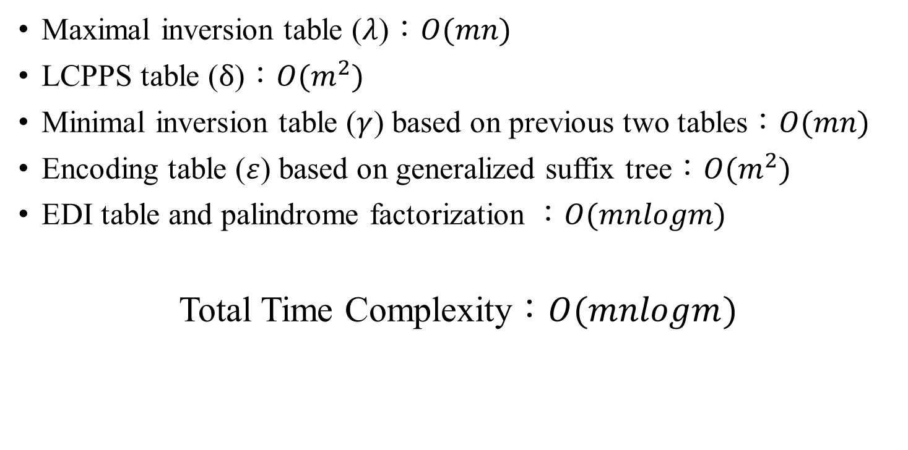
Time Complexity
Maximal inversion table ($λ$)：$O(mn)$
LCPPS table ($δ$)：$O(m^{2})$
Minimal inversion table ($γ$) based on previous two tables：$O(mn)$
Encoding table ($ε$) based on generalized suffix tree：$O(m^{2})$
EDI table and palindrome factorization ：$O(mnlogm)$
Total Time Complexity：$O(mnlogm)$

Slide 25
Thanks for your listening.

Slide 26



Each inversion is palindrome
$$A$$
acaaca
aca
aca
$$δ\left(6, 6\right)=3$$
$$B$$
tgttgt
tgt
tgt
$$A$$
aaaa
a
aaa
$$δ\left(4, 4\right)=3$$
$$B$$
tttt
t
ttt

Slide 27
Why we do this？
agg
ag
aggg
aggg
aggg
ccct
ccct
c
t
ccct
cc
t

Slide 28


Simple Quadratic Algorithm
$$PL(S[1..j])=\min_{ⅈ}\left\{PL\left(S\left[1..i−1\right]\right)+1:i≤j, S\left[i..j\right]is a palindrome\right\}$$
c | a | a | a | b | a | a | a | b | a | a | a | b | a | a | a
$$G_{j−1}$$
2
6
10
14
15
16
c | a | a | a | b | a | a | a | b | a | a | a | b | a | a | a | b
$$G_{j}$$
5
9
13
17

Slide 29
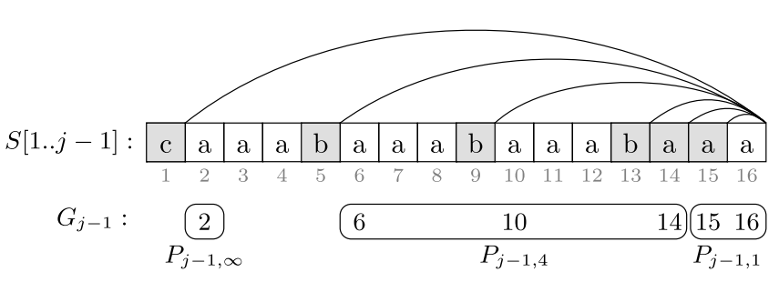
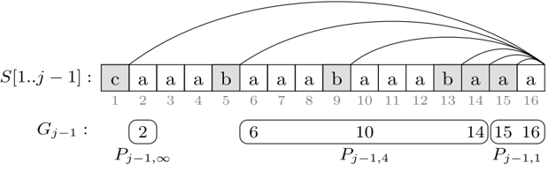
Group Suffix Palindrome
c | a | a | a | b | a | a | a | b | a | a | a | b | a | a | a
2
6
10
14
15
16

Slide 30
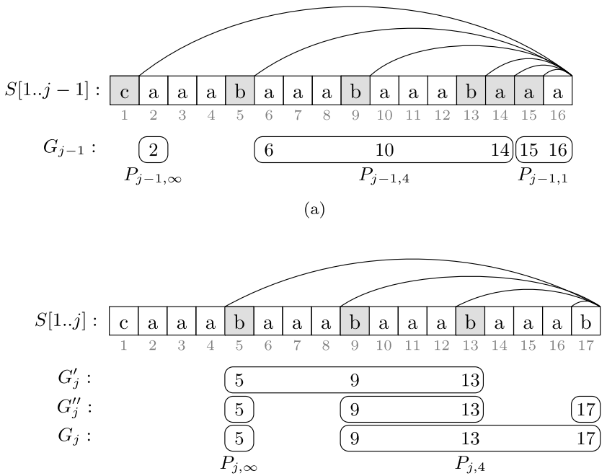

Slide 31
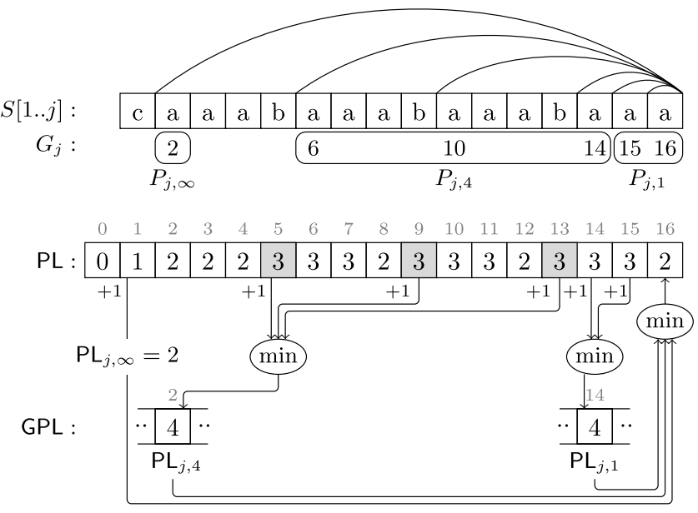
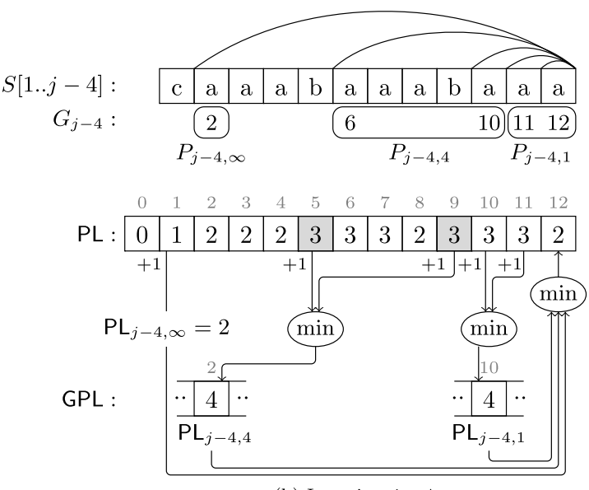
Faster Factorization

