Slide 1
Longest Increasing Subsequences in Sliding Windows
Michael H. Albert, Alexander Golynski, Angèle M. Hamel,
Alejandro López-Ortiz, S. Srinivasa Rao, Mohammad Ali Safari
Theoretical Computer Science 321 (2004) 405 – 414
Presenter：Yu-Cheng Chang
Date：June 10, 2020
Notes:
Michael H. Albert : Department of Computer Science, University of Otago, Dunedin, New Zealand
Alexander Golynski : School of Computer Science, University of Waterloo, Waterloo, Ont., Canada N2L3G1
Angèle M. Hamel : Department of Physics and Computer Science, Wilfrid Laurier University, Waterloo, Ont., CanadaN2L3C5
Alejandro López-Ortiz : 同B
S. Srinivasa Rao : 同B
Mohammad Ali Safari : 同B

Slide 2
Abstract
We consider the problem of finding the longest increasing subsequence in a sliding window over a given sequence (LISW). We propose an output-sensitive data structure that solves this problem in time O(nloglog n + OUTPUT) for a sequence of n elements. This data structure substantially improves over the naïve generalization of the longest increasing subsequence algorithm and in fact produces an output-sensitive optimal solution.

Slide 3
LISW
Longest Increasing Subsequence in a sliding window：
針對正整數之排列 π = π(1)π(2)…π(n)
Window size = 6 π = 257368491
Window | 257368 | 573684 | 736849 | 368491
LIS | 2368 | 568 | 3689 | 3689

Slide 4
Row Tower
window = 736849
7 | 3 3 | 36 36 6 | 368 368 68 8 | 348 348 48 4 4 | 3489 3489 489 49 49 9 | 3489(2) 489(1) 49(2) 9(1)
Notes:
Robinson–Schensted–Knuth 變化而來

Slide 5
d, σ
d ：drop out sequence
σ ：drop out permutation of row tower
d = {2,5,3,6}
σ = {1,3,2,4}
3489 3489 489 49 49 9 | 3489(2) 489(1) 49(2) 9(1)
principle row

Slide 6
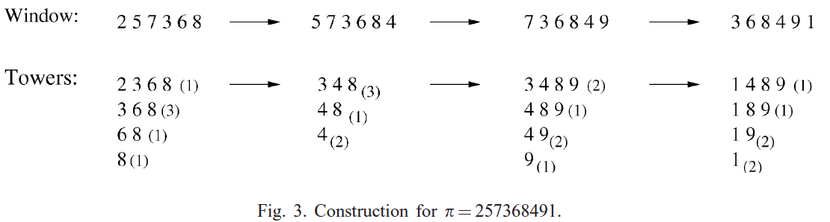
Update
d = {1,4,5,6} → d = {3,6,4} → d = {2,5,3,6} → d = {6,1,2,4}
σ = {1,2,3,4} → σ = {1,3,2} → σ = {1,3,2,4} → σ = {4,1,2,3}

Slide 7
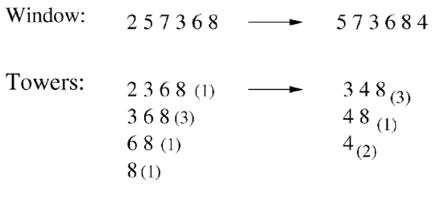
Update - d
expire
d = {1,4,5,6} {0,3,4,5} {3,4,5}
i₁ = the least index of an element of the principal row which is larger than b
i_{t+1} = d(i_{t+1}) > d(i_{t})
i = {2,3}
d(i_{t+1}) = d(i_{t}) for t = 1,2,…,k – 1
d(i₁) = w + 1 (w is window size)
d(3) = d(2) = 4
d(2) = w + 1 = 7 or 6?
d = {1,4,5,6} → d = {3,6,4}

Slide 8
Update - σ
expire
σ = {1,2,3,4} {0,1,2,3} {1,2,3}
i同上頁 = {2,3}
σ(i_{t+1}) = σ(i_{t}) for t = 1,2,…,k – 1
σ(i₁) = l (l is length of principle row)
σ(3) = σ(2) = 2
σ(2) = l = 3
σ = {1,2,3,4} → σ = {1,3,2}

Slide 9
Time Complexity
expire/add | O(l) per element
query time for the length of LIS of current window | O(1) & O(n) space
若要能夠取得 LIS 非單純取得長度，
該論文使用van Emde Boas Tree

Slide 10
Get LIS
2
2
Column
Column[1] | 2
Column[2]
Column[3]
Column[4]

Slide 11
Get LIS
2 | 25
2 | 25 5
Column
Column[1] | 2
Column[2] | 5 | 2
Column[3]
Column[4]

Slide 12
Get LIS
2 | 25 | 257
2 | 25 5 | 257 57 7
Column
Column[1] | 2
Column[2] | 5 | 2
Column[3] | 7 | 5 | 2
Column[4]

Slide 13
Get LIS
2 | 25 | 257 | 2573
2 | 25 5 | 257 57 7 | 237 37 3 3
Column
Column[1] | 2
Column[2] | 5 → 3 | 2
Column[3] | 7 | 5 | 2
Column[4]

Slide 14
Get LIS
2 | 25 | 257 | 2573 | 25736
2 | 25 5 | 257 57 7 | 237 37 3 3 | 236 36 36 36 6
Column
Column[1] | 2
Column[2] | 3 | 2
Column[3] | 7 → 6 | 5 → 3 | 2
Column[4]

Slide 15
Get LIS
2 | 25 | 257 | 2573 | 25736 | 257368
2 | 25 5 | 257 57 7 | 237 37 3 3 | 236 36 36 36 6 | 2368 368 368 368 68 8
Column
Column[1] | 2
Column[2] | 3 | 2
Column[3] | 6 | 3 | 2
Column[4] | 8 | 6 | 3 | 2
Reversed LIS of this window

Slide 16
Next
257368 | 57368
2368 368 368 368 68 8 | 368 368 368 68 8
Column
Column[1] | 3
Column[2] | 6 | 3
Column[3] | 8 | 6 | 3
Column[4]

Slide 17
Next
257368 | 57368 | 573684
2368 368 368 368 68 8 | 368 368 368 68 8 | 348 348 348 48 4 4
Column
Column[1] | 3
Column[2] | 6 → 4 | 3
Column[3] | 8 | 6 | 3
Column[4]
Reversed LIS of this window

Slide 18
Next
257368 | 57368 | 573684 | 73684
2368 368 368 368 68 8 | 368 368 368 68 8 | 348 348 348 48 4 4 | 348 348 48 4 4
Column
Column[1] | 3
Column[2] | 4 | 3
Column[3] | 8 | 6 | 3
Column[4]

Slide 19
Next
257368 | 57368 | 573684 | 73684 | 736849
2368 368 368 368 68 8 | 368 368 368 68 8 | 348 348 348 48 4 4 | 348 348 48 4 4 | 3489 3489 489 49 49 9
Column
Column[1] | 3
Column[2] | 4 | 3
Column[3] | 8 | 6 | 3
Column[4] | 9 | 8 | 6 | 3
Reversed LIS of this window

Slide 20
Next
573684 | 73684 | 736849 | 36849 | 368491
348 348 348 48 4 4 | 348 348 48 4 4 | 3489 3489 489 49 49 9 | 3489 489 49 49 9 | 1489 189 19 19 1 1
Column
Column[1] | 1
Column[2] | 4 | 3
Column[3] | 8 | 6 | 3
Column[4] | 9 | 8 | 6 | 3
Reversed LIS of this window

Slide 21
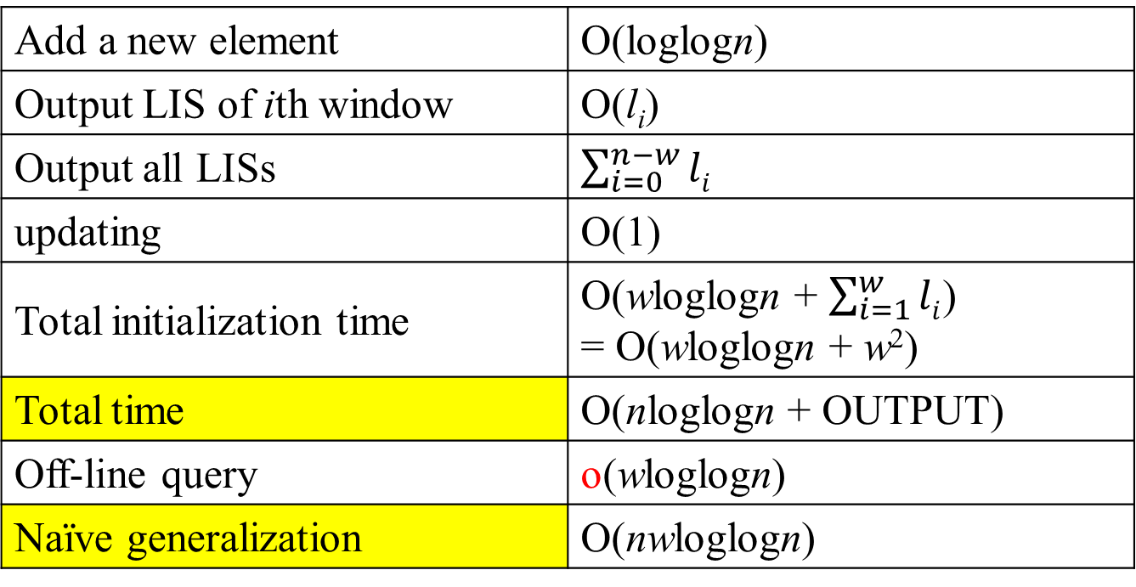
Time Complexity
Add a new element | O(loglogn)
Output LIS of ith window | O(l_{i})
Output all LISs | $\sum_{i=0}^{n−w}{li}$
updating | O(1)
Total initialization time | O(wloglogn + $\sum_{i=1}^{w}{li}$) = O(wloglogn + w²)
Total time | O(nloglogn + OUTPUT)
Off-line query | o(wloglogn)
Naïve generalization | O(nwloglogn)

