Slide 1
Alignment with Non-overlapping Inversions in O(n³)-Time
Augusto F. Vellozo, Carlos E.R. Alves, and Alair Pereira do Lago
Algorithms in Bioinformatics: 6th International Workshop, WABI 2006, Zurich, Switzerland, September 11-13, 2006. Proceedings (pp.186-196)
Presenter：Yu-Cheng Chang
Date：Aug. 18, 2020
Notes:
Zurich 蘇黎世(瑞士)
WABI : Workshop on Algorithm in Bioinformatics
1. 聖保羅大學的數學與統計研究所 (巴西)
2 .聖保羅猶大塔德大學
3. 同1

Slide 2
Abstract (1/2)
Alignments of sequences are widely used for biological sequence comparisons. Only biological events like mutations, insertions and deletions are usually modeled and other biological events like inversions are not automatically detected by the usual alignment algorithms. Alignment with inversions does not have a known polynomial algorithm and a simplification to the problem that considers only non-overlapping inversions were proposed by Schöniger and Waterman [20] in 1992 as well as a corresponding O(n⁶) solution. An improvement to an algorithm with O(n³logn)-time complexity was announced in an extended abstract [1] and, in this present paper, we give an algorithm that solves this simplified problem in O(n³)-time and O(n²)-space in the more general framework of an edit graph.
Notes:
Schöniger(shu ni ga) 德文

Slide 3
Abstract (2/2)
Inversions have recently [4,7,13,17] been discovered to be very important in Comparative Genomics and Scherer et al. in 2005 [11] experimentally verified inversions that were found to be polymorphic in the human genome. Moreover, 10% of the 1,576 putative inversions reported overlap RefSeq genes in the human genome. We believe our new algorithms may open the possibility to more detailed studies of inversions on DNA sequences using exact optimization algorithms and we hope this may be particularly interesting if applied to regions around known rearrangements boundaries. Scherer report 29 such cases and prioritize them as candidates for biological and evolutionary studies.
Notes:
Scherer ( like share )

Slide 4
Alignments with non-overlapping inversions
A = ACTTACCATGCACT
B = ATCGCATGGTACT
B’ = A_TCG_CATGGTACT
Inversion of string “GCATGGT” => ACCATGC
Inversion = removed, reverted, complemented and inserted back
A = ACTTACCATGCACT
B’ = A_TTACCATGCACT
原本要 6 steps (刪除、插入、替換)，加入 inversion 後只要 3 steps

Slide 5
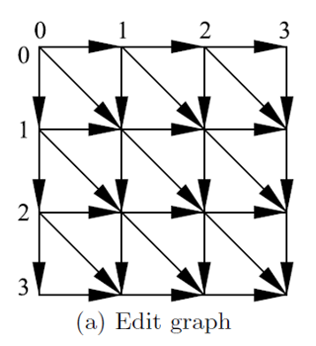
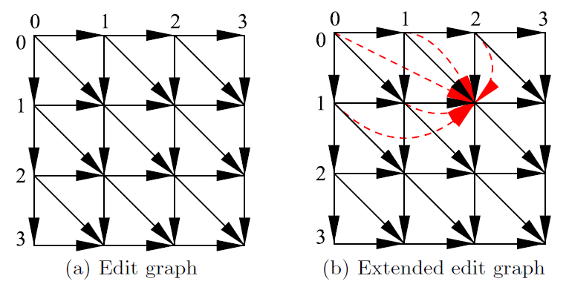
Edit graph & Extended edit graph
G’ (Inversion of G)
G
G
C
A
T
T
A
A
T
G

Slide 6
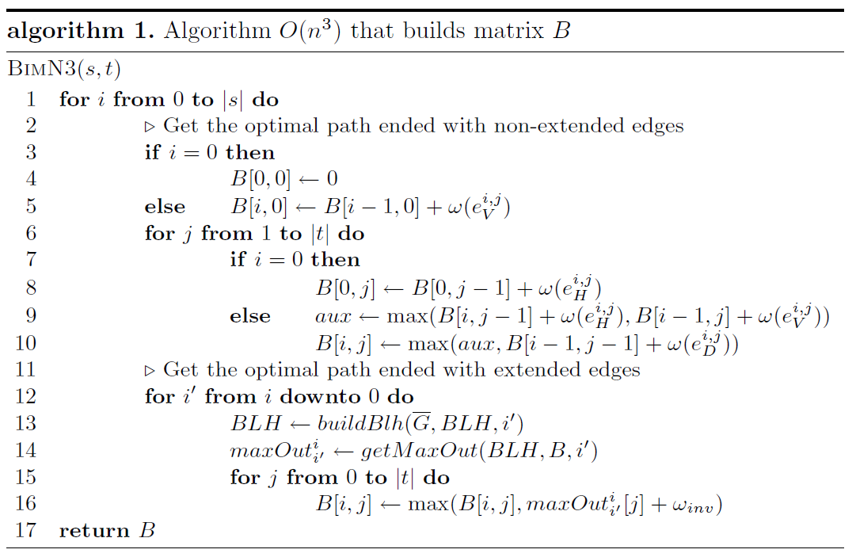
Algorithm
|s| = n , |t| = m
O(n) * O(m + mn)
= O(n³)
O(m)
O(m)
O(m)
O(mn)
O(m)

Slide 7
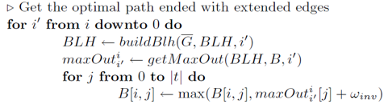
Algorithm
JEANETTE P. SCHMIDT － All Highest Scoring Paths in Weighted Grid Graphs and Their Application to Finding All Approximate Repeats in Strings － SIAM Journal on Computing Vol. 27, No. 4, pp. 972-992, August 1998
Gad M. Landau and Michal Ziv-Ukelson － On the Common Substring Alignment Problem － Journal of Algorithms 41, 338–359 (2001)
Based on section 6 [1]
Based on subsection 6.2 [2]

Slide 8
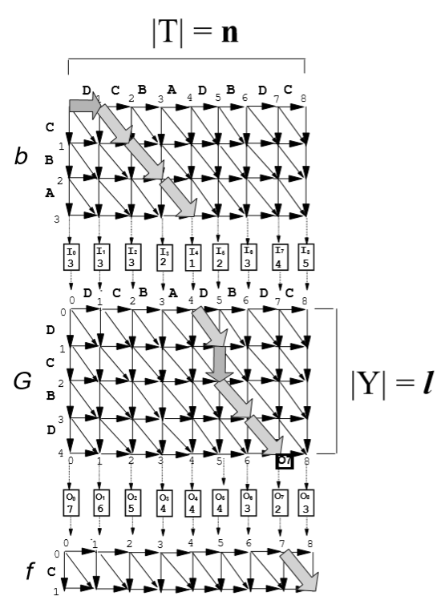
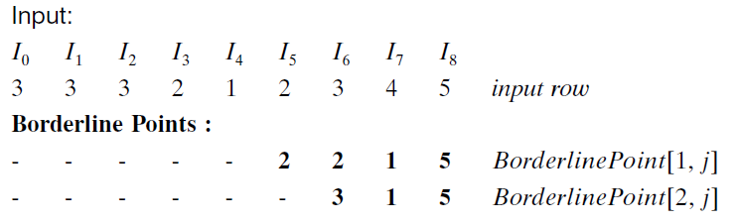
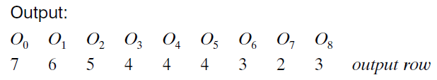
maxOut
只要有 Input row 跟 BLH
就能用O(n)求出 Output row
Gad M. Landau and Michal Ziv-Ukelson － On the Common Substring Alignment Problem Journal of Algorithms 41, 338–359 (2001)
Notes:
2016/2/23 林必祥
2020/4/21 李紹瑄
詳情請見該兩位學長姊的meeting報告

Slide 9
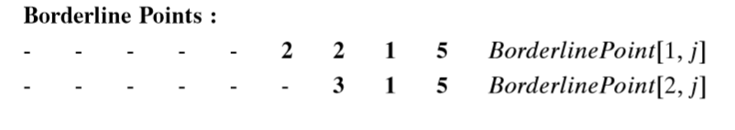
maxOut (SMAWK Algorithm 的衍伸)
 | 0 | 1 | 2 | 3 | 4 | 5 | 6 | 7 | 8
0 | 7 | 6 | 5 | 4 | 4 | 4 | 5 | 6 | 7
1 |  | 7 | 6 | 5 | 5 | 5 | 6 | 7 | 8
2 |  |  | 7 | 6 | 6 | 6 | 7 | 6 | 7
3 |  |  |  | 6 | 6 | 5 | 5 | 4 | 5
4 |  |  |  |  | 5 | 4 | 3 | 2 | 3
5 |  |  |  |  |  | 6 | 5 | 4 | 5
6 |  |  |  |  |  |  | 7 | 6 | 5
7 |  |  |  |  |  |  |  | 8 | 7
8 |  |  |  |  |  |  |  |  | 9
2016/2/23 林必祥
2020/4/21 李紹瑄 p.12 ~ 29
Notes:
2016/2/23 林必祥
2020/4/21 李紹瑄
詳情請見該兩位學長姊的meeting報告

Slide 10
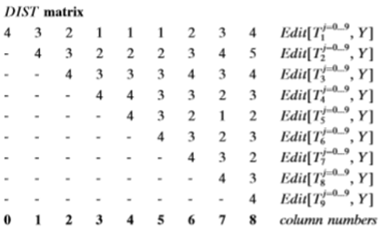
buildBLH
此時 l = |Y| = 4，若|Y|+1，則 DIST 只需要 O(nl) 時間就能更新完畢
因此 BLH 也可以在同樣的時間下更新完畢
同樣的，若|Y|-1，也可在 O(nl) 的時間內更新完畢
DIST_{l+1}
…
JEANETTE P. SCHMIDT － All Highest Scoring Paths in Weighted Grid Graphs and Their Application to Finding All Approximate Repeats in Strings － SIAM Journal on Computing Vol. 27, No. 4, pp. 972-992, August 1998

Slide 11
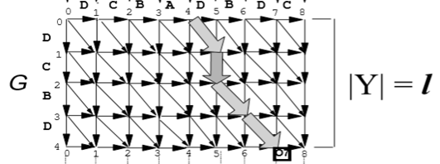
buildBLH
此時 l = |Y| = 4，若|Y|+1，則 DIST 只需要 O(nl) 時間就能更新完畢
JEANETTE P. SCHMIDT － All Highest Scoring Paths in Weighted Grid Graphs and Their Application to Finding All Approximate Repeats in Strings － SIAM Journal on Computing Vol. 27, No. 4, pp. 972-992, August 1998

Slide 12
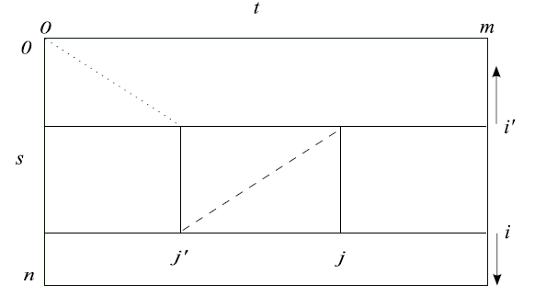
Execution of algorithm
由於從 (0,0) 走到 (i’, j’) 及從 (i’,j’) 走到 (i, j) 是不同字串
才需要使用到提及 maxOut 的那篇論文來連接，並保持最佳的weight
在 Edit Graph 中，從 (0,0) 走到 (i’, j’)
在 Edit Graph 中，從 (i’,j’) 走到 (i, j)
(走 Extended Path)

Slide 13
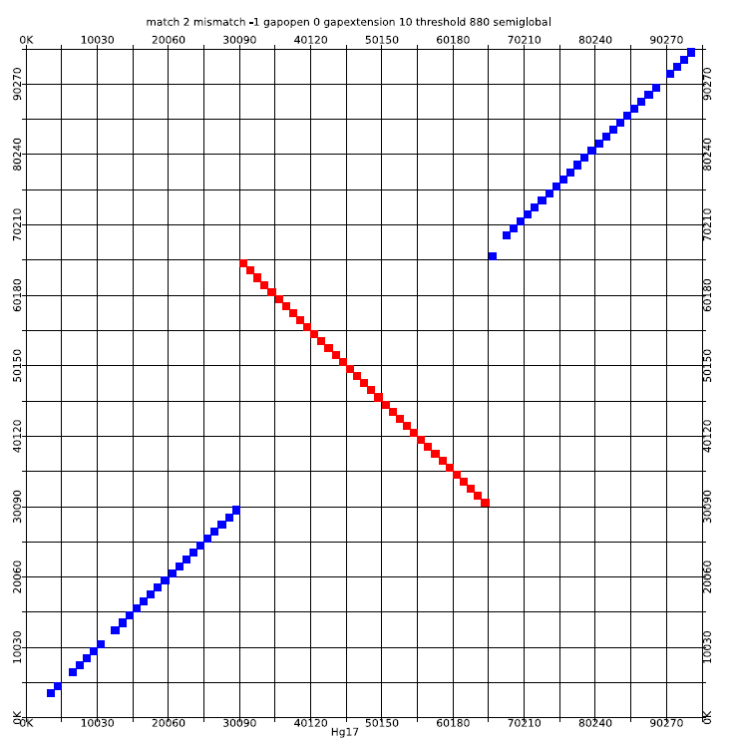
Experiment
比對人類與黑猩猩的基因
若不考慮 threshold 則有 98.6% 基因可成功配對
若考慮 threshold 則有 94.8% 基因可成功配對
此圖為有考慮 threshold

Slide 14
Experiment
If the sequences to be aligned were DNA sequences then Algorithm 1 was faster than
sparse algorithm, but if the sequences to be aligned were sequences of DNA fragments, where the number of matches is small, then the sparse algorithm was faster than the Algorithm 1
O(n³) ? O(r²log²r), r = the number of matches

