Slide 1
ASCA-PSO : Adaptive Sine Cosine Optimization Algorithm Integrated with Particle Swarm for Pairwise Local Sequence Alignment
Mohamed Issa, Aboul Ella Hassanien, Diego Oliva, Ahmed Helmi, Ibrahim Ziedan and Ahmed Alzohairy
Expert Systems with Applications, 2018, Vol. 99, pp.56-70.
Presenter : Tz-Hsu Lee
Date : Aug. 18, 2020.

Slide 2
Abstract(1/2)
The sine cosine algorithm (SCA), a recently proposed population-based optimization algorithm, is based on the use of sine and cosine trigonometric functions as operators to update the movements of the search agents. To optimize performance, different parameters on the SCA must be appropriately tuned. Setting such parameters is challenging because they permit the algorithm to escape from local optima and avoid premature convergence. The main drawback of the SCA is that the parameter setting only affects the exploitation of the prominent regions. However, the SCA has good exploration capabilities. This article presents an enhanced version of the SCA by merging it with particle swarm optimization (PSO). solutions in terms of accuracy and computational time.

Slide 3
Abstract(2/2)
PSO exploits the search space better than the operators of the standard SCA. The proposed algorithm, called ASCA-PSO, has been tested over several unimodal and multimodal benchmark functions, which show its superiority over the SCA and other recent and standard meta-heuristic algorithms. Moreover, to verify the capabilities of the SCA, the SCA has been used to solve the real-world problem of a pairwise local alignment algorithm that tends to find the longest consecutive substrings between two biological sequences. Experimental results provide evidence of the good performance of the ASCA-PSO solutions in terms of accuracy and computational time.

Slide 4
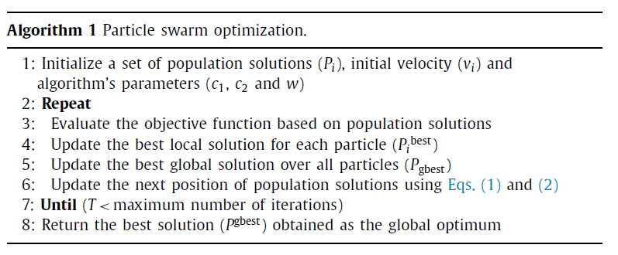
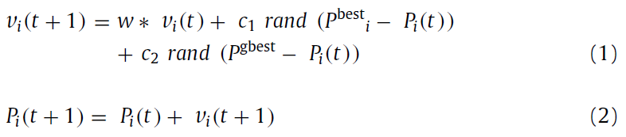

Particle Swarm Optimization (PSO)

Slide 5
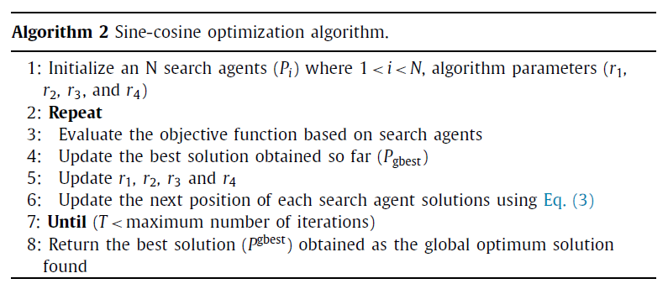
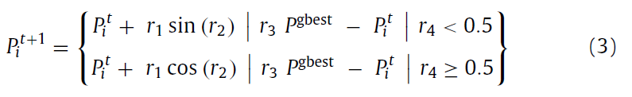

Sine-cosine Optimization Algorithm (SCA)(1/2)
Notes:
r2 : [0,2拍]
r4 : [0,1]

Slide 6
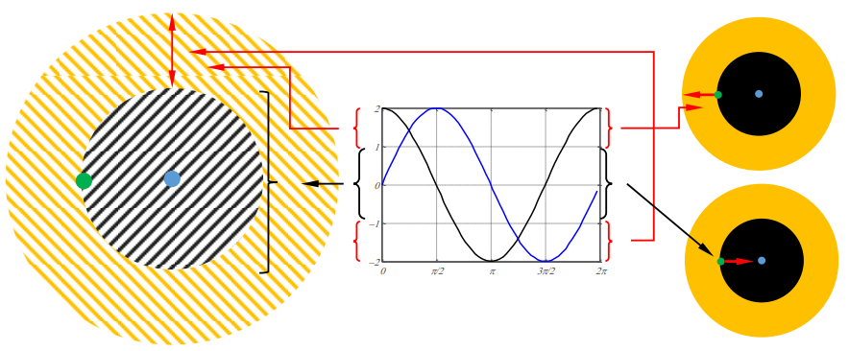
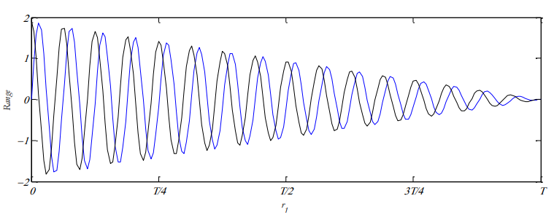
Sine-cosine Optimization Algorithm (SCA)(2/2)
Notes:
Explore : (1,2] [-2,-1)
Expoit : [-1,1]

Slide 7
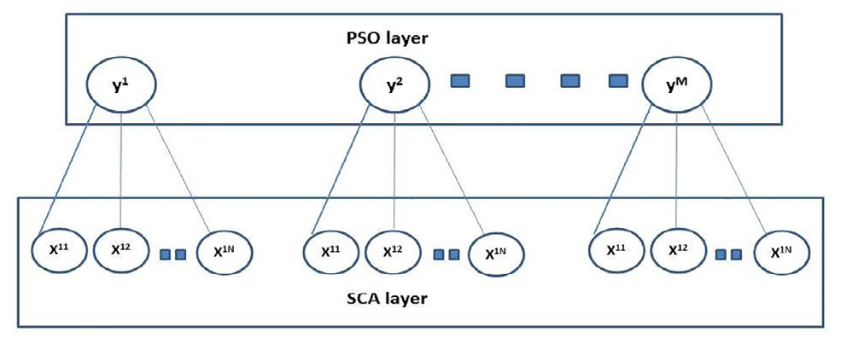

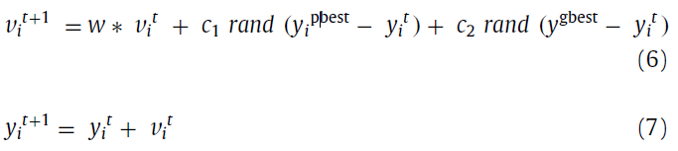
Adaptive Sine Cosine Integrated with Particle Swarm (ASCA-PSO)(1/2)
Notes:
SCA : slow convergence and the tendency to become trapped in local optima solutions
the bottom layer focuses on exploring the search space
the top layer focuses on exploiting the best solutions found by the bottom layer.
y i also represents the best solution found by each i group in the bottom layer.
( y i pbest ) represents the best single solution for y i over all previous iterations.
y gbest is the best global solution for all individuals and is determined as the best solution in the top layer

Slide 8
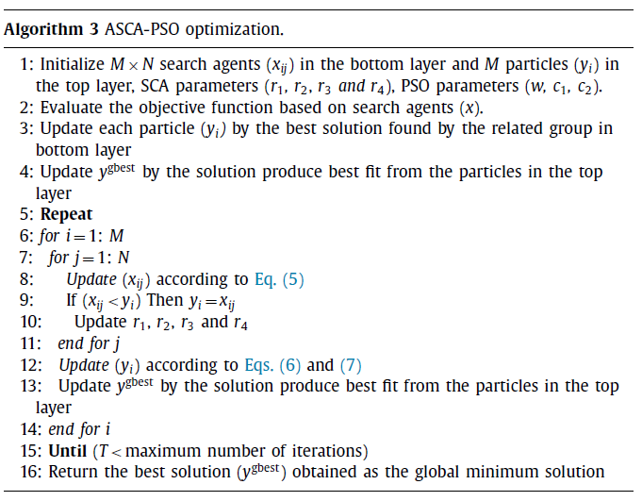
Adaptive Sine Cosine Integrated with Particle Swarm (ASCA-PSO)(2/2)
Notes:
SCA : slow convergence and the tendency to become trapped in local optima solutions
the bottom layer focuses on exploring the search space
the top layer focuses on exploiting the best solutions found by the bottom layer.
y i also represents the best solution found by each i group in the bottom layer.
( y i pbest ) represents the best single solution for y i over all previous iterations.
y gbest is the best global solution for all individuals and is determined as the best solution in the top layer

Slide 9
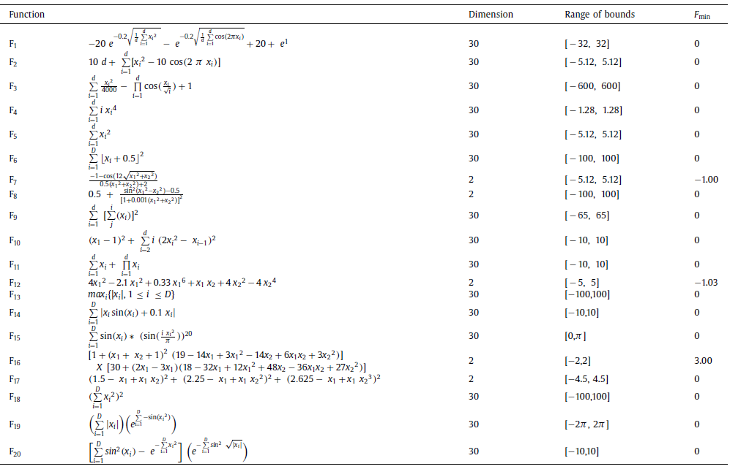
Experimental Results and Discussion(1/3)

Slide 10
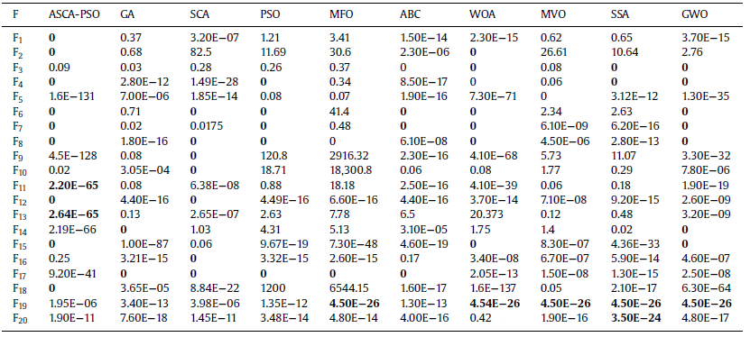
Experimental Results and Discussion(2/3)
Standard deviation of testing functions for all algorithms

Slide 11
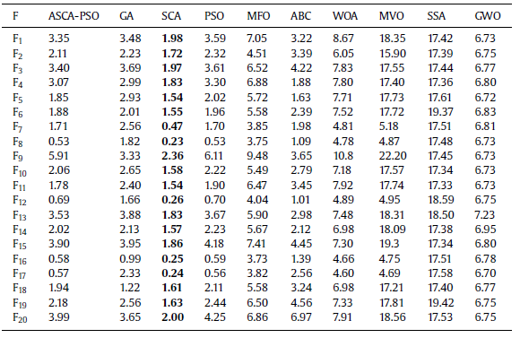
Experimental Results and Discussion(3/3)
The elapsed time of computing functions for all algorithms

Slide 12
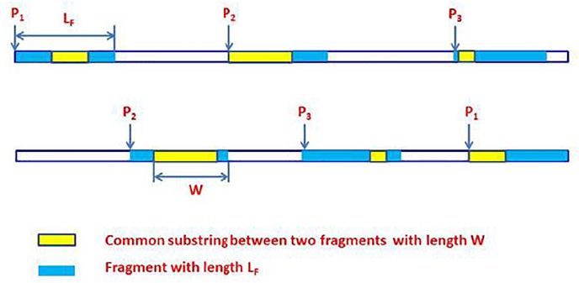
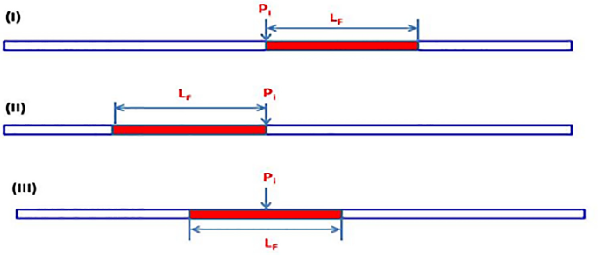
The Fragmentation Local Alignment Proposed Method (1/2)

Slide 13

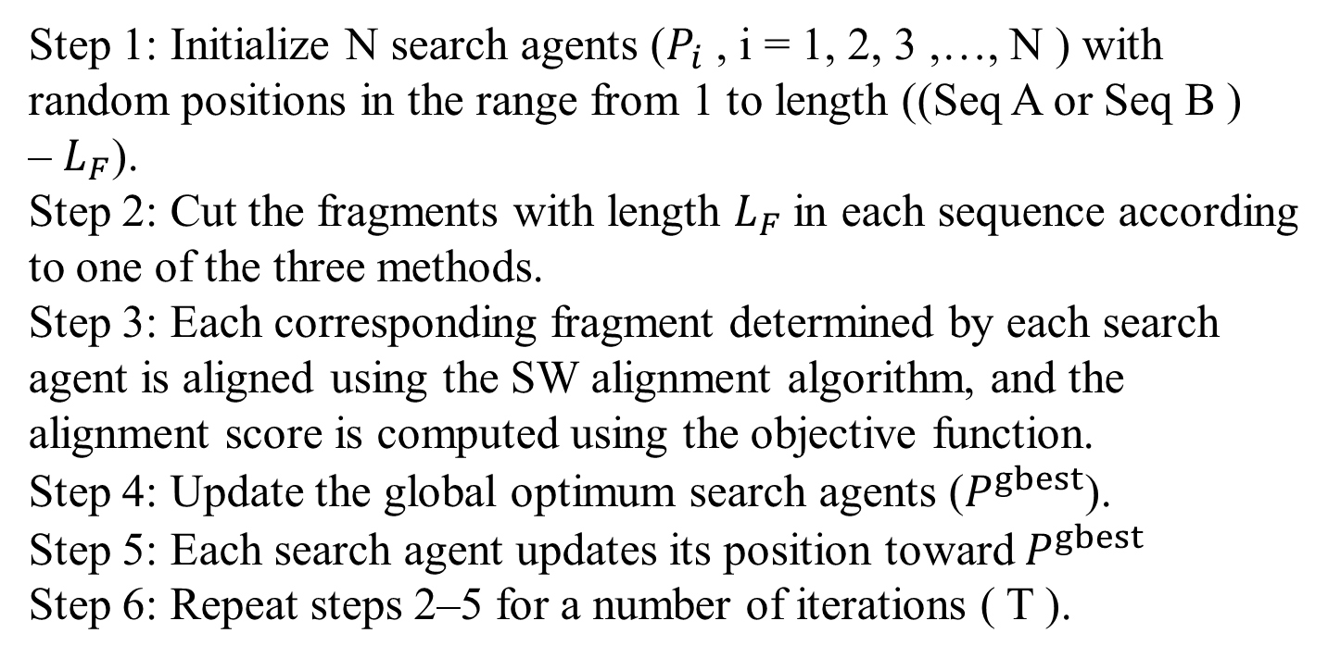
The Fragmentation Local Alignment Proposed Method (2/2)
Step 1: Initialize N search agents ($P_{i}$ , i = 1, 2, 3 ,…, N ) with random positions in the range from 1 to length ((Seq A or Seq B )
– $L_{F}$).
Step 2: Cut the fragments with length $L_{F}$in each sequence according to one of the three methods.
Step 3: Each corresponding fragment determined by each search agent is aligned using the SW alignment algorithm, and the alignment score is computed using the objective function.
Step 4: Update the global optimum search agents ($P^{gbest}$).
Step 5: Each search agent updates its position toward $P^{gbest}$
Step 6: Repeat steps 2–5 for a number of iterations ( T ).
Objective function :

Slide 14
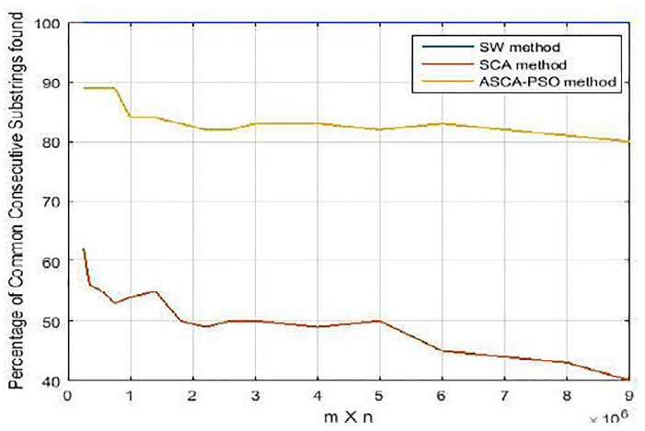
The experimental results(1/3)

Slide 15
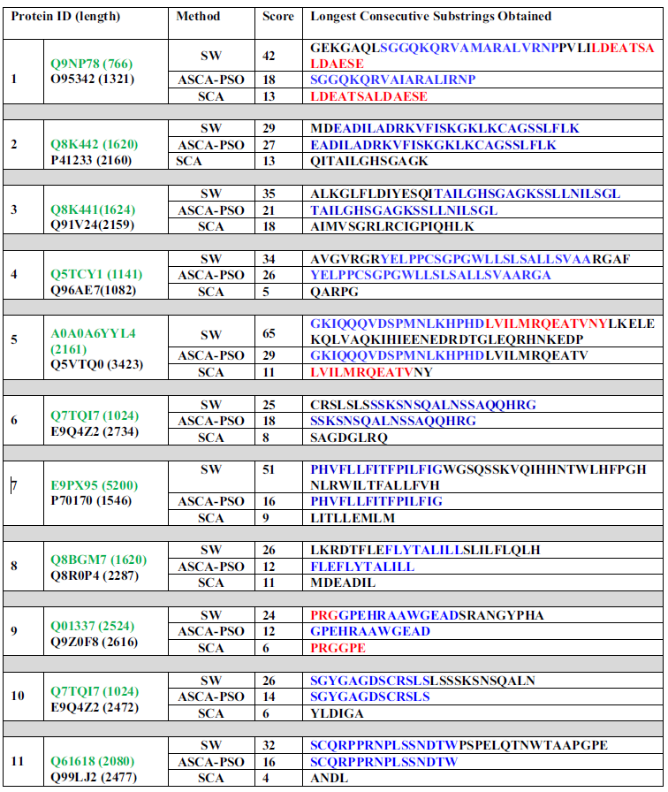
The experimental results(2/3)

Slide 16
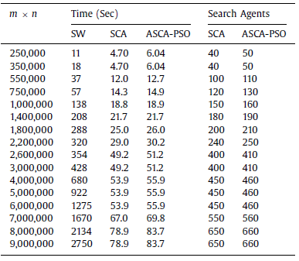
The experimental results(3/3)

Slide 17
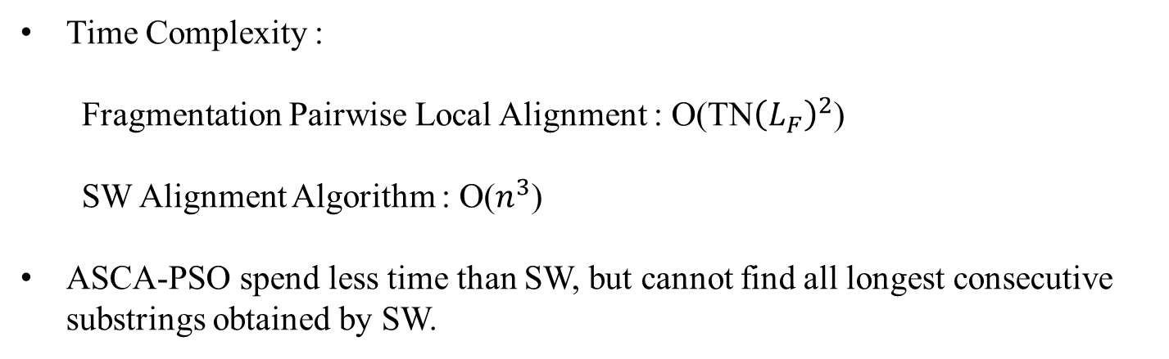
Conclusions
Time Complexity :
Fragmentation Pairwise Local Alignment : O(TN${\left(L_{F}\right)}^{2}$)
SW Alignment Algorithm : O($n^{3}$)
ASCA-PSO spend less time than SW, but cannot find all longest consecutive substrings obtained by SW.

