Slide 1
Scheduling for Heterogeneous Systems Using Constrained Critical Paths
Minhaj Ahmad Khan
Parallel Computing, Volume 38, Issues 4-5, April-May 2012, Pages 175-193
Presenter : Chih-Kai Wu
Date: Aug. 18, 2020.
Notes:
聖胡安是美國自治領地波多黎各的首府和最大城市

Slide 2
Abstract (1/2)
A complex computing problem may be efficiently solved on a system with multiple processing elements by dividing its implementation code into several tasks or modules that execute in parallel. The modules may then be assigned to and scheduled on the processing elements so that the total execution time is minimum. Finding an optimal schedule for parallel programs is a non-trivial task and is considered to be NP-complete.For heterogeneous systems having processors with different characteristics, most of the scheduling algorithms use greedy approach to assign processors to the modules.

Slide 3
Abstract (2/2)
This paper suggests a novel approach called constrained earliest finish time (CEFT) to provide better schedules for heterogeneous systems using the concept of the constrained critical paths (CCPs). In contrast to other approaches used for heterogeneous systems, the CEFT strategy takes into account a broader view of the input task graph. Furthermore, the statically generated CCPs may be efficiently scheduled in comparison with other approaches.The experimentation results show that the CEFT scheduling strategy outperforms the well-known HEFT, DLS and LMT strategies by producing shorter schedules for a diverse collection of task graphs.

Slide 4
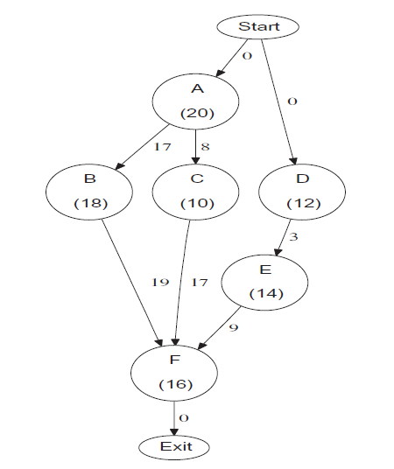

Slide 5
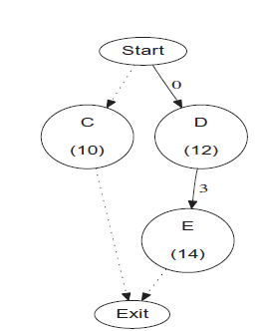
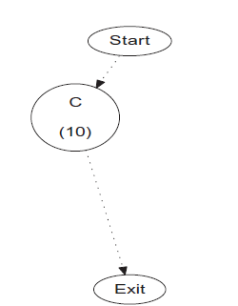

Slide 6
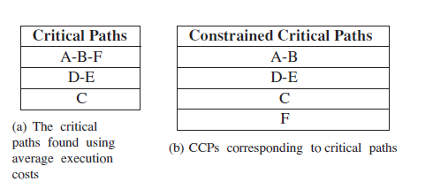

Slide 7
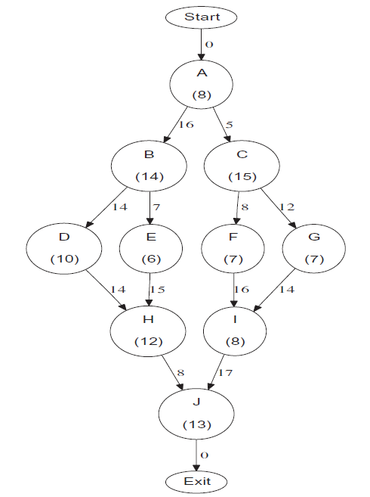

Slide 8
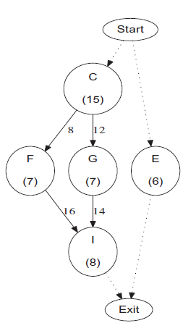
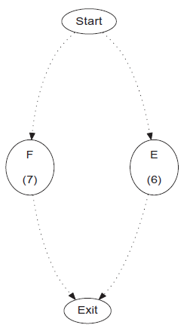
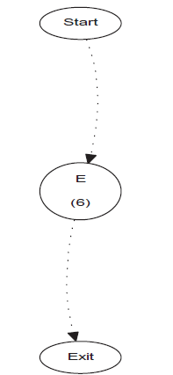

Slide 9
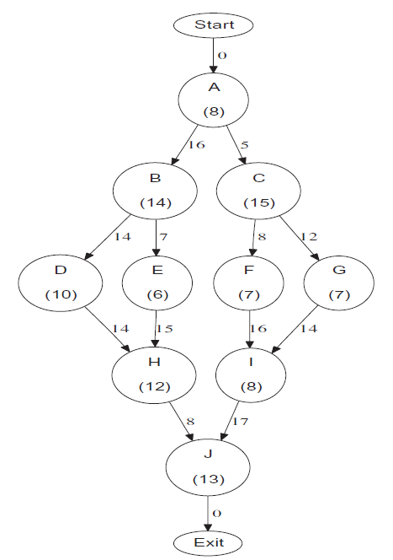
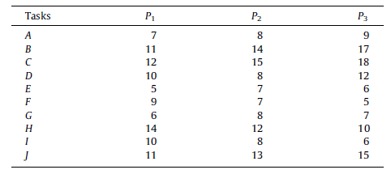
CCP | P1 | P2 | P3
A-B-D | 28 | 30 | 38
C-G | 28+12+6=46 | 7+5+15+8=35(12~35) | 7+5+18+7=37
F | 27+8+9= 44 | 35+7=42 | 27+8+5= 40(35~40)
E | 28+5=33 | 18+7+7=27 (20~27) 35+7=42 | 18+7+6=31 (25~31)
H | 31+15+14=60 | 31+15+12=58 | 28+14+10=52(42~52)
I | 40+16+10=66 | 40+16+8= 64 | 35+14+6=55(49~55) 52+6=58
J | 58+17+11=86 | 58+17+13=88 | 58+15=73

Slide 10
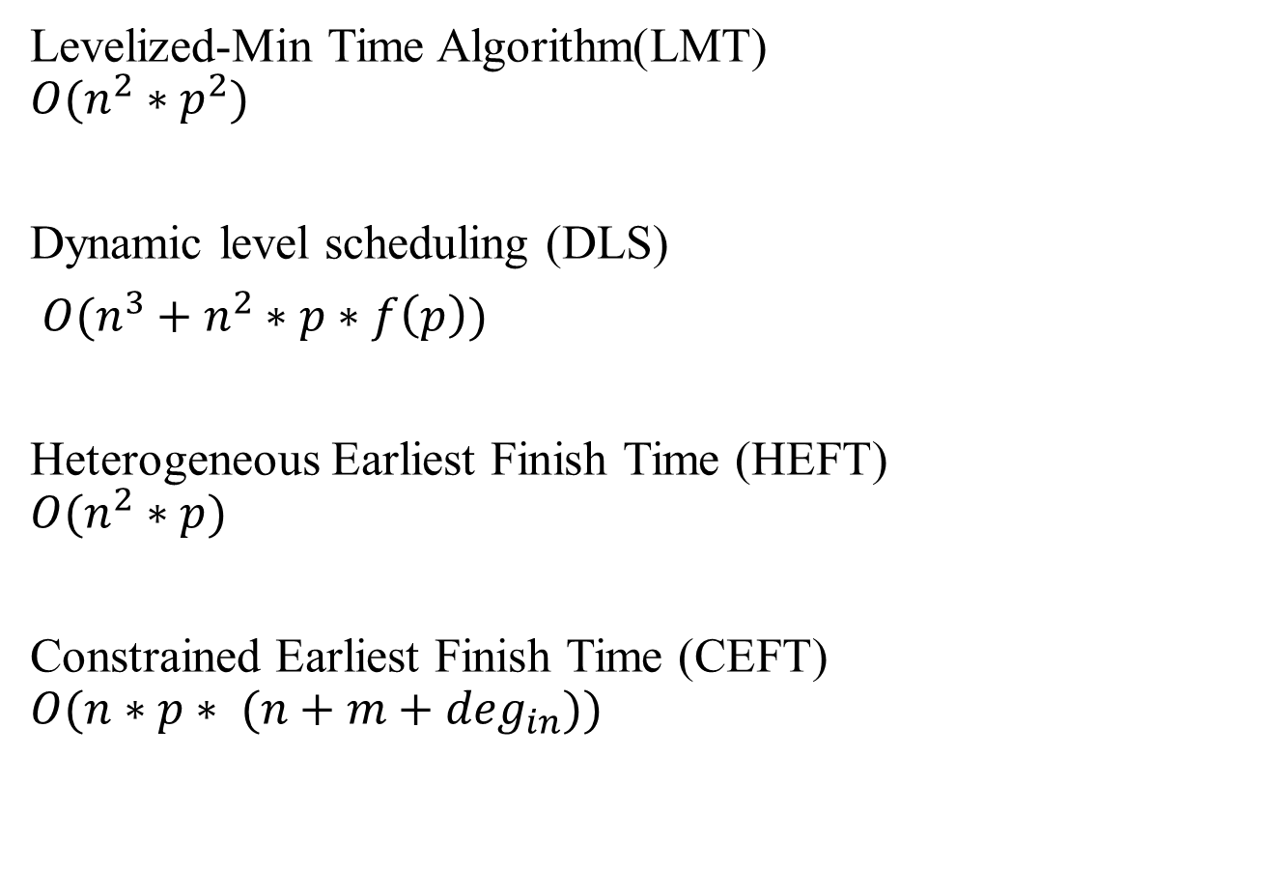
Levelized-Min Time Algorithm(LMT)
$$O(n^{2}∗p^{2})$$
Dynamic level scheduling (DLS)
${O(n}^{3}+n^{2}∗p∗f\left(p\right))$
Heterogeneous Earliest Finish Time (HEFT)
$$O(n^{2}∗p)$$
Constrained Earliest Finish Time (CEFT)
$$O(n∗p∗ (n+m+\deg_{in}))$$

Slide 11
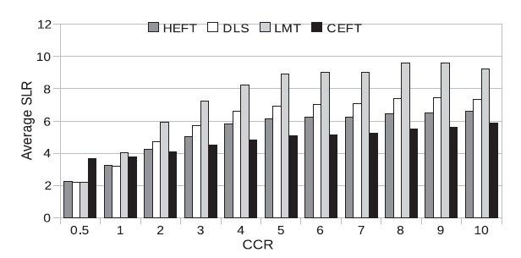

Slide 12
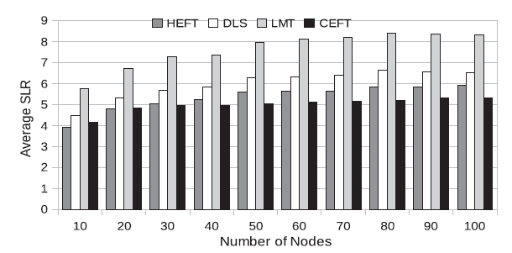

Slide 13
