Slide 1
A Path Recorder Algorithm for Multiple Longest Common Subsequences Problems
Shiwei Wei ,Yuping Wang, Yuanchao Yang and Sen Liu
Bioinformatics, Volume 36, Issue 10, 15 May 2020, Pages 3035–3042.
Presenter: Shao-Xuan Lee
Date: Aug. 25, 2020

Slide 2
Abstract(1/2)
Motivation: Searching the Longest Common Subsequences of many sequences is called a Multiple Longest Common Subsequence (MLCS) problem which is a very fundamental and challenging problem in many fields of data mining. The existing algorithms cannot not applicable to problems with long and large-scale sequences due to their huge time and space consumption. To efficiently handle large-scale MLCS problems, a Path Recorder Directed Acyclic Graph (PRDAG) model and a novel Path Recorder Algorithm (PRA) are proposed.

Slide 3
Abstract(2/2)
Results: In PRDAG, we transform the MLCS problem into searching the longest path from the Directed Acyclic Graph (DAG), where each longest path in DAG corresponds to an MLCS. To tackle the problem efficiently, we eliminate all redundant and repeated nodes during the construction of DAG, and for each node, we only maintain the longest paths from the source node to it but ignore all non-longest pathes. As a result, the size of the DAG becomes very small, and the memory space and search time will be greatly saved. Empirical experiments have been performed on a standard benchmark set of both DNA sequences and protein sequences. The experimental results demonstrate that our model and algorithm outperform the related leading algorithms, especially for large-scale MLCS problems.

Slide 4
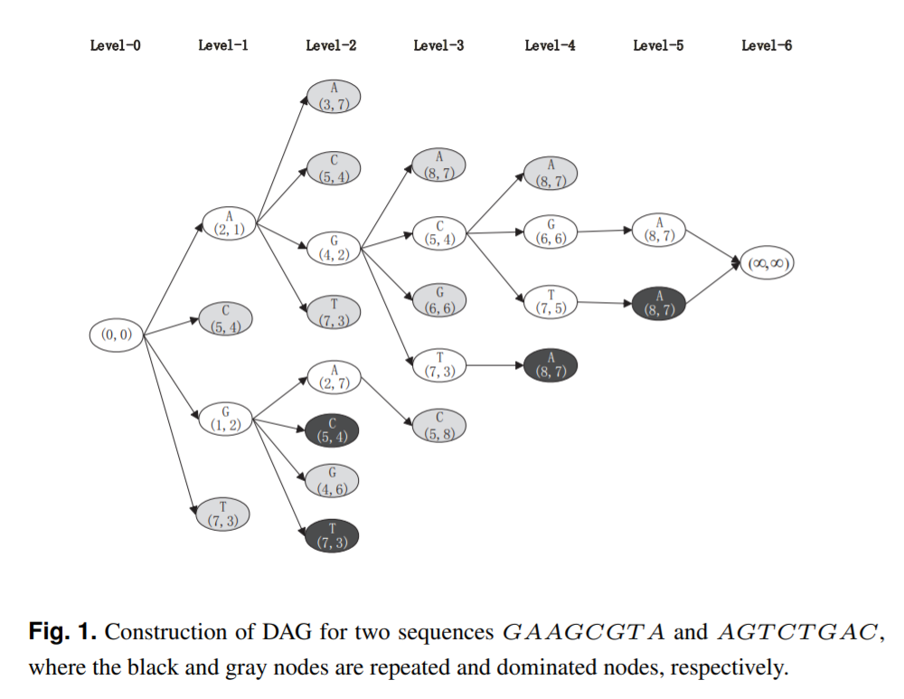
Directed Acyclic Graph (DAG)
A = G A A G C G T A
B = A G T C T G A C

Slide 5
The Path Recorder Directed Acyclic Graph Model (PRDAG)
A = G A A G C G T A
B = A G T C T G A C
1 2 3 4 5 6 7 8
Q
A (2,1) | C (5,4) | G (1,2) | T (7,3)
Q
O (0,0)
A (2,1)
1
C (5,4)
O (0,0)
O (0,0)
1
0
0
G (1,2)
1
T (7,3)
1

Slide 6
A = G A A G C G T A
B = A G T C T G A C
1 2 3 4 5 6 7 8
Successors :
A(3, 7), C(5, 4), G(4, 2) ,T(7, 3)
A (2,1)
Hash table : O(1)
A (3,7)
2
A (2,1)
1
G (4,2)
C (5,4)
2
O (0,0)
2
0
G (1,2)
1
Q
C (5,4) | G (1,2) | T (7,3) | A (3,7) | G (4,2)
T (7,3)
2

Slide 7
A = G A A G C G T A
B = A G T C T G A C
1 2 3 4 5 6 7 8
C (5,4)
Successors :
A(8, 7), G(6, 6) ,T(7, 5)
A (3,7)
2
A (2,1)
G (4,2)
1
2
A (8,7)
C (5,4)
3
O (0,0)
2
G (6,6)
3
0
G (1,2)
T (7,5)
1
3
T (7,3)
G (1,2) | T (7,3) | A (3,7) | G (4,2) | A (8,7) | G (6,6) | T (7,5)
Q
2

Slide 8
G (1,2)
Successors :
A(2, 7), C(5, 4), G(4, 6), T(7, 3)
A = G A A G C G T A
B = A G T C T G A C
1 2 3 4 5 6 7 8
A (3,7)
2
G (4,2)
A (2,1)
2
1
T (7,5)
3
C (5,4)
G (6,6)
O (0,0)
2
3
A (8,7)
0
G (1,2)
3
1
A (2,7)
2
T (7,3)
G (4,6)
T (7,3) | A (3,7) | G (4,2) | A (8,7) | G (6,6) | T (7,5) | A (2,7) | G (4,6)
2
Q
2

Slide 9
A = G A A G C G T A
B = A G T C T G A C
1 2 3 4 5 6 7 8
T (7,3)
Successors :
A(8, 7)
A (3,7)
2
G (4,2)
A (2,1)
2
1
T (7,5)
3
C (5,4)
G (6,6)
O (0,0)
2
3
A (8,7)
0
G (1,2)
3
1
A (2,7)
2
T (7,3)
G (4,6)
A (3,7) | G (4,2) | A (8,7) | G (6,6) | T (7,5) | A (2,7) | G (4,6)
2
Q
2

Slide 10
A = G A A G C G T A
B = A G T C T G A C
1 2 3 4 5 6 7 8
A (3,7)
Successors :
C(5,8)
A (3,7)
C (5,8)
2
3
G (4,2)
A (2,1)
2
1
T (7,5)
3
C (5,4)
G (6,6)
O (0,0)
2
3
A (8,7)
0
G (1,2)
3
1
A (2,7)
2
T (7,3)
G (4,6)
G (4,2) | A (8,7) | G (6,6) | T (7,5) | A (2,7) | G (4,6) | C (5,8)
2
Q
2

Slide 11
A = G A A G C G T A
B = A G T C T G A C
1 2 3 4 5 6 7 8
G (4,2)
Successors :
A(8, 7), C(5, 4), G(6, 6), T(7, 3)
A (3,7)
C (5,8)
2
G (4,2)
A (2,1)
2
1
T (7,5)
3
C (5,4)
G (6,6)
O (0,0)
3
3
A (8,7)
0
G (1,2)
3
1
A (2,7)
2
T (7,3)
G (4,6)
A (8,7) | G (6,6) | T (7,5) | A (2,7) | G (4,6) | C (5,8)
3
Q
2

Slide 12
A = G A A G C G T A
B = A G T C T G A C
1 2 3 4 5 6 7 8
A (3,7)
2
G (4,2)
A (2,1)
2
1
T (7,5)
4
C (5,4)
G (6,6)
(∞,∞)
O (0,0)
3
4
6
A (8,7)
0
G (1,2)
C (5,8)
5
1
A (2,7)
3
2
T (7,3)
G (4,6)
3
2

Slide 13
A = G A A G C G T A
B = A G T C T G A C
1 2 3 4 5 6 7 8
A (3,7)
2
G (4,2)
A (2,1)
2
1
T (7,5)
4
C (5,4)
G (6,6)
(∞,∞)
O (0,0)
3
4
6
A (8,7)
0
G (1,2)
C (5,8)
5
1
A (2,7)
3
2
T (7,3)
G (4,6)
3
2

Slide 14
A = G A A G C G T A
B = A G T C T G A C
1 2 3 4 5 6 7 8
T (7,5)
O (0,0)
A (2,1)
G (4,2)
C (5,4)
4
A (8,7)
(∞,∞)
0
1
2
G (6,6)
3
5
6
4
MLCSs : A G C G A and A G C T A

Slide 15
Experiments
Y. Chen, A. Wan, and W. Liu. “A fast parallel algorithm for finding the longest common sequence of multiple biosequences.”, BMC Bioinformatics,vol. 7, no. 4, 2006.
Q. Wang, D. Korkin, and Y. Shang, “A Fast Multiple Longest Common Subsequence (MLCS) Algorithm,” IEEE Trans. Knowledge and Data Eng., vol. 23, no. 3, pp. 321-334, Mar. 2011
Y. Li, Y. Wang, Z. Zhang, Y. Wang, D. Ma, and J. Huang, “A novel fast and memory efficient parallel mlcs algorithm for long and largescale sequences alignments,” Data Engineering (ICDE), 2016 IEEE 32nd International Conference on, pp. 1170–1181, 2016.

Slide 16
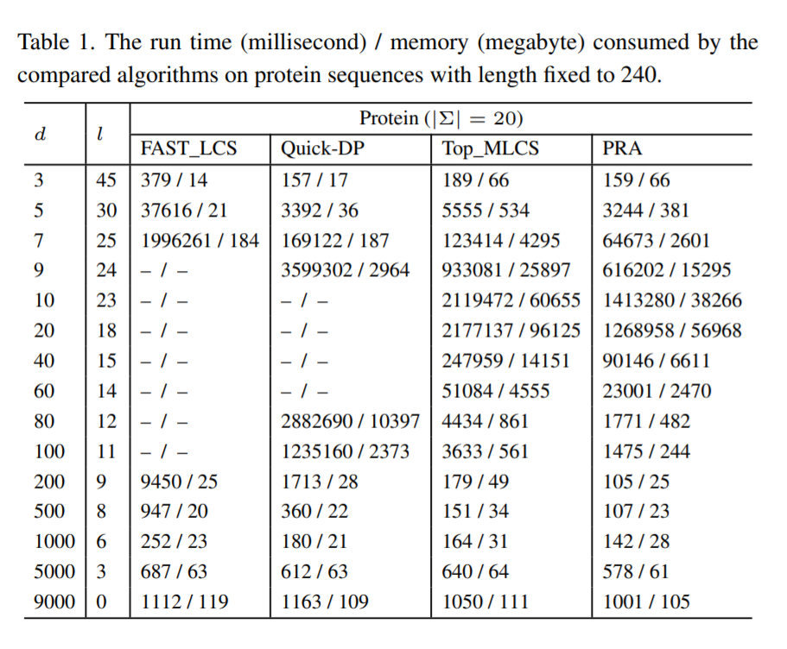
Experiments
(1) Fix the sequence length and change the number of sequences
d : the number of sequences
l : the length of the obtained MLCS

Slide 17
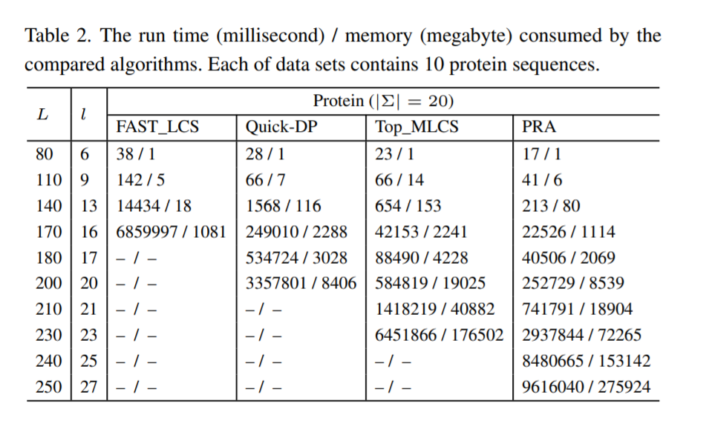
Experiments
(2) Fix the number of sequences and change the length of sequences
L : the Length of sequences
l : the length of the obtained MLCS
Notes:
Chen, Y., Wan, A., and Liu, W. (2006). A fast parallel algorithm for finding the longest common sequence of multiple biosequences. BMC BIOINFORMATICS, 7(4). Symposium of Computations in Bioinformatics and Bioscience in Conjunction with the International Mult-Symposium on Computer and Computational Sciences, Hangzhou, PEOPLES R CHINA, JUN 20-24, 2006

