Slide 1
MPSAGA: a matrix-based pair-wise sequence alignment algorithm for global alignment with position based sequence representation
Jyoti Lakhani, Ajay Khunteta, Anupama Choudhary & Dharmesh Harwani
Sādhanā, volume 44, Article number: 171 (2019)
Presenter: Yuan-Hsiu Tsai
Date: Aug. 25, 2020

Slide 2
Abstract(1/2)
The proposed algorithm is a novel matrix-based global pair-wise sequence alignment with a de novo sequence representation. Needleman–Wunsch, noblest, Emboss-Needle, ALIGN, LALIGN, FOGSAA, DIALIGN, ACANA, MUMmer, etc. are few other algorithms that are most commonly used for global pair-wise sequence alignment. Needleman–Wunsch algorithm is one of the most popular algorithms that provides the best possible pair-wise sequence alignment, but the algorithm output is associated with high time and space complexities. To resolve these complex issues, researchers have proposed several algorithms to reduce time and space complexities in the pair-wise sequence alignment. Most of these algorithms provide solutions, but compromise the optimal result in favor of plummeting time and space complexities.

Slide 3
Abstract(2/2)
An attempt has been made in the present research to develop MPSAGA and a completely unique positional matrix (PM) based sequence representation to deal with the time and space complexities without compromising sequence alignment results (MPSAGA is in public domain available at https://github.com/JyotiLakhani1/MPSAGA). A benchmarking of the proposed algorithm has also been performed with other popular pair-wise sequence alignment algorithms with and without positional matrix-based sequence representation. The use of an integer instead of string data type and exclusive clustering method in MPSAGA with positional matrix based sequence representation resulted in a noteworthy reduction in the memory usage (space) and execution time in the pair-wise alignment of biological sequences.

Slide 4
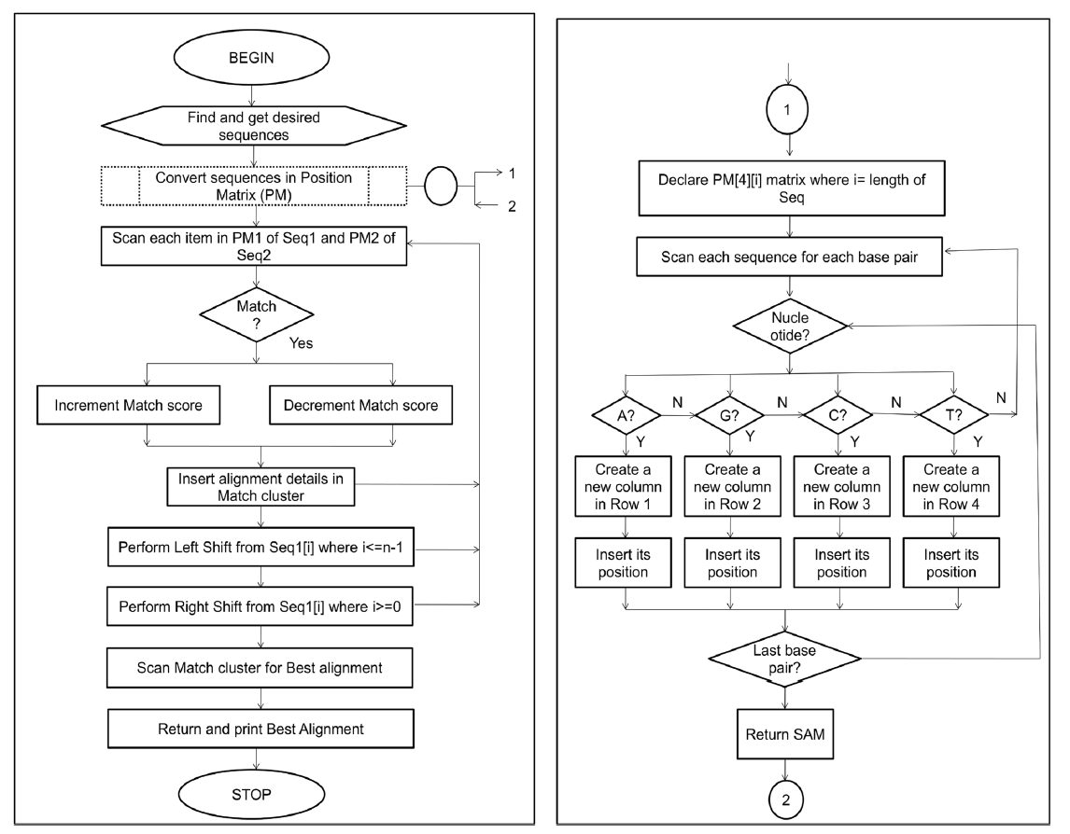

Slide 5
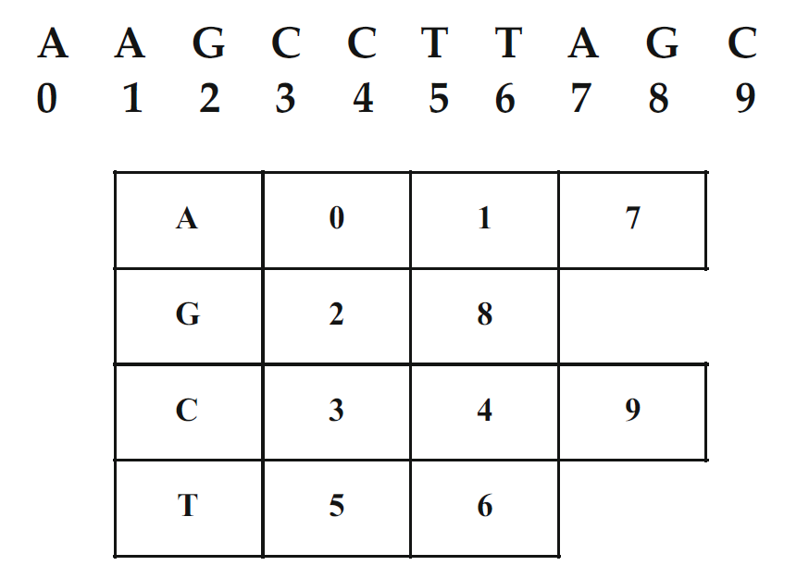
Position matrix

Slide 6
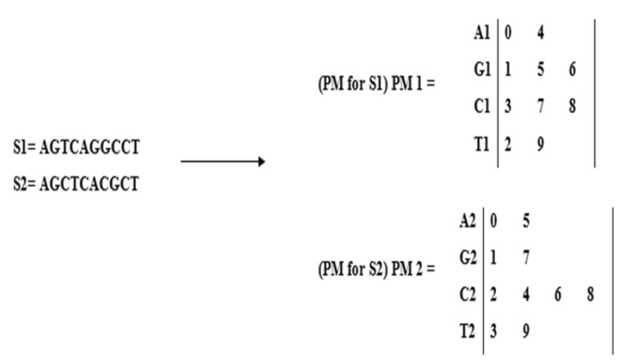

Slide 7
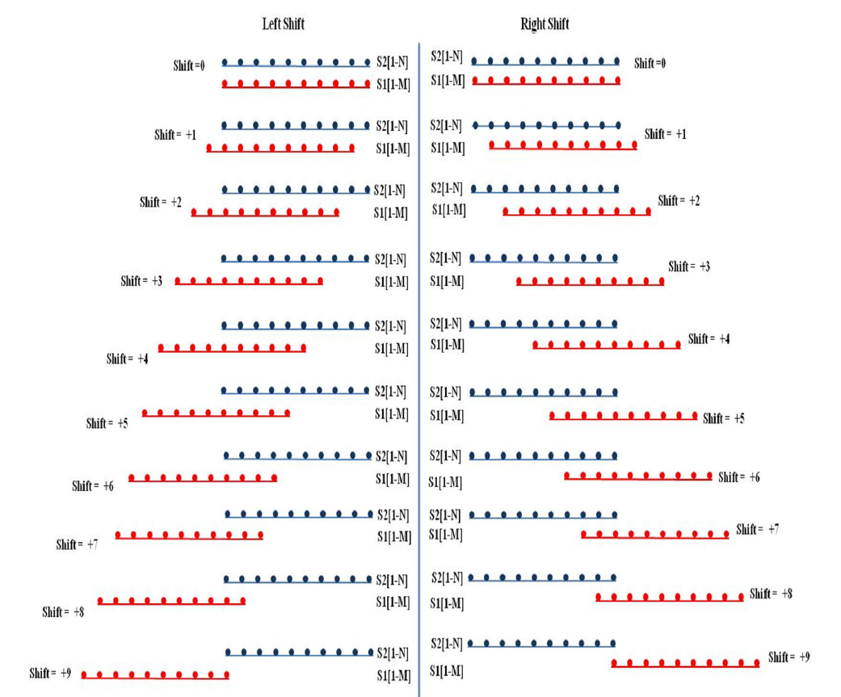

Slide 8
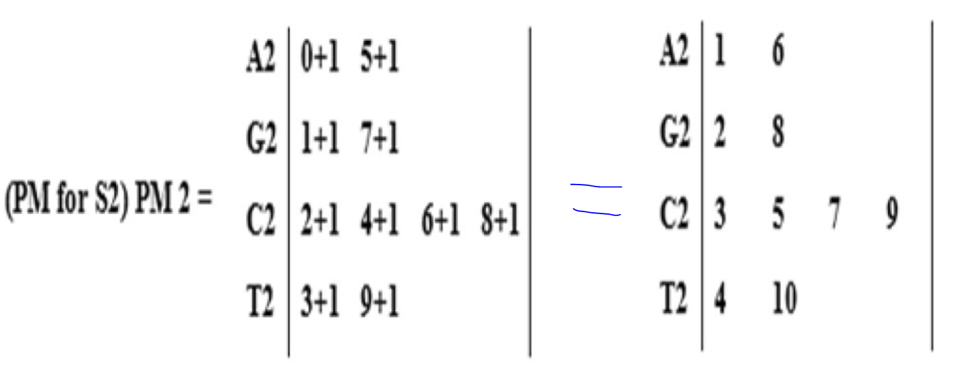
Shift based on position matrix

Slide 9
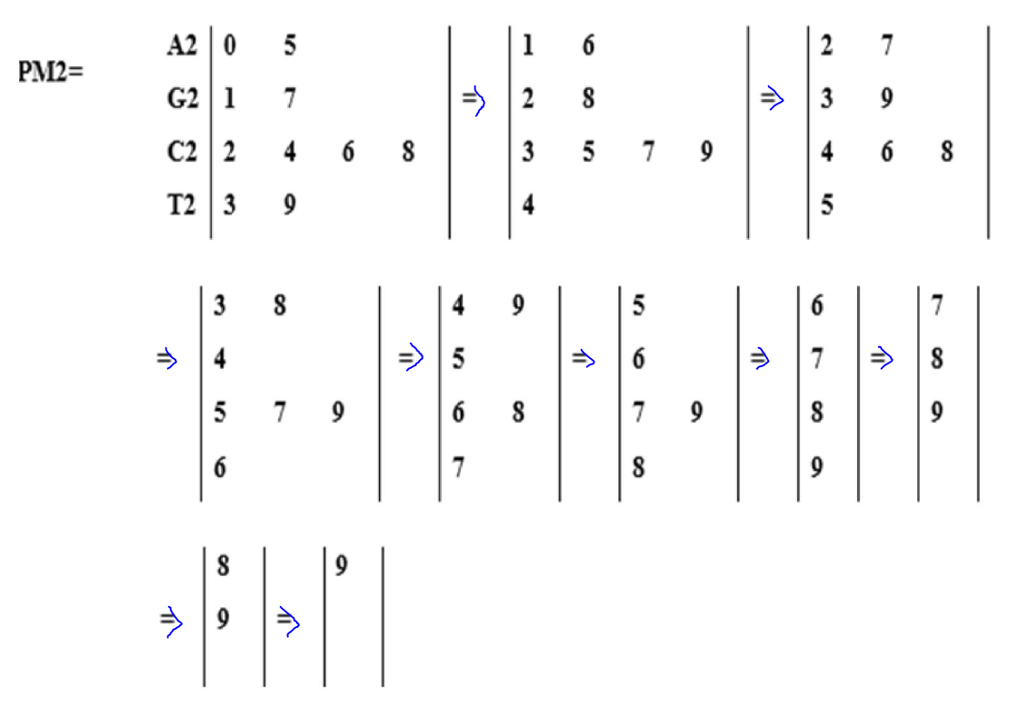

Slide 10
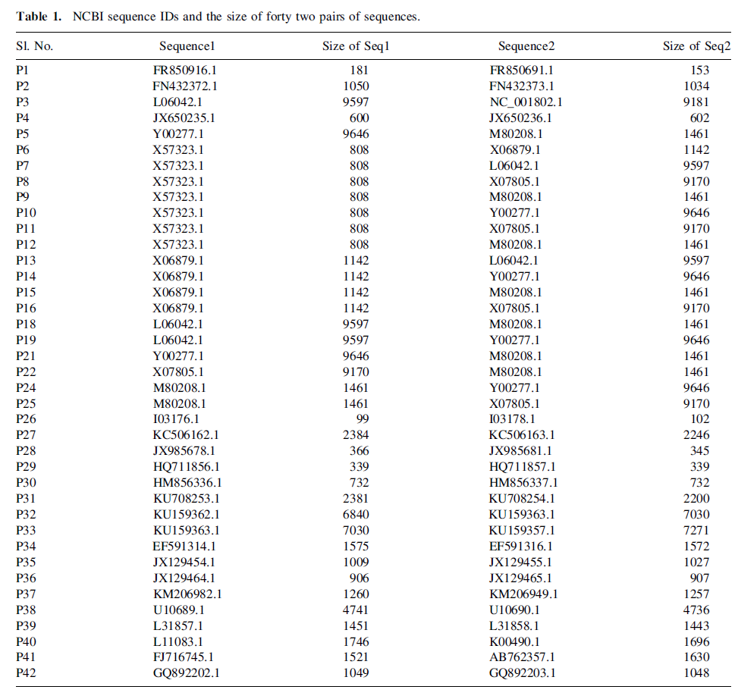

Slide 11
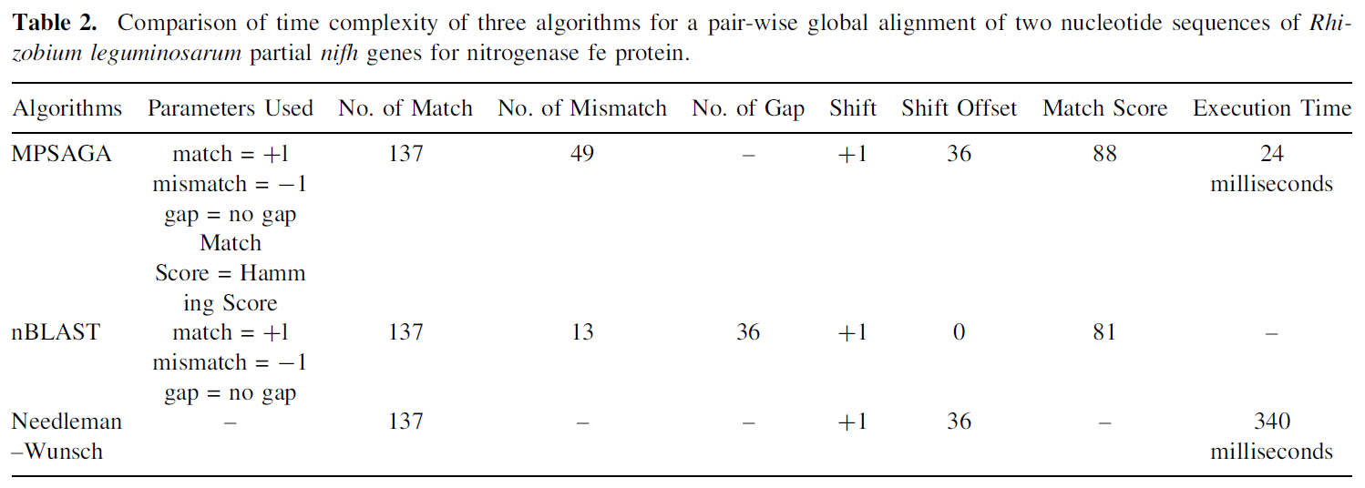

Slide 12
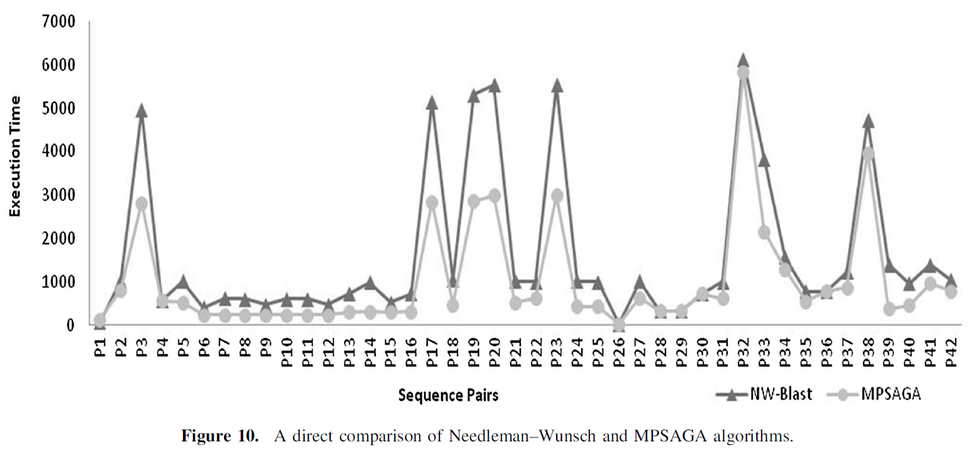

Slide 13
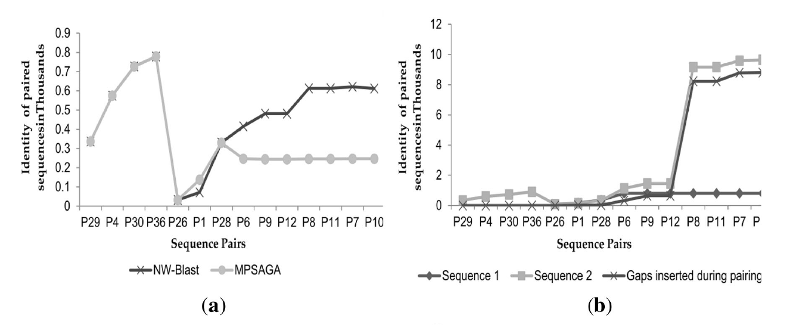

Slide 14
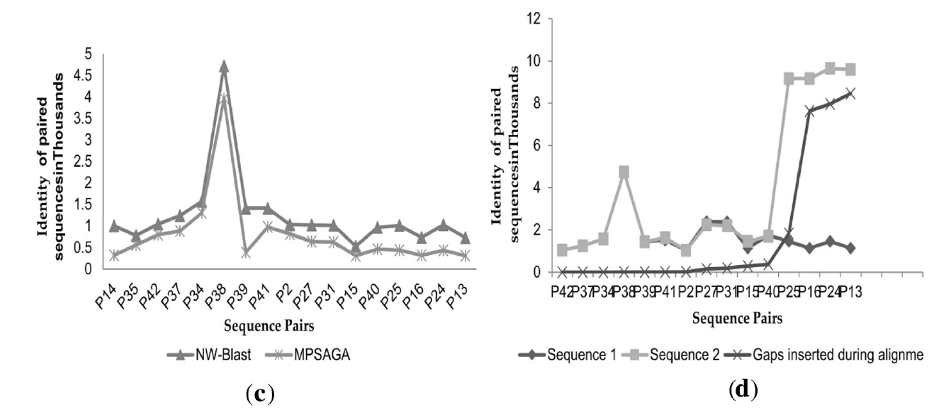

Slide 15
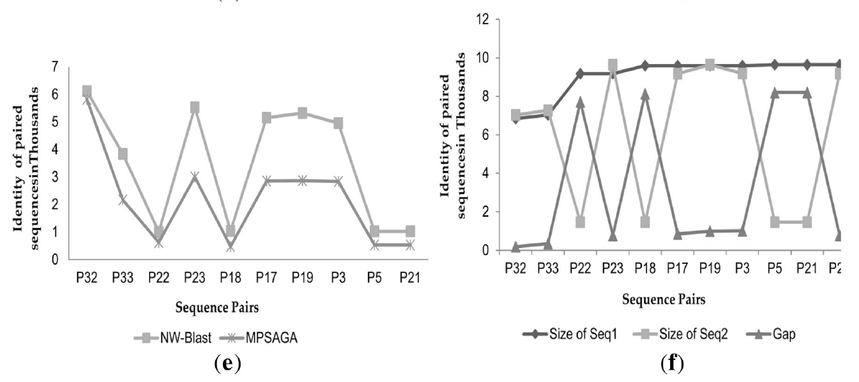

Slide 16
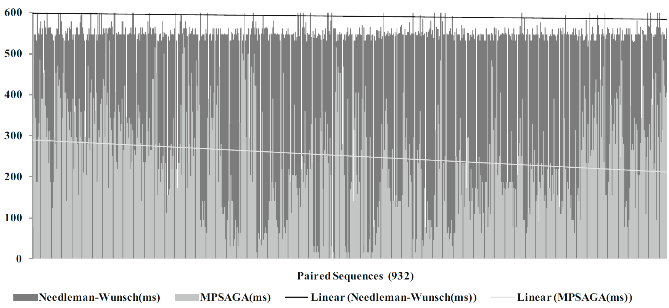

Slide 17
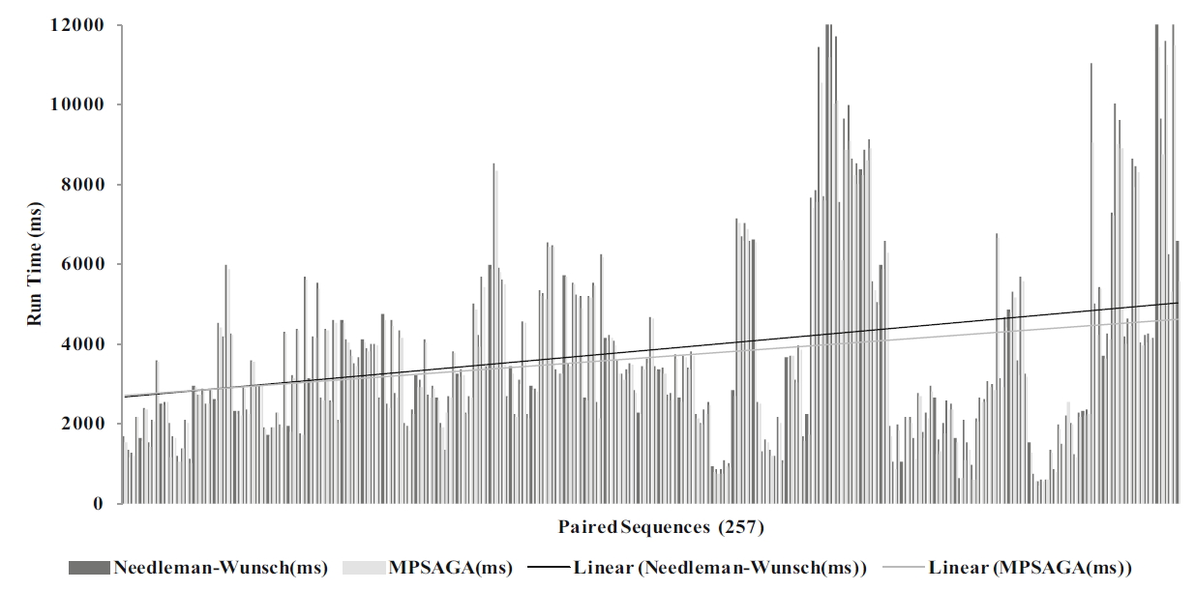

Slide 18
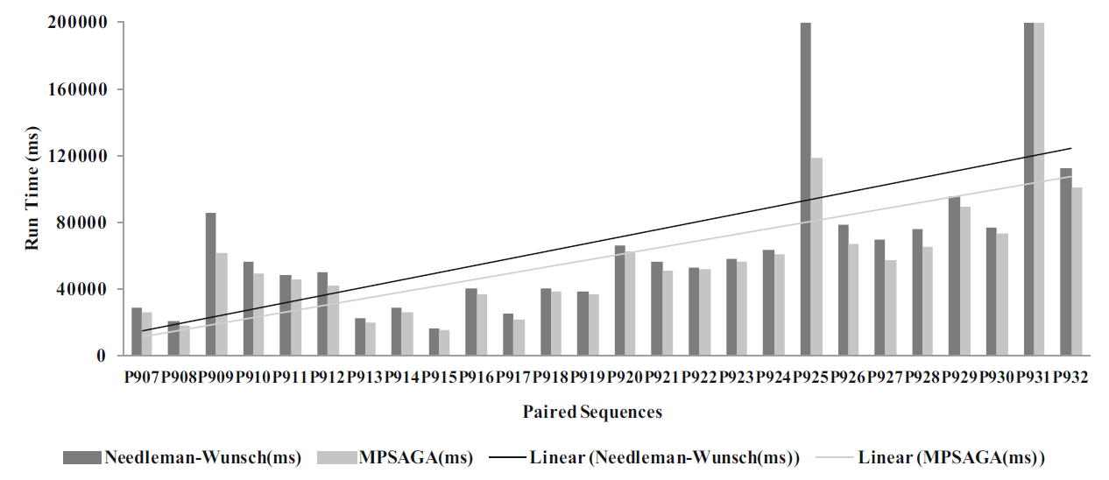

Slide 19
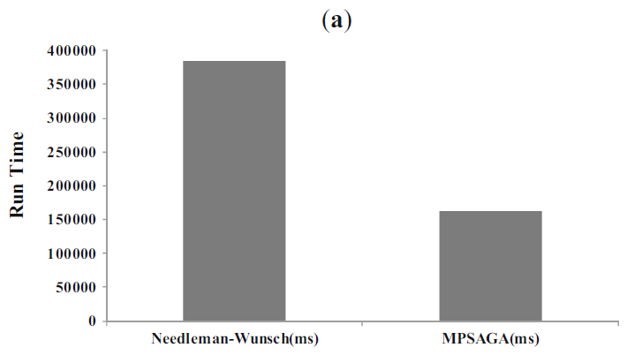
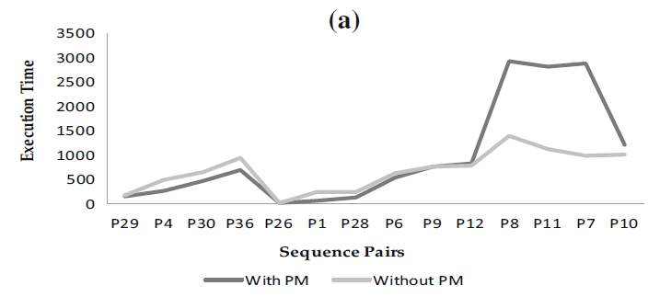

Slide 20
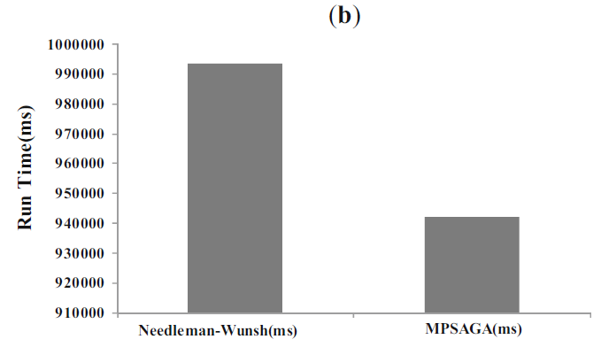
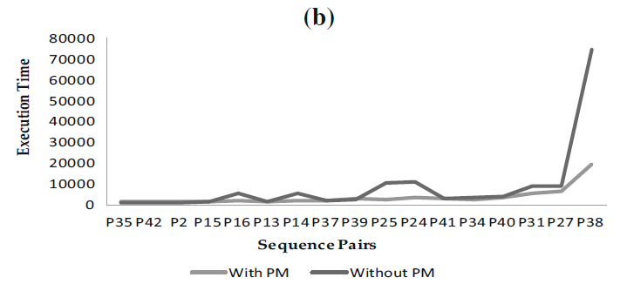

Slide 21
