Slide 1
Messy Genetic Algorithms: Motivation, Analysis, and First Results
David E. Goldberg, Bradley Korb, and Kalyanmoy Deb
Complex systems, 1989, Vol. 3, No. 5, pp.493-530.
Presenter : Tz-Hsu Lee
Date : Sep. 08, 2020.
Notes:
journal

Slide 2
Rapid, Accurate Optimization of Difficult Problems Using Fast Messy Genetic Algorithms
David E. Goldberg, Kalyanmoy Deb, Hillol Kargupta,
and Georges Harik
Proceedings of the 5th International Conference on Genetic Algorithms, 1993, pp.56-64.
Presenter : Tz-Hsu Lee
Date : Sep. 08, 2020.
Notes:
journal

Slide 3
Abstract(1/3)
Researchers have long sought genetic algorithms (GAs) that can solve difficult search, optimization, and machine learning problems quickly. Despite years of work on simple GAs and their variants it is still unknown how difficult a problem simple GAs can solve, how quickly they can solve it, and with what reliability. More radical design departures than these have been taken, however, and the messy GA(mGA) approach has attempted to solve problems of bounded difficulty quickly and reliably by taking the notion of building-block linkage quite seriously. Early efforts were apparently successful in achieving polynomial convergence on some difficult problems, but the initialization bottleneck that required a large initial population was thought to be the primary obstacle to faster mGA performance.

Slide 4
Abstract(2/3)
This paper replaces the partially enumerative initialization and selective primordial phase of the original messy GA with probabilistically complete initialization and a primordial phase that performs building-block filtering via selection and random gene deletion. In this way, the fast mGA is able to evaluate the best building blocks from modestly sized populations of longer strings, thereafter cutting down the string length by throwing off the genes of lesser importance. Design calculations are performed for population sizing, selection-deletion timing, and genic thresholding. On problems of bounded difficulty, ranging from 30-bits to 150-bits, the fast mGA finds global optima reliably in a time that both theoretically and empirically grows no more quickly than a subquadratic function of the number of decision variables.

Slide 5
Abstract(3/3)
The paper outlines the key remaining challenges and suggests extension of the technique to other-than-binary structures.

Slide 6

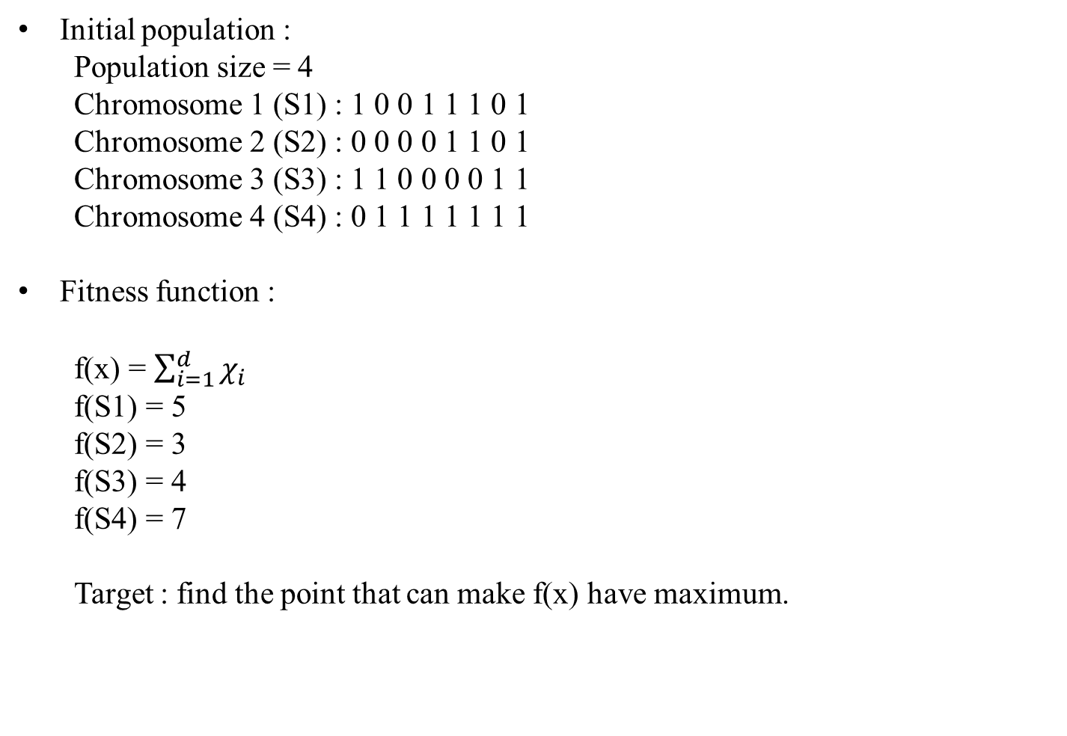
Genetic algorithm (GA) (1/3)
Initial population :
Population size = 4
Chromosome 1 (S1) : 1 0 0 1 1 1 0 1
Chromosome 2 (S2) : 0 0 0 0 1 1 0 1
Chromosome 3 (S3) : 1 1 0 0 0 0 1 1
Chromosome 4 (S4) : 0 1 1 1 1 1 1 1
Fitness function :
f(x) = $\sum_{i=1}^{d}{χ_{i}}$
f(S1) = 5
f(S2) = 3
f(S3) = 4
f(S4) = 7
Target : find the point that can make f(x) have maximum.

Slide 7
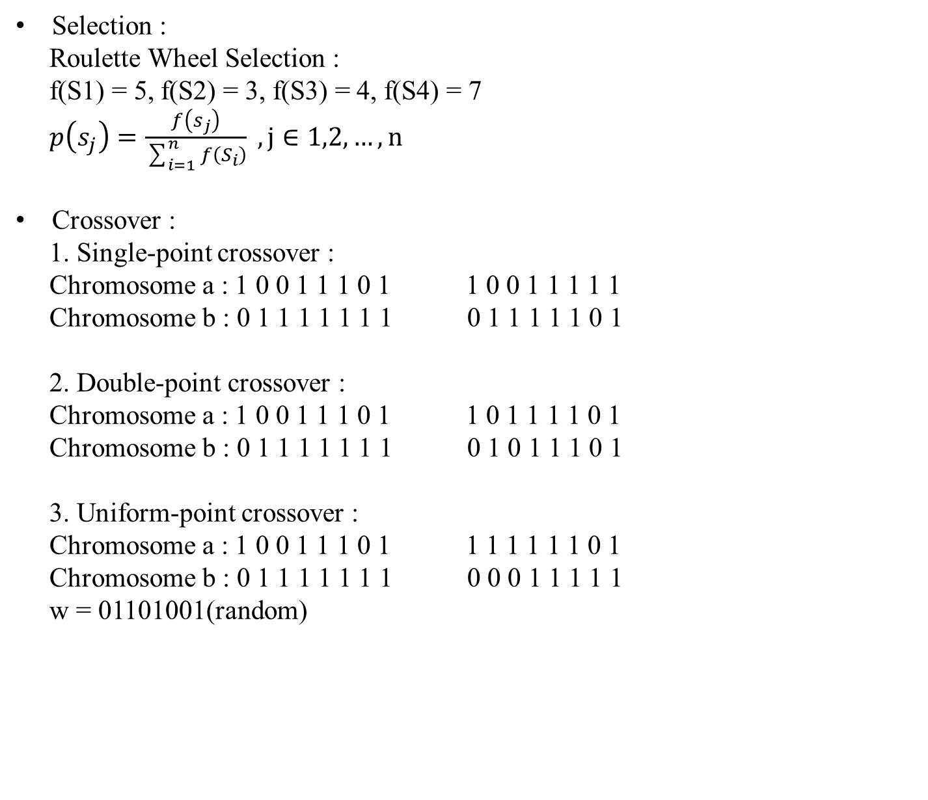
Genetic algorithm (GA) (2/3)
Selection :
Roulette Wheel Selection :
f(S1) = 5, f(S2) = 3, f(S3) = 4, f(S4) = 7
$p\left(s_{j}\right)=\frac{f\left(s_{j}\right)}{\sum_{i=1}^{n}{f\left(S_{i}\right)}} , j∈1,2,…,n$
Crossover :
1. Single-point crossover :
Chromosome a : 1 0 0 1 1 1 0 1 1 0 0 1 1 1 1 1
Chromosome b : 0 1 1 1 1 1 1 1 0 1 1 1 1 1 0 1
2. Double-point crossover :
Chromosome a : 1 0 0 1 1 1 0 1 1 0 1 1 1 1 0 1
Chromosome b : 0 1 1 1 1 1 1 1 0 1 0 1 1 1 0 1
3. Uniform-point crossover :
Chromosome a : 1 0 0 1 1 1 0 1 1 1 1 1 1 1 0 1
Chromosome b : 0 1 1 1 1 1 1 1 0 0 0 1 1 1 1 1
w = 01101001(random)

Slide 8

Genetic algorithm (GA) (3/3)
Mutation :
1. Simple mutation :
Chromosome a : 1 0 0 1 1 1 0 1 1 0 0 0 1 1 1 1
Chromosome b : 1 0 0 1 1 1 0 1 1 0 0 0 1 1 1 1
Chromosome c : 1 0 0 1 1 1 0 1 1 0 0 0 1 1 1 1 (change)
2. Uniform mutation :
x $:[0,3]$
Chromosome a : 1 3 0 2 2 1 1 0 1 3 2 2 2 2 1 3 (random)

Slide 9
Messy genetic algorithm (MGA) (1/4)
Deceptive Problem :
S0 : 1 1 1 1 1 1 1 1 1 1 1 S3 : 1 1 1 * * * * * * 1 1
S1 : 1 1 1 * * * * * * * * S4 : 0 0 0 * * * * * * 0 0
S2 : * * * * * * * * * 1 1 S5 : 0 0 0 1 1 1 1 1 1 0 0
fitness(S1) > avg(fitness), fitness(S2) > avg(fitness)
crossover(S1,S2) => S3
fitness(S3) < fitness(S4)
if S0 is the best solution, then GA will converge to S5 not S0.
Destroy good building blocks :
1 * * * * * * * 1 : good building blocks
Chromosome a : 1 0 0 0 0 0 0 0 1 1 0 0 0 0 0 0 0 0
Chromosome b : 0 0 0 0 0 0 0 0 0 0 0 0 0 0 0 0 0 1

Slide 10
Messy genetic algorithm (MGA) (2/4)
Messy chromosome representation :
1. under specification :
Messy chromosome : (3,0) (1,1) (5,0) (7,1)
Actual chromosome : 1 0 0 1 0 0 1 1 1
Template chromosome : 1 0 1 1 1 0 0 1 1
2. over specification :
Messy chromosome : (3,0)(1,1)(3,1)(7,1)(5,0)(4,1)(8,0)(9,1)(6,0)(2,1)(5,1)
Actual chromosome : 1 1 0 1 0 0 1 0 1

Slide 11
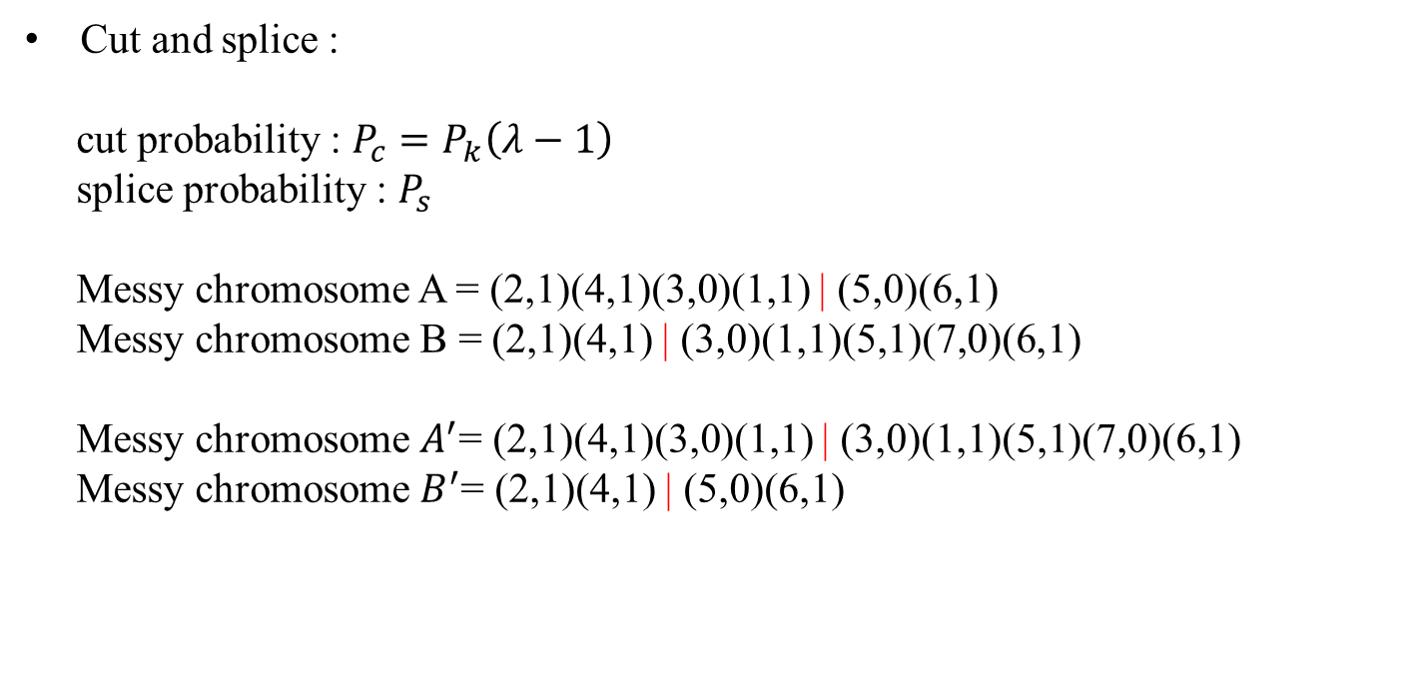
Messy genetic algorithm (MGA) (3/4)
Cut and splice :
cut probability : $P_{c}=P_{k}\left(λ−1\right)$
splice probability : $P_{s}$
Messy chromosome A = (2,1)(4,1)(3,0)(1,1) | (5,0)(6,1)
Messy chromosome B = (2,1)(4,1) | (3,0)(1,1)(5,1)(7,0)(6,1)
Messy chromosome $A^{′}$= (2,1)(4,1)(3,0)(1,1) | (3,0)(1,1)(5,1)(7,0)(6,1)
Messy chromosome $B^{′}$= (2,1)(4,1) | (5,0)(6,1)

Slide 12
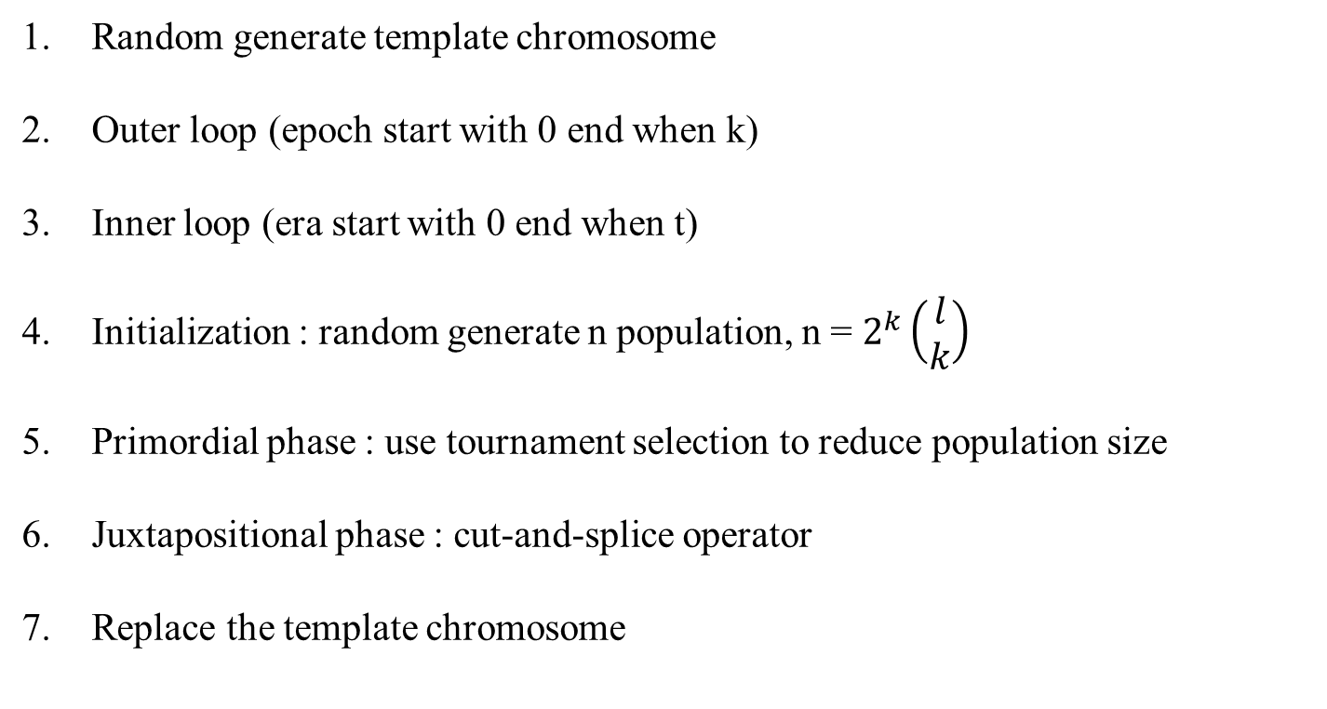
Messy genetic algorithm (MGA) (4/4)
Random generate template chromosome
Outer loop (epoch start with 0 end when k)
Inner loop (era start with 0 end when t)
Initialization : random generate n population, n = $2^{k}\left(\begin{matrix}l \\ k\end{matrix}\right)$
Primordial phase : use tournament selection to reduce population size
Juxtapositional phase : cut-and-splice operator
Replace the template chromosome

Slide 13
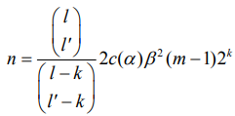

Fast Messy genetic algorithm (FMGA) (1/3)
Time complexity :
Initialization : $O\left(l^{k}\right)$
Primordial : 0
Juxtapositional : $O\left(l\log{l}\right)$
Total : $O\left(l^{k}\right)$
Modifications :
1. Initialization :
Probabilistically complete initialization :

Slide 14
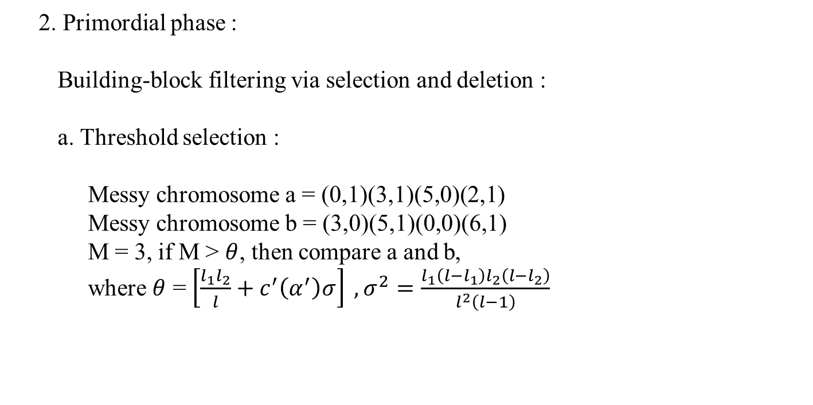
Fast Messy genetic algorithm (FMGA) (2/3)
2. Primordial phase :
Building-block filtering via selection and deletion :
a. Threshold selection :
Messy chromosome a = (0,1)(3,1)(5,0)(2,1)
Messy chromosome b = (3,0)(5,1)(0,0)(6,1)
M = 3, if M > $θ$, then compare a and b,
where $θ$ = $\left[\frac{l_{1}l_{2}}{l}+c^{′}\left(α^{′}\right)σ\right] ,σ^{2}=\frac{l_{1}\left(l−l_{1}\right)l_{2}\left(l−l_{2}\right)}{l^{2}\left(l−1\right)}$

Slide 15
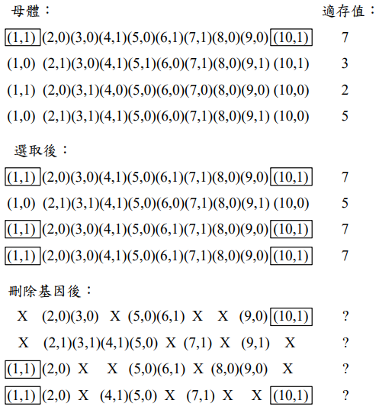
Fast Messy genetic algorithm (FMGA) (3/3)
b. Deletion :

Slide 16
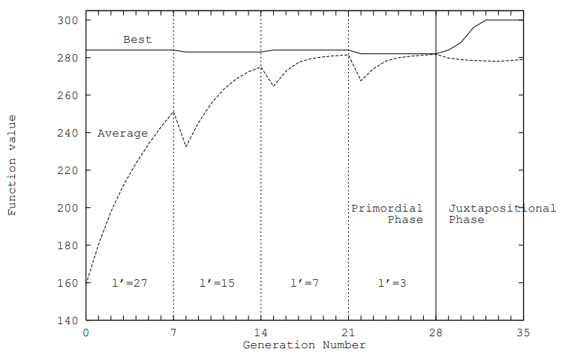
Results(1/2)

Slide 17
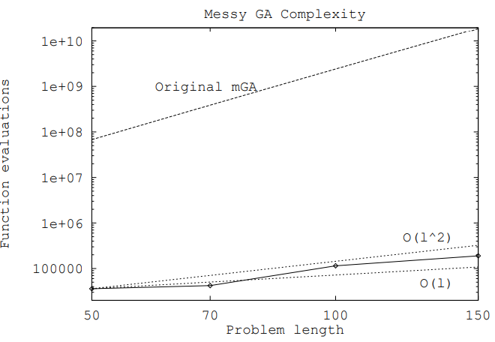
Results(2/2)

