Slide 1
Linear Time Algorithms for Generalizations of the Longest Common Substring Problem
Michael Arnold, Enno Ohlebusch
Algorithmica (2011) 60: 806–818
Presenter: En-An Song
Date: Sept 8, 2020

Slide 2
Abstract(1/2)
In its simplest form, the longest common substring problem is to find a longest substring common to two or multiple strings. Using (generalized) suffix trees, this problem can be solved in linear time and space.
A first generalization is the k-common substring problem: Given m strings of total length n, for all k with 2 ≤ k ≤ m simultaneously find a longest substring common to at least k of the strings. It is known that the k-common substring problem can also be solved in O(n) time.

Slide 3
Abstract(2/2)
A further generalization is the k-common repeated substring problem: Given m strings T⁽¹⁾ ,T⁽²⁾ ,...,T^{(m)} of total length n and m positive integers x₁,...,x_{m}, for all k with 1 ≤ k ≤ m simultaneously find a longest string ω for which there are at least k strings T^{(i1)} ,T^{(i2)} ,...,T^{(ik)} (1 ≤ i₁ < i₂ < ··· < i_{k} ≤ m) such that ω occurs at least x_{ij} times in T^{(ij)} for each j with 1 ≤ j ≤ k. (For x₁ =···= x_{m} = 1, we have the k-common substring problem.) In this paper, we present the first O(n) time algorithm for the k-common repeated substring problem. Our solution is based on a new linear time algorithm for the k-common substring problem.

Slide 4
Longest common substring
T₁ : acacc
T₂ : accaa
T₁ T₂ Longest common substring
T₁
T₂
a | c | a | c | c
a | c | c | a | a

Slide 5
k-common substring problem
T₁ : acac
T₂ : aac
T₃ : caac
2-common substring :
T₂ :
T₃ :
3-common substring :
T₁ :
T₂ :
T₃ :
a | a | c
c | a | a | c
a | c | a | c
a | a | c
c | a | a | c

Slide 6
k-common repeated substring problem
T₁ : acac , x₁= 2
T₂ : acccac , x₂= 2
T₃ : caaac , x₃= 1
2-common repeated substring :
T₁ :
T₂ :
3-common repeated substring :
T₁ :
T₂ :
T₃ :
a | c | a | c
a | c | c | c | a | c
a | c | a | c
a | c | c | c | a | c
c | a | a | a | c

Slide 7
Longest common prefix
Lexicographic ordering
T₁ : acacac
LCP[1] = 0
T₂ : accc
LCP[2] = 2 , T₁ : acacac , T₂ : accc
T₃ : accdac
LCP[3] = 3 , T₂ : accc , T₃ : accdac
T₄ : accdad
LCP[4] = 4 , T₃ : accdac , T₄ : accdad

Slide 8
Longest common prefix
LCP[i] : T_{i} and T_{i-1} longest common prefix
T₁
a | c | a | c | a | c
LCP[1] = 0
T₂
a | c | c | c
LCP[2] = 2
T₃
a | c | c | d | a | c
LCP[3] = 3
T₄
a | c | c | d | a | d
LCP[4] = 4
longest common prefix between T₁ … T₃ min{ LCP[2] = 2 , LCP[3] = 3} = 2
Finding longest common prefix between T_{i}….T_{j}
min{LCP[i+1],LCP[i+2]….LCP[j]}

Slide 9
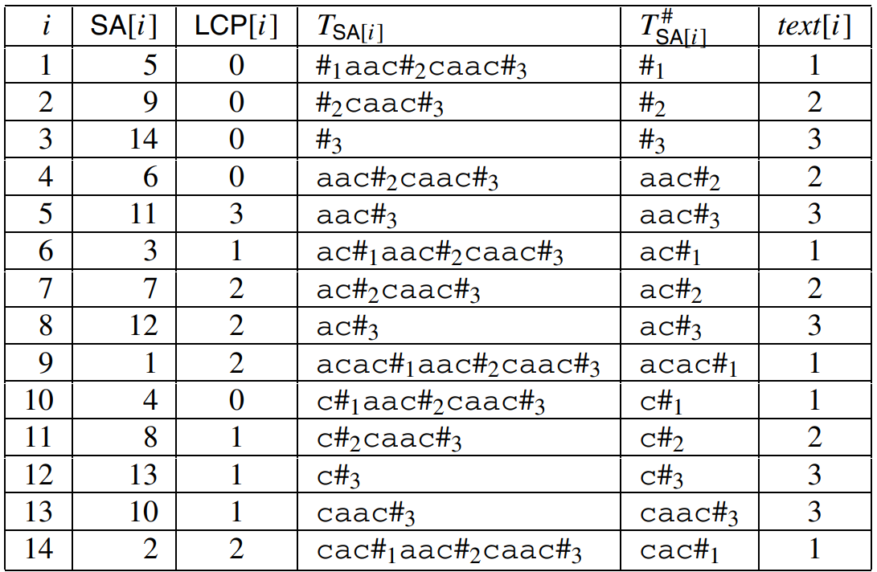
k-common substring problem
T₁ = acac , T₂ = aac , T₃ = caac
T = acac#₁aac#₂caac#₃
Suffix array :
SA[1] = acac#₁aac#₂caac#₃
SA[2] = cac#₁aac#₂caac#₃
SA[3] = ac#₁aac#₂caac#₃
SA[4] = c#₁aac#₂caac#₃
…
SA[14] = #₃

Slide 10
k-common substring problem
a | c | a | c
a | a | c
c | a | a | c
p
RMQ(LCP[p+1]….LCP[q]) = 2
q
Notes:
假設我要計算3-common substring problem,最簡單的方法就是找到一個區間p,q，且區間內的text必須包含text[i]=1 2 3，接著我計算RMQ(LCP[p+1]….LCP[q]),依序計算就可以找到3-common substring 的最大值了。

Slide 11
k-common substring problem
1
0
2
0
3
1
1 | 2 | 3
k = 3 : SA[1] SA[2] SA[3] ‘s LCP = 0
k = 2 : SA[2] SA[3] ‘s LCP = 0
k | 2 | 3
lcs | 0 | 0

Slide 12
k-common substring problem
T₁ T₃ T₄ Longest common prefix
= min{LCP[2],LCP[3],LCP[4]}
= min{ min{LCP[2],LCP[3]} , LCP[4]}}
1
0
2
0
3
1
1
0
2
0
3
0
4
9
1 | 2 | 3
1 | 2 | 3
k = 3 : SA[1] SA[3] SA[4] ‘s LCP = min{0,0} = 0
k = 2 : SA[3] SA[4] ‘s LCP = min{1,0} = 0
k | 2 | 3
lcs | 0 | 0

Slide 13
k-common substring problem
1
0
3
0
4
9
1
0
3
0
4
3
5
4
1 | 2 | 3
1 | 2 | 3
k = 3 : SA[1] SA[4] SA[5] ‘s LCP = min{0,4} = 0
k = 2 : SA[4] SA[5] ‘s LCP = min{6,3} = 3
k | 2 | 3
lcs | 3 | 0

Slide 14
k-common substring problem
1
0
4
3
5
4
1
0
4
1
5
1
6
12
1 | 2 | 3
1 | 2 | 3
k = 3 : SA[4] SA[5] SA[6] ‘s LCP = min{0,1} = 0
k = 2 : SA[5] SA[6] ‘s LCP = min{6,1} = 1
k | 2 | 3
lcs | 3 | 1

Slide 15
k-common substring problem
4
1
5
1
6
12
4
1
5
1
6
2
7
8
1 | 2 | 3
1 | 2 | 3
k = 3 : SA[5] SA[6] SA[7] ‘s LCP = min{1,2} = 1
k = 2 : SA[6] SA[7] ‘s LCP = min{12,2} = 2
k | 2 | 3
lcs | 3 | 1

Slide 16
k-common substring problem
5
1
6
2
7
8
5
1
6
2
7
2
8
3
1 | 2 | 3
1 | 2 | 3
k = 3 : SA[5] SA[7] SA[8] ‘s LCP = min{1,2} = 0
k = 2 : SA[7] SA[8] ‘s LCP = min{2,3} = 2
k | 2 | 3
lcs | 3 | 1

Slide 17
k-common substring problem
5
1
7
2
8
3
5
1
7
2
8
2
9
14
1 | 2 | 3
1 | 2 | 3
k = 3 : SA[7] SA[8] SA[9] ‘s LCP = min{2,2} = 2
k = 2 : SA[8] SA[9] ‘s LCP = min{2,3} = 2
k | 2 | 3
lcs | 3 | 2

Slide 18
k-common substring problem
7
2
8
2
9
14
7
0
8
0
9
14
10
11
1 | 2 | 3
1 | 2 | 3
k = 3 : SA[7] SA[8] SA[10] ‘s LCP = min{2,0} = 0
k = 2 : SA[8] SA[10] ‘s LCP = min{2,0} = 0
k | 2 | 3
lcs | 3 | 2

Slide 19
k-common substring problem
7
0
8
0
10
11
7
0
8
0
10
1
11
7
1 | 2 | 3
1 | 2 | 3
k = 3 : SA[8] SA[10] SA[11] ‘s LCP = min{0,1} = 0
k = 2 : SA[10] SA[11] ‘s LCP = min{1,1} =1
k | 2 | 3
lcs | 3 | 2

Slide 20
k-common substring problem
8
0
10
1
11
7
8
0
10
1
11
1
12
2
1 | 2 | 3
1 | 2 | 3
k = 3 : SA[10] SA[11] SA[12] ‘s LCP = min{1,1} = 1
k = 2 : SA[11] SA[12] ‘s LCP = min{7,1} =1
k | 2 | 3
lcs | 3 | 2

Slide 21
k-common substring problem
10
1
11
1
12
2
10
1
11
1
12
2
13
5
1 | 2 | 3
1 | 2 | 3
k = 3 : SA[10] SA[11] SA[13] ‘s LCP = min{1,1} = 1
k = 2 : SA[11] SA[13] ‘s LCP = min{1,1} =1
k | 2 | 3
lcs | 3 | 2

Slide 22
k-common substring problem
10
1
11
1
13
2
10
1
11
1
13
2
14
13
1 | 2 | 3
1 | 2 | 3
k = 3 : SA[11] SA[13] SA[14] ‘s LCP = min{1,2} = 1
k = 2 : SA[13] SA[14] ‘s LCP = min{2,2} =2
k | 2 | 3
lcs | 3 | 2

Slide 23

Time complexity : k-common substring problem
O(m*n)
m : string 的數量
n : $\sum_{i=1}^{m}{|Ti|}$

Slide 24
Improve k-common substring problem
a
1
b
1
c
2
d
2
e
3
intptr
1 | 2 | 3 | 4 | 5 | …
a | b
1
c | d
2
e
3
1 | 2 | 3 | 4 | 5
textptr
1 | 2 | 3 | 4 | 5

Slide 25
Improve k-common substring problem
intptr
0 | 1 | 2 | 3 | 4 | …
intptr
0 | 1 | 2 | 3 | 4 | …
a | b
0
c | d
1
e
4
f
10
a
0
c | d
0
e
0
f
10
textptr
1 | 2 | 3 | 4 | 5
textptr
1 | 2 | 3 | 4 | 5
LCP(SA[e],SA[f]) = 0

Slide 26
Improve k-common substring problem
intptr
0 | 1 | 2 | 3 | 4 | …
a
0
c | d
e
f
10
textptr
1 | 2 | 3 | 4 | 5

Slide 27
Time complexity : Improve k-common substring problem
每個Interval最多只會被生成以及被merge一次，所以至多執行2n次，因此時間複雜度為O(n)
intptr
0 | 1 | 2 | 3 | 4 | …
a
0
c | d
0
e
0
f
10
textptr
1 | 2 | 3 | 4 | 5

Slide 28
k-common repeated substring problem
ω is longest common substring with T₁ T₂ T₃
x₁ = 2 , T₁中的 ω 需要出現2次
x₂ = 2 , T₂中的 ω 需要出現2次
x₃ = 1 , T₃中的 ω 需要出現1次
T₁ : acac
T₂ : acccac
T₃ : caaac
a | c | a | c
a | c | c | c | a | c
a | c | c | c | a
a
2
b
c
d
e
1 | 2 | 3
Time complexity : k-common repeated substring problem : O(n)

