Slide 1
Performance Effective Task Scheduling Algorithm for Heterogeneous Computing System
Ilavarasan, Thambidurai and Mahilmannan
Proceedings of the 4th International Symposium on Parallel and Distributed Computing, 4-6 July 2005, Lille, France
Presenter : Chih-Kai Wu
Date: Sep.8, 2020.
Notes:
里耳（法語：Lille，法語發音：[lil]），法國北部城市，上法蘭西大區諾爾省的一個市鎮，同時也是大區首府及該省的省會，下轄里耳區[1]，其市鎮面積為34.83平方公里，2017年1月1日時人口數量為232,787人，是該省及該大區人口最多的市鎮，在所有法國城市中排名第10位。此外，里耳與相鄰的魯貝、圖爾寬及阿斯克新城等所在共同組成了人口超過百萬的公共社區，並已於2015年升級成為都會區。
里耳位於法國北部，距離比利時邊境大約10公里，多條高速公路和鐵路在此交匯，是法國、英國和比利時三國之間的陸上交通樞紐，亦是法國境內巴黎以北最大的城市[2]。里耳自中世紀起建城，近代為重要的邊塞及工業中心，現代則成為一座綜合性的工商業中心。里耳在國際合作中獲得了較大的發展，當地依託高鐵站所建立的Euralille街區已成為法國最大的綜合性商務區之一，2008年1月28日，里耳-科特賴克-圖爾奈歐洲都會區成立，成為歐洲最大的跨國區域合作組織之一。

Slide 2
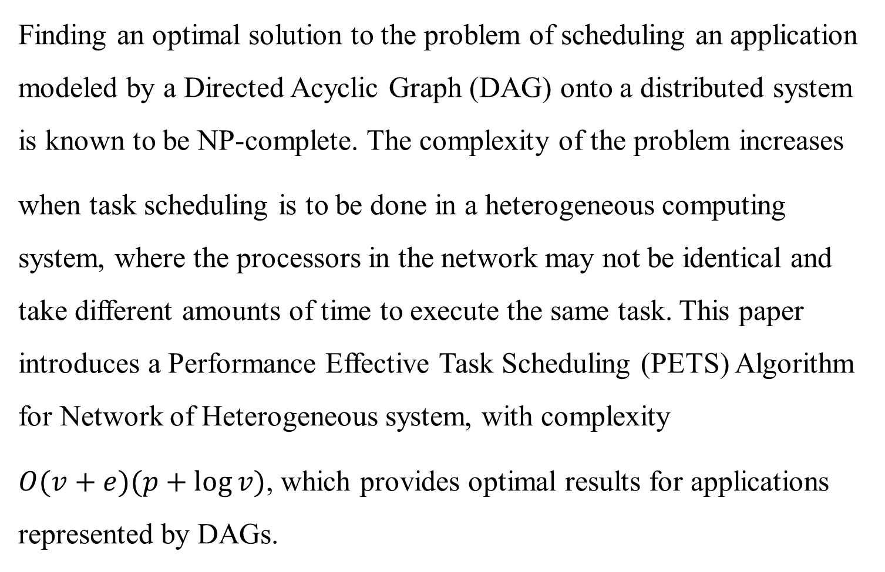
Abstract (1/2)
Finding an optimal solution to the problem of scheduling an application modeled by a Directed Acyclic Graph (DAG) onto a distributed system is known to be NP-complete. The complexity of the problem increases
when task scheduling is to be done in a heterogeneous computing system, where the processors in the network may not be identical and take different amounts of time to execute the same task. This paper introduces a Performance Effective Task Scheduling (PETS) Algorithm for Network of Heterogeneous system, with complexity
$O(v+e)(p+\log{v})$, which provides optimal results for applications represented by DAGs.

Slide 3
Abstract (2/2)
The performance of the algorithm is illustrated by comparing the schedule length, speedup, efficiency and the scheduling time with existing algorithms such as, Heterogeneous Earliest Finish Time (HEFT) and Critical-Path On a processor (CPOP) and Levelized Min Time (LMT) reported in this paper. The comparison study based on both randomly generated graphs and graphs of some real applications shows that PETS algorithm substantially outperforms existing algorithms.

Slide 4
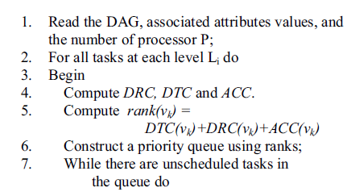
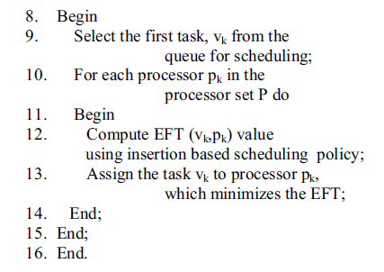
Performance Effective Task Scheduling (PETS) Algorithm

Slide 5

$$DTC\left(v_{i}\right)=\sum_{i=1}^{x}{C_{i,j}}$$
$DRC\left(v_{i}\right)=Max\left\{rank(v_{j})\right\}$ , where $v_{j}$ is the predecessor of $v_{i}$
$$ACC\left(v_{i}\right)=\frac{\sum_{j=1}^{m}{W_{i,j}}}{m}$$

Slide 6
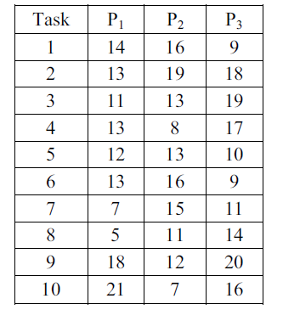
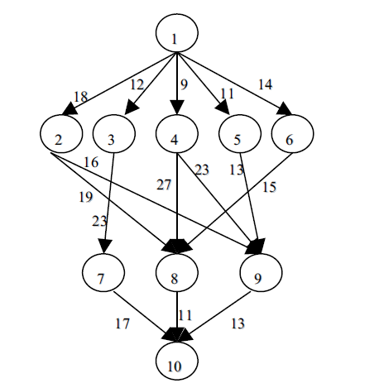
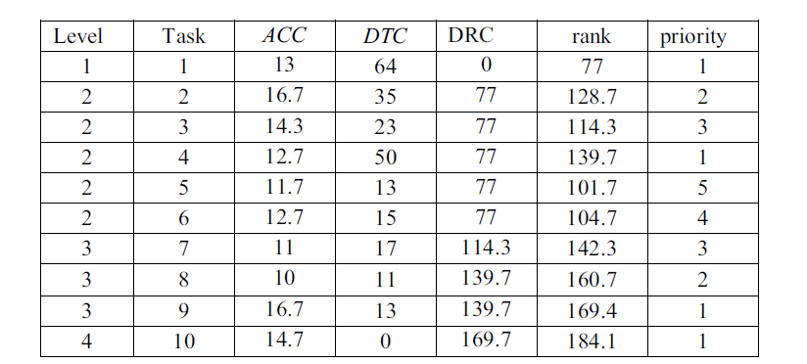

Slide 7

$EST\left(v_{i},p_{j}\right)=Max\left\{avail\left[j\right],max⁡(AFT\left(v_{t}+C_{t,i}\right))\right\}$
where $v_{t}∈pred(v_{i})$
$$EFT\left(v_{i},p_{j}\right)=W_{i,j}+EST\left(v_{i},p_{j}\right)$$

Slide 8
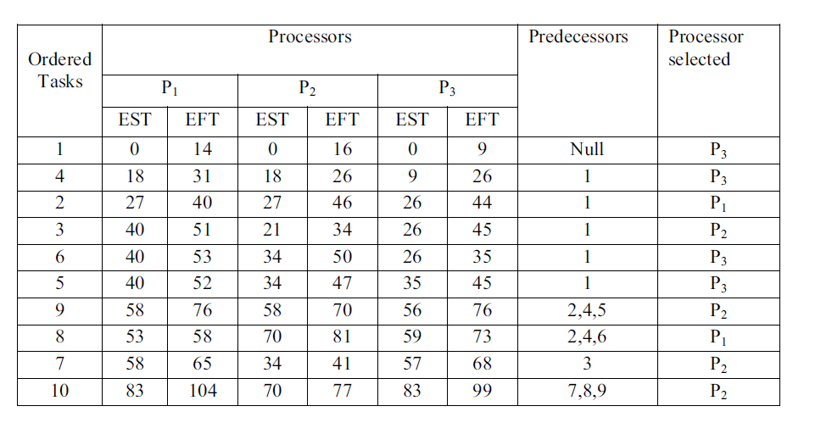
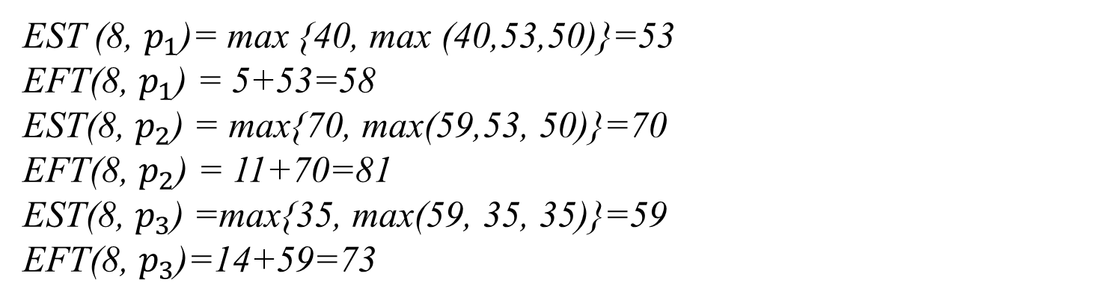
EST (8, $p_{1}$)= max {40, max (40,53,50)}=53
EFT(8, $p_{1}$) = 5+53=58
EST(8, $p_{2}$) = max{70, max(59,53, 50)}=70
EFT(8, $p_{2}$) = 11+70=81
EST(8, $p_{3}$) =max{35, max(59, 35, 35)}=59
EFT(8, $p_{3}$)=14+59=73

Slide 9
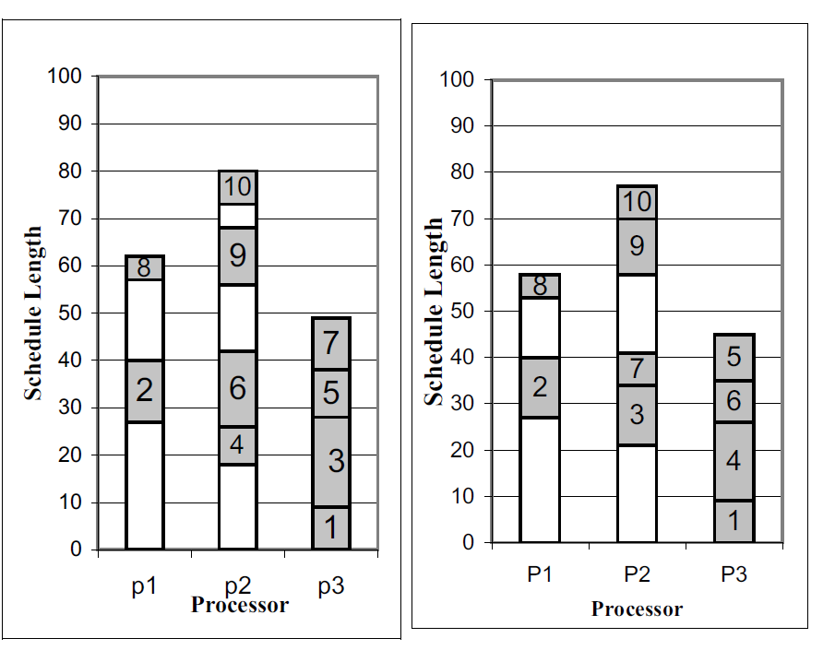
HEFT task順序為1,3,4,2,5,6,9,7,8,10
PETS task順序為1,4,2,3,6,5,9,8,7,10

Slide 10
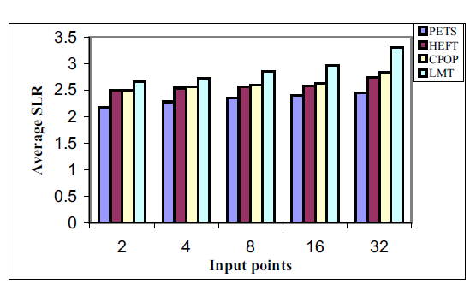
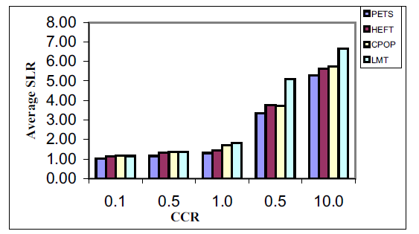

HEFT$O\left(n^{2}∗p\right)$ PETS$O(v+e)(p+\log{v})$

