Slide 1
Prediction of siRNA functionality using generalized string kernel and support vector machine
Reiji Teramoto, Mikio Aoki, Toru Kimura, Masaharu Kanaoka
FEBS(Federation of European Biochemical Societies ) Letters 579 (2005) 2878–2882
Presenter: Chu-Kai Liu
Date: Nov. 10, 2009

Slide 2
Abstract (1/2)
Small interfering RNAs (siRNAs) are becoming widely used for sequence-specific gene silencing in mammalian cells, but designing an effective siRNA is still a challenging task. In this study, we developed an algorithm for predicting siRNA functionality by using generalized string kernel (GSK) combined with support vector machine (SVM).

Slide 3
Abstract (2/2)
With GSK, siRNA sequences were represented as vectors in a multi-dimensional feature space according to the numbers of subsequences in each siRNA, and subsequently classified with SVM into effective or ineffective siRNAs. We applied this algorithm to published siRNAs, and could classify effective and ineffective siRNAs with 90.6%, 86.2% accuracy, respectively.

Slide 4
1. SiRNAs(1/3)
Small interfering RNA (siRNA), sometimes known as short interfering RNA or silencing RNA, is a class of double-stranded RNA molecules, 20-25 nucleotides in length, that play a variety of roles in biology. Most notably, siRNA is involved in the RNA interference (RNAi) pathway, where it interferes with the expression of a specific gene. In addition to their role in the RNAi pathway, siRNAs also act in RNAi-related pathways, e.g., as an antiviral mechanism or in shaping the chromatin structure of a genome.

Slide 5
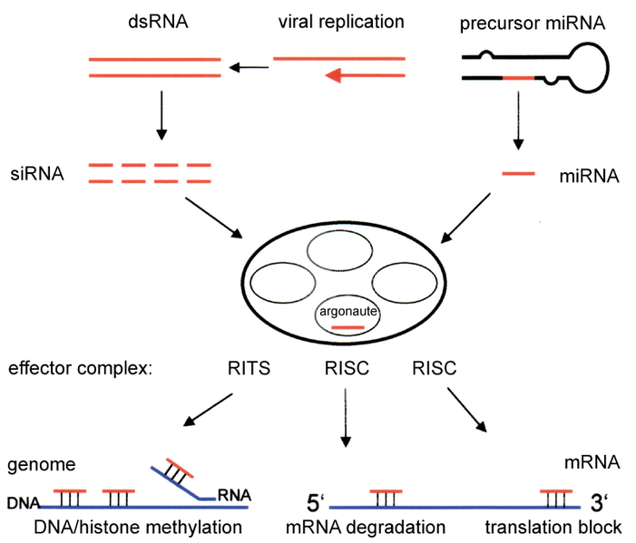
1. SiRNAs(2/3)

Slide 6
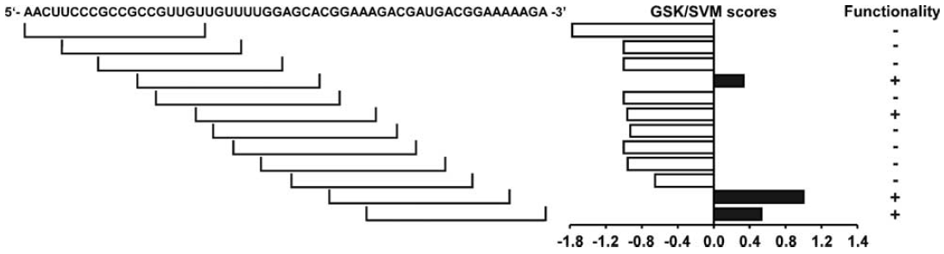
1. SiRNAs(3/3)
Relationship between luciferase siRNA sequence and GSK/SVMscores.

Slide 7
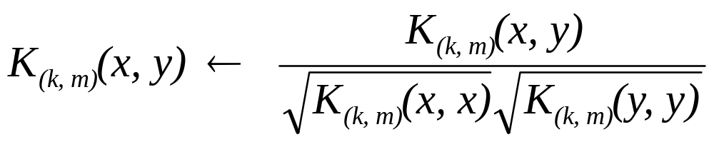
2. Mismatch string kernel(1/2)
The (k, m)-mismatch string kernel ((k, m)-MSK) maps feature space generated by shared occurrences of fixed k-length subsequences differing by at most m mismatches. For a sequence x of a given length, we define the feature vectors for all the k-mer as Ф_{(k, m)}(x).
K_{(k, m)}(x, y) = {Ф_{(k, m)}(x), Ф_{(k, m)}(y).}
For normalization:

Slide 8
2. Mismatch string kernel(2/2)
Example:
A = {C, G}, k-mer = 3, m = 1.
[CCC, CCG, CGC, CGG, GCC, GCG, GGC, GGG]
CCGC=[ 0, 1, 1, 0, 0, 0, 0, 0 ]
GCCC=[ 1, 0, 0, 0, 1, 0, 0, 0 ]
mCCGC=[1+1, 1, 1, 1+1, 0, 1, 1, 0 ]
mGCCC=[1+1, 1, 1, 0, 1+1, 1, 1, 0 ]
mismatch CCGC = {(_CG, C_G, CC_), (_GC, C_C, CG_) }
mismatch GCCC = {(_CC, G_C, GC_), (_CC, C_C, CC_) }
Inner product = 8
Normalization = 8/12 = 0.667

Slide 9
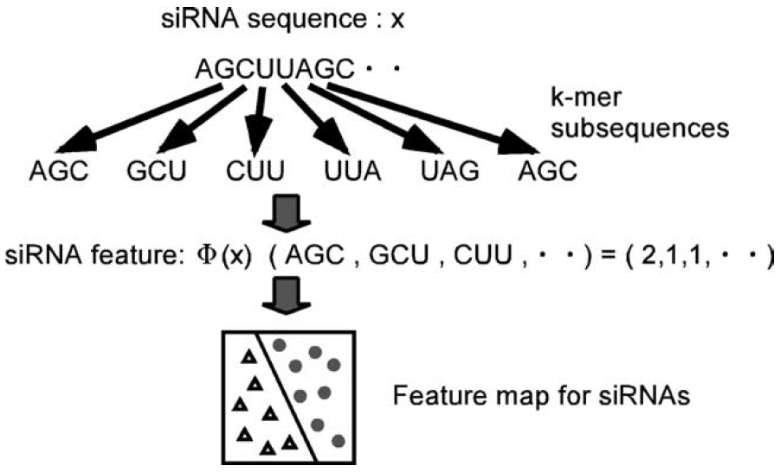
3. Generalized string kernel(1/1)
GSK is a sum of all the (k_{i}, m_{i})-mismatch kernels. The (k₁, m₁, . . .,k_{s}, m_{s})-GSK K_{(k1, m1, . . .,ks, ms)} (x, y) is defined as:

Slide 10
4. Materials
From Khvorova’s large data sets containing sequence and function of siRNAs.
a subset of 94 siRNAs targeting the firefly luciferase(螢光素酶) and human cyclophilin(環孢素) B genes.
the effective class contained 53 siRNAs and the ineffective class contained 41 siRNAs.

Slide 11
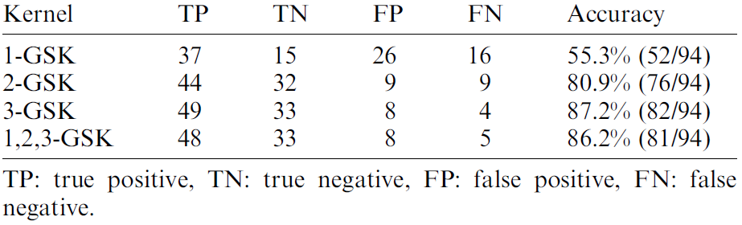
5. Results(1/7)
Comparison of discriminative performance among 1-, 2-, 3-, and (1,2,3)-GSK/SVM for the test data set representing 53 effective and 41 ineffective siRNAs.

Slide 12
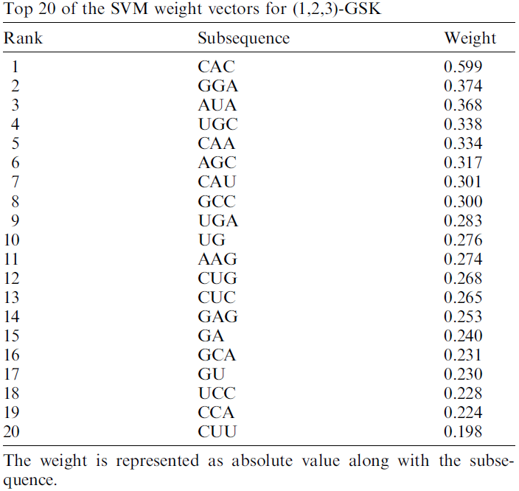
5. Results(2/7)

Slide 13
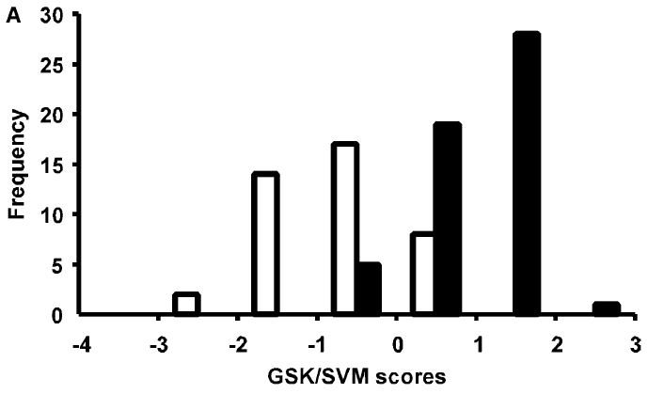
5. Results(3/7)
90.6% of the effective and 80.5% of the ineffective siRNAs had positive and negative scores, respectively.

Slide 14
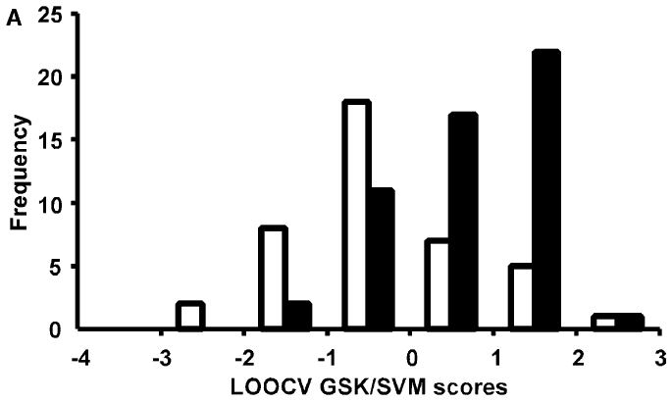
5. Results(4/7)
75.5% of the effective and 68.3% of the neffective siRNAs . Accuracy = 72.3% (68/94), of which 40 TP, 28 TN, 13 FP, and 13 FN.

Slide 15
5. Results(5/7)
75.5% of the effective and 68.3% of the neffective siRNAs . Accuracy = 72.3% (68/94), of which 40 TP, 28 TN, 13 FP, and 13 FN.

Slide 16
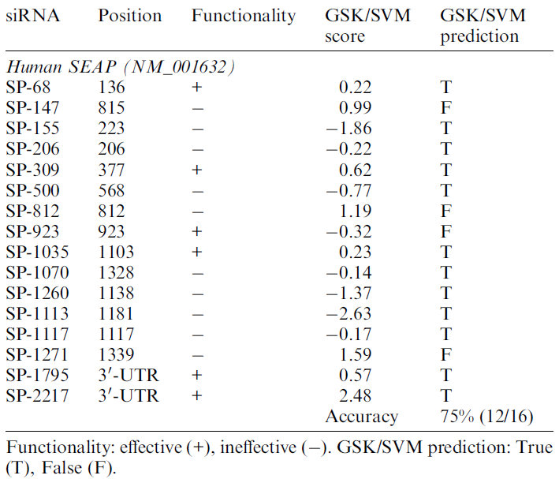
5. Results(6/7)
GSK/SVM algorithm for 16 human SEAP gene siRNAs.

Slide 17
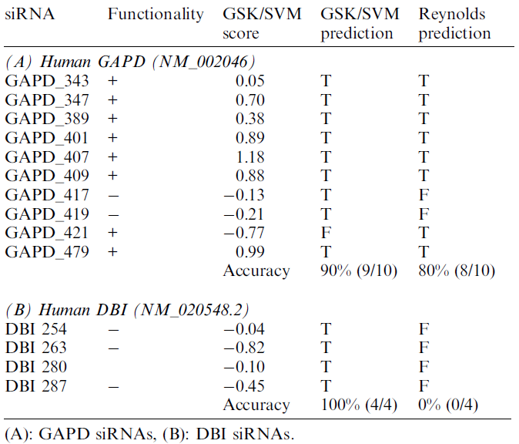
5. Results(7/7)
GSK/SVM with that of Reynolds rational design algorithm over 10 siRNAs for GAPD gene and 4 siRNAs for DBI gene.

