Slide 1
An optimal algorithm for the maximum-density path in a tree
Bang Ye Wu(吳邦一)
Information Processing Letters 109(2009) 975-979
Presenter: Siao-Ming Jhou
Date: Nov. 24, 2009

Slide 2
Abstract
We studied the problem of finding the maximum-density path in a tree. By spine decomposition and a linear-time algorithm for the maximum density segment problem, we developed an O(n logn) time algorithm, which improves the previously best result of O(n log² n) by using centroid decomposition. We also show the time complexity is optimal in the algebraic computation tree model.

Slide 3
Problem: Maximum-Density Path in a Tree (TreeMDP)
Instance: An n-node tree T = (V , E), a weight we and a positive length le for each edge e ∈ E, and two constant values Lmin Lmax.
Goal: Find a simple path P in T such that its density w(P)/l(P) is maximum among all paths of lengths within the interval [Lmin, Lmax], in which l(P) = e∈P le and w(P) = e∈P we are the length and the weight of
the path P , respectively.

Slide 4
Theorem 1. Even when the input tree is restricted to a twin star, the TreeMDP problem has an Ω(n logn) lower bound in the algebraic computation tree model.
A twin star is a tree with two internal nodes. The TreeMDP problem will be named as TwinMDP if the input tree is restricted to a twin star.
Problem: Set Intersection Problem
Instance: Two sets {x₁, x₂, . . . , x_{n}} and {y₁, y₂, . . . , y_{n}} of positive integers.
Goal: Determine whether there exist indices i and j such that x_{i} = y _{j} .

Slide 5
Corollary 2. The sorted TwinMDP problem can be solved in linear time.
Given a sequence {(wi , li)}^{n}_{i=1} with li >=0 and two numbers Lmin <=Lmax, the maximum-density segment (MDS) problem looks for two indices j<=k such that
Σ^{k}_{i=j} li is inthe interval [Lmin, Lmax] and (Σ^{k}_{i=j}wi)/(Σ^{k}_{i=j} li) is maximum.Chung and Lu [4] gave a linear time algorithm for the problem.

Slide 6
In other words, it looks for an index pair ( j,k) such that L ^{j} + L₀ + L _{k} satisfies the length constraint and (W_{j} + W₀ + W_{k})/(L _{j} + L₀ + L_{k}) is maximized, in which L₀ and W₀ are the length and the weight of the center edge. We can easily transform the sorted TwinMDP problem into the RangeMDS problem as follows. We set w_{n} = W₁;
w_{n−i} = W_{i+1} − W_{i} for 1<=i<=n − 1;
w_{n+1} = W₀; w_{n+2} = ; and w_{n+2+i} = W_{i+1}− W_{i} for 1<=i<=m −1.
Lemma 3. If there exists an O(n logn) time algorithm for the TreeMDP problem on binary trees, the problem on arbitrary trees can also be solved with the same time complexity, in which n is the number of nodes.

Slide 7
Centroid decomposition Algorithm
1: if the tree contains only one node then return −∞;
2: root T at its centroid r;
3: for each child v of r do find MDP(Tr , v) recursively;
4: choose the best path P1 among the paths at Step 3.
5: for each child v of r do
find the weights and lengths of the paths from r to all nodes in T _{v} ;
6: sort the pairs of weights and lengths by their lengths;
7: for each pair u and v of children of r do
find the best path containing path (u, r, v) by solving a sorted TwinMDP problem;
8: choose the best path P2 among the paths at Step 7;
9: return the better of P1 and P2.

Slide 8
t(n) =Σ³_{i=1} t(n_{i} +1) + O(n logn), in which n_{i}<=n/ 2 andΣ³_{i=1} n_{i} = n − 1.

Slide 9
Spine decomposition algorithm
1: transform T into a binary tree T ;
2: transform T into a right-skew tree T ;
3: build the BMT of the spine S of T ; let r be the root;
4: call subroutine MergeSpine(r) and output the returned solution;
Subroutine MergeSpine(r)
5: if r is not a leaf in the BMT then let q1 and q2 are the children of r;
6: call MergeSpine(q1) and MergeSpine(q1);
7: compute D(r) from D(q1) and D(q2);
return D(r);
else
8: let v be the spine node corresponding to r;
9: if v has no left branch then
10: set r.best to −∞; set both r.LList and r.RList to Null;
else
11: build BMT(Y ) of the spine Y of the left branch of v;
12: call MergeSpine(q), in which q is the root of BMT(Y );
13: set r.best to q.best; set both r.LList and r.RList to q.LList;
14: return D(r).

Slide 10
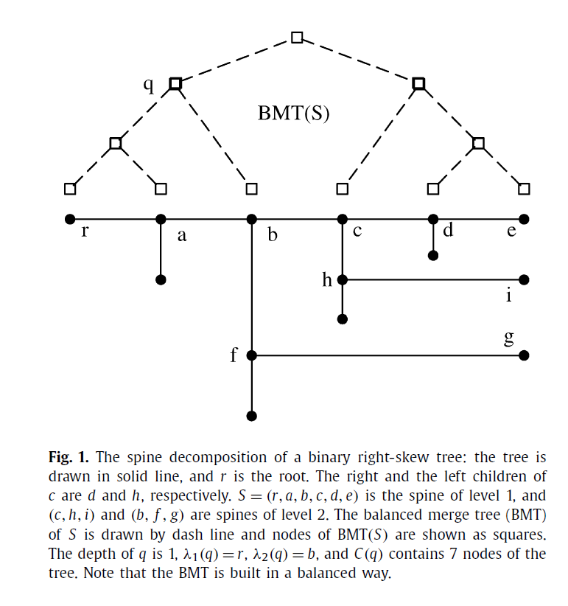

Slide 11
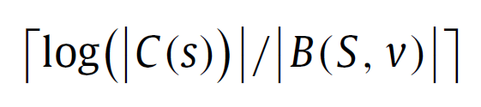
Property 5. The BMT of a spine of k nodes can be constructed in O(k) time if the number of nodes in each left branch is given.
A node q of BMT(S) corresponds to a subpath S of S.The two endpoints of S are denoted by λ₁(q) and λ₂(q), in which λ₁(q) is the node closer to the root of the tree T . Particularly if q is a leaf of BMT(S), then λ₁(q) = λ₂(q) is the spine node corresponding to q. The node set of S and all subtrees left to S is denoted by C(q), and we say that the nodes are covered by q. Let v be a node of spine S and q the corresponding node (a leaf) in the BMT. It can be shown by induction that the depth of q, i.e., the number of BMT edges from q to the root s, is

Slide 12
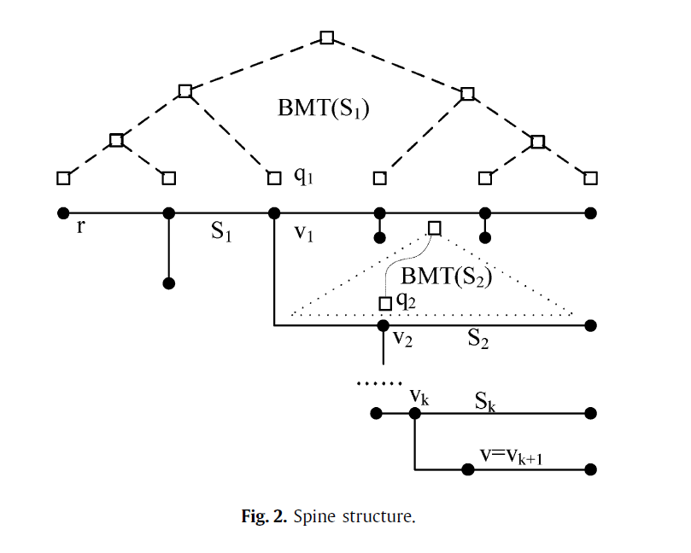

Slide 13
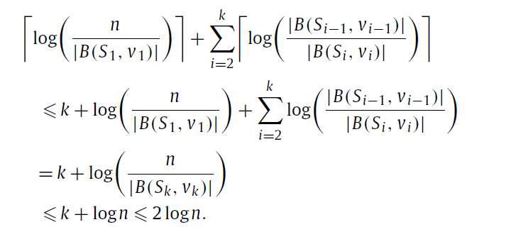

Slide 14
END

