Slide 1
Hashiwokakero is NP-complete
Daniel Andersson
Information Processing Letters 109 (2009) 1145–1146
Presenter: Kai-Yu Chen
Date: Nov. 24, 2009

Slide 2
Abstract
In a Hashiwokakero puzzle, one must build bridges to connect a set of islands. We show that deciding the solvability of such puzzles is NP-complete.

Slide 3
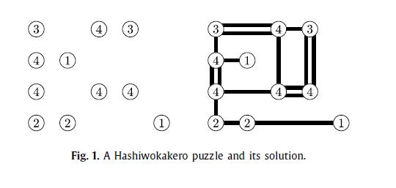
Introduction
using vertical and horizontal line segments
A bridge must not cross any other bridge or island

Slide 4
Theorem 1. Deciding the solvability of a Hashiwokakero puzzle is NP-complete.
We construct a reduction from the following NP-hard problem : Given a finite set P ⊂ Z², is there a Hamiltonian circuit in the unit distance graph of P ?

Slide 5
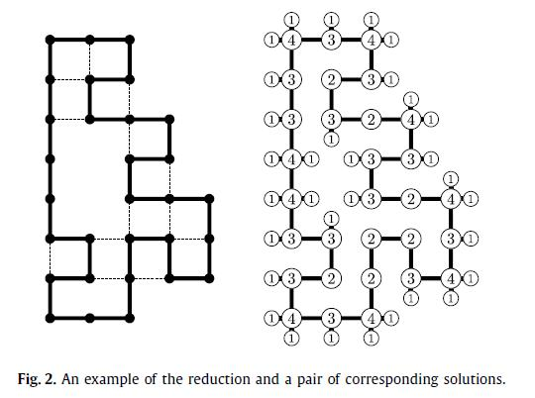
Reduction
We assume |P|≧3.For each x ∈ P , output an island at 2x with bridge requirement 6 − |{y ∈ P: |x − y| = 1}| (big island)
And an island at x + y with bridge requirement 1(small island) for each y ∈ Z² \ P such that |x− y| = 1.

