Slide 1
An optimal algorithm for the maximum-density path in a tree
Bang Ye Wu(吳邦一)
Information Processing Letters 109(2009) 975-979
Presenter: Siao-Ming Jhou
Date: Dec. 1, 2009

Slide 2
Abstract
We studied the problem of finding the maximum-density path in a tree. By spine decomposition and a linear-time algorithm for the maximum density segment problem, we developed an O(n logn) time algorithm, which improves the previously best result of O(n log² n) by using centroid decomposition. We also show the time complexity is optimal in the algebraic computation tree model.

Slide 3
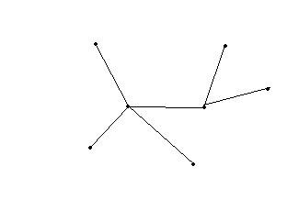
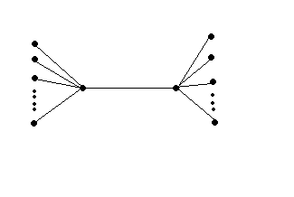
TreeMDP l(P)=Σ_{e∈P}l_{e} ,w(P)= Σ_{e∈P}W_{e}
SIP reduce to TwinMDP
(x₁,x₂,…,x_{n}),(y₁,y₂,…y_{n})
存在i,j i≠j,使得x_{i}=y_{j}
Sorted TwinMDP reduce to RangeMDS
(x₁,x₂,…,x_{n})

Slide 4
w_{n} = W₁; w_{n−i} = W_{i+1} − W_{i} for 1≤i≤n − 1;
w_{n+1} = W₀; w_{n+2} = W₁; and w_{n+2+i} = W_{i+1}− W_{i} for 1≤i≤m −1.

Slide 5
q.best: the best solution entirely within C(q).
q.LList: the length-sorted list (W_{i} , L_{i}) of weights and lengths of paths from λ₁(q) to all nodes covered by q.
• q.RList: the length-sorted list (W_{i} , L_{i}) of weights and lengths of paths from λ₂(q) to all nodes covered by q.

Slide 6
Spine decomposition algorithm
1: transform T into a binary tree T ;
2: transform T into a right-skew tree T ;
3: build the BMT of the spine S of T ; let r be the root;
4: call subroutine MergeSpine(r) and output the returned solution;
Subroutine MergeSpine(r)
5: if r is not a leaf in the BMT then let q1 and q2 are the children of r;
6: call MergeSpine(q1) and MergeSpine(q2);
7: compute D(r) from D(q1) and D(q2);
return D(r);
else
8: let v be the spine node corresponding to r;
9: if v has no left branch then
10: set r.best to −∞; set both r.LList and r.RList to Null;
else
11: build BMT(Y ) of the spine Y of the left branch of v;
12: call MergeSpine(q), in which q is the root of BMT(Y );
13: set r.best to q.best; set both r.LList and r.RList to q.LList;
14: return D(r).

Slide 7
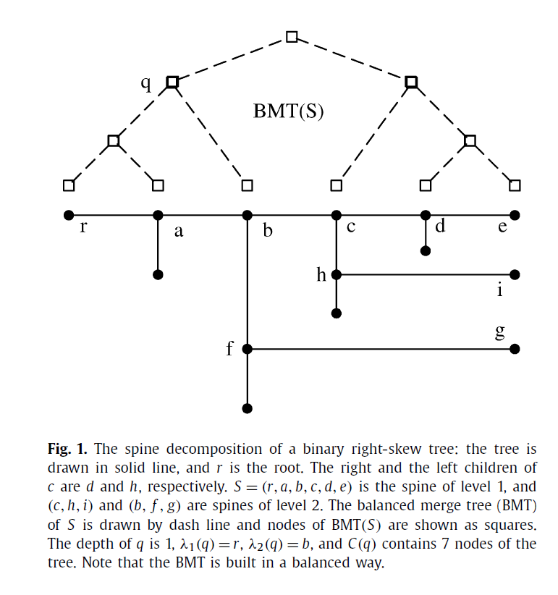

Slide 8
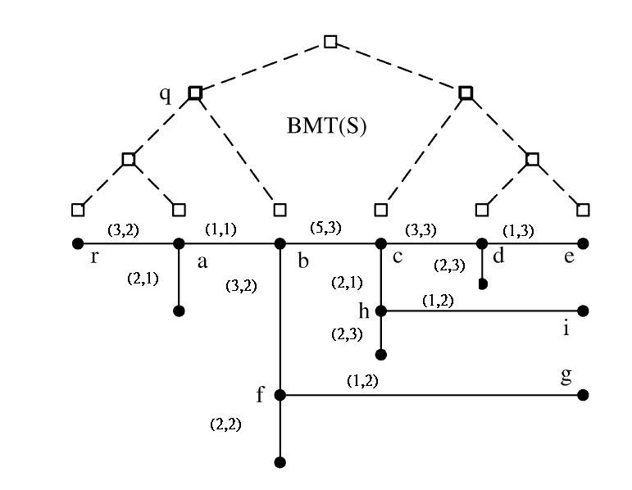

Slide 9
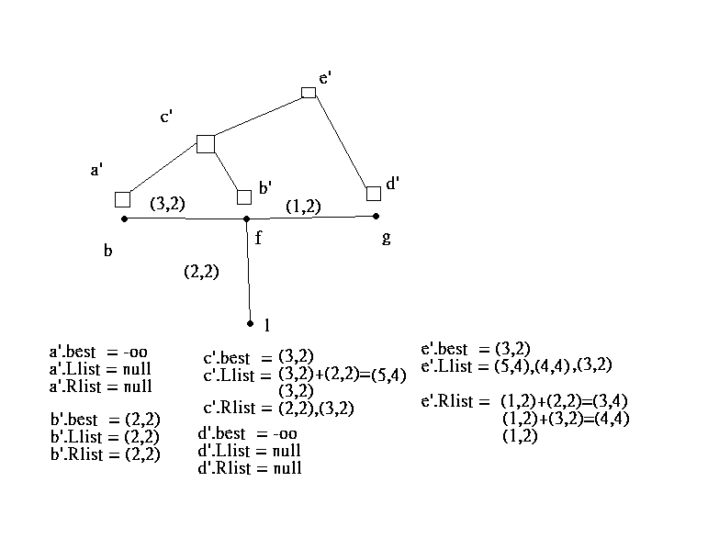

Slide 10
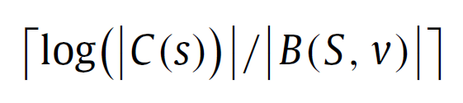
Property 5. The BMT of a spine of k nodes can be constructed in O(k) time if the number of nodes in each left branch is given.
A node q of BMT(S) corresponds to a subpath S of S.The two endpoints of S are denoted by λ₁(q) and λ₂(q), in which λ₁(q) is the node closer to the root of the tree T . Particularly if q is a leaf of BMT(S), then λ₁(q) = λ₂(q) is the spine node corresponding to q. The node set of S and all subtrees left to S is denoted by C(q), and we say that the nodes are covered by q. Let v be a node of spine S and q the corresponding node (a leaf) in the BMT. It can be shown by induction that the depth of q, i.e., the number of BMT edges from q to the root s, is

Slide 11
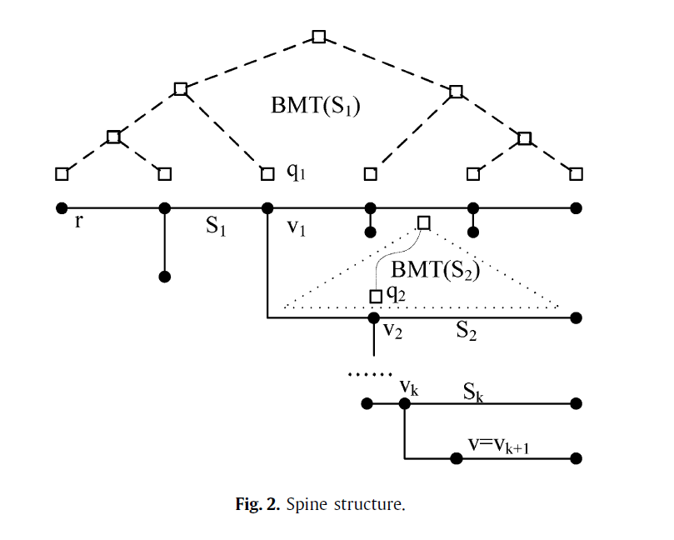

Slide 12
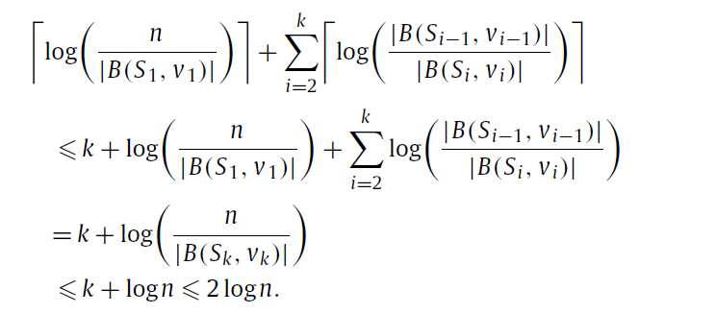

Slide 13
END

