Slide 1
Developed Algorithm for Making Up Convex Hull Based on Binary Tree ​ Naing Linn Aung, Evgeni M. Portnov and Kirill O. Epishin
2020 International Conference on Industrial Engineering, Applications and Manufacturing (ICIEAM)
Presenter: Chih-Hsuan Chien
Date: Dec. 15, 2021

Slide 2
Abstract
In computer vision, convex hulls are used for pattern recognition and other image analysis using special points. This paper suggests the developed algorithm for making up a convex hull based on a binary tree. The main idea of the algorithm, proposed in this paper, is very similar to the underlying principle incremental algorithm. The new algorithm quite quickly exceeds the running time of the Graham algorithm with a large number of points in the convex hull. This is due to the best complexity of the algorithm. The Graham's algorithm has O(nlogn) complexity when the new algorithm has O(nlogh) average complexity.

Slide 3
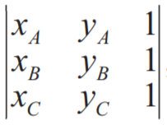
Function
ccw(A,B,C) = det(A,B,C) > 0
Det(A,B,C) =

Slide 4
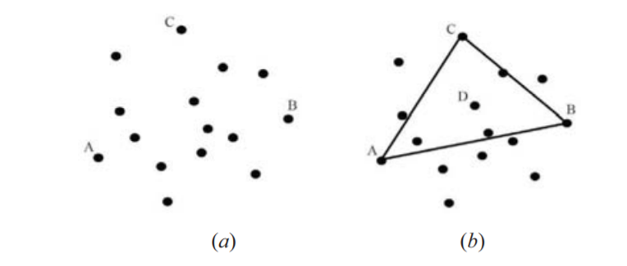
Steps
A:the left extreme point.
B:right extreme point.
C:which is farthest from line A, B.
D:(A+B+C)/3

Slide 5
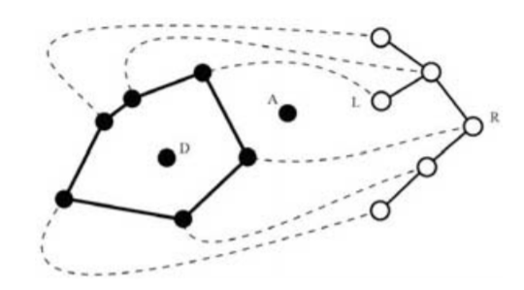
Steps
built a search tree that contains our convex hull sorted by an angle relative to the center D.
L:is the left of A.
R:is the right of A.

Slide 6
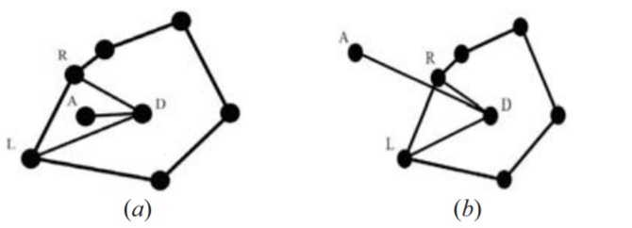
Steps
If ccw (L, R, A),then add A to convex hull.

Slide 7
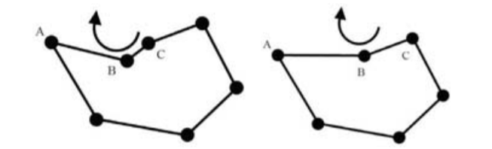
Steps
1. If ccw (afternext,next, point) then B should not be deleted and we must stop deleting points in this direction .
2. Otherwise, point B must be removed, since it is inside the new convex hull.
3. Then we need to consider point C as the next candidate for removal and go to step 1.

Slide 8
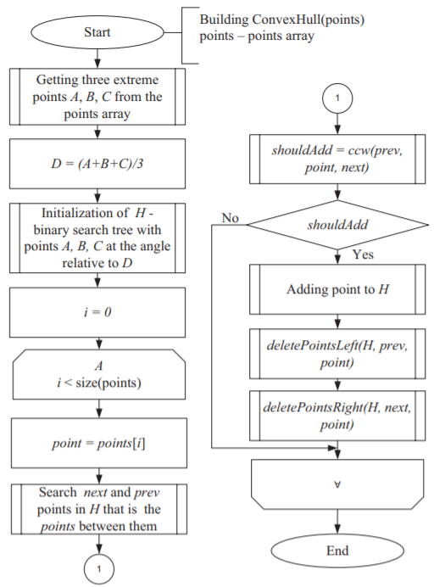

Slide 9
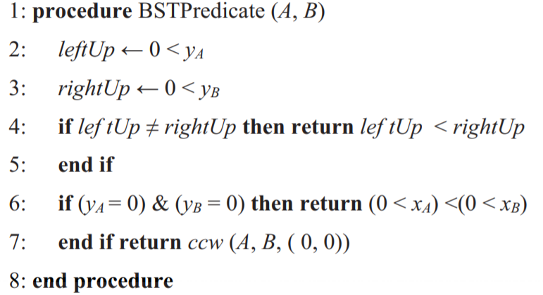
BSTPredicate

Slide 10
BSTPredicate
將中心點座標轉換至(0,0)
比較:
1.比較兩個點各在x軸的上半部or下半部，如果在不同部分，上半部的點>下半部的點
2.如果兩點都在x軸上比較x座標大小
3.兩點在同一邊的話，ccw(A,B,(0,0))

Slide 11
Time Complexity
O( 2N + N + NlogM ) = O( NlogM )

Slide 12
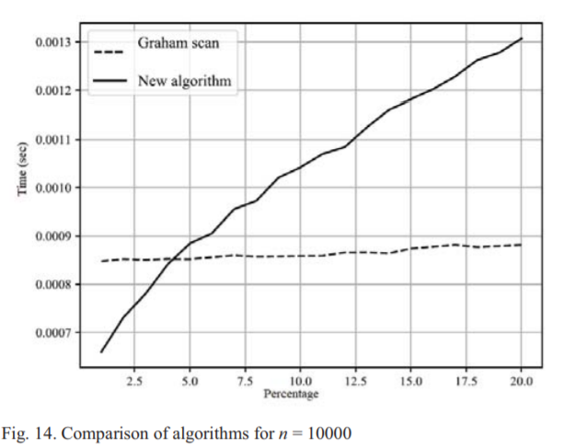
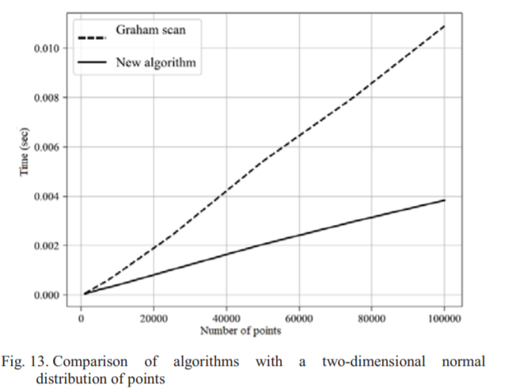
Experiment

