Slide 1
A Branch Elimination-based Efficient Algorithm for Large-scale Multiple Longest Common Subsequence Problem
Shiwei Wei, Yuping Wang, and Yiu-ming Cheung
IEEE Transactions on Knowledge and Data Engineering, 2021.09.30
Presenter : Yu-Ju Liao
Date : Oec. 15, 2021

Slide 2
Abstract
It is a key issue to find out all longest common subsequences of multiple sequences over a set of finite alphabets, namely MLCS problem, in computational biology, pattern recognition and information retrieval, to name a few. However, it is very challenging to tackle the large-scale MLCS problem effectively and efficiently due to the high complexity of time and space. To this end, this paper will therefore propose a Branch Elimination-based Space and Time efficient algorithm called BEST-MLCS, which includes the following four key strategies: 1) Estimation scheme for the lower bound of the length of MLCS. 2) Estimation scheme for the upper bound of the length of the paths through the current match point.

Slide 3
Abstract
3) Branch elimination strategy by finding all useless match points and removing the branches not on the longest paths. 4) A new Directed Acyclic Graph (DAG) construction method for constructing the smallest DAG among the existing ones. As a result, the proposed algorithm BEST-MLCS can save a lot of space and time and can handle much larger scale MLCS problems than the existing algorithms. Extensive experiments conducted on biological DNA sequences show that the performance of the proposed algorithm BEST MLCS outperforms three state-of-the-art algorithms in terms of run time and memory consumption.

Slide 4
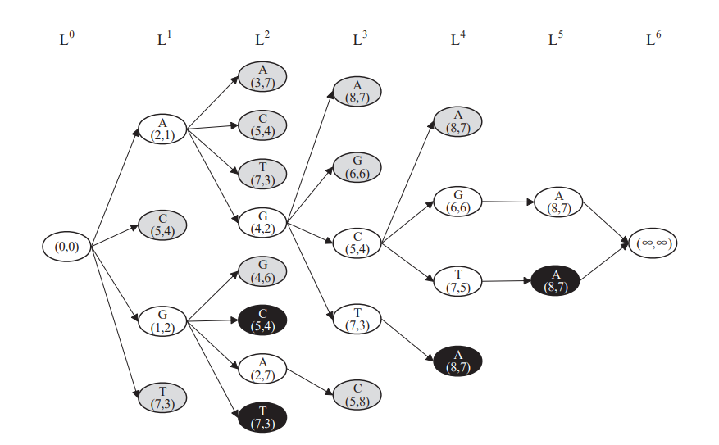
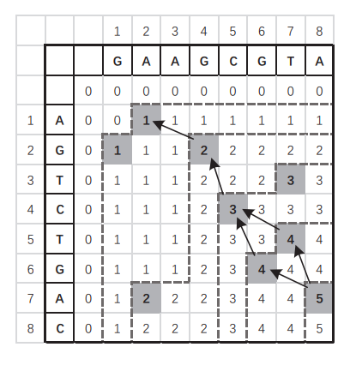
DAG
S₁ = GAAGCGTA
S₂ = AGTCTGAC

Slide 5
DAG
S₁ = GAAGCGTA
S₂ = AGTCTGAC

Slide 6
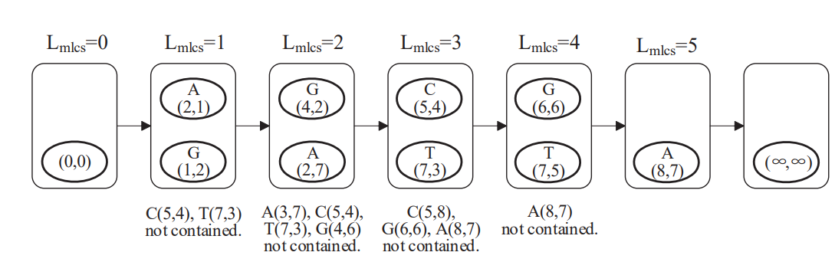
Quick Estimation of Lower Bound
S₁ = GAAGCGTA
S₂ = AGTCTGAC
k = 2

Slide 7
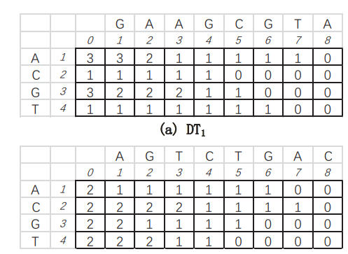
Efficient Estimation of Upper Bound
U(p,∞) = ∑ _{σ∈Σ} min{num_{s1} (σ, p₁), num_{s2} (σ, p₂), · · · , numsd (σ, p_{d})}
S₁ = GAAGCGTA
S₂ = AGTCTGAC

Slide 8
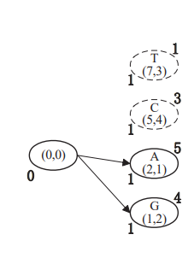
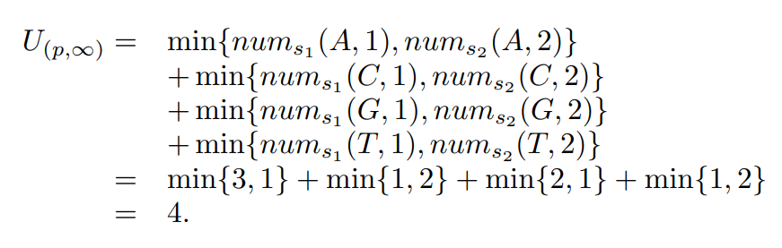
Efficient Estimation of Upper Bound
U(p,∞) = ∑ _{σ∈Σ} min{num_{s1} (σ, p₁), num_{s2} (σ, p₂), · · · , numsd (σ, p_{d})}
S₁ = GAAGCGTA
S₂ = AGTCTGAC

Slide 9
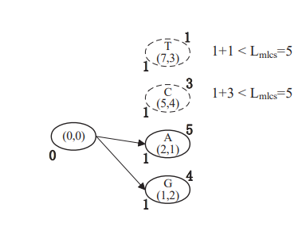
Construct Smaller DAG
lev(p) + U(p,∞) < L_{mlcs}
S₁ = GAAGCGTA
S₂ = AGTCT GAC
L_{mlcs} = 5

Slide 10
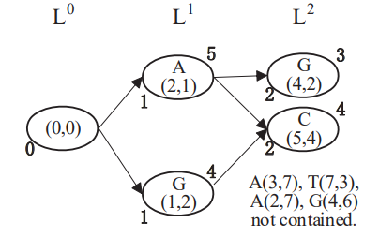
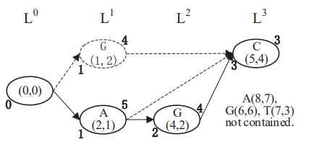
Construct Smaller DAG
S₁ = GAAGCGTA
S₂ = AGTCT GAC
L_{mlcs} = 5

Slide 11
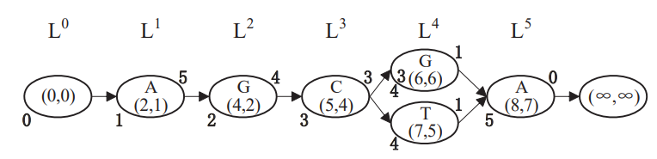
Construct Smaller DAG
S₁ = GAAGCGTA
S₂ = AGTCTGAC

Slide 12
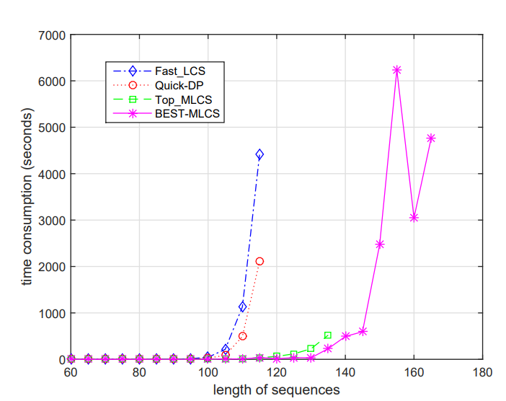
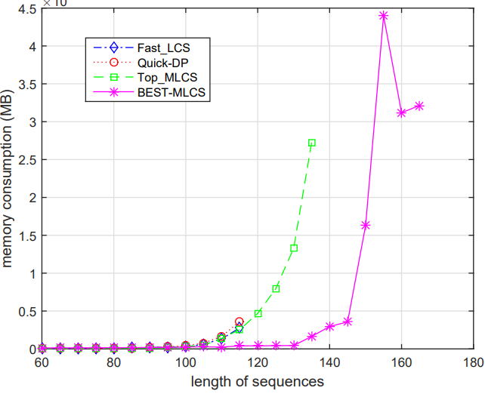
Experimental Results

