Slide 1
Computing Longest Previous Factor in linear time and applications
Maxime Crochemore and Lucian Ilie
Information Processing Letters
Volume 106, Issue 2, 15 April 2008, Pages 75-80
Presenter: Shin-Cheng Lin
Date: Dec. 15, 2021

Slide 2
Abstract
We give two optimal linear-time algorithms for computing the Longest Previous Factor (LPF) array corresponding to a string w. For any position i in w, LPF[i] gives the length of the longest factor of w starting at position i that occurs previously in w. Several properties and applications of LPF are investigated. They include computing the Lempel–Ziv factorization of a string and detecting all repetitions (runs) in a string in linear time independently of the integer alphabet size.

Slide 3
LPF
Longest Previous Factor(substring)
string abbaabbbaaabab
abbaabbba aabab
abbaabb baaabab

Slide 4
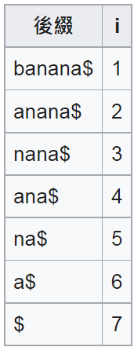
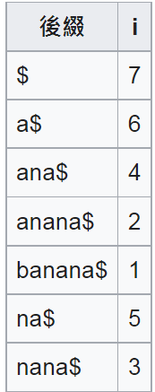
SA
Suffix array
S = banana$

Slide 5
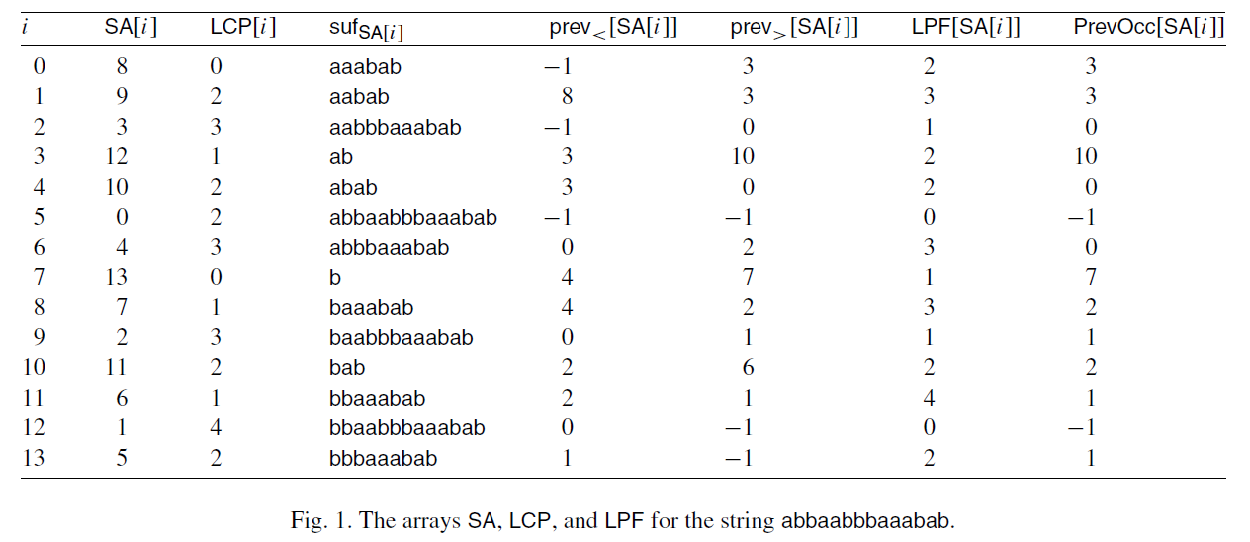
For any position i, the longest factor starting at i that occurs also to the left of i in w is the longest common prefix between the suffix suf_{i} and the suffixes starting to the left of i in w.

Slide 6
direct algorithm
Compute the closest positions in SA

Slide 7
abbaabbbaaabab
SA[8]=aaabab, LPF[8]=2, PrevOcc[8]=3
SA[9]=aabab

Slide 8
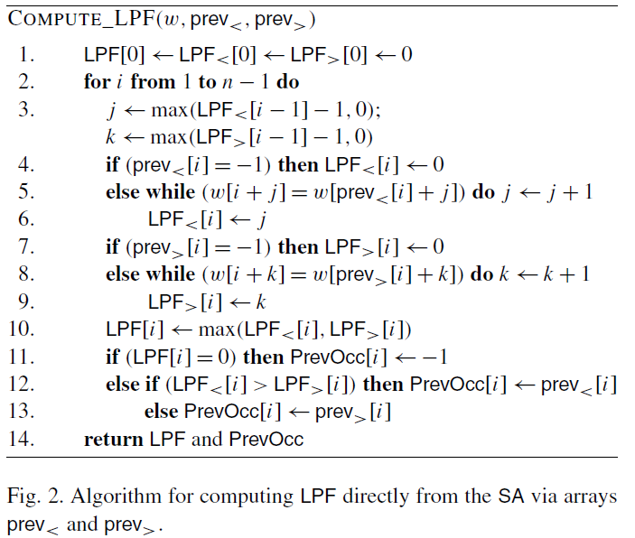
LPF[i] ≧ LPF[i − 1] − 1
O(n)

Slide 9
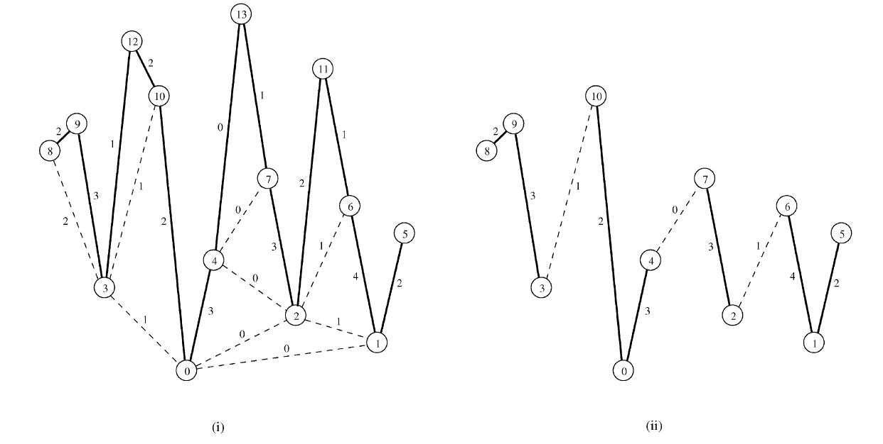
algorithm using LCP

