Slide 1
DouZero: Mastering DouDizhu with Self-Play Deep Reinforcement Learning
Daochen Zha, Jingru Xie, Wenye Ma, Sheng Zhang, Xiangru Lian, Xia Hu, Ji Liu
38th International Conference on Machine Learning, PMLR 139:12333-12344, 2021
Presenter: Ying-Yu Lin
Date: Dec.22, 2021

Slide 2
Abstract:
Games are abstractions of the real world, where artificial agents learn to compete and cooperate with other agents. While significant achievements have been made in various perfect- and imperfect-information games, DouDizhu (a.k.a. Fighting the Landlord), a three-player card game, is still unsolved. DouDizhu is a very challenging domain with competition, collaboration, imperfect information, large state space, and particularly a massive set of possible actions where the legal actions vary significantly from turn to turn. Unfortunately, modern reinforcement learning algorithms mainly focus on simple and small action spaces, and not surprisingly, are shown not to make satisfactory progress in DouDizhu.

Slide 3
Abstract:
In this work, we propose a conceptually simple yet effective DouDizhu AI system, namely DouZero, which enhances traditional Monte-Carlo methods with deep neural networks, action encoding, and parallel actors. Starting from scratch in a single server with four GPUs, DouZero outperformed all the existing DouDizhu AI programs in days of training and was ranked the first in the Botzone leaderboard among 344 AI agents. Through building DouZero, we show that classic Monte-Carlo methods can be made to deliver strong results in a hard domain with a complex action space.

Slide 4
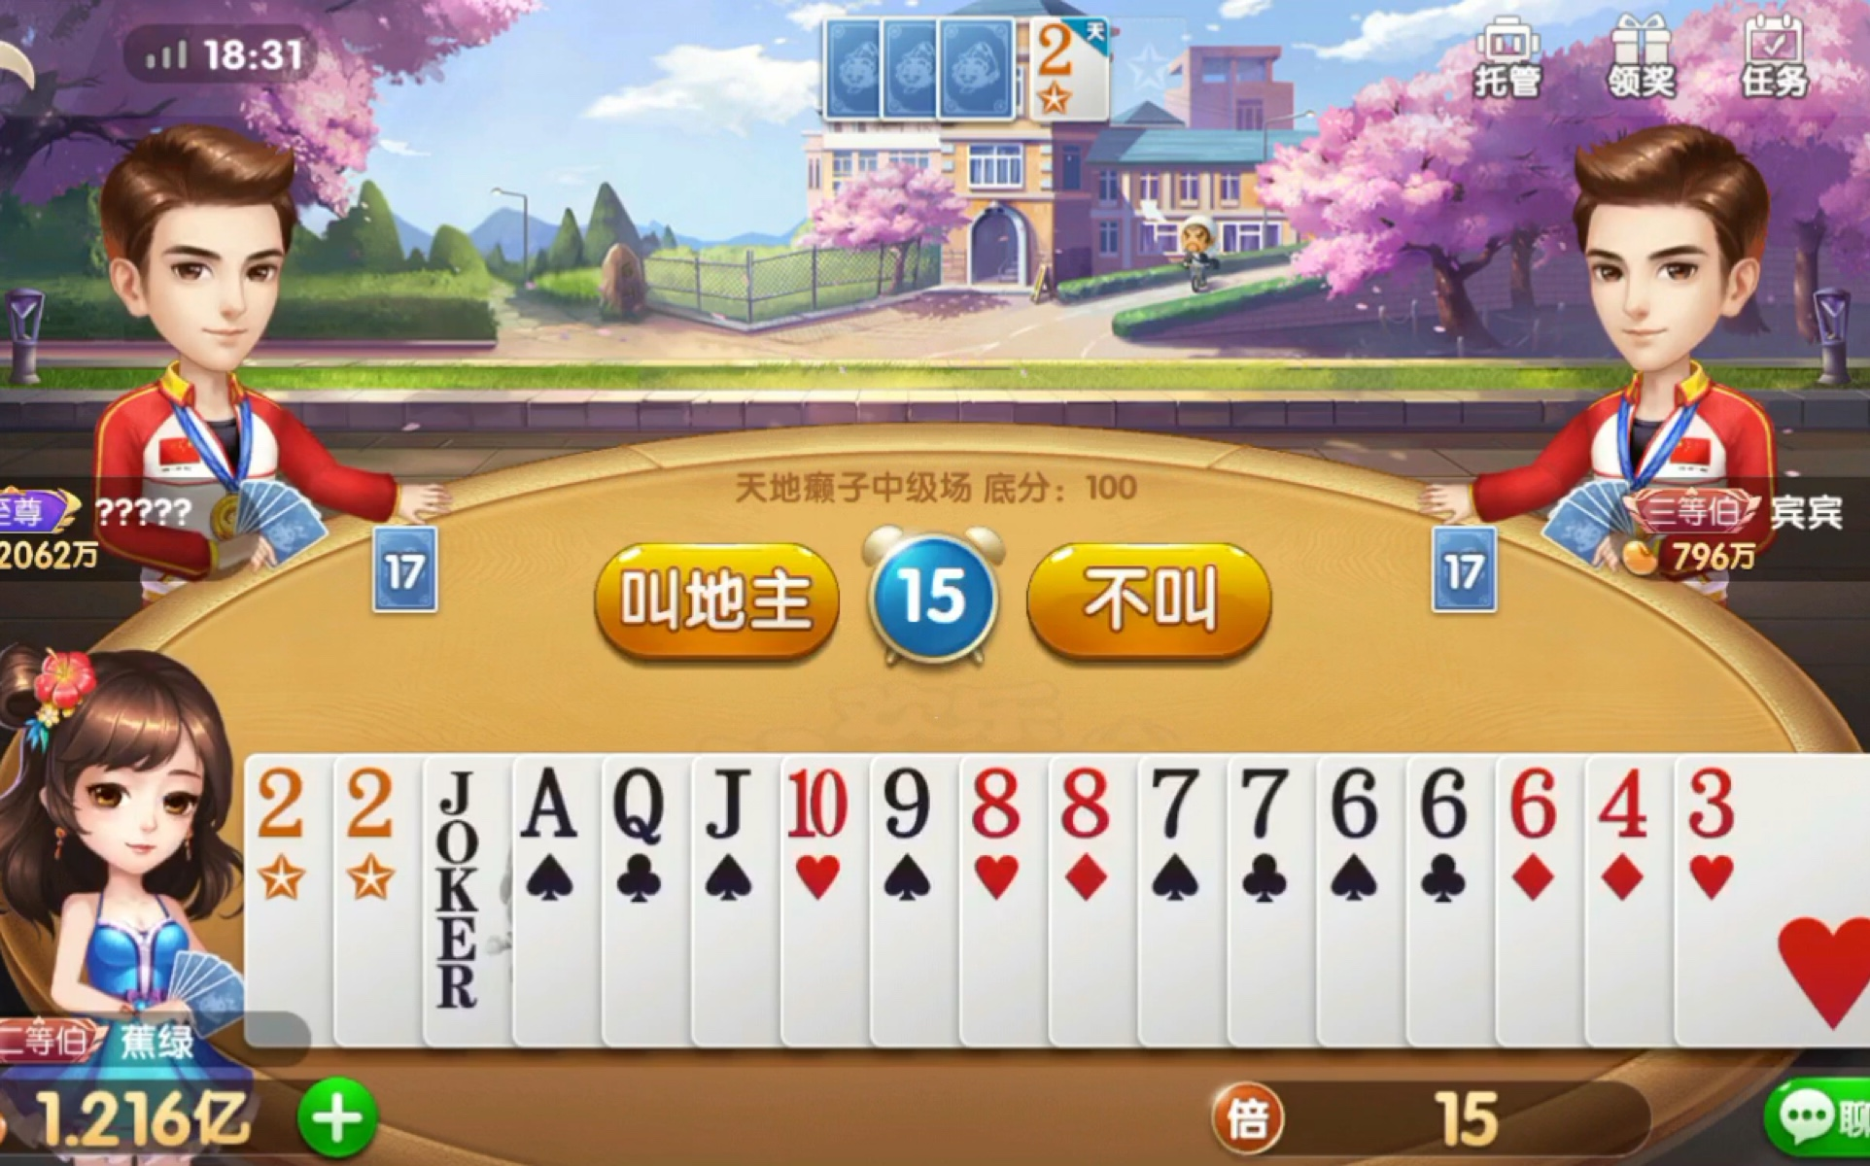
鬥地主規則介紹-叫地主
兩位農民合攻一位地主
只要一位農民出完牌就算農民獲勝
地主不是通賠就是通殺
輪流當莊家
從莊家開始逆時針叫地主
叫地主分數:0,1,2,3,6,12,24
地主可多擁有三張牌

Slide 5
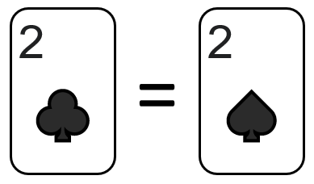

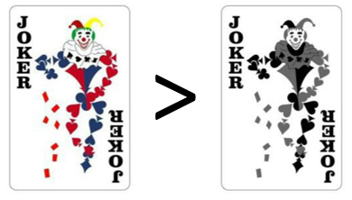
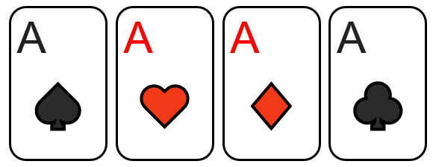
鬥地主規則介紹-玩牌
所有的牌只比點數大小不比花色
鬼牌在鬥地主中是王牌，彩色鬼牌比黑白鬼牌大
火箭:同時拿到兩張鬼牌，可壓倒所有牌型，積分也翻倍
炸彈(鐵支):四張一樣的牌，積分翻倍

Slide 6
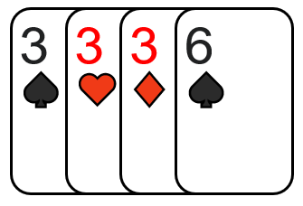
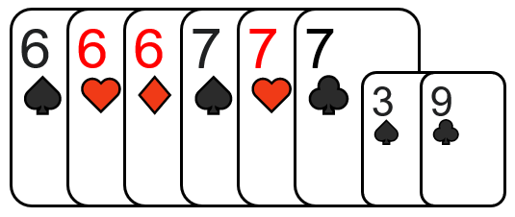
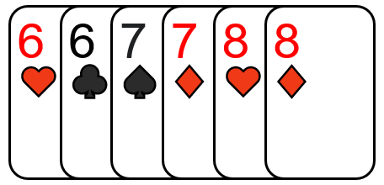
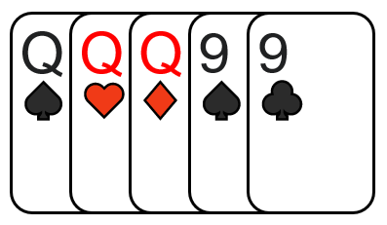
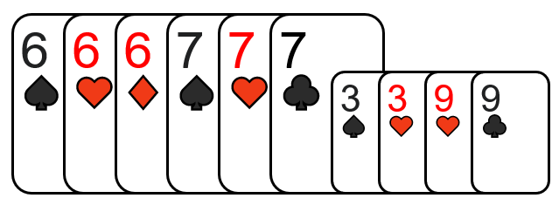
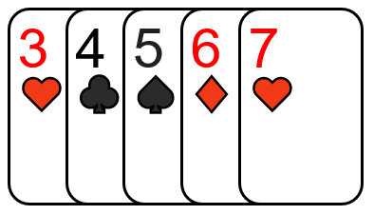
鬥地主規則介紹-玩牌
三帶一:三張一樣的牌加上一張廢牌
三帶二:三張一樣的牌加上一對
飛機:連號的三帶一或三帶二，2除外
連對:只要三組以上連號的對子可以一起出，2除外
順子:至少五張最多12張，從3~A都可以一起出

Slide 7
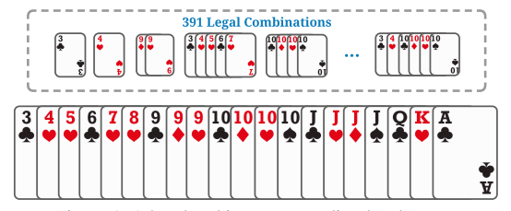
reinforcement learning

Slide 8
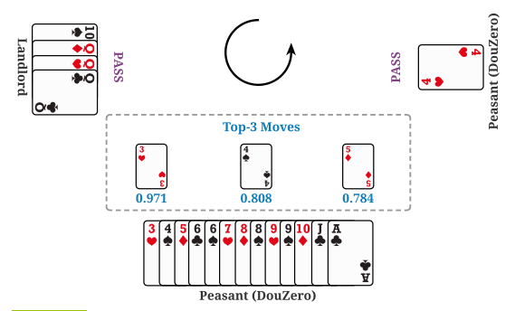
Properties that make DouDizhu particularly challenging to solve
1.Peasants need to cooperate in fighting against the Landlord.
2.DouDizhu has a complex and large action space due to the combination of cards.

Slide 9
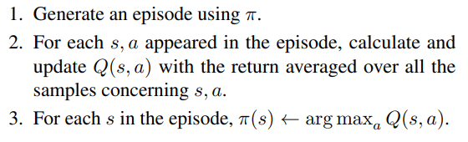
Monte-Carlo method
Deep Monte-Carlo method
1.replace the Q-table with a neural network
2.use mean-square-error (MSE) to update the Q-network

Slide 10
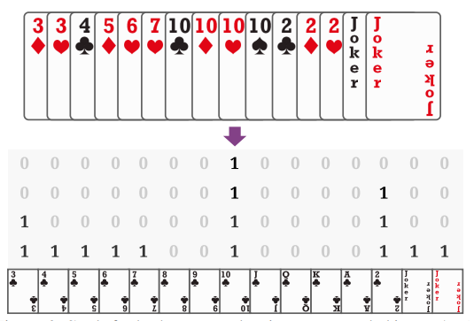
DouZero System

Slide 11
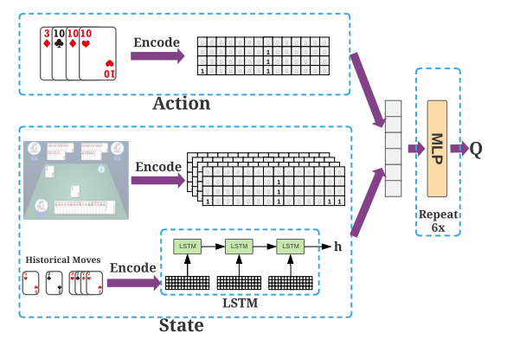
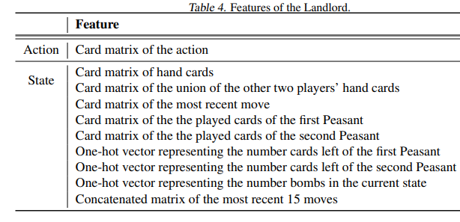
DouZero System

Slide 12
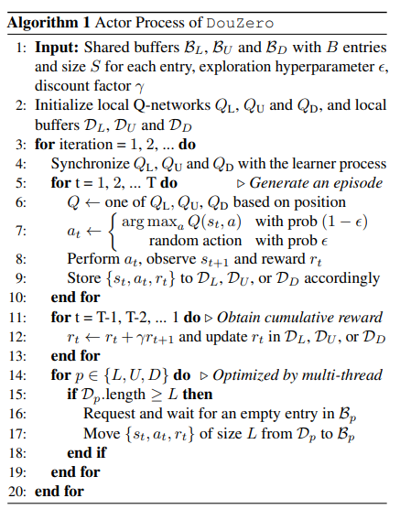
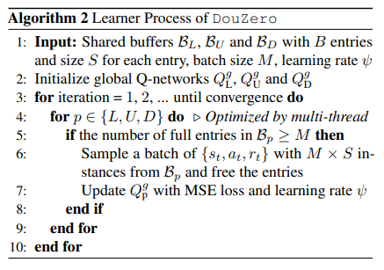
DouZero System

Slide 13
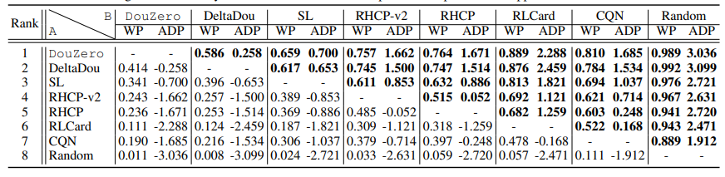
Experiments
WP : Winning Percentage
ADP : Average Difference in Points

Slide 14
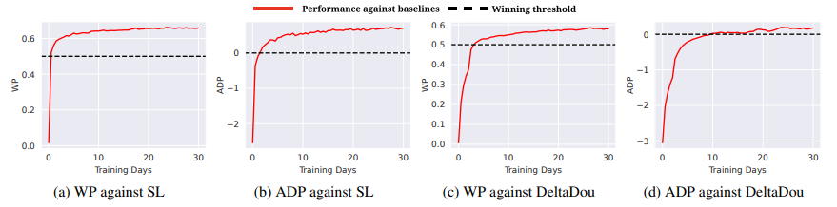
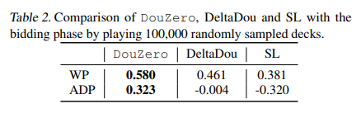
Experiments

Slide 15
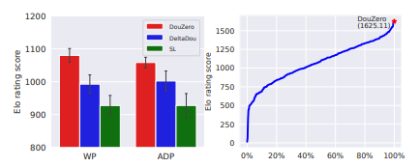
Experiments

