Slide 1
An Efficient Algorithm for Solving the Longest Common Square Subsequence Problem
學生：李紹瑄
指導教授：楊昌彪 教授
Department of Computer Science and Engineering
National Sun Yat-sen University
December 2021

Slide 2
Longest Common Subsequence (LCS) Problem
A = cggattgat, B = tcgtagttg
Subsequence A’ of A：
A = cggattgat ⟹ A’ = gtt
Common subsequence of A and B：
A = cggattgat
B = tcgtagttg
CS(A, B) = ctat
Longest common subsequence of A and B：
A = cggattgat
B = tcgtagttg
LCS(A, B)= cgattg

Slide 3
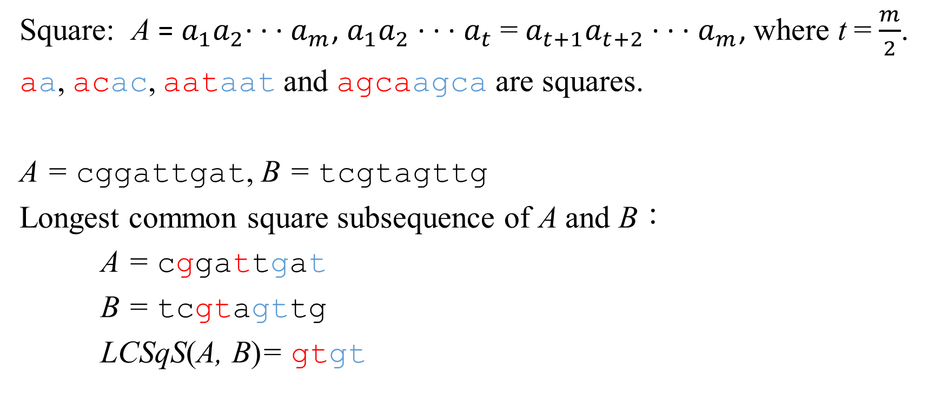
Longest Common Square Subsequence (LCSqS) Problem
Square: A = $a_{1}a_{2}$· · · $a_{m}$, $a_{1}a_{2}$ · · · $a_{t}$ = $a_{t+1}a_{t+2}$ · · · $a_{m}$, where t = $\frac{m}{2}$.
aa, acac, aataat and agcaagca are squares.
A = cggattgat, B = tcgtagttg
Longest common square subsequence of A and B：
A = cggattgat
B = tcgtagttg
LCSqS(A, B)= gtgt

Slide 4
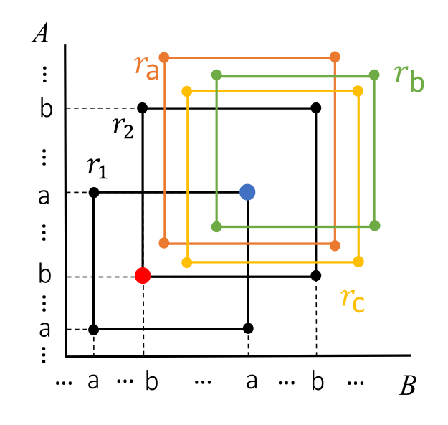
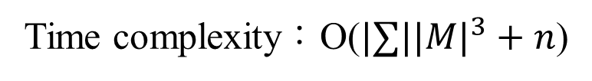
Longest Common Square Subsequence (LCSqS) Problem
Time complexity：O($|∑|{|M|}^{3}+n$)
T. Inoue, S. Inenaga, H. Hyyr¨o, H. Bannai, and M. Takeda, “Computing longest common square subsequences,” Proceedings of 9th Annual Symposium on Combinatorial Pattern Matching, Vol. 15, Qingdao, China, pp. 1–13, 2018.

Slide 5
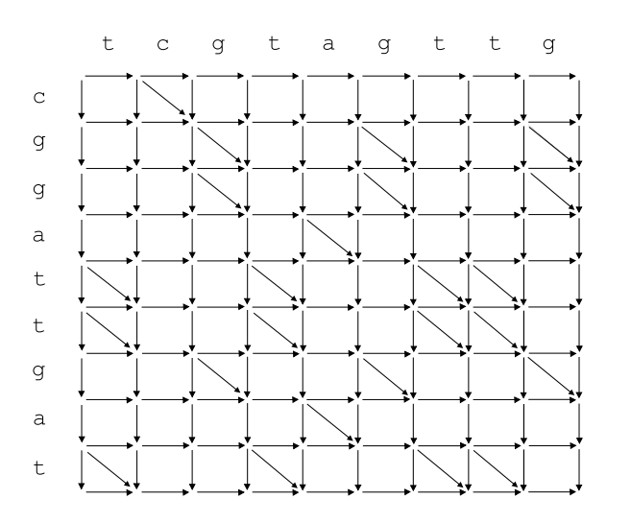
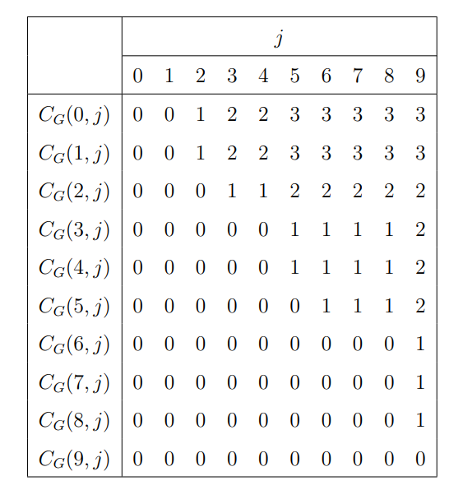
Grid Directed Acyclic Graph (GDAG)
A = cgga, B = tcgtagttg

Slide 6

Grid Directed Acyclic Graph (GDAG)
A = cgga, B = tcgtagttg
0 1 2 3 4 5 6 7 8 9

Slide 7
Grid Directed Acyclic Graph (GDAG)
A = cgga, B = tcgtagttg
0 1 2 3 4 5 6 7 8 9

Slide 8
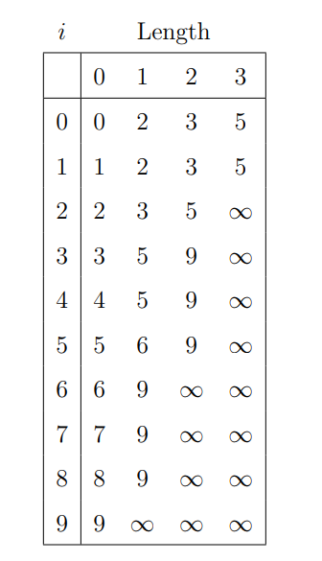
The S-table
A = cgga, B = tcgtagttg

Slide 9
The S-table
A = cgga, B = tcgtagttg

Slide 10
The S-table
A = cgga, B = tcgtagttg

Slide 11
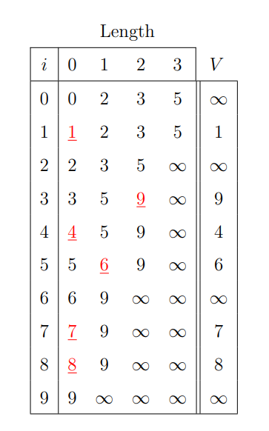
The linear-space S-table

Slide 12
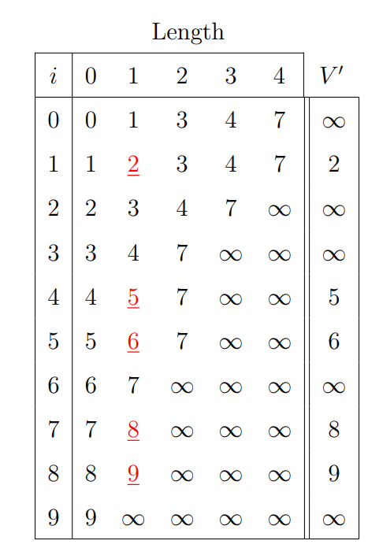
The linear-space S-table of Aα and B
A = cgga, B = tcgtagttg
A = cggat, B = tcgtagttg

Slide 13
The linear-space S-table of Aα and B
A = cggat, B = tcgtagttg
V
Matching point = 1, 4, 7, 8
V’
1
∞
9
4
6
∞
7
8
∞
0 | 1 | 2 | 3 | 4 | 5 | 6 | 7 | 8 | 9
O | R | O | O | R | O | N | R | U | U
1 | 4 | 7 | 8
2 | 5 | ∞

Slide 14
The linear-space S-table of Aα and B
 | 0 | 1 | 2 | 3 | 4 | 5 | 6 | 7 | 8 | 9
V | O | R | O | O | R | O | N | R | U | U | V’
1
∞
9
4
6
∞
7
8
∞
 | 1 | 4 | 4 | 4 | 7 | 7 | 7 | 8
A = cggat, B = tcgtagttg
O | O | O | O | R | O | N | R | U | U | 2
Matching point = 1, 4, 7, 8
O | O | O | O | R | O | N | R | U | U | ∞
O | O | O | O | R | O | N | R | U | O | ∞
O | O | O | O | O | O | N | R | U | O | 5
O | O | O | O | O | O | O | R | U | O | 6
Time complexity：O(n)
O | O | O | O | O | O | O | R | U | O | ∞
O | O | O | O | O | O | O | O | R | O | 8
B.-S. Lin, The Algorithms for the Linear Space S-table on the Longest Common Subsequence Problem. Master’s Thesis, National Sun Yat-sen University, Kaohsiung, Taiwan, 2017.
O | O | O | O | O | O | O | O | O | O | 9
O | O | O | O | O | O | O | O | O | O | ∞

Slide 15
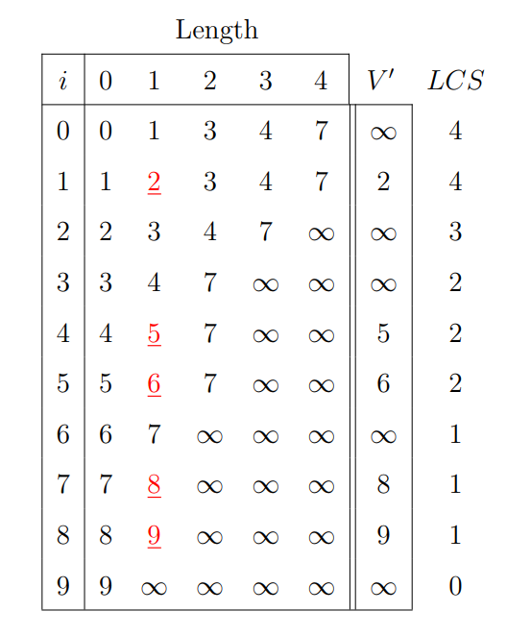
The linear-space S-table of Aα and B
A = cggat, B = tcgtagttg

Slide 16
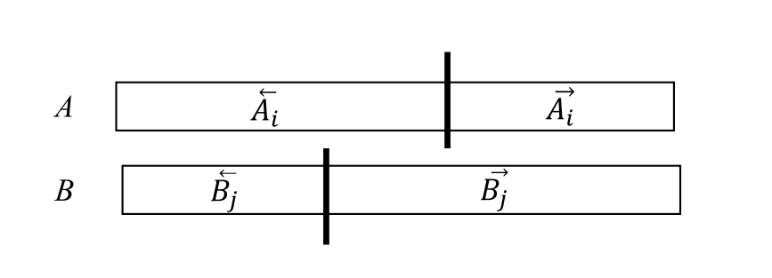
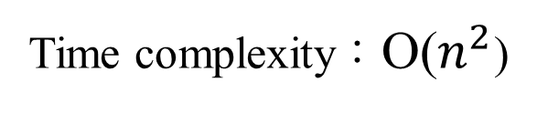
Our Algorithm
1
2
3
4
LCS( 1, 2 )
LCS( 1, 3 )
LCS( 1, 4 )
LCS( 2, 3 )
LCS( 2, 4 )
LCS( 3, 4 )
Time complexity：O($n^{2}$)

Slide 17
Our Algorithm
1
2
3
4
A = cggat tgat, B = tcgt agttg
LCS( 1, 2 ) = 3
LCS( 1, 3 ) = 3
LCS( 1, 4 ) = 2
LCS( 2, 3 ) = 3
LCS( 2, 4 ) = 2
LCS( 3, 4 ) = 2

Slide 18
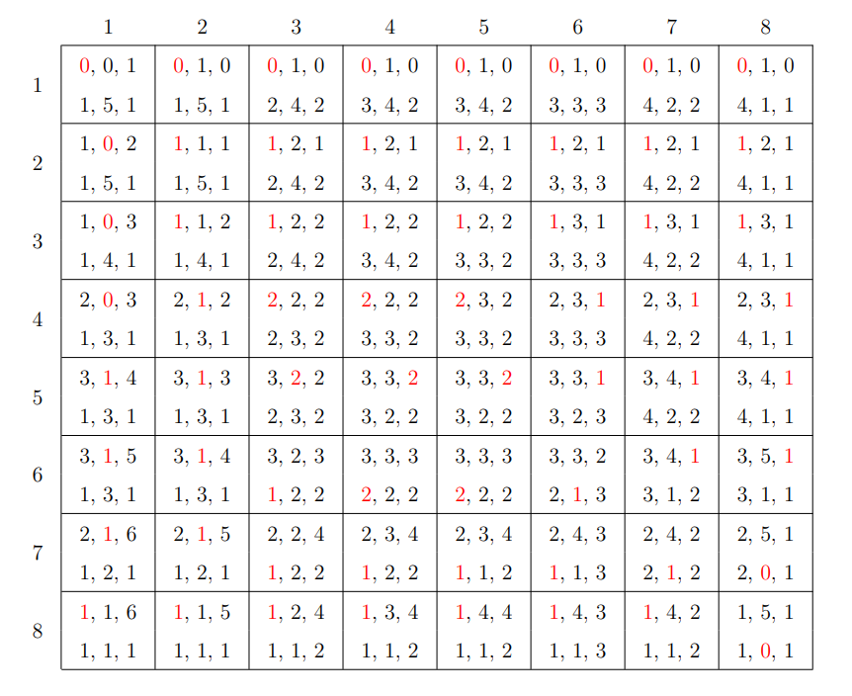
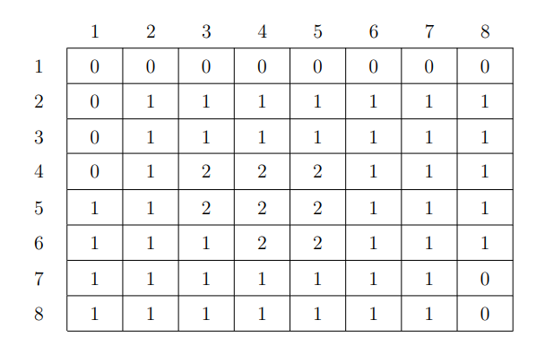
Our Algorithm
A = cggattgat, B = tcgtagttg

Slide 19
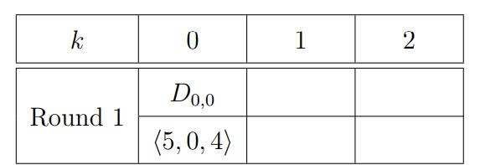
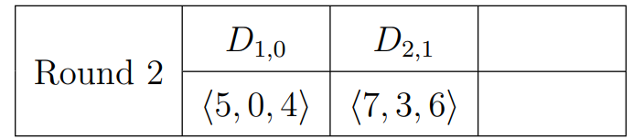
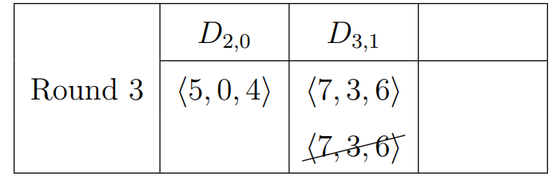
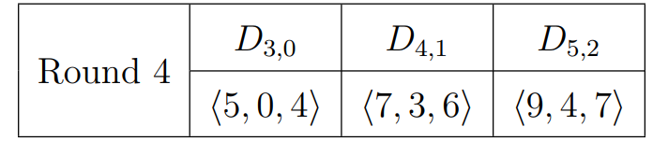
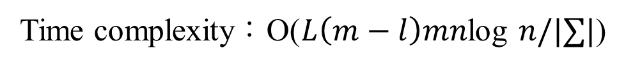
Our Algorithm
A = cggat tgat, B = tcgt agttg
0 1 2 3 4 5 6 7 8 9
0 1 2 3 4 5 6 7 8 9
LCSqS(A, B)= gtgt
Time complexity：O($L\left(m−l\right)mn$log $n/|∑|$)
T.-W. Liang, C.-B. Yang, and K.-S. Huang, “A fast algorithm for the longest common palindromic subsequence problem,” Proceedings of The 37th Workshop on Combinatorial Mathematics and Computation Theory, Taipe, Taiwan, 2019.

Slide 20
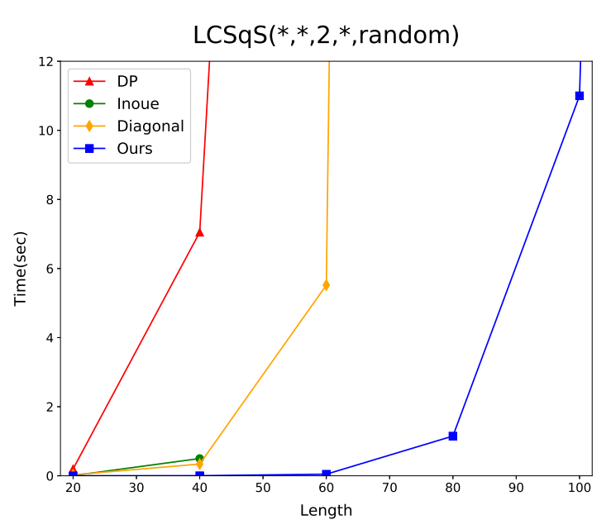
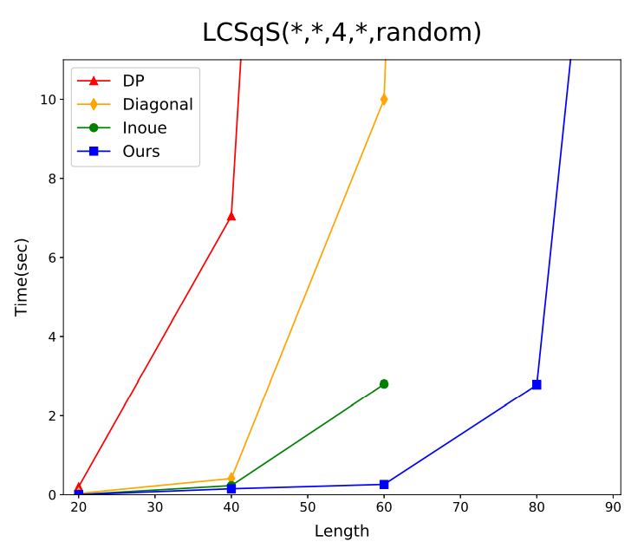
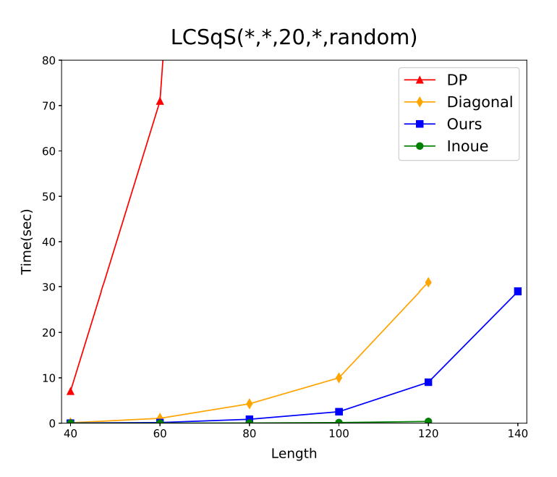
Experimental Results

Slide 21
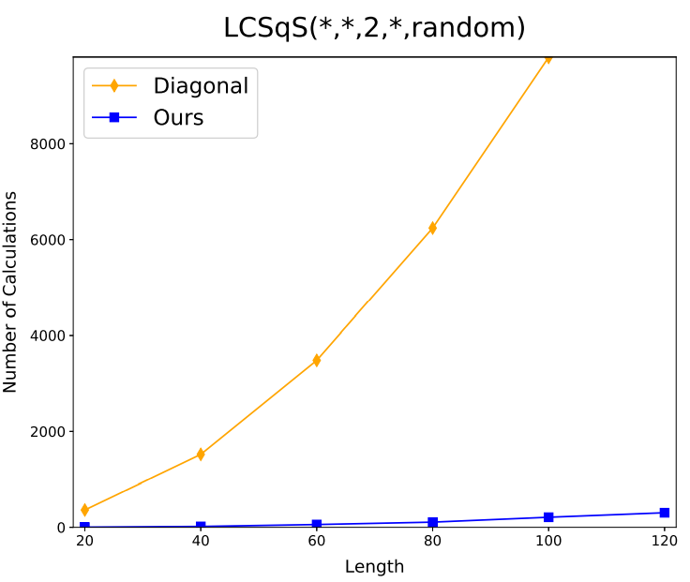
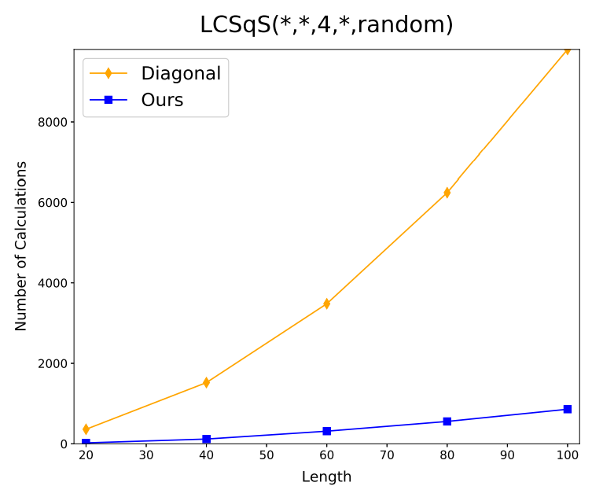
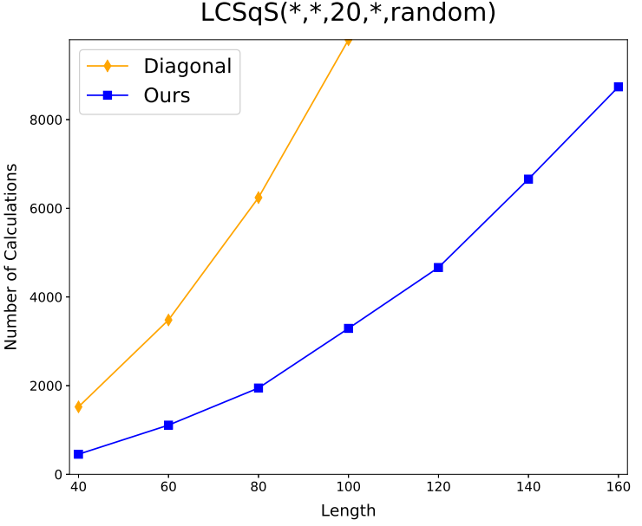
Experimental Results

Slide 22
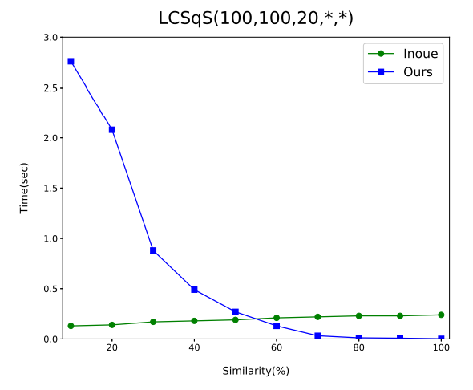
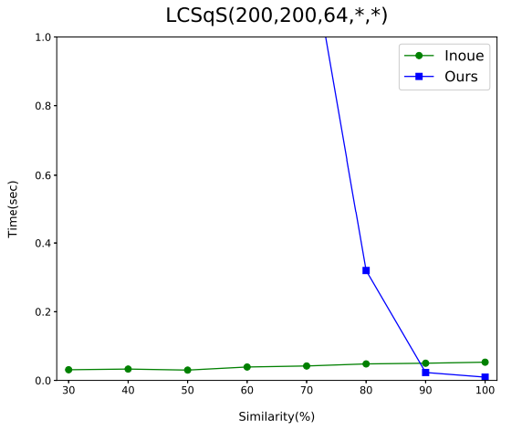
Experimental Results

Slide 23
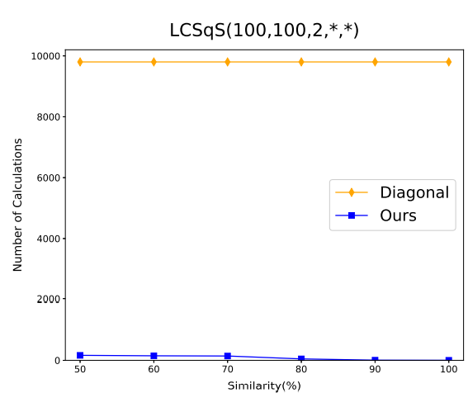
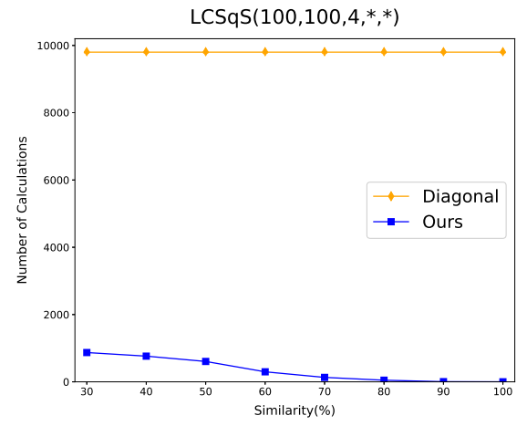
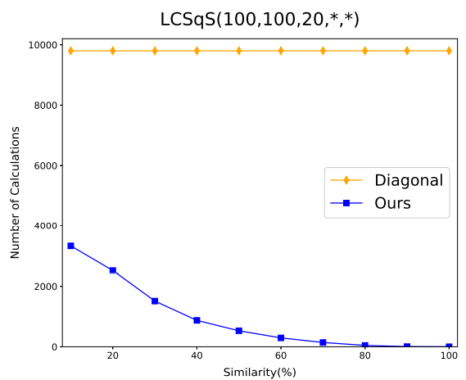
Experimental Results

Slide 24
Conclusion
From the experimental results, we observe that our algorithm is more efficient when the |Σ| is low or the similarity is high, while the Inoue algorithm is more efficient when the |Σ| is high or the similarity is low. We can use more efficient algorithms in different input situations.
Our algorithm might be improved in the execution of the diagonal algorithm. If this improvement can be developed, the time complexity of the LCSqS problem may be reduced.

Slide 25
Thank you for listening

