Slide 1
GRP-HEFT: A Budget-Constrained Resource Provisioning Scheme for Workflow Scheduling in IaaS Clouds
Hamid Reza Faragardi , Mohammad Reza Saleh Sedghpour , Saber Fazliahmadi, Thomas Fahringer , Member, IEEE, and Nayereh Rasouli
IEEE TRANSACTIONS ON PARALLEL AND DISTRIBUTED SYSTEMS, VOL. 31, NO. 6, JUNE 2020
Date: Dec. 23,2021
Presenter: Jue-Jun Wu

Slide 2
Abstract
In Infrastructure as a Service (IaaS) Clouds, users are charged to utilize cloud services according to a pay-per-use model. If users intend to run their workflow applications on cloud resources within a specific budget, they have to adjust their demands for cloud resources with respect to this budget. Although several scheduling approaches have introduced solutions to optimize the makespan of workflows on a set of heterogeneous IaaS cloud resources within a certain budget, the hourly-based cost model of some well-known cloud providers (e.g., Amazon EC2 Cloud) can easily lead to a higher makespan and some schedulers may not find any feasible solution. In this article, we propose a novel resource provisioning mechanism and a workflow scheduling algorithm, named Greedy Resource Provisioning and modified HEFT (GRP-HEFT), for minimizing the makespan of a given workflow subject to a budget constraint for the hourly-based cost model of modern IaaS clouds. As a resource provisioning mechanism, we propose a greedy algorithm which lists the instance types according to their efficiency rate. For our scheduler, we modified the HEFT algorithm to consider a budget limit. GRP-HEFT is compared against state-of-the-art workflow scheduling techniques, including MOACS (MultiObjective Ant Colony System), PSO (Particle Swarm Optimization), and GA (Genetic Algorithm). The experimental results demonstrate that GRP-HEFT outperforms GA, PSO, and MOACS for several well-known scientific workflow applications for different problem sizes on average by 13.64, 19.77, and 11.69 percent, respectively. Also in terms of time complexity, GRP-HEFT outperforms GA, PSO and MOACS.

Slide 3
we particularly focus on the hourly-based cost model, since it is widely used by large public cloud providers.
如果 pA 在比 pB 實例更短的時間內執行任務，則實例類型 A 比實例類型 B 更快。這種加速背後的原因可能是 (i) 實例類型的虛擬處理器的 MIPS 速率更高，(ii) 虛擬內核數量更多，(iii) 更大的內存大小和存儲容量，以及更快的存儲訪問時間.雲提供商使用指標名稱計算單元 (CU)（例如 Amazon EC2 使用的 ECU）或類似概念（例如平均性能 [2]）指定不同類型所提供實例的處理能力。
CU=計算單位， CU 值不僅取決於核心數，還取決於其他參數，例如內存大小。在 Amazon EC2 中，“m1.medium”和“m1.small”都包含單個虛擬 CPU，而它們的 CU 值分別為 3.75 和 1.7，這反映了這些實例類型的不同內存大小。
有多個實例類型具有相同的效率，則優先考慮速度最快的一個（即更高的 CU）

Slide 4
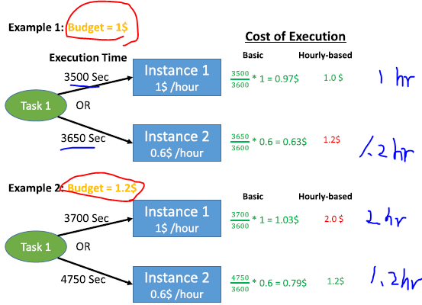
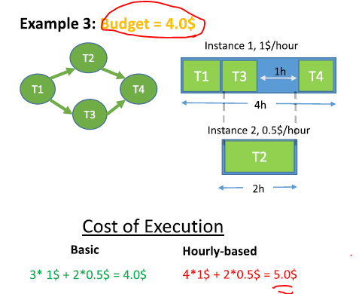
Notes:
為什麼成本模型的這個小變化會導致所有傳統的預算受限的工作流調度算法失敗？

Slide 5
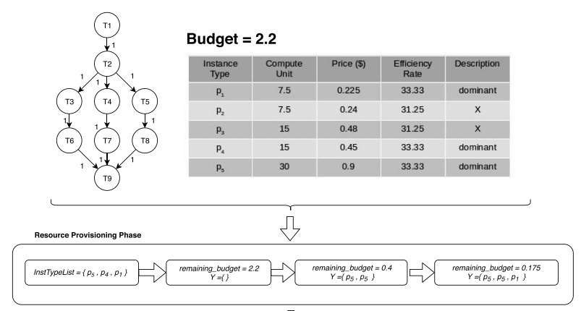

https://aws.amazon.com/tw/ec2/instance-types/
${Price}_{i}≤{Price}_{j}$ & ${CU}_{i}≥{CU}_{j}$
Notes:
什麼型態 要幾個在預算之內

Slide 6
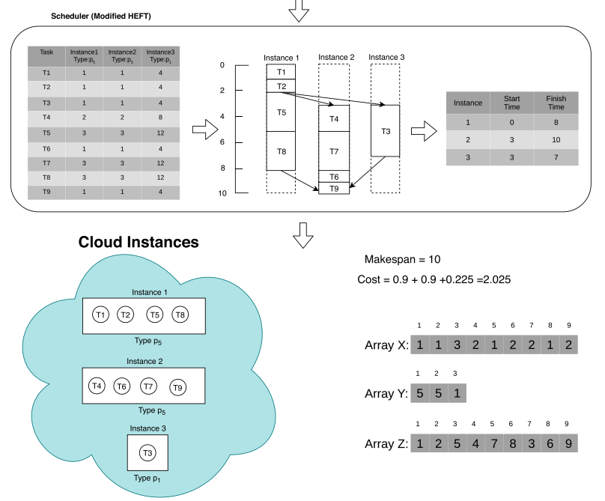

Slide 7
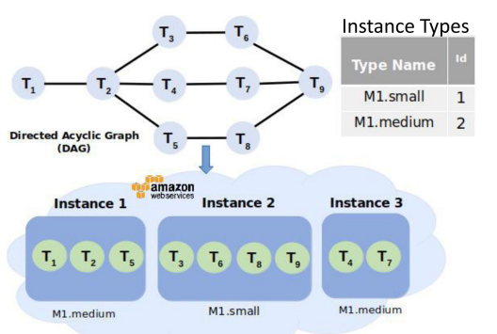
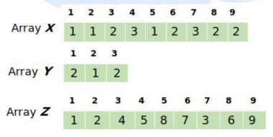
 | CPU | memory | CU
m1.medium | a single virtual CPU | Large | 3.75
m1.small | a single virtual CPU | small | 1.7
Array x: represent the assignment of tasks to instances
Array y: represent the type of each instance
Array z: represent the execution order of tasks
Notes:
hourly-based
m1.medium”和“m1.small”都包含單個虛擬 CPU，而它們的 CU 值分別為 3.75 和 1.7，這反映了這些實例類型的不同內存大小。優先考慮速度最快的一個

Slide 8
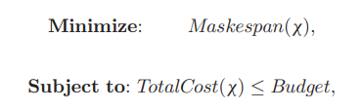
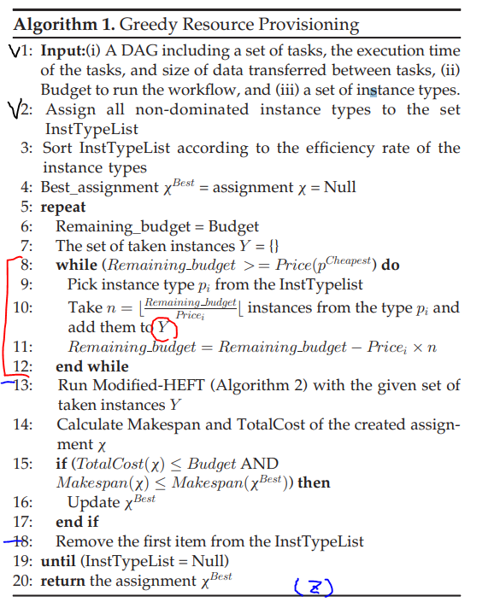
The generated set of instances Y , is given as an input to a modified version of the well-known HEFT algorithm.
The modified-HEFT completes the assignment x by filling the values of X and Z arrays.
Eventually, the best assignment found across all iterations returns the final solution.

Slide 9
Notes:
依照效率高到低排序好，Greedy Resource Provisioning + modified HEFT

Slide 10
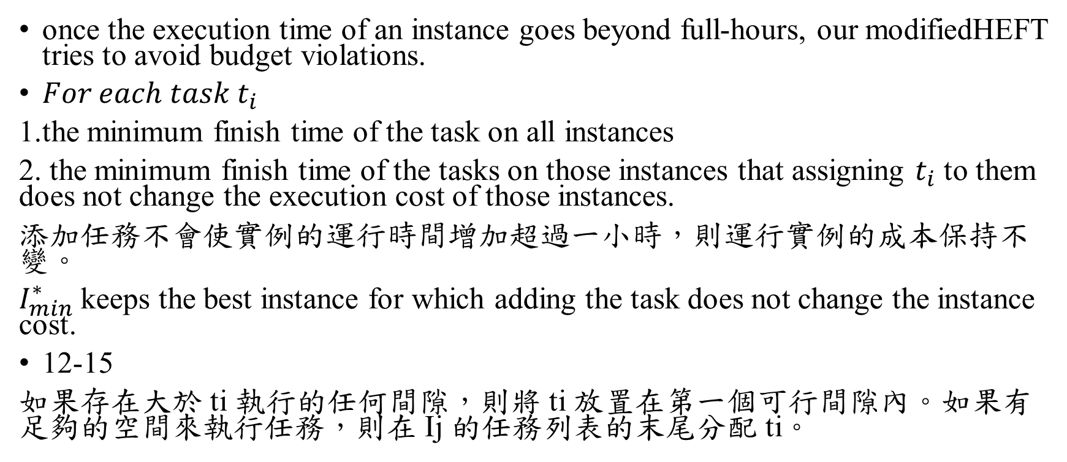
difference
once the execution time of an instance goes beyond full-hours, our modifiedHEFT tries to avoid budget violations.
${For each task t}_{i}$
1.the minimum finish time of the task on all instances
2. the minimum finish time of the tasks on those instances that assigning $t_{i}$ to them does not change the execution cost of those instances.
添加任務不會使實例的運行時間增加超過一小時，則運行實例的成本保持不變。
$I_{min}^{∗}$ keeps the best instance for which adding the task does not change the instance cost.
12-15
如果存在大於 ti 執行的任何間隙，則將 ti 放置在第一個可行間隙內。如果有足夠的空間來執行任務，則在 Ij 的任務列表的末尾分配 ti。
Notes:
由於資源提供方法沒有考慮提供實例的運行時間超過一小時的情況，因此在調度階段可能會違反預算約束。

Slide 11
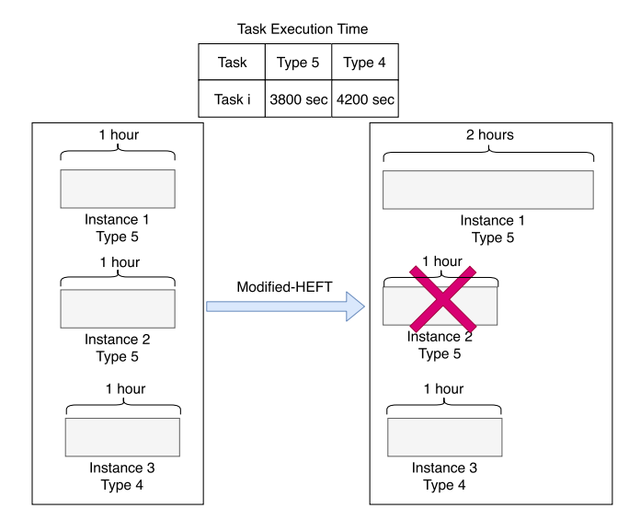
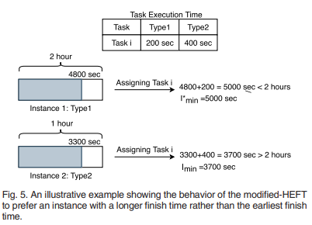
Difference
Modified-HEFT employs a Budget-Violation Avoidance(BVA) mechanism for dealing with such situations.
Once the execution time of an instance goes beyond full-hours, our modified HEFT tries to avoid budget violations.
Notes:
添加任務不會使實例的運行時間增加超過一小時，則運行實例的成本保持不變。
Heft不關心預算
如果存在大於 ti 執行的任何間隙，則將 ti 放置在第一個可行間隙內

Slide 12
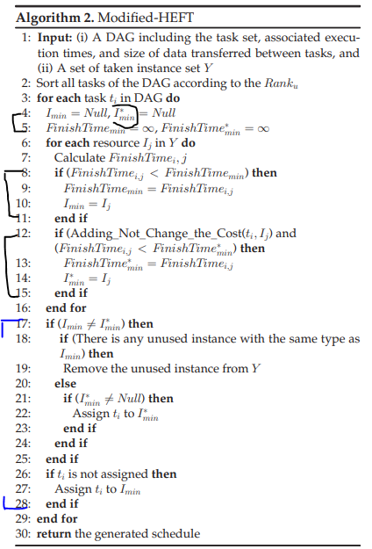

Difference
Modified-HEFT employs a Budget-Violation Avoidance(BVA) mechanism for dealing with such situations.
Once the execution time of an instance goes beyond full-hours, our modifiedHEFT tries to avoid budget violations.
$I_{min}^{∗}$ keeps the best instance for which adding the task does not change the instance cost.

Slide 13
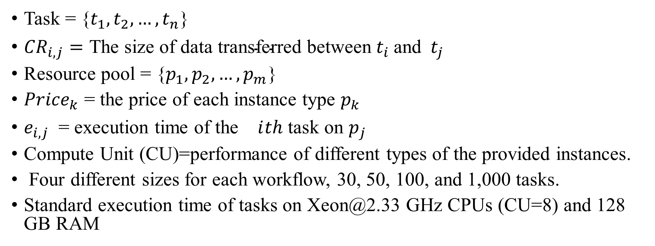
Parameter
Task = {$t_{1},t_{2},…,t_{n}$}
${CR}_{i,j}=\text{The} \text{size} \text{of} \text{data} \text{transferred} \text{between}{ t}_{i} \text{and}{ t}_{j}$
Resource pool = {$p_{1},p_{2},…,p_{m}$}
${Price}_{k}$ = the price of each instance type $p_{k}$
$e_{i,j}$ = execution time of the ${}_{}^{}ith$ task on $p_{j}$
Compute Unit (CU)=performance of different types of the provided instances.
Four different sizes for each workflow, 30, 50, 100, and 1,000 tasks.
Standard execution time of tasks on Xeon@2.33 GHz CPUs (CU=8) and 128 GB RAM

Slide 14
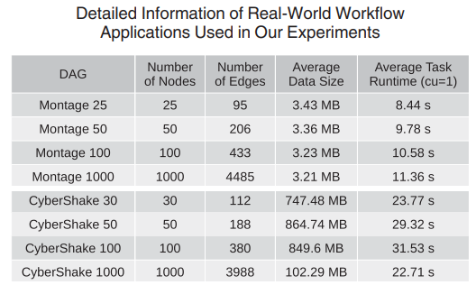
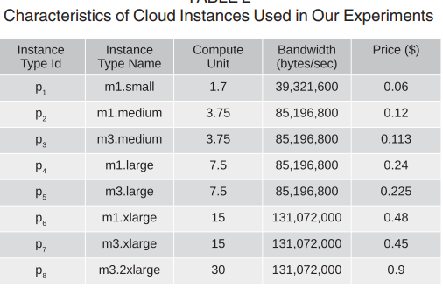
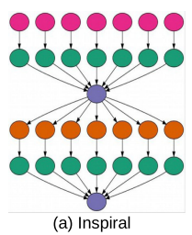
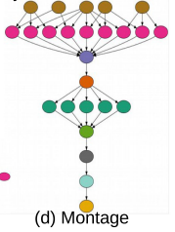
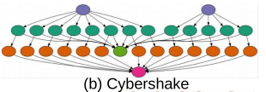
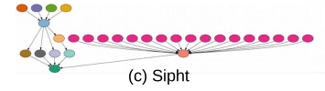

Slide 15
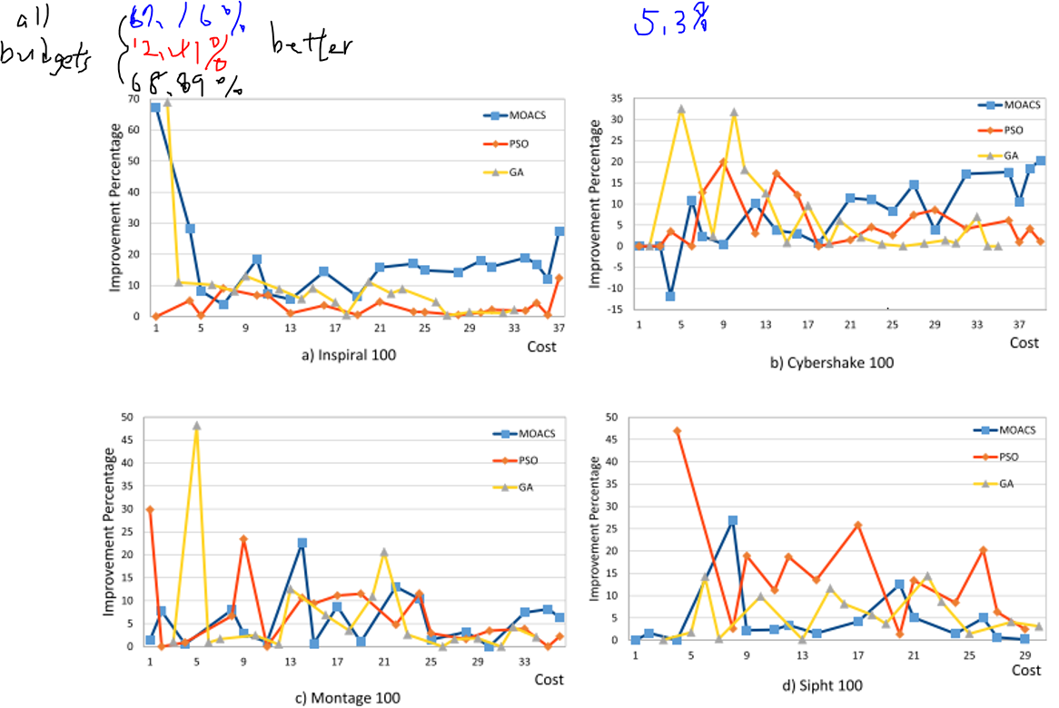

Slide 16
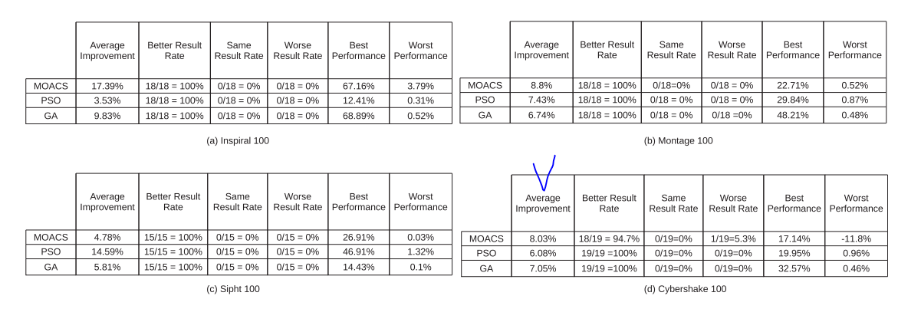

Slide 17
Thanks for listening.

Slide 19
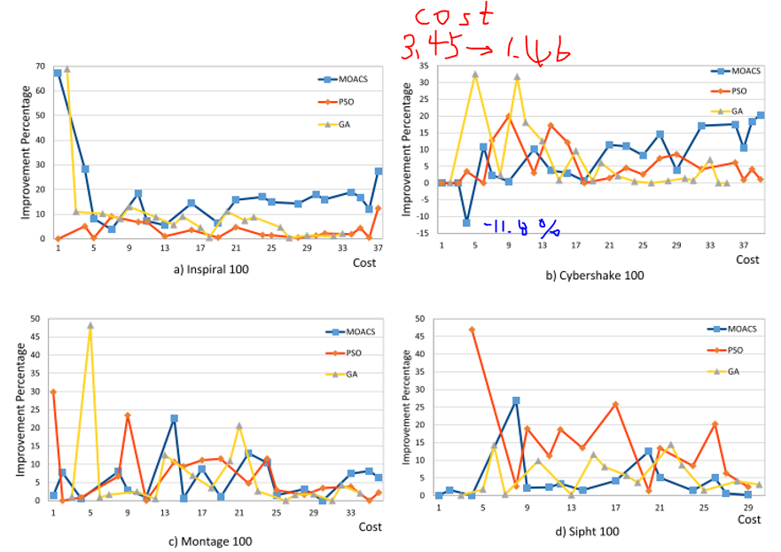

Slide 20
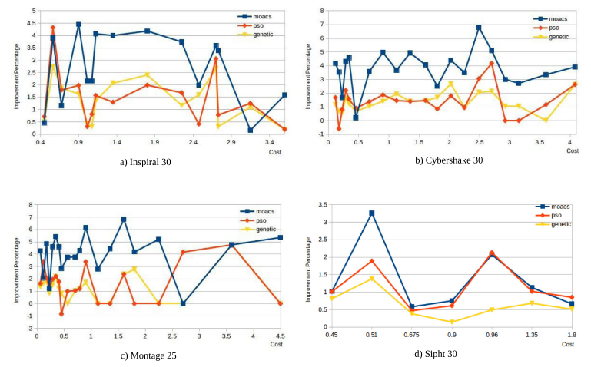


Slide 21
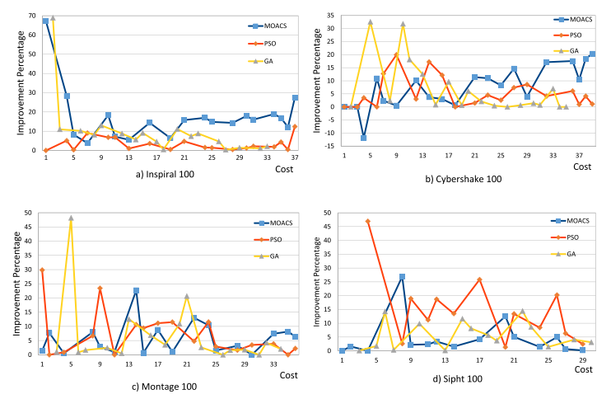

Slide 22
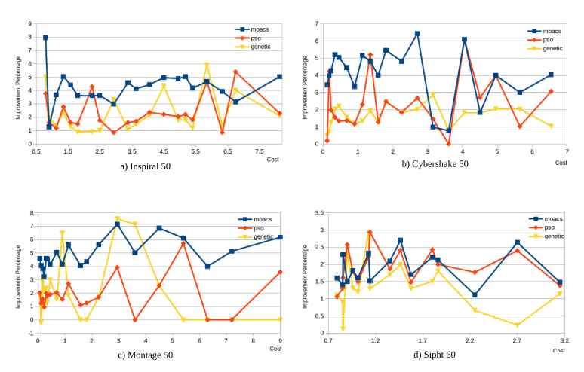

Slide 23
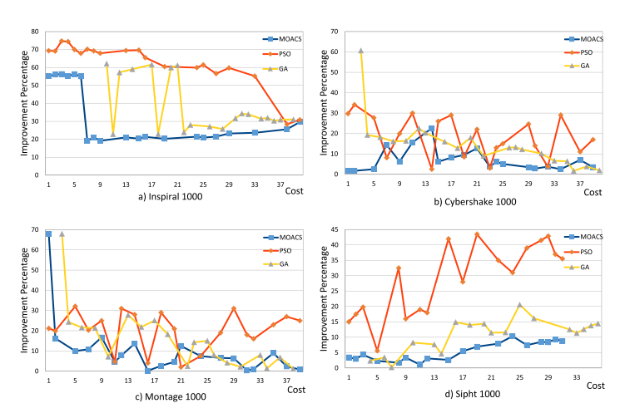

Slide 24
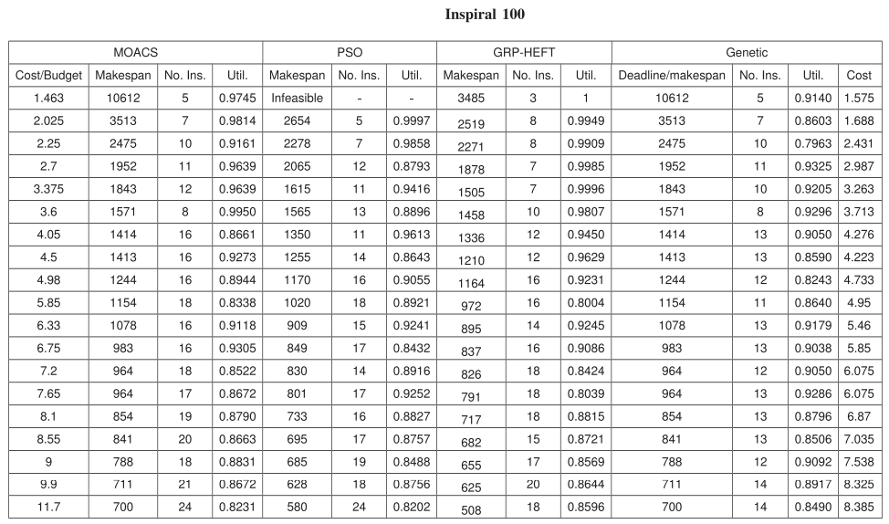



Slide 25
For workflows with 100 tasks, the results generated by GRPHEFT improves . The average makespan improvement against MOACS, PSO, and GA is 13.64, 31.64, and 19.93 percent, respectively.

