Slide 1
Monte Carlo Sampling for Regret Minimization in Extensive Games
Marc Lanctot, Kevin Waugh, Martin Zinkevich, Michael Bowling
Twenty-Third Annual Conference on Neural Information Processing Systems, NIPS 2009, Hyatt Regency Vancouver, Vancouver, B.C., Canada
Presenter: Jing-Ping Jan
Date: Dec. 28, 2021

Slide 2
Abstract
Sequential decision-making with multiple agents and imperfect information is commonly modeled as an extensive game. One efficient method for computing Nash equilibria in large, zero-sum, imperfect information games is counterfactual regret minimization (CFR). In the domain of poker, CFR has proven effective, particularly when using a domain-specific augmentation involving chance outcome sampling. In this paper, we describe a general family of domain-independent CFR sample-based algorithms called Monte Carlo counterfactual regret minimization (MCCFR) of which the original and poker-specific versions are special cases. We start by showing that MCCFR performs the same regret updates as CFR on expectation. Then, we introduce two sampling schemes: outcome sampling and external sampling, showing that both have bounded overall regret with high probability. Thus, they can compute an approximate equilibrium using self-play.

Slide 3
Abstract
Finally, we prove a new tighter bound on the regret for the original CFR algorithm and relate this new bound to MCCFR’s bounds. We show empirically that, although the sample-based algorithms require more iterations, their lower cost per iteration can lead to dramatically faster convergence in various games.

Slide 4
Introduction- Nash equilibrium
Business case
Original price: 80, 1200 customers
Cost: 20
One of them decrease 1 dollar: gain 100 customers(80 customers are from another and 20 new customers)
Both decrease 1 dollar: both gain 20 new customers
If we want to decrease price to 38~42 dollars, which price should be select?

Slide 5
Introduction- Nash equilibrium
 | A
B |  | 42 | 41 | 40 | 39 | 38
 | 42 | 43120 | 43260 | 43200 | 42940 | 42480
 |  | 43120 | 41360 | 39600 | 39840 | 36080
 | 41 | 41360 | 41580 | 41600 | 41420 | 41040
 |  | 43260 | 41580 | 39900 | 38220 | 36540
 | 40 | 39600 | 39900 | 40000 | 39900 | 39600
 |  | 43200 | 41600 | 40000 | 38400 | 36800
 | 39 | 37840 | 38220 | 38400 | 38380 | 38160
 |  | 42940 | 41420 | 39900 | 38380 | 36860
 | 38 | 36080 | 36540 | 36800 | 36860 | 36720
 |  | 42480 | 41040 | 39600 | 38160 | 36720

Slide 6
Introduction- Mixed Strategies
Mixed strategies(40:60):
Goalkeeper choose left: 58 % *0.4+93 % *0.6 = 79%
Goalkeeper choose right: 95 % *0.4+70 % *0.6 = 80%
 | Goalkeeper
Player | Probability of scoring(%) | Left | Right
 | Left | 58 | 95
 | Right | 93 | 70

Slide 7
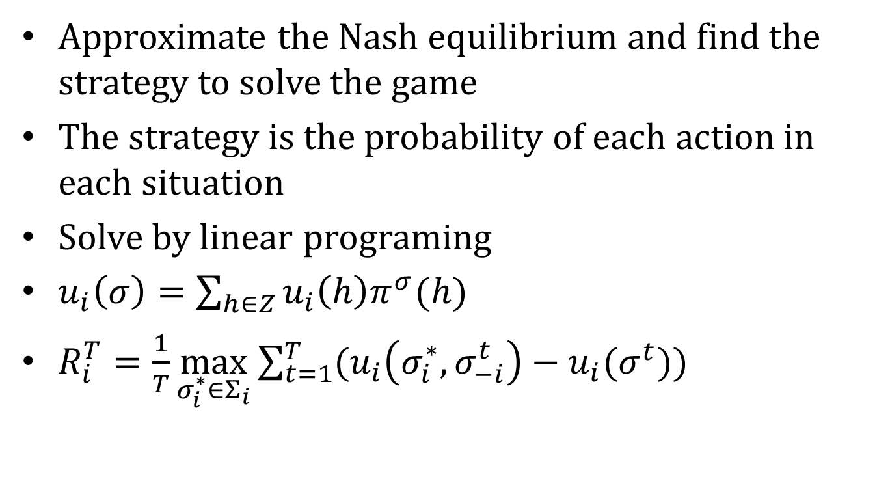
Look back - Regret minimization
Approximate the Nash equilibrium and find the strategy to solve the game
The strategy is the probability of each action in each situation
Solve by linear programing
$u_{i}\left(σ\right)=\sum_{h∈Z}{u_{i}\left(h\right)π^{σ}(h)}$
$R_{i}^{T}=\frac{1}{T}\max_{σ_{i}^{∗}∈Σ_{i}}{\sum_{t=1}^{T}{(u_{i}\left(σ_{i}^{∗}, σ_{−i}^{t}\right)−u_{i}(σ^{t}))}}$

Slide 8
Look back - Regret minimization
Kuhn poker
With three cards: J, Q, K
Each player antes 1
One betting round
One-bet maximum
12 information sets

Slide 9
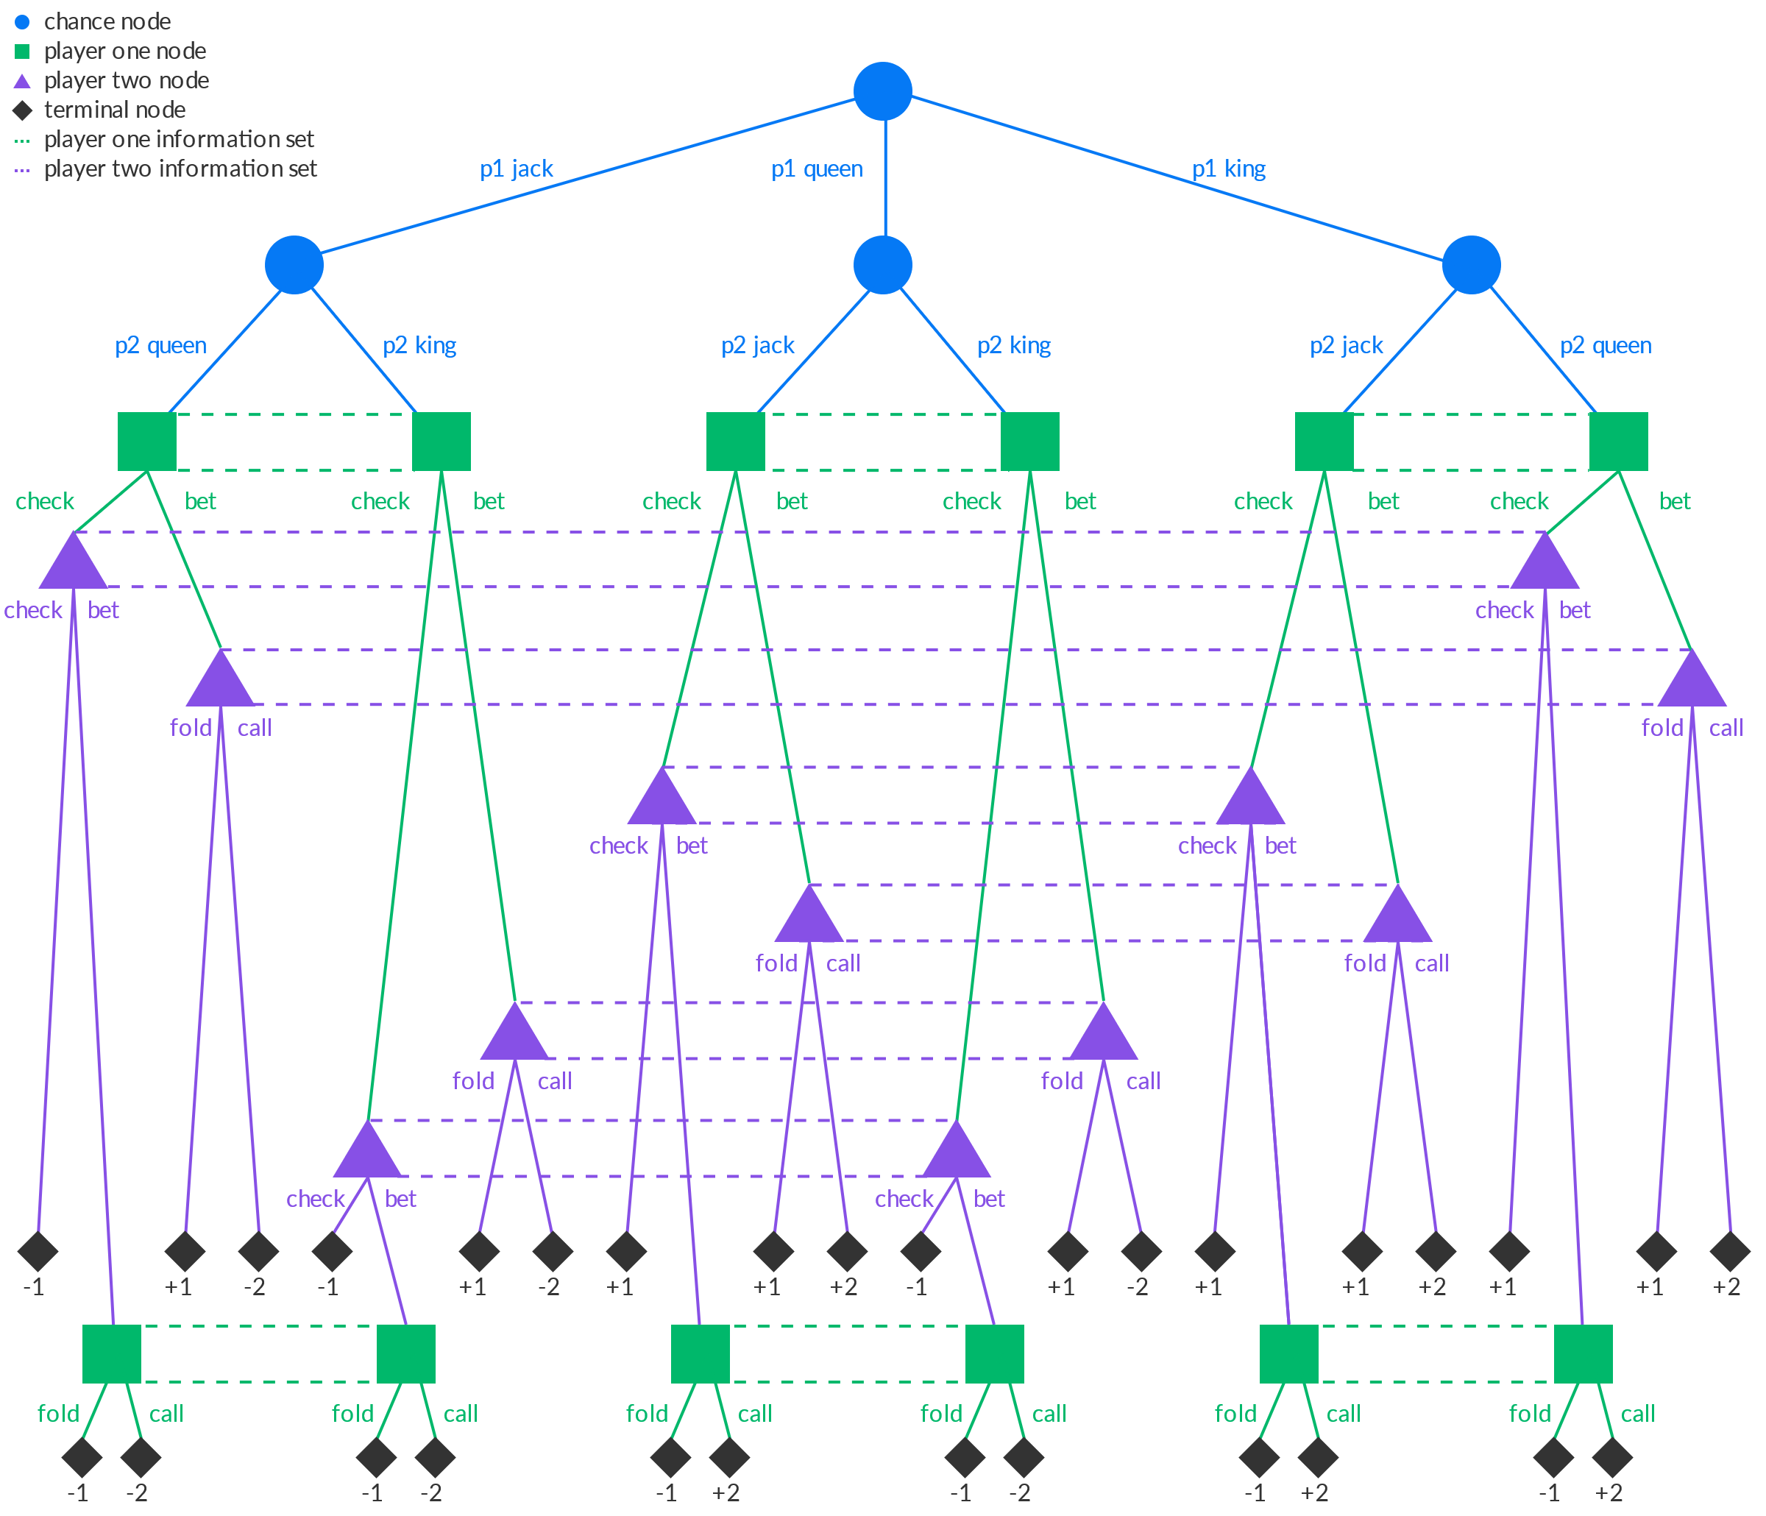
Look back - Regret minimization

Slide 10
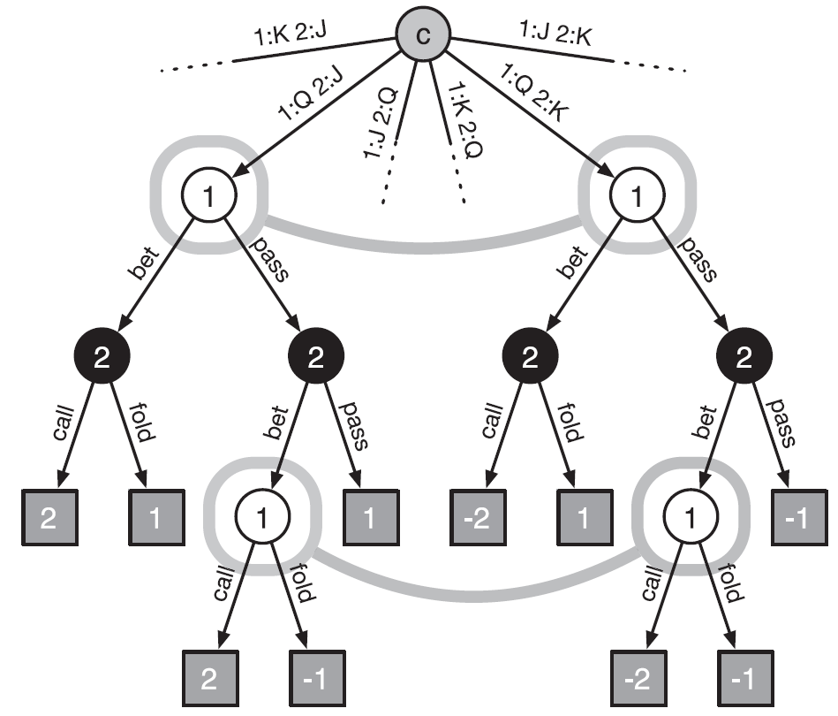
Look back - Regret minimization

Slide 11
Look back - Regret minimization
#chips player1 can win | Player 2 J
Player 1 Q | History = pass, bet | Bet
 | Call | 2
 | Fold | -1
#chips player1 can win | Player 2 K
Player 1 Q | History = pass, bet | Bet
 | Call | -2
 | Fold | -1

Slide 12
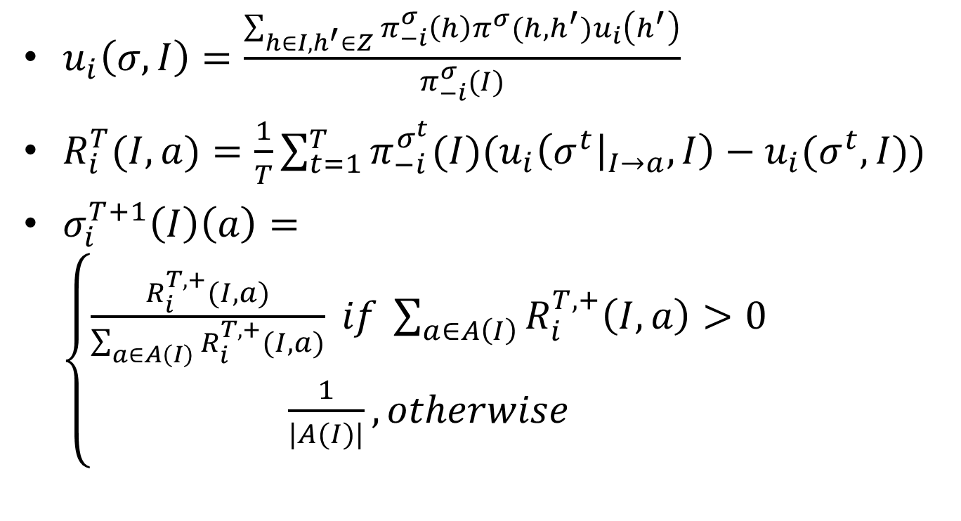
Look back - Counterfactual regret minimization(CFR)
$u_{i}\left(σ,I\right)=\frac{\sum_{h∈I,h^{′}∈Z}{{π_{−i}^{σ}\left(h\right)π^{σ}(h,h^{′})u}_{i}\left(h^{′}\right)}}{π_{−i}^{σ}(I)}$
$R_{i}^{T}(I,a)=\frac{1}{T}{\sum_{t=1}^{T}{π_{−i}^{σ^{t}}(I)(u_{i}\left(σ^{t}{\left.​\right|}_{I→a},I\right)−u_{i}(σ^{t},I))}}$
$σ_{i}^{T+1}\left(I\right)\left(a\right)=\left\{\begin{aligned}\frac{R_{i}^{T,+}(I,a)}{\sum_{a∈A\left(I\right)}{R_{i}^{T,+}(I,a)}} if \sum_{a∈A\left(I\right)}{R_{i}^{T,+}\left(I,a\right)>0} \\ \frac{1}{|A(I)|}, otherwise\end{aligned}\right.$

Slide 13
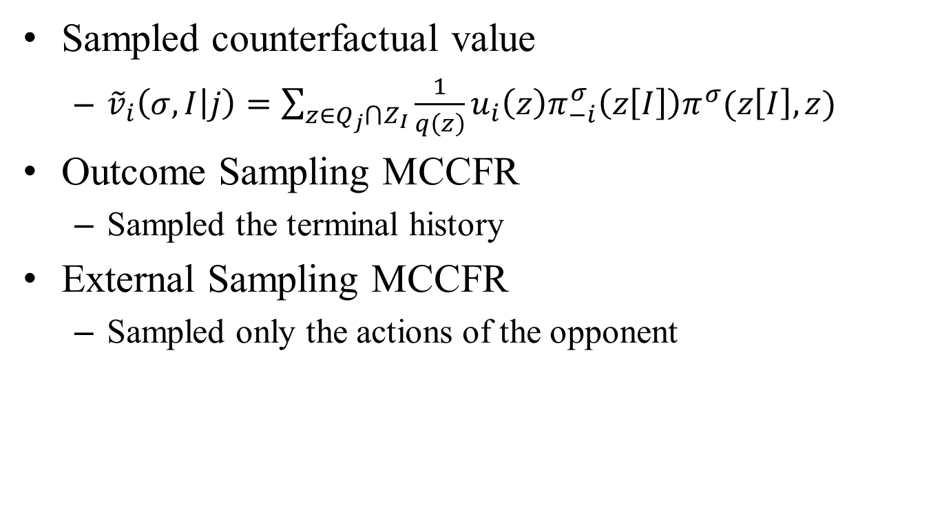
Monte Carlo CFR
Sampled counterfactual value
${\tilde{v}}_{i}\left(σ,I | j\right)=\sum_{z∈Q_{j}⋂Z_{I}}{\frac{1}{q\left(z\right)}u_{i}\left(z\right)π_{−i}^{σ}\left(z\left[I\right]\right)π^{σ}(z\left[I\right],z)}$
Outcome Sampling MCCFR
Sampled the terminal history
External Sampling MCCFR
Sampled only the actions of the opponent

Slide 14
Introduction – Monte Carlo Sampling

Slide 15
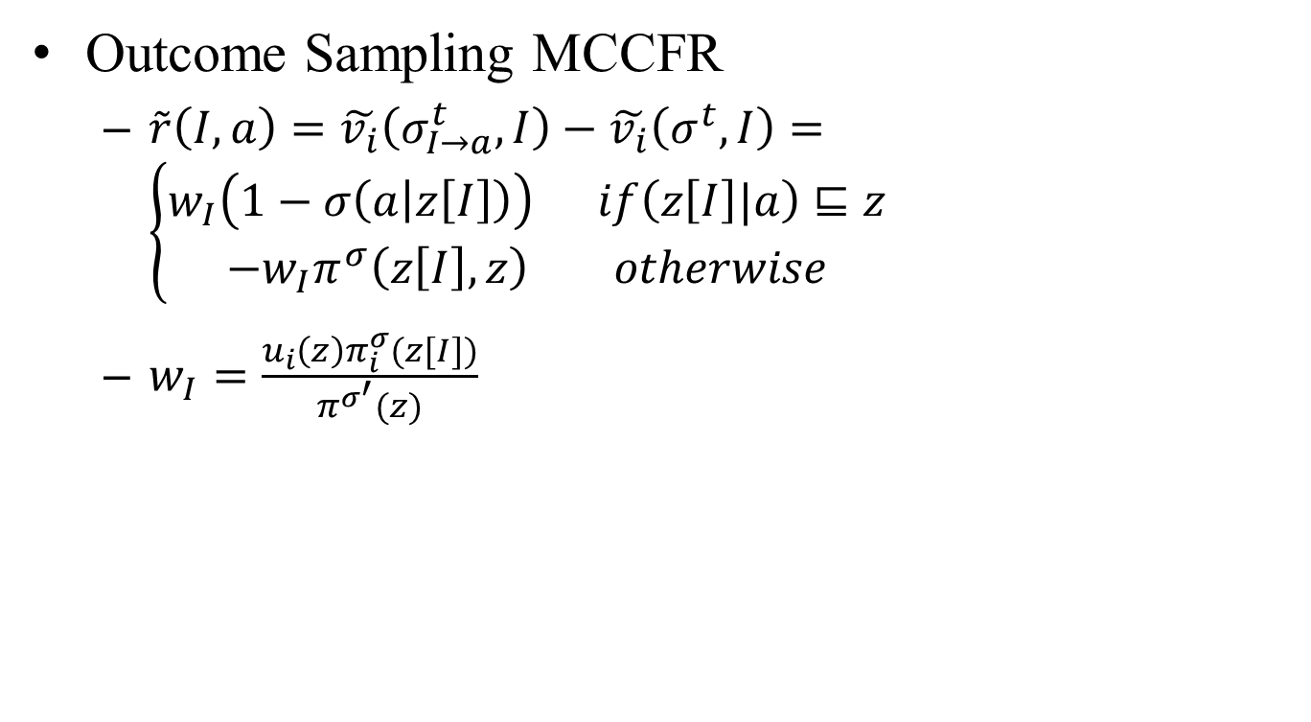
Monte Carlo CFR
Outcome Sampling MCCFR
$\tilde{r}\left(I,a\right)=\tilde{v_{i}}\left(σ_{I→a}^{t},I\right)−\tilde{v_{i}}\left(σ^{t},I\right)=\left\{\begin{aligned}w_{I}\left(1−σ\left(a | z\left[I\right]\right)\right) if\left(z\left[I\right]|a\right)⊑z \\ −w_{I}π^{σ}\left(z\left[I\right],z\right) otherwise\end{aligned}\right.$
$w_{I}=\frac{u_{i}\left(z\right)π_{i}^{σ}(z[I])}{π^{σ^{′}}(z)}$

Slide 16
Look back - Regret minimization

Slide 17

Monte Carlo CFR
External Sampling MCCFR
$\tilde{r}\left(I,a\right)=\sum_{z∈Q⋂Z_{I}}{({\tilde{v}}_{i}\left(σ_{I→a}^{t},I\right)−{\tilde{v}}_{i}(σ^{t},I))}$
$=\left(1−σ\left(a | I\right)\right)\sum_{z∈Q⋂Z_{I}}{u_{i}\left(z\right)π_{i}^{σ}(z\left[I\right]a, z)}$

Slide 18
Introduction- Mixed Strategies
Mixed strategies(40:60):
Goalkeeper choose left: 58 % *0.383+93 % *0.617 = 79.6%
Goalkeeper choose right: 95 % *0.383+70 % *0.617 = 79.6%
 | Goalkeeper
Player | Probability of scoring(%) | Left | Right
 | Left | 58 | 95
 | Right | 93 | 70

Slide 19
Monte Carlo CFR – Experimental result
One Card Poker
Goofspiel
Latent Tic-Tac-Toe
Princess and Monster
Notes:
H = history
I = information

Slide 20
Monte Carlo CFR – Experimental result
One Card Poker, deck size = 500
Notes:
H = history
I = information

Slide 21
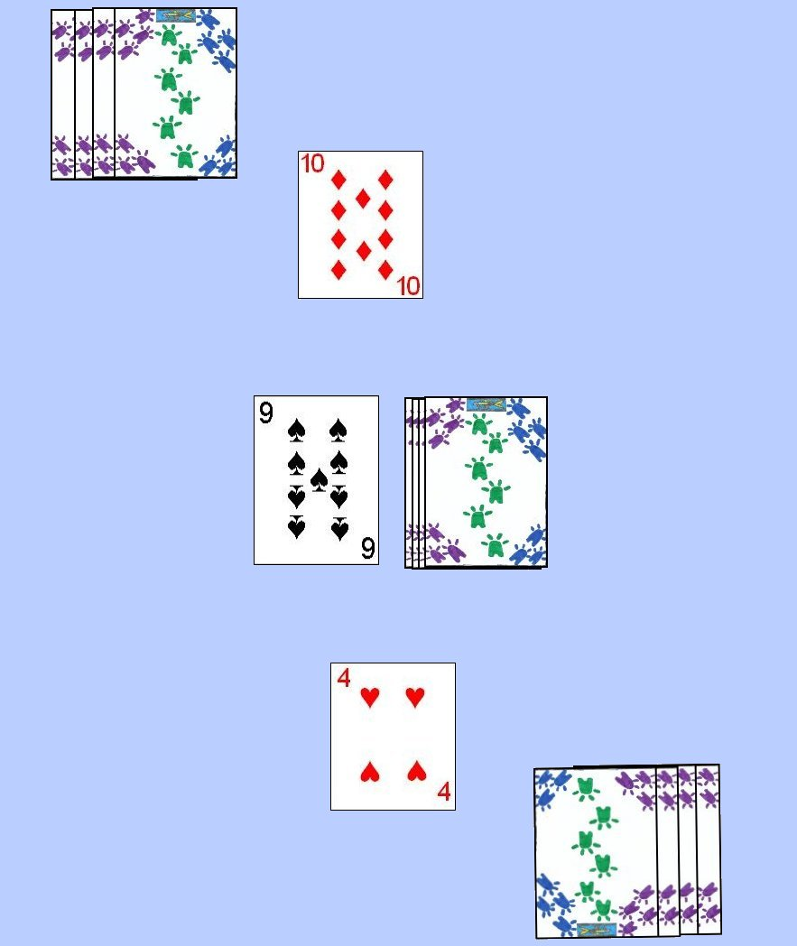
Monte Carlo CFR – Experimental result
Goofspiel
Size = 7
The player with the highest total points wins
Players only find out the result of each bid and not which cards were use to bid
Notes:
H = history
I = information

Slide 22
Monte Carlo CFR – Experimental result
Latent Tic-Tac-Toe
Notes:
H = history
I = information

Slide 23
Monte Carlo CFR – Experimental result
Latent Tic-Tac-Toe
Notes:
H = history
I = information

Slide 24
Monte Carlo CFR – Experimental result
Latent Tic-Tac-Toe
Notes:
H = history
I = information

Slide 25
Monte Carlo CFR – Experimental result
Latent Tic-Tac-Toe
Notes:
H = history
I = information

Slide 26
Monte Carlo CFR – Experimental result
Latent Tic-Tac-Toe
Notes:
H = history
I = information

Slide 27
Monte Carlo CFR – Experimental result
Latent Tic-Tac-Toe
Notes:
H = history
I = information

Slide 28
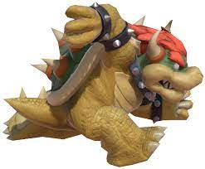
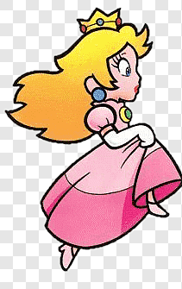

Monte Carlo CFR – Experimental result
Princess and Monster , 3 by 3 grid graph and 13 steps
Notes:
H = history
I = information

Slide 29
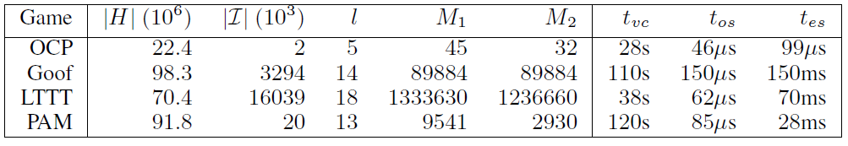
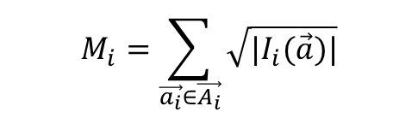
Monte Carlo CFR – Experimental result
One Card Poker
Goofspiel
Latent Tic-Tac-Toe
Princess and Monster
$$M_{i}=\sum_{\vec{a_{i}}∈\vec{A_{i}}}{\sqrt{|I_{i}(\vec{a})|}}$$
Notes:
H = history
I = information

Slide 30
Monte Carlo CFR – Experimental result
Notes:
H = history
I = information

Slide 31
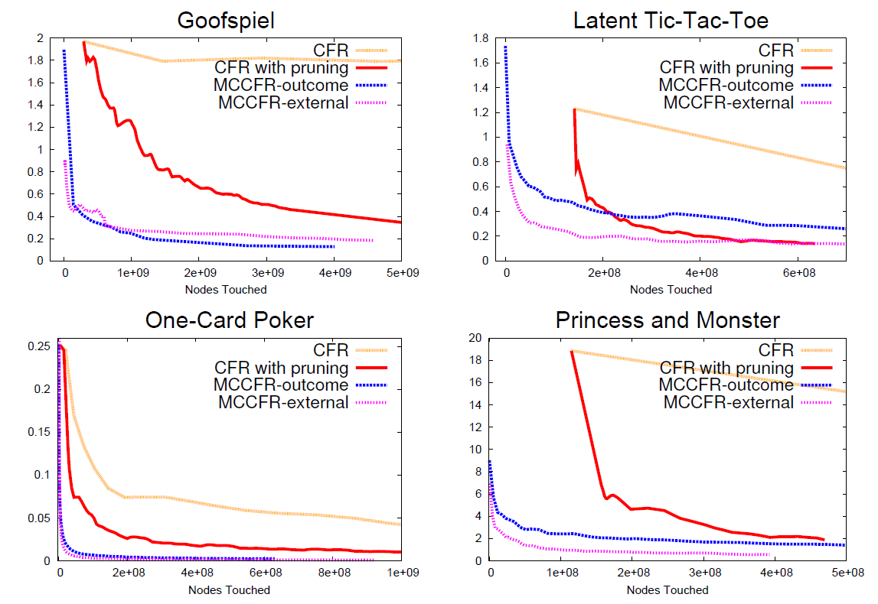

Monte Carlo CFR – Experimental result
$ε_{σ}=b_{1}\left(σ_{2}\right)+b_{2}(σ_{1})$
Notes:
H = history
I = information

