Slide 1
IEEE Transactions on Pattern Analysis and Machine Intelligence, vol. 36, pp. 2199-2213, 2014, Xianbiao Qi, Rong Xiao, Jun Guo, and Lei Zhang
Pairwise Rotation Invariant Co-occurrence Local Binary Pattern
Presenter：Wei-Hao Fu
Date：2018/01/09
Notes:
1

Slide 2
Abstract (1/2)
In this work, we introduce a novel pairwise rotation invariant co-occurrence local binary pattern (PRI-CoLBP) feature which incorporates two types of context - spatial co-occurrence and orientation cooccurrence. Different from traditional rotation invariant local features, pairwise rotation invariant co-occurrence features preserve relative angle between the orientations of individual features. The relative angle depicts the local curvature information, which is discriminative and rotation invariant.

Slide 3
Abstract (2/2)
Experimental results on the CUReT, Brodatz, KTH-TIPS texture dataset, Flickr Material dataset, and Oxford 102 Flower dataset further demonstrate the superior performance of the proposed feature on texture classification, material recognition and flower recognition tasks.

Slide 4
Local Binary Pattern (LBP)
54 | 92 | 14
48 | 50 | 8
65 | 28 | 44
1 | 1 | 0
0 | 50 | 0
1 | 0 | 0
LBP: 11000010

Slide 5
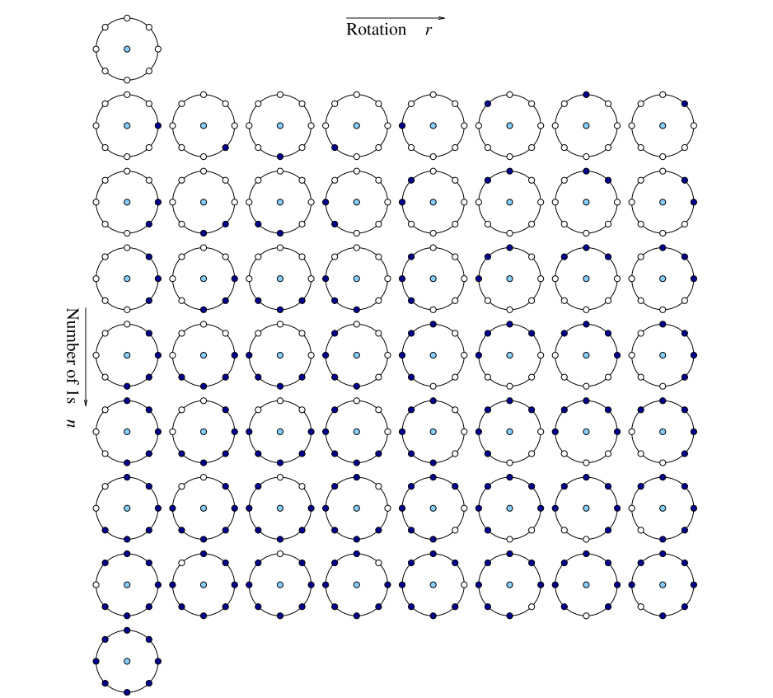
Uniform-LBP
From 256 dimension to 59.

Slide 6
Uniform Rotation Invariant LBP
From 59 dimension to 10.
Rotation invariant.
RU-LBP
1
2
3
4
5
6
7
8
9
10
Others

Slide 7
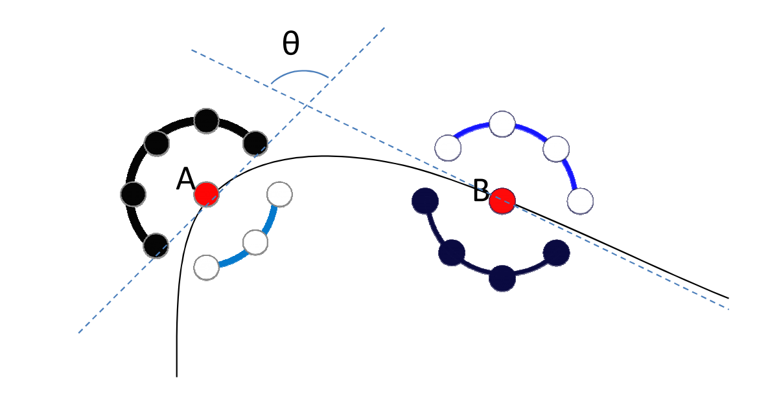
CoLBP

Slide 8
UU-CoLBP
UU-CoLBP = [Uniform-LBP, Uniform-LBP]_{co}
Two problems:
Dimension is too high: 59*59=3481
UU-CoLBP is not pairwise rotation invariant.
90°

Slide 9
RURU-CoLBP
RURU-CoLBP = [RU-LBP, RU-LBP]_{co}
RURU-CoLBP discards the angle information.

Slide 10
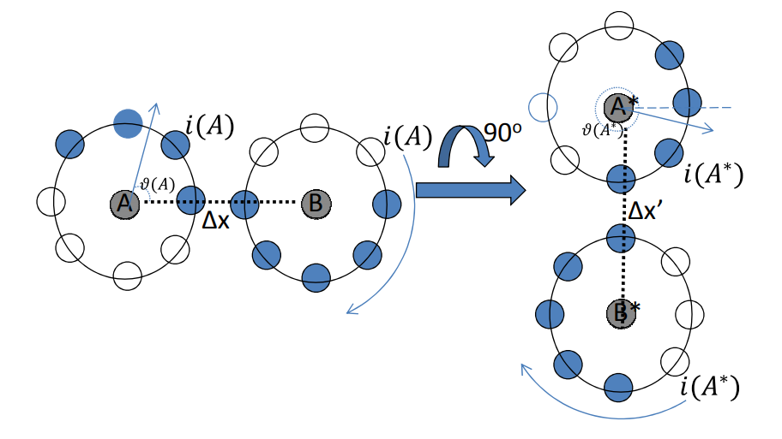
Pairwise Rotation Invariant CoLBP
PRI-CoLBP = [RU-LBP, U-LBP]_{co}

Slide 11
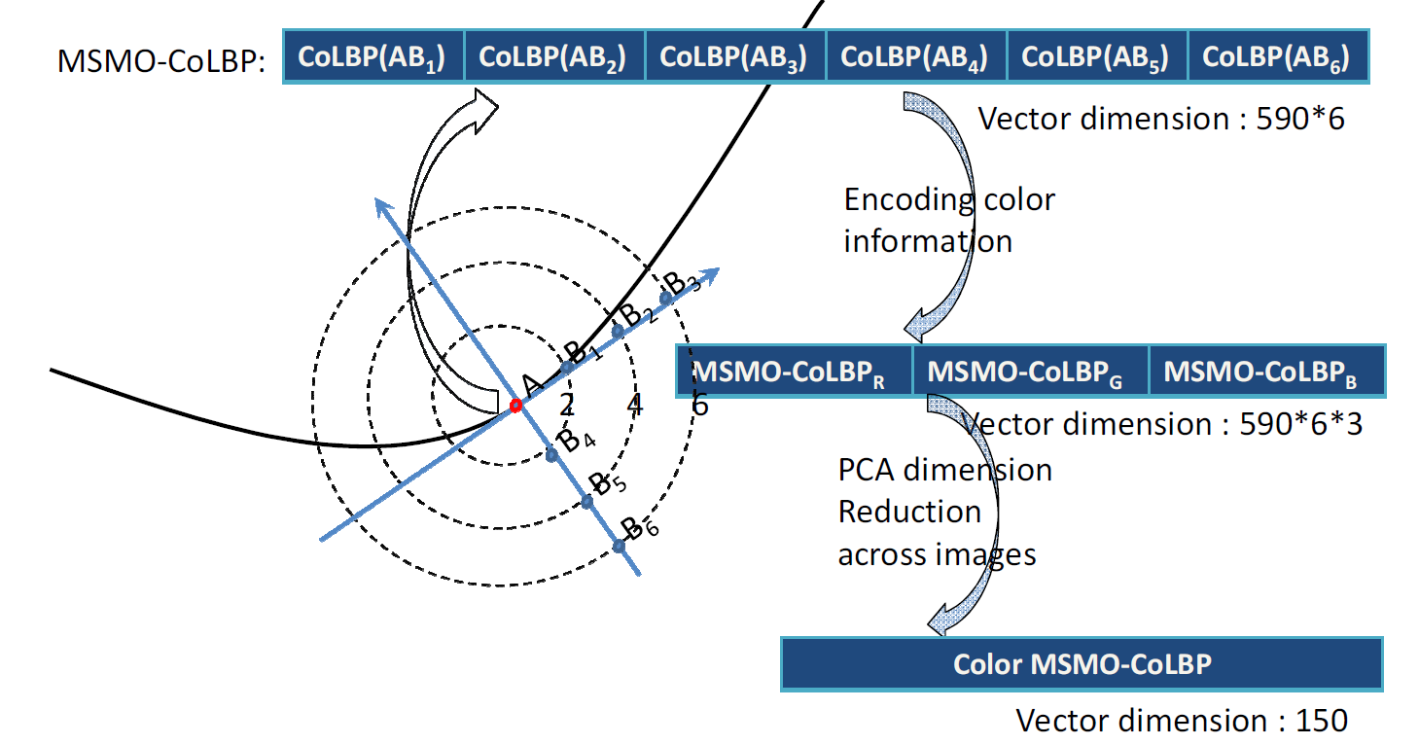
Multi-Scale and Multi-Orientation PRI-CoLBP
MSMO PRI-CoLBP
Notes:
Principal component analysis (PCA)

Slide 12
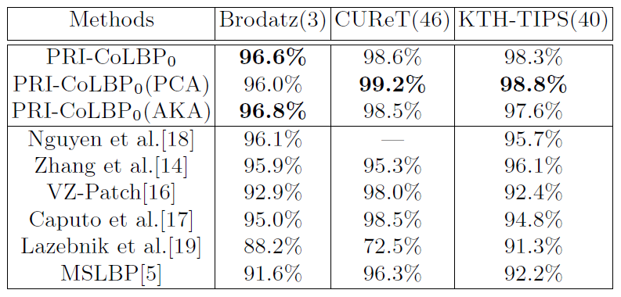
Experimental result (1/2)

Slide 13
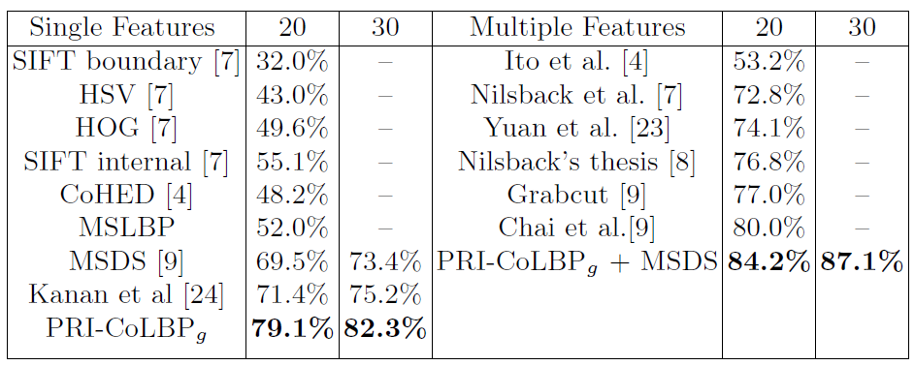
Experimental result (2/2)

