Slide 1
Similar Subsequence Search in Time Series Databases
Shrikant Kashyap
Mong Li Lee
Wynne Hsu
Proceedings of the 22 International Conference on Database and Expert Systems Applications, Toulouse, France,
pp. 232-246, 2011
Presenter: Hsiu-Chieh Hung
Date: 2018/1/9

Slide 2
Abstract
Finding matching subsequences in time series data is an important problem. The classical approach to search for matching subsequences has been on the principle of exhaustive search, where all possible candidates are generated and evaluated or all the terms of the time series in a data base are examined. As a result most of the subsequence search algorithms are cubic in nature with few algorithms of quadratic nature. Some approximate algorithms have been proposed, as a result, to speed up the search for matching subsequences. In this work, we propose a fast and efficient exact subsequence search algorithm which is subquadratic in nature. We introduce the notion of eHaar (envelope Haar) to prune parts of the time series data which will not contain subsequences that can match the query subsequence. This pruning phase dramatically reduces the search space, thus allowing dynamic time warping based subsequence search techniques to be applied on gigabyte-size time series databases. Experiment results demonstrate that the proposed approach outperforms existing state-of-the art techniques.

Slide 3
Haar wavelet transform
S = 9 7 5 3 0 2 -4 -6
Averages
9 | 7 | 5 | 3 | 0 | 2 | -4 | -6 |  | Coefficients
8 |  | 4 |  | 1 |  | -5 |  |  | 1 | 1 | -1 | 1
6 |  |  |  | -2 |  |  |  |  | 2 |  | 3
2 |  |  |  |  |  |  |  |  | 4

Slide 4
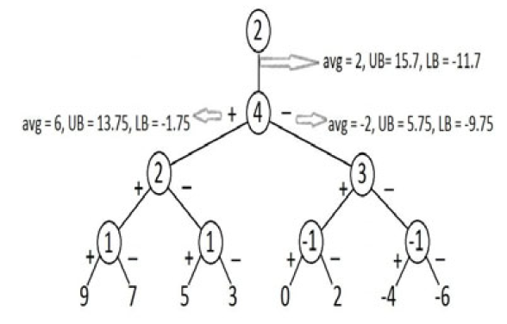
Haar wavelet transform
S = 9 7 5 3 0 2 -4 -6
C = 2 4 2 3 1 1 -1 1

Slide 5
Haar wavelet transform
S = 9 7 5 3 0 2 -4 -6
Averages
9 | 7 | 5 | 3 | 0 | 2 | -4 | -6 |  | Coefficients
8 |  | 4 |  | 1 |  | -5 |  |  | 1 | 1 | -1 | 1
6 |  |  |  | -2 |  |  |  |  | 2 |  | 3
2 |  |  |  |  |  |  |  |  | 4
C = C₁ C₂ C₃ C₄ …… C_{N}
C = 2 4 2 3 1 1 -1 1

Slide 6
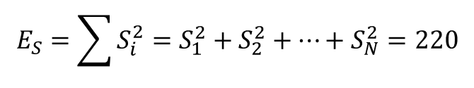
Haar wavelet transform
S = 9 7 5 3 0 2 -4 -6
Averages
9 | 7 | 5 | 3 | 0 | 2 | -4 | -6 |  | Coefficients
8 |  | 4 |  | 1 |  | -5 |  |  | 1 | 1 | -1 | 1
6 |  |  |  | -2 |  |  |  |  | 2 |  | 3
2 |  |  |  |  |  |  |  |  | 4
C = C₁ C₂ C₃ C₄ …… C_{N}
C = 2 4 2 3 1 1 -1 1
$$E_{S}=\sum{S_{i}^{2}}=S_{1}^{2}+S_{2}^{2}+⋯+S_{N}^{2}=220$$
$$E_{S}=2^{3}∗\left(2^{2}+4^{2}\right)+2^{2}∗\left(2^{2}+3^{2}\right)+2∗\left(1^{2}+1^{2}+{\left(−1\right)}^{2}+1^{2}\right)=220$$

Slide 7
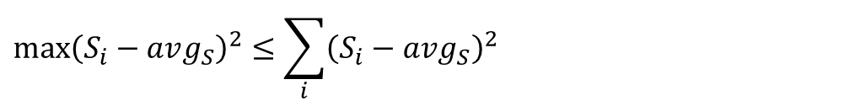



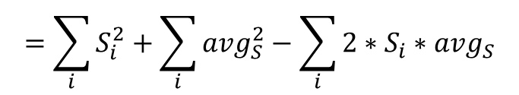
Envelope Haar(eHaar)
Upper bound and lower bound：$avg_{S}±max⁡(S_{i}−avg_{S})$
$${\max\left(S_{i}−avg_{S}\right)}^{2}≤\sum_{i}{{\left(S_{i}−avg_{S}\right)}^{2}}$$
$$=\sum_{i}{S_{i}^{2}+\sum_{i}{avg_{S}^{2}−\sum_{i}{2∗S_{i}∗avg_{S}}}}$$
$$=E_{S}+N∗avg_{S}^{2}−2∗avg_{S}^{2}∗N$$
$$=E_{S}−N∗avg_{S}^{2}$$
$$=E_{S}−N∗C_{1}^{2}$$

Slide 8
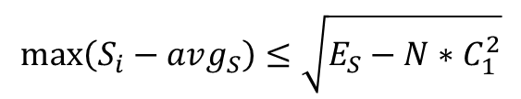
Envelope Haar(eHaar)
Upper bound and lower bound：$avg_{S}±max⁡(S_{i}−avg_{S})$
$${\max\left(S_{i}−avg_{S}\right)}^{2}≤\sum_{i}{{\left(S_{i}−avg_{S}\right)}^{2}}$$
$$=\sum_{i}{S_{i}^{2}+\sum_{i}{avg_{S}^{2}−\sum_{i}{2∗S_{i}∗avg_{S}}}}$$
$$=E_{S}+N∗avg_{S}^{2}−2∗avg_{S}^{2}∗N$$
$$=E_{S}−N∗avg_{S}^{2}$$
$$=E_{S}−N∗C_{1}^{2}$$
$$\max\left(S_{i}−avg_{S}\right)≤\sqrt{E_{S}−N∗C_{1}^{2}}$$

Slide 9
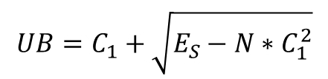
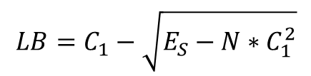
Envelope Haar(eHaar)
Upper bound and lower bound：$avg_{S}±max⁡(S_{i}−avg_{S})$
Level 0
$$UB=C_{1}+\sqrt{E_{S}−N∗C_{1}^{2}}$$
$$LB=C_{1}−\sqrt{E_{S}−N∗C_{1}^{2}}$$

Slide 10
Envelope Haar(eHaar)
Level 0
Level 1
Level 2
Level 3

Slide 11
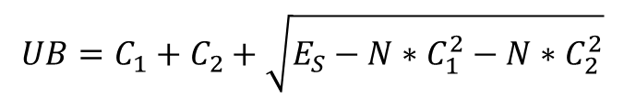
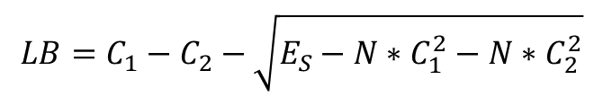
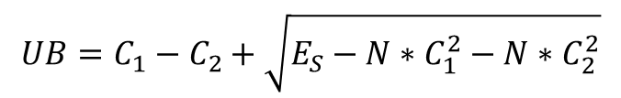
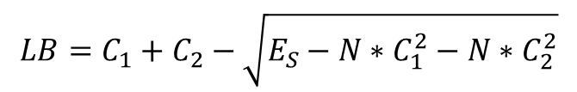
Envelope Haar(eHaar)
Upper bound and lower bound：$avg_{S}±max⁡(S_{i}−avg_{S})$
Level 1
$$UB=C_{1}+C_{2}+\sqrt{E_{S}−N∗C_{1}^{2}−N∗C_{2}^{2}}$$
$$LB=C_{1}+C_{2}−\sqrt{E_{S}−N∗C_{1}^{2}−N∗C_{2}^{2}}$$
or
$$UB=C_{1}−C_{2}+\sqrt{E_{S}−N∗C_{1}^{2}−N∗C_{2}^{2}}$$
$$LB=C_{1}−C_{2}−\sqrt{E_{S}−N∗C_{1}^{2}−N∗C_{2}^{2}}$$

Slide 12
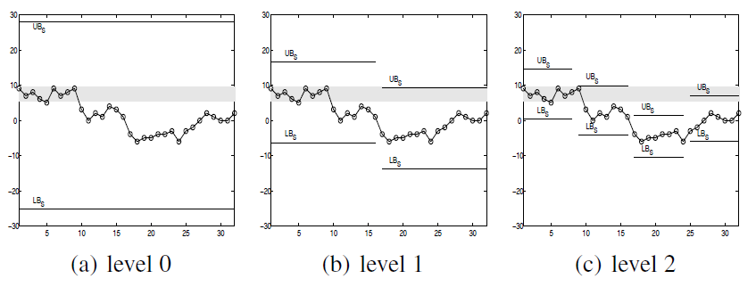
Envelope Haar(eHaar)

Slide 13
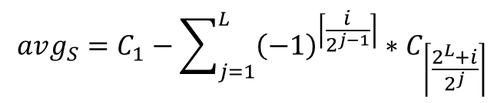
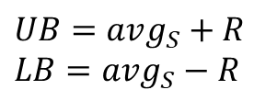
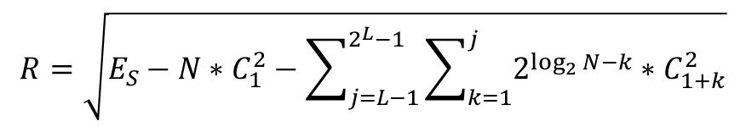
Envelope Haar(eHaar)
$$UB=avg_{S}+R$$
$$LB=avg_{S}−R$$
$$avg_{S}=C_{1}−\sum_{j=1}^{L}{{\left(−1\right)}^{\left\lceil \frac{i}{2^{j−1}}\right\rceil }∗C_{\left\lceil \frac{2^{L}+i}{2^{j}}\right\rceil }}$$
L: Level
i: sequence number for particular level
$$R=\sqrt{E_{S}−N∗C_{1}^{2}−\sum_{j=L−1}^{2^{L}−1}{\sum_{k=1}^{j}{2^{\log_{2}{N}−k}∗C_{1+k}^{2}}}}$$

Slide 14
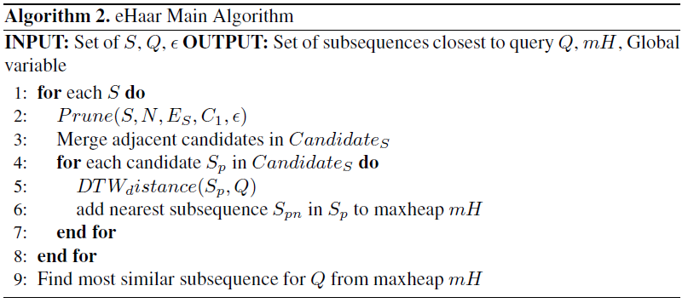
Envelope Haar(eHaar)

Slide 15
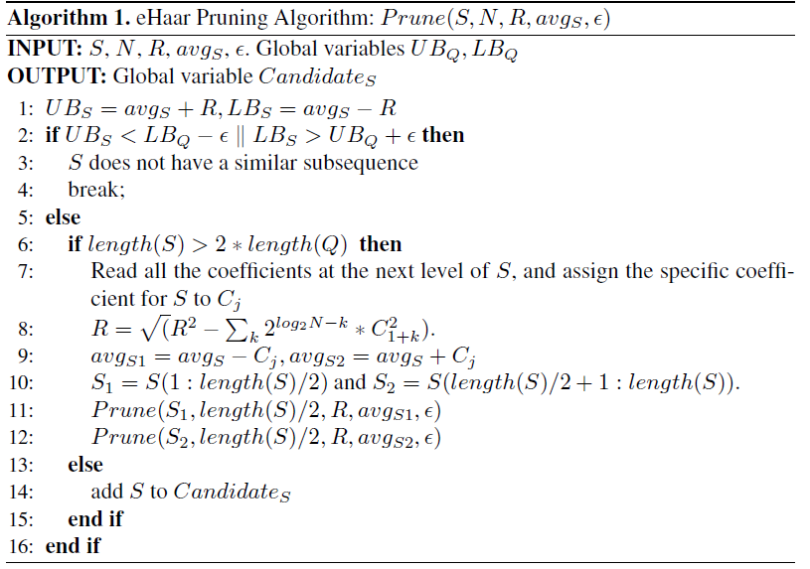
Envelope Haar(eHaar)

Slide 16
Envelope Haar(eHaar)

Slide 17
Envelope Haar(eHaar)

Slide 18

Envelope Haar(eHaar)
$$S_{1} { S}_{2} { S}_{3} { S}_{4}$$

Slide 19
Envelope Haar(eHaar)

Slide 20
Envelope Haar(eHaar)

Slide 21
Experiment
Stock dataset：500 time series of length 256
Arcene dataset：800 time series of length 4096
Random Walk dataset：5GB dataset and length of each time series is 256

Slide 22
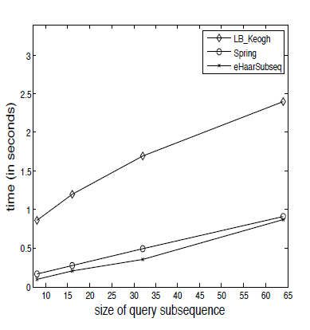
Experiment
Stock dataset

Slide 23
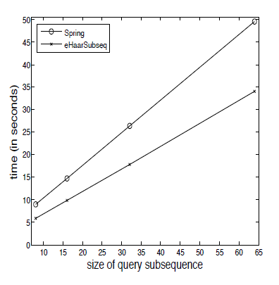
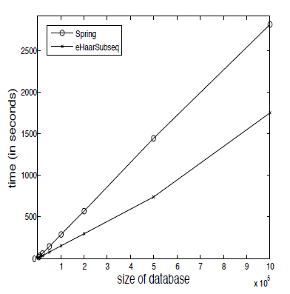
Experiment
Arcene dataset
Random Walk dataset

