Slide 1
The substring inclusion constraint longest common subsequence problem can be solved in quadratic time
Muhammad Rashed Alam, M. Sohel Rahman
AƖEDA Group, Department of CSE, BUET, Dhaka-1000, Bangladesh
Journal of Discrete Algorithms,Volume 17 (2012), Pages 67–73
Presenter: Ting-Wei Liang
Date:2018/01/09

Slide 2
Abstract(1/2)
In this paper, we study some variants of the Constrained Longest Common Subsequence (CLCS) problem, namely, the substring inclusion CLCS (Substring-IC-CLCS) problem and a generalized version thereof. In the Substring-IC-CLCS problem, we are to find a longest common subsequence (LCS) of two given strings containing a third constraint string (given) as a substring. Previous solution to this problem runs in cubic time, i.e, O(nmk) time, where n,m and k are the length of the 3 input strings. In this paper, we present simple O(nm) time algorithms to solve the Substring-IC-CLCS problem.

Slide 3
Abstract(2/2)
We also study the Generalized Substring-IC-LCS problem where we are given two strings of length n and m respectively and an ordered list of p strings and the goal is to find an LCS containing each of them as a substring in the order they appear in the list. We present an O(nmp) algorithm for this generalized version of the problem.

Slide 4
Substring-IC-CLCS Problem
X = x₁x₂…x_{m} = aatgcctaggc
Y = y₁y₂…y_{n} = acgatctggac
S = gtac
C = Substring-IC-CLCS (X, Y) = agtac

Slide 5
Generalized Substring-IC-CLCS Problem
X = x₁x₂…x_{m} = fabcfgbda
Y = y₁y₂…y_{n} = fabgcfbgda
S = {abc, bda}
C = fabcfbda

Slide 6

Generalized Substring-IC-CLCS Problem
X = x₁x₂…x_{m} = dabdcfedbgcfe
Y = y₁y₂…y_{n} = dabcdegfe
S = {abc, bce}, Z = abce
C = dabcegfe
$→$ “abc” and “bce” is overlapped

Slide 7

Preliminaries
X = DABEABC , S = ABC
When S occurs in the range $X_{2…7} and X_{5…7}$
We will have $S_{X}\left[7\right]=5$
If $S_{r}=ABC$, we will have $S_{X}\left[r,7\right]=5$

Slide 8
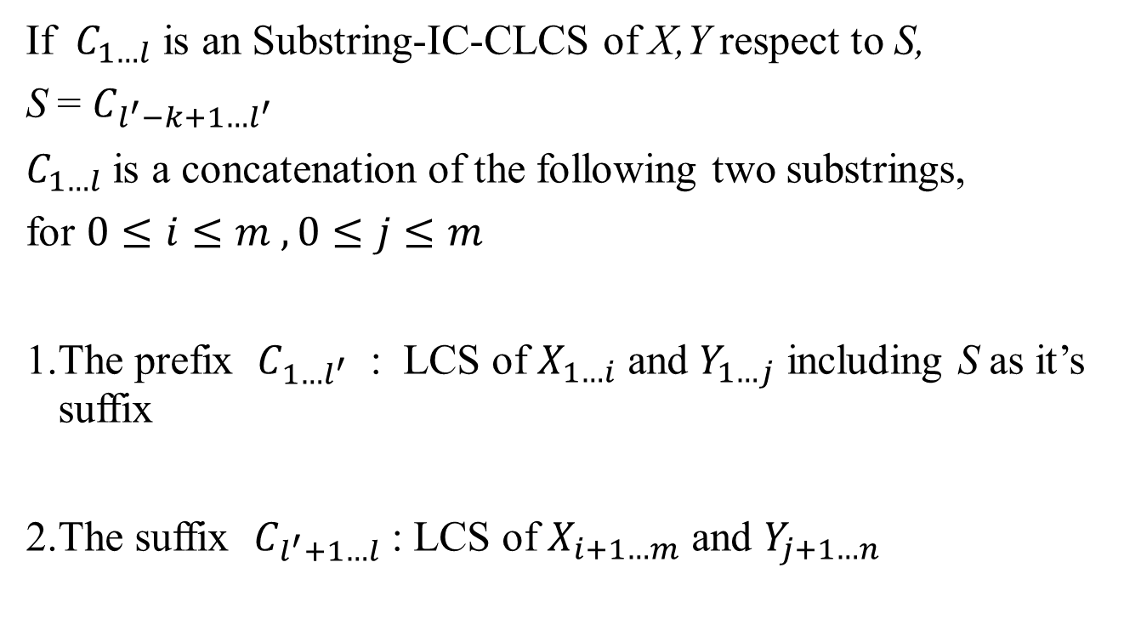
Property
If $C_{1…l}$ is an Substring-IC-CLCS of X,Y respect to S,
S = $C_{l^{′}−k+1…l^{′}}$
$C_{1…l}$ is a concatenation of the following two substrings,
for $0≤i≤m , 0≤j≤m$
1.The prefix $C_{1…l^{′}}$ : LCS of $X_{1…i}$ and $Y_{1…j}$ including S as it’s suffix
2.The suffix $C_{l^{′}+1…l}$ : LCS of $X_{i+1…m}$ and $Y_{j+1…n}$

Slide 9
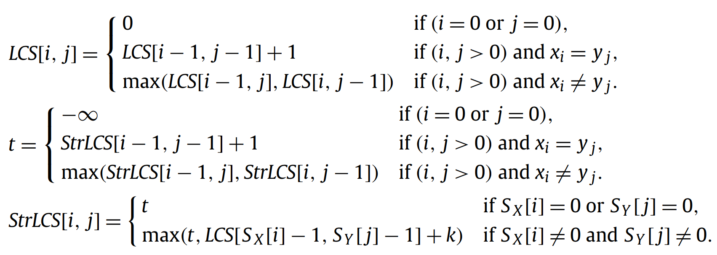
Dynamic programming algorithm for Substring-IC-LCS

Slide 10
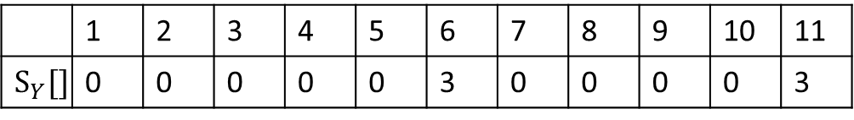
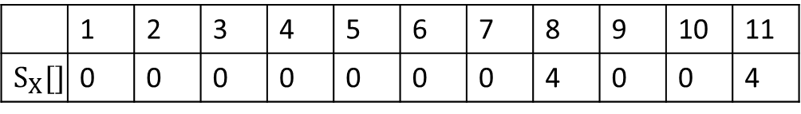
Dynamic programming algorithm for Substring-IC-LCS
X = x₁x₂…x_{m} = BCGGTAGCBAC
Y = y₁y₂…y_{n} = BCGTACBBBAC
S = GTAC
 | 1 | 2 | 3 | 4 | 5 | 6 | 7 | 8 | 9 | 10 | 11
$$S_{X}[]$$ | 0 | 0 | 0 | 0 | 0 | 0 | 0 | 4 | 0 | 0 | 4
 | 1 | 2 | 3 | 4 | 5 | 6 | 7 | 8 | 9 | 10 | 11
$$S_{Y}[]$$ | 0 | 0 | 0 | 0 | 0 | 3 | 0 | 0 | 0 | 0 | 3

Slide 11
LCS[i,j]
 |  | B | C | G | G | T | A | G | C | B | A | C
 | 0 | 0 | 0 | 0 | 0 | 0 | 0 | 0 | 0 | 0 | 0 | 0
B | 0 | 1 | 1 | 1 | 1 | 1 | 1 | 1 | 1 | 1 | 1 | 1
C | 0 | 1 | 2 | 2 | 2 | 2 | 2 | 2 | 2 | 2 | 2 | 2
G | 0 | 1 | 2 | 3 | 3 | 3 | 3 | 3 | 3 | 3 | 3 | 3
T | 0 | 1 | 2 | 3 | 3 | 4 | 4 | 4 | 4 | 4 | 4 | 4
A | 0 | 1 | 2 | 3 | 3 | 4 | 5 | 5 | 5 | 5 | 5 | 5
C | 0 | 1 | 2 | 3 | 3 | 4 | 5 | 5 | 6 | 6 | 6 | 6
B | 0 | 1 | 2 | 3 | 3 | 4 | 5 | 5 | 6 | 7 | 7 | 7
B | 0 | 1 | 2 | 3 | 3 | 4 | 5 | 5 | 6 | 7 | 7 | 7
B | 0 | 1 | 2 | 3 | 3 | 4 | 5 | 5 | 6 | 7 | 7 | 7
A | 0 | 1 | 2 | 3 | 3 | 4 | 5 | 5 | 6 | 7 | 8 | 8
C | 0 | 1 | 2 | 3 | 3 | 4 | 5 | 5 | 6 | 7 | 8 | 9

Slide 12
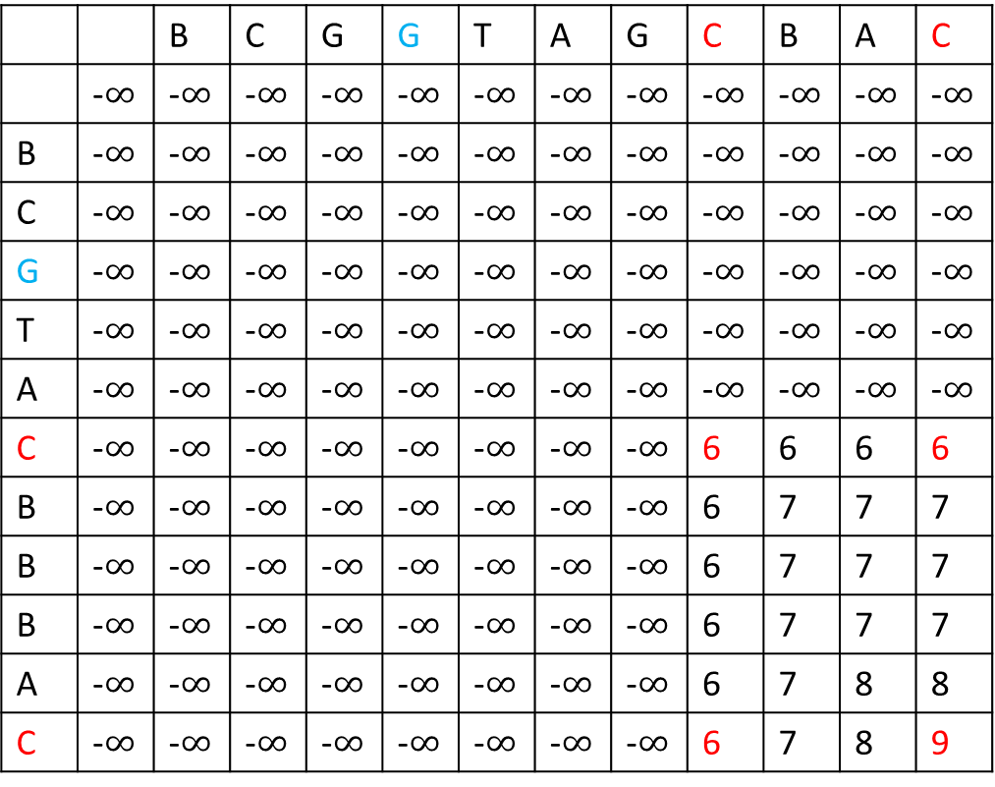
StrLCS[i,j]
 |  | B | C | G | G | T | A | G | C | B | A | C
 | -$∞$ | -$∞$ | -$∞$ | -$∞$ | -$∞$ | -$∞$ | -$∞$ | -$∞$ | -$∞$ | -$∞$ | -$∞$ | -$∞$
B | -$∞$ | -$∞$ | -$∞$ | -$∞$ | -$∞$ | -$∞$ | -$∞$ | -$∞$ | -$∞$ | -$∞$ | -$∞$ | -$∞$
C | -$∞$ | -$∞$ | -$∞$ | -$∞$ | -$∞$ | -$∞$ | -$∞$ | -$∞$ | -$∞$ | -$∞$ | -$∞$ | -$∞$
G | -$∞$ | -$∞$ | -$∞$ | -$∞$ | -$∞$ | -$∞$ | -$∞$ | -$∞$ | -$∞$ | -$∞$ | -$∞$ | -$∞$
T | -$∞$ | -$∞$ | -$∞$ | -$∞$ | -$∞$ | -$∞$ | -$∞$ | -$∞$ | -$∞$ | -$∞$ | -$∞$ | -$∞$
A | -$∞$ | -$∞$ | -$∞$ | -$∞$ | -$∞$ | -$∞$ | -$∞$ | -$∞$ | -$∞$ | -$∞$ | -$∞$ | -$∞$
C | -$∞$ | -$∞$ | -$∞$ | -$∞$ | -$∞$ | -$∞$ | -$∞$ | -$∞$ | 6 | 6 | 6 | 6
B | -$∞$ | -$∞$ | -$∞$ | -$∞$ | -$∞$ | -$∞$ | -$∞$ | -$∞$ | 6 | 7 | 7 | 7
B | -$∞$ | -$∞$ | -$∞$ | -$∞$ | -$∞$ | -$∞$ | -$∞$ | -$∞$ | 6 | 7 | 7 | 7
B | -$∞$ | -$∞$ | -$∞$ | -$∞$ | -$∞$ | -$∞$ | -$∞$ | -$∞$ | 6 | 7 | 7 | 7
A | -$∞$ | -$∞$ | -$∞$ | -$∞$ | -$∞$ | -$∞$ | -$∞$ | -$∞$ | 6 | 7 | 8 | 8
C | -$∞$ | -$∞$ | -$∞$ | -$∞$ | -$∞$ | -$∞$ | -$∞$ | -$∞$ | 6 | 7 | 8 | 9

Slide 13
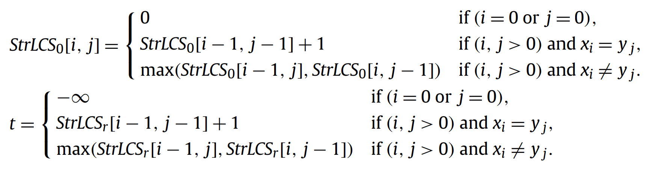
Dynamic programming algorithm for Generalized Substring-IC-LCS (no overlap)

Slide 14
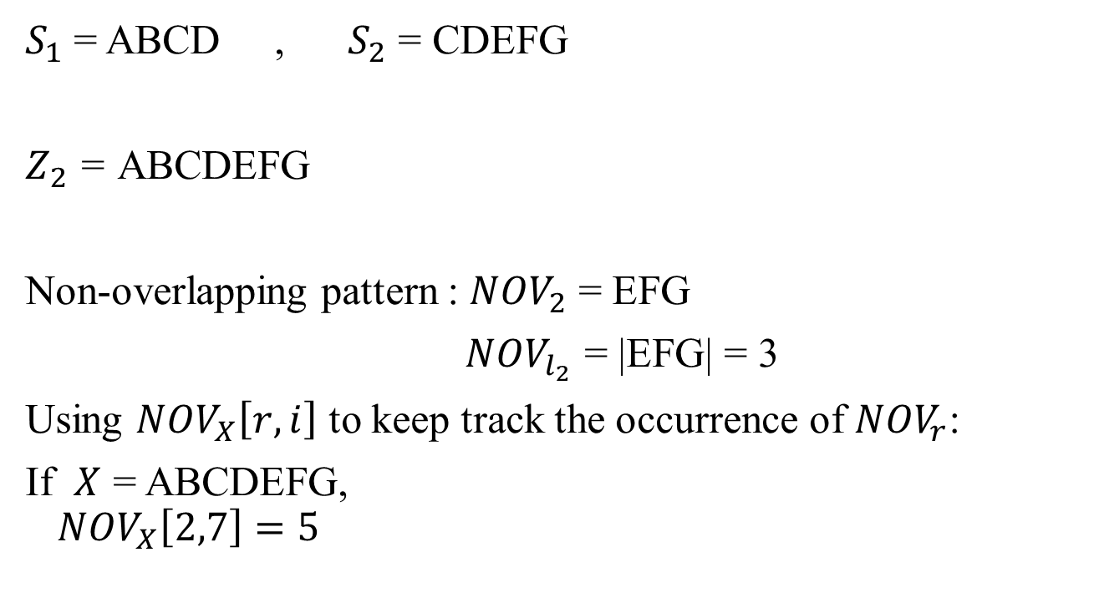
Preliminaries
$S_{1}$ = ABCD , $S_{2}$ = CDEFG
$Z_{2}$ = ABCDEFG
Non-overlapping pattern : ${NOV}_{2}$ = EFG
${NOV}_{l_{2}}$ = |EFG| = 3
Using ${NOV}_{X}\left[r,i\right]$ to keep track the occurrence of ${NOV}_{r}$:
If $X$ = ABCDEFG,
$${NOV}_{X}\left[2,7\right]=5$$

Slide 15
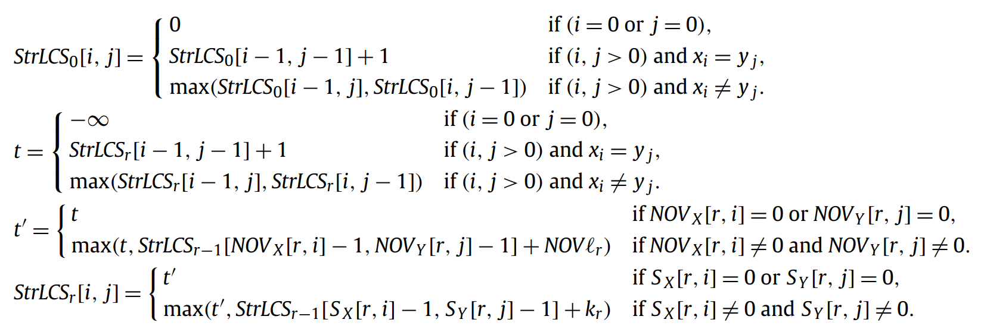
Dynamic programming algorithm for Generalized Substring-IC-LCS (overlapped)

Slide 16
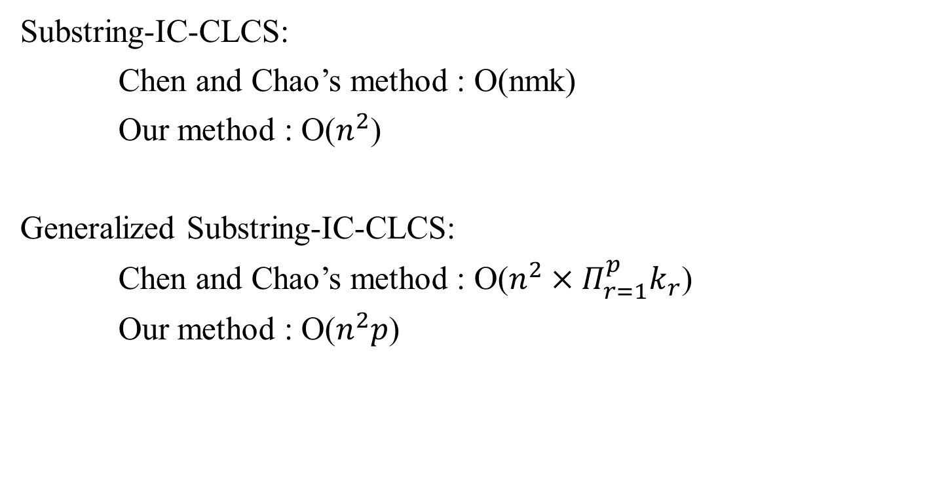
Conclusion
Substring-IC-CLCS:
Chen and Chao’s method : O(nmk)
Our method : O($n^{2}$)
Generalized Substring-IC-CLCS:
Chen and Chao’s method : O($n^{2}×Π_{r=1}^{p}k_{r}$)
Our method : O($n^{2}p$)

