Slide 1
DTW-Global Constraint Learning Using Tabu Search Algorithm
Bilel BenAli, Youssef Masmoudi, Souhail Dhouib
Procedia Computer Science, Volume 82, 2016, pp. 12-19
Presenter : Bo-Xian Chen
Date : 2018/1/16

Slide 2
Abstract(1/2)
Many methods have been proposed to measure the similarity between time series data sets, each with advantages and weaknesses. It is to choose the most appropriate similarity measure depending on the intended application domain and data considered. The performance of machine learning algorithms depends on the metric used to compare two objects. For time series, Dynamic Time Warping (DTW) is the most appropriate distance measure used. Many variants of DTW intended to accelerate the calculation of this distance are proposed. The distance learning is a subject already well studied. Indeed Data Mining tools, such as the algorithm of k-Means clustering, and K-Nearest Neighbor classification, require the use of a similarity/distance measure. This measure must be adapted to the application domain.
Notes:
Neighbour
【英】= neighbor

Slide 3
Abstract(2/2)
For this reason, it is important to have and develop effective methods of computation and algorithms that can be applied to a large data set integrating the constraints of the specific field of study. In this paper a new hybrid approach to learn a global constraint of DTW distance is proposed. This approach is based on Large Margin Nearest Neighbors classification and Tabu Search algorithm. Experiments show the effectiveness of this approach to improve time series classification results.

Slide 4
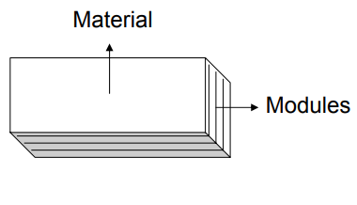
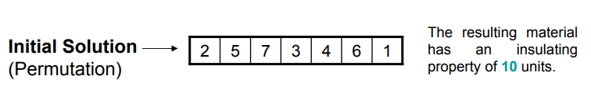
Tabu Search Algorithm(1/6)
Short-term
Intermediate-term
Long-term

Slide 5
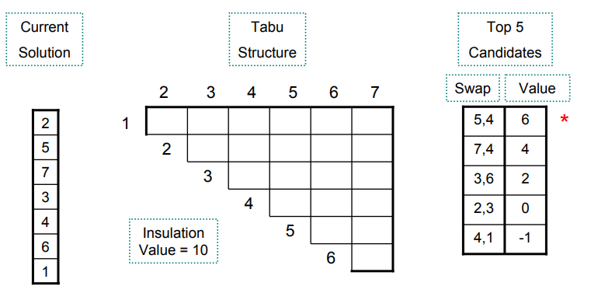
Tabu Search Algorithm(2/6)

Slide 6
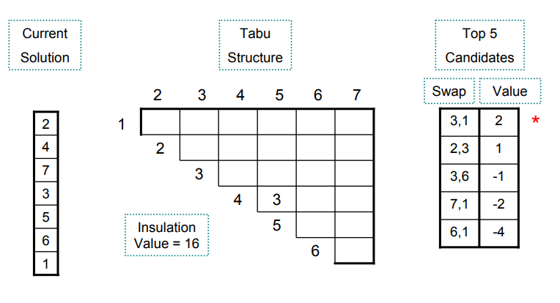
Tabu Search Algorithm(3/6)

Slide 7
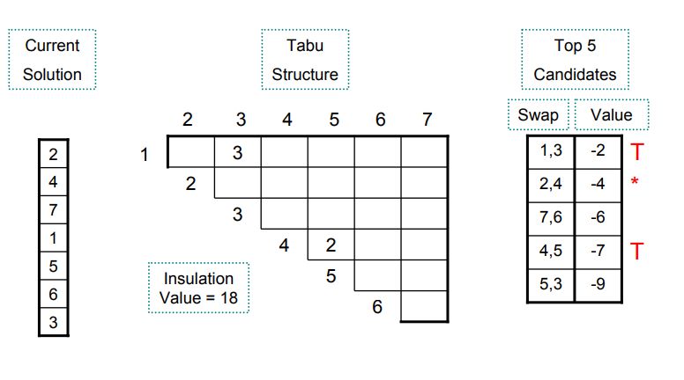
Tabu Search Algorithm(4/6)

Slide 8
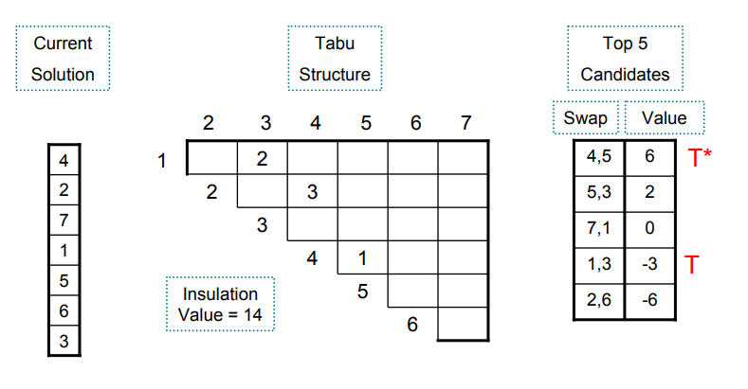
Tabu Search Algorithm(5/6)
Aspiration criterion

Slide 9
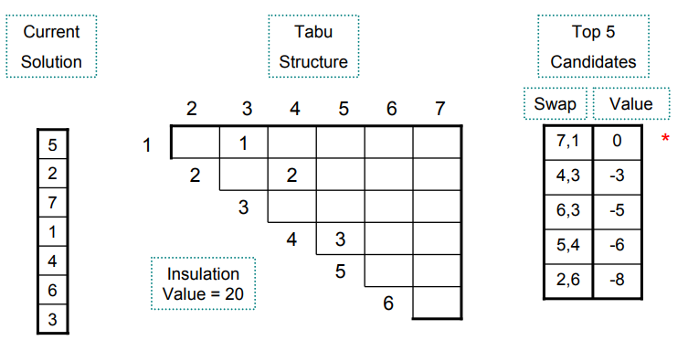
Tabu Search Algorithm(6/6)

Slide 10
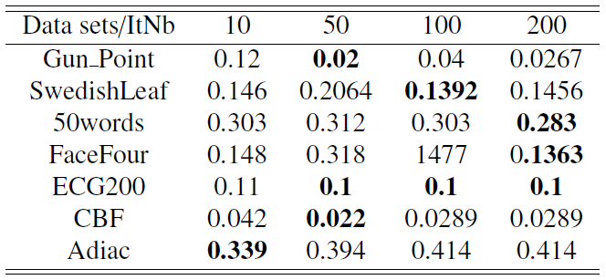
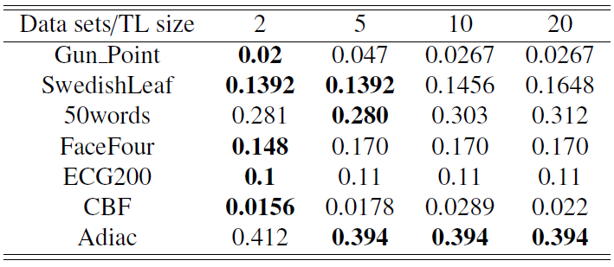
Experiment
Three parameter
The number of iterations
The size of Tabu List
The number of global constraints segment

Slide 11
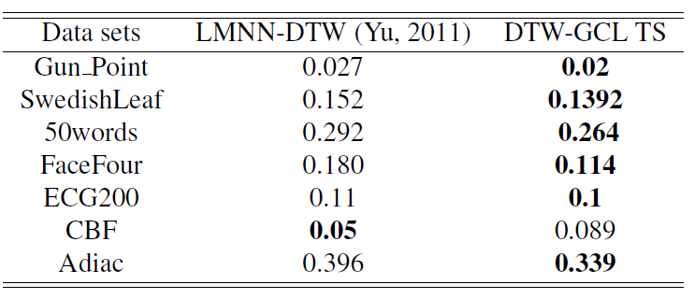
Experiment

