Slide 1
On All-Substrings Alignment Problems
Wei Fu, Wing-Kai Hon, and Wing-Kin Sung
Computing and Combinatorics, 9th Annual International Conference, COCOON 2003, Big Sky, USA, July, 2003.
Presenter : Shie-Yan Lee
2018/1/16

Slide 2
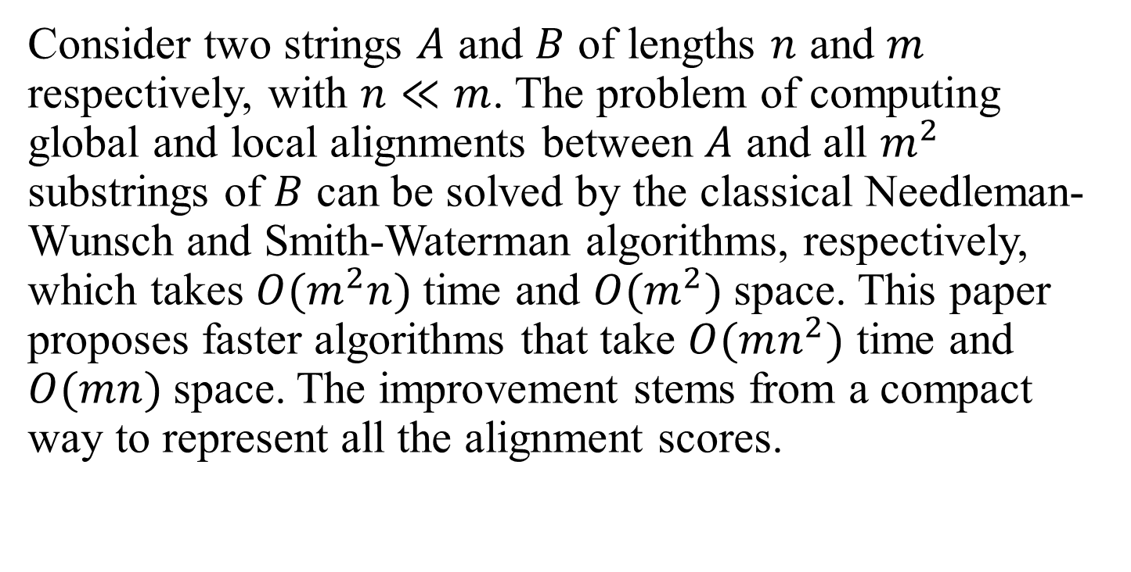
Abstract
Consider two strings $A$ and $B$ of lengths $n$ and $m$ respectively, with $n≪m$. The problem of computing global and local alignments between $A$ and all $m^{2}$ substrings of $B$ can be solved by the classical Needleman-Wunsch and Smith-Waterman algorithms, respectively, which takes $O(m^{2}n)$time and $O(m^{2})$ space. This paper proposes faster algorithms that take $O(mn^{2})$ time and $O(mn)$space. The improvement stems from a compact way to represent all the alignment scores.

Slide 3
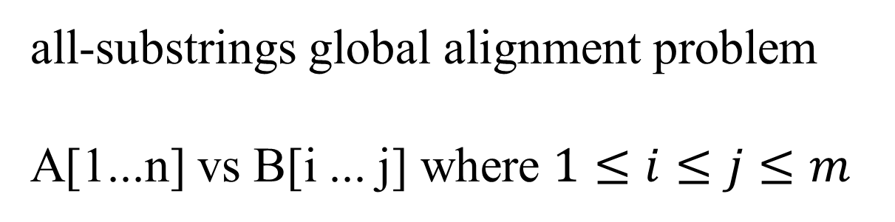
Problem definition
A
n
B
m
all-substrings global alignment problem
A[1...n] vs B[i ... j] where $1≤i≤j≤m$

Slide 4
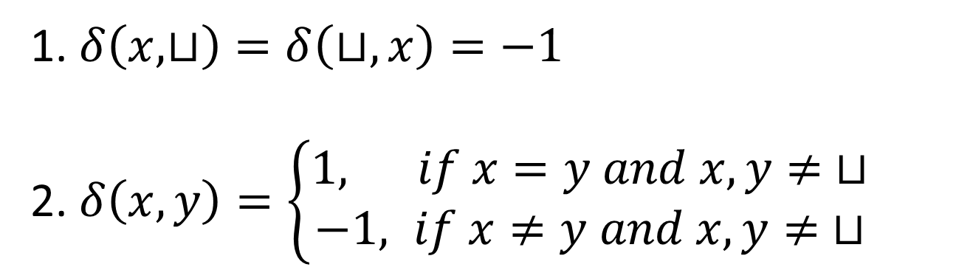
Score scheme
1. $δ\left(x,⊔\right)=δ\left(⊔,x\right)=−1$
2. $δ\left(x,y\right)=\left\{\begin{aligned}1, if x=y and x,y≠ ⊔ \\ −1, if x≠y and x,y≠ ⊔\end{aligned}\right.$

Slide 5

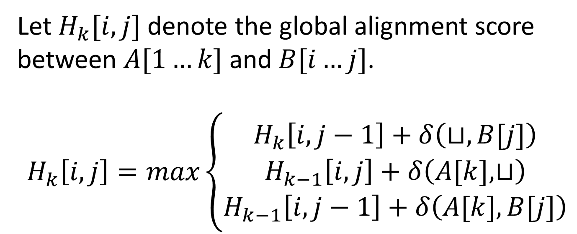



All-substrings global alignment
Let $H_{k}[i,j]$ denote the global alignment score between $A[1…k]$ and $B[i…j]$.
$$H_{k}\left[i,j\right]=max\left\{\begin{aligned}H_{k}\left[i,j−1\right]+δ\left(⊔,B[j]\right) \\ H_{k−1}\left[i,j\right]+δ\left(A[k],⊔\right) \\ H_{k−1}\left[i,j−1\right]+δ\left(A[k],B[j]\right)\end{aligned}\right.$$
$$1$$
$$k$$
A
$$i$$
$$j$$
B

Slide 6
All-substrings global alignment
Let $H_{k}[i,j]$ denote the global alignment score between $A[1…k]$ and $B[i…j]$.
$$H_{k}\left[i,j\right]=max\left\{\begin{aligned}H_{k}\left[i,j−1\right]+δ\left(⊔,B[j]\right) \\ H_{k−1}\left[i,j\right]+δ\left(A[k],⊔\right) \\ H_{k−1}\left[i,j−1\right]+δ\left(A[k],B[j]\right)\end{aligned}\right.$$
$$1$$
$$k$$
A
$$i$$
$$j$$
B

Slide 7
All-substrings global alignment
Let $H_{k}[i,j]$ denote the global alignment score between $A[1…k]$ and $B[i…j]$.
$$H_{k}\left[i,j\right]=max\left\{\begin{aligned}H_{k}\left[i,j−1\right]+δ\left(⊔,B[j]\right) \\ H_{k−1}\left[i,j\right]+δ\left(A[k],⊔\right) \\ H_{k−1}\left[i,j−1\right]+δ\left(A[k],B[j]\right)\end{aligned}\right.$$
$$1$$
$$k$$
A
$$i$$
$$j$$
B

Slide 8
All-substrings global alignment
Let $H_{k}[i,j]$ denote the global alignment score between $A[1…k]$ and $B[i…j]$.
$$H_{k}\left[i,j\right]=max\left\{\begin{aligned}H_{k}\left[i,j−1\right]+δ\left(⊔,B[j]\right) \\ H_{k−1}\left[i,j\right]+δ\left(A[k],⊔\right) \\ H_{k−1}\left[i,j−1\right]+δ\left(A[k],B[j]\right)\end{aligned}\right.$$
$$1$$
$$k$$
A
$$i$$
$$j$$
B

Slide 9
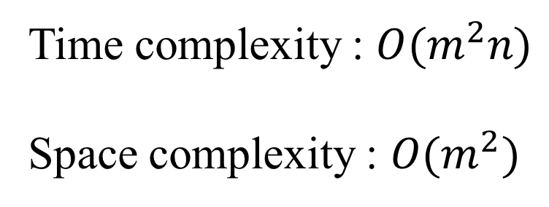





All-substrings global alignment
$$H_{1}$$
$$H_{2}$$
$$H_{3}$$
$$H_{4}$$
...
$$H_{n}$$
Time complexity : $O(m^{2}n)$
Space complexity : $O(m^{2})$

Slide 10
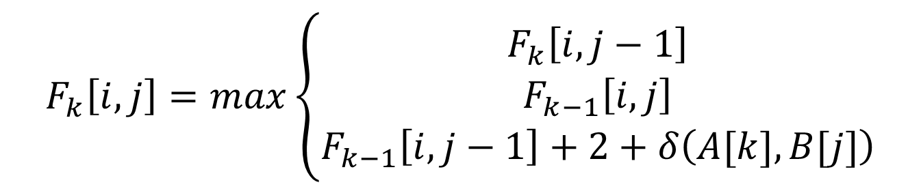





Transformation of $H_{k}$
$$F_{k}\left[i,j\right]=H_{k}\left[i,j\right]+j−i+1+k$$
$$1$$
$$k$$
A
$$i$$
$$j$$
B
$$F_{k}\left[i,j\right]=max\left\{\begin{aligned}F_{k}\left[i,j−1\right] \\ F_{k−1}\left[i,j\right] \\ F_{k−1}\left[i,j−1\right]+2+δ\left(A[k],B[j]\right)\end{aligned}\right.$$

Slide 11
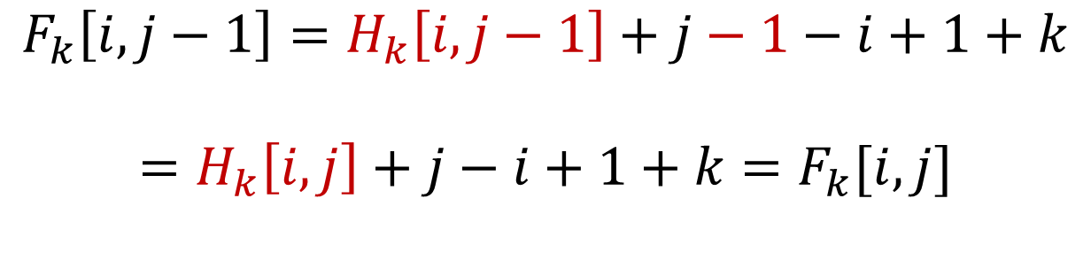
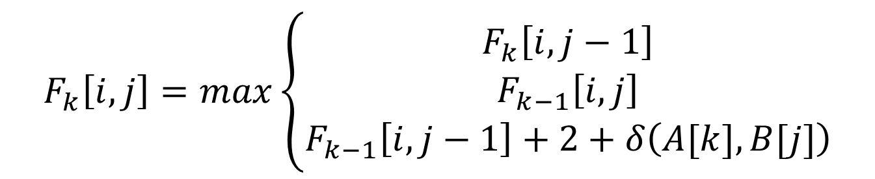
Transformation of $H_{k}$
$$F_{k}\left[i,j\right]=H_{k}\left[i,j\right]+j−i+1+k$$
$$F_{k}\left[i,j\right]=max\left\{\begin{aligned}F_{k}\left[i,j−1\right] \\ F_{k−1}\left[i,j\right] \\ F_{k−1}\left[i,j−1\right]+2+δ\left(A[k],B[j]\right)\end{aligned}\right.$$
$$F_{k}\left[i,j−1\right]=H_{k}\left[i,j−1\right]+j−1−i+1+k$$
$$=H_{k}\left[i,j\right]+j−i+1+k=F_{k}[i,j]$$

Slide 12
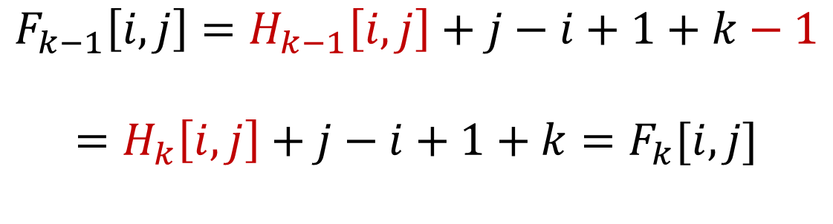
Transformation of $H_{k}$
$$F_{k}\left[i,j\right]=H_{k}\left[i,j\right]+j−i+1+k$$
$$F_{k}\left[i,j\right]=max\left\{\begin{aligned}F_{k}\left[i,j−1\right] \\ F_{k−1}\left[i,j\right] \\ F_{k−1}\left[i,j−1\right]+2+δ\left(A[k],B[j]\right)\end{aligned}\right.$$
$$F_{k−1}\left[i,j\right]=H_{k−1}\left[i,j\right]+j−i+1+k−1$$
$$=H_{k}\left[i,j\right]+j−i+1+k=F_{k}[i,j]$$

Slide 13
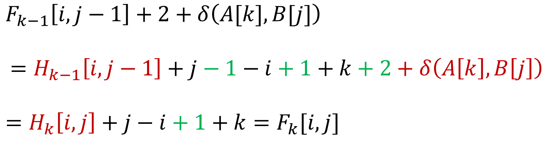
Transformation of $H_{k}$
$$F_{k}\left[i,j\right]=H_{k}\left[i,j\right]+j−i+1+k$$
$$F_{k}\left[i,j\right]=max\left\{\begin{aligned}F_{k}\left[i,j−1\right] \\ F_{k−1}\left[i,j\right] \\ F_{k−1}\left[i,j−1\right]+2+δ\left(A[k],B[j]\right)\end{aligned}\right.$$
$F_{k−1}\left[i,j−1\right]+2+δ\left(A[k],B[j]\right)$
$$=H_{k−1}\left[i,j−1\right]+j−1−i+1+k+2+δ\left(A\left[k\right],B\left[j\right]\right)$$
$=H_{k}\left[i,j\right]+j−i+1+k=F_{k}[i,j]$

Slide 14
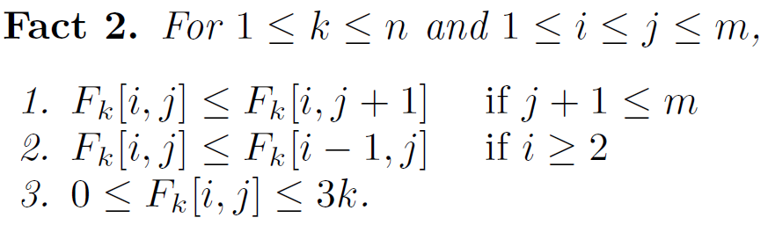
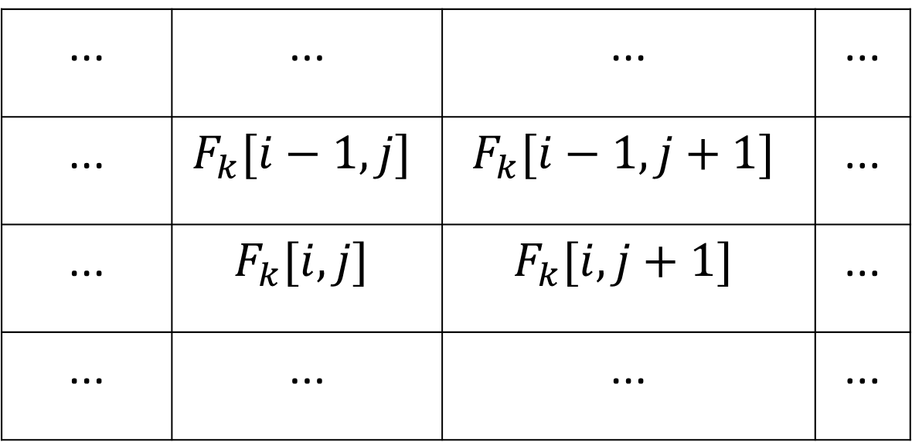

$$F_{k}$$
... | ... | ... | ...
... | $$F_{k}[i−1,j]$$ | $$F_{k}[i−1,j+1]$$ | ...
... | $$F_{k}[i,j]$$ | $$F_{k}[i,j+1]$$ | ...
... | ... | ... | ...

Slide 15
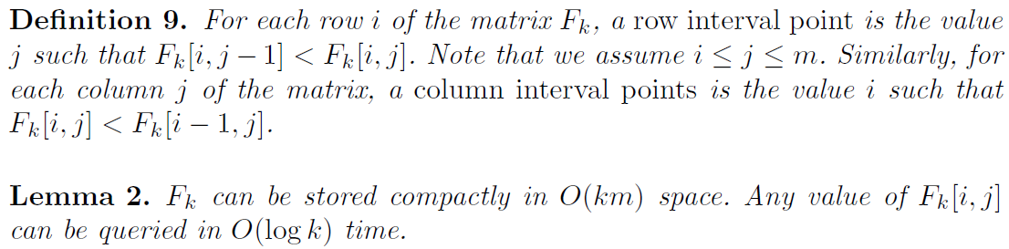

Slide 16

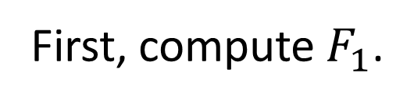




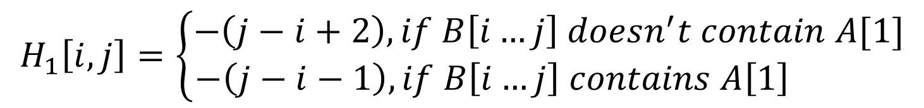
Computation of $F_{n}$
First, compute $F_{1}$.
$$H_{1}\left[i,j\right]=\left\{\begin{aligned}−\left(j−i+2\right), if B\left[i…j\right] doesn^{′}t contain A[1] \\ −\left(j−i−1\right),if B\left[i…j\right] contains A\left[1\right] \end{aligned}\right.$$
$$1$$
A
$$i$$
$$j$$
B
$$F_{1}\left[i,j\right]=\left\{\begin{aligned}0 , if B\left[i…j\right] doesn^{′}t contain A[1] \\ 3 ,if B\left[i…j\right] contains A[1]\end{aligned}\right.$$

Slide 17
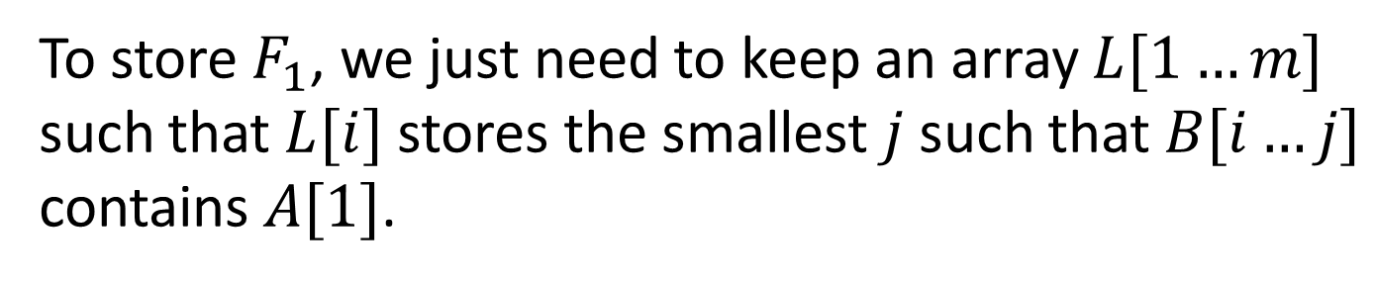
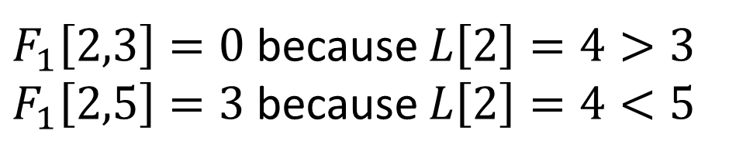
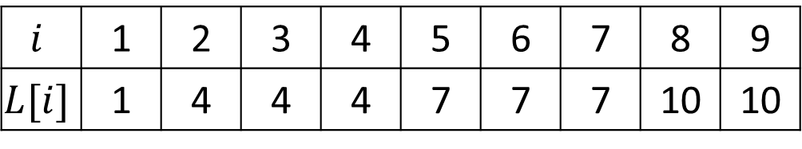
Computation of $F_{n}$
To store $F_{1}$, we just need to keep an array $L[1…m]$
such that $L[i]$ stores the smallest $j$ such that $B[i…j]$
contains $A[1]$.
A
A
B
ABCABCABC
$$i$$ | 1 | 2 | 3 | 4 | 5 | 6 | 7 | 8 | 9
$$L[i]$$ | 1 | 4 | 4 | 4 | 7 | 7 | 7 | 10 | 10
$F_{1}\left[2,3\right]=0$ because $L\left[2\right]=4>3$
$F_{1}\left[2,5\right]=3$ because $L\left[2\right]=4<5$

Slide 18
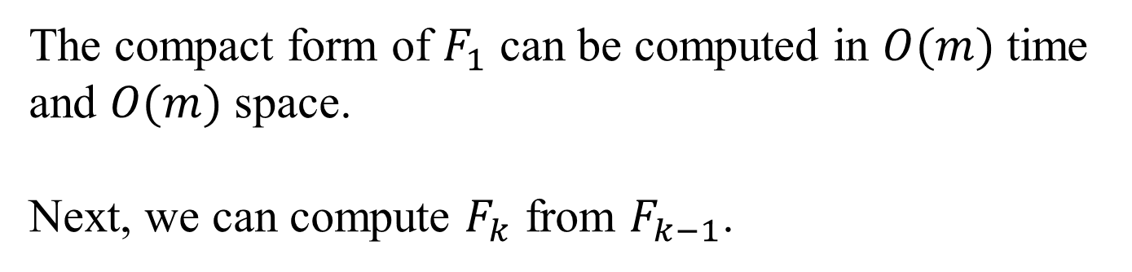
Computation of $F_{n}$
The compact form of $F_{1}$ can be computed in $O(m)$ time
and $O(m)$ space.
Next, we can compute $F_{k}$ from $F_{k−1}$.

Slide 19
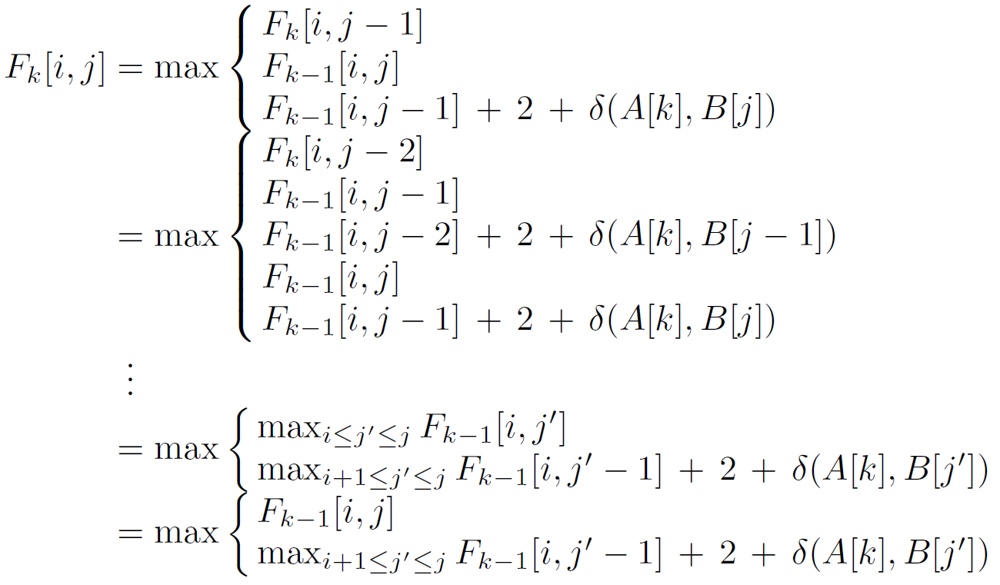
Computation of $F_{n}$

Slide 20
Computation of $F_{n}$

Slide 21
Computation of $F_{n}$

Slide 22
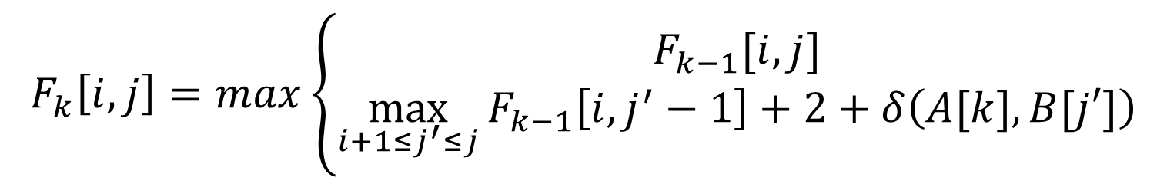

Computation of $F_{n}$
$$F_{k}\left[i,j\right]=max\left\{\begin{aligned}F_{k−1}[i,j] \\ \max_{i+1≤j^{′}≤j}{F_{k−1}\left[i,j^{′}−1\right]+2+δ\left(A[k],B[j′]\right)}\end{aligned}\right.$$
Let $G_{k}$ denote$\max_{i+1≤j^{′}≤j}{F_{k−1}\left[i,j^{′}−1\right]+2+δ\left(A[k],B[j′]\right)}$.
$$F_{k}\left[i,j\right]=max\left\{\begin{aligned}F_{k−1}[i,j] \\ G_{k}[i,j]\end{aligned}\right.$$

Slide 23
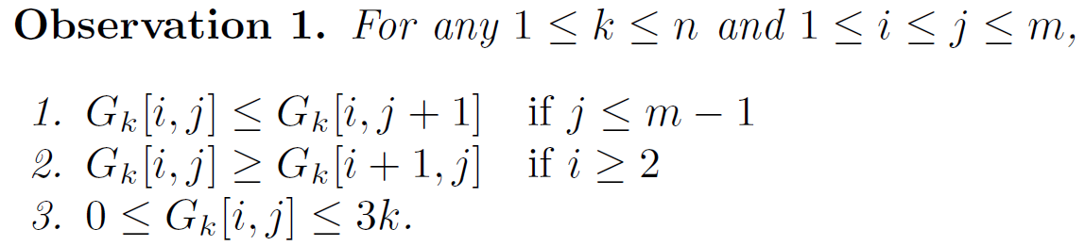
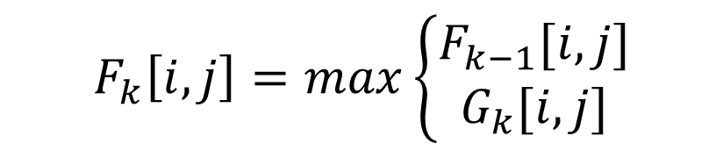

Computation of $F_{n}$
$$F_{k}\left[i,j\right]=max\left\{\begin{aligned}F_{k−1}[i,j] \\ G_{k}[i,j]\end{aligned}\right.$$
These observations suggest that $G_{k}$ can be stored using
row interval points. So in $O(km)$ time, we can find all the possible
row interval points of $G_{k}$.

Slide 24
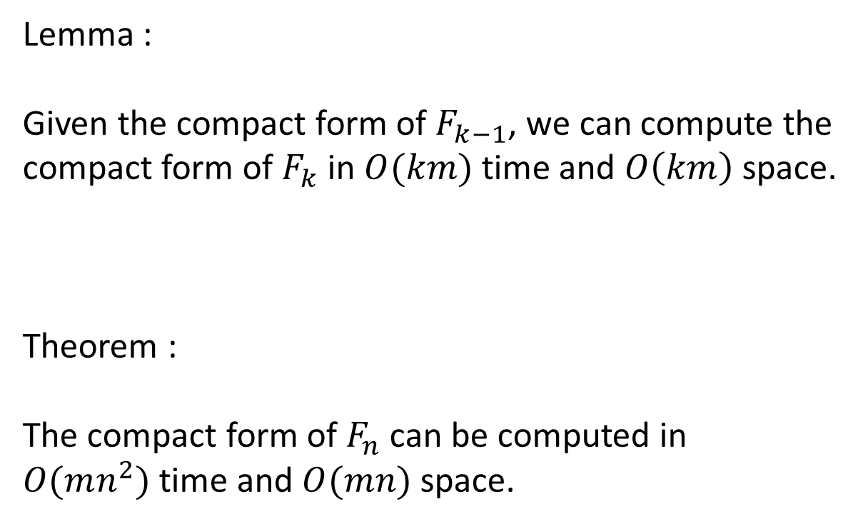
Computation of $F_{n}$
Lemma :
Given the compact form of $F_{k−1}$, we can compute the
compact form of $F_{k}$ in $O(km)$ time and $O\left(km\right)$ space.
Theorem :
The compact form of $F_{n}$ can be computed in
$O(mn^{2})$ time and $O(mn)$ space.

Slide 25
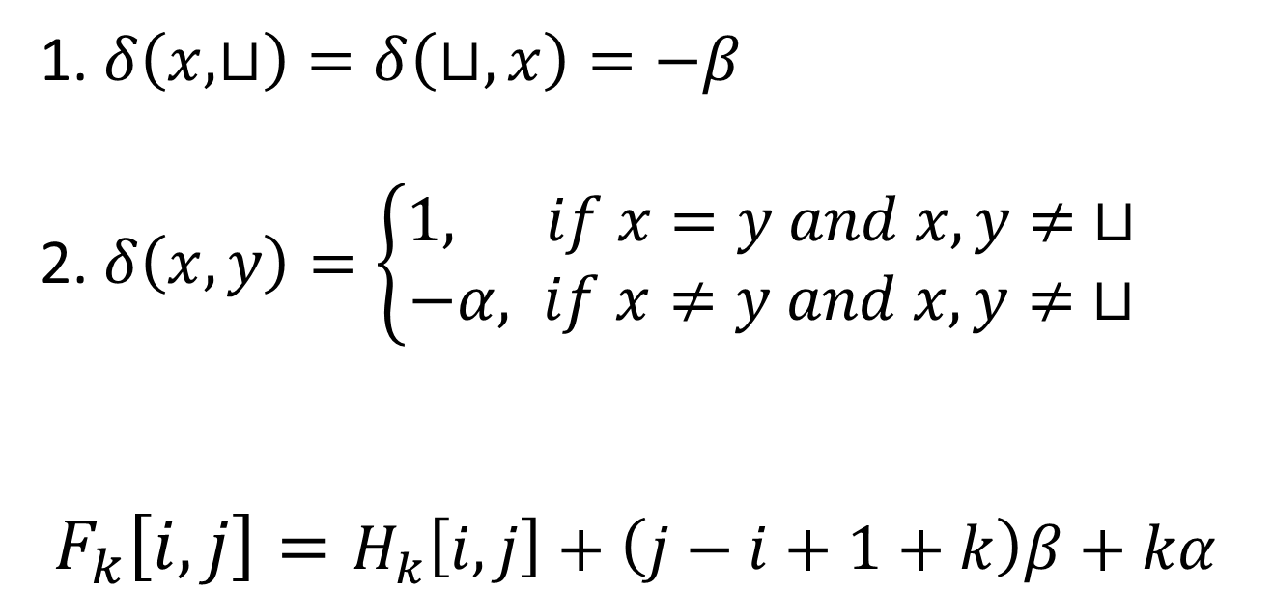
Generalizing the score scheme
1. $δ\left(x,⊔\right)=δ\left(⊔,x\right)=−β$
2. $δ\left(x,y\right)=\left\{\begin{aligned}1, if x=y and x,y≠ ⊔ \\ −α, if x≠y and x,y≠ ⊔\end{aligned}\right.$
$F_{k}\left[i,j\right]=H_{k}\left[i,j\right]+\left(j−i+1+k\right)β+kα$

Slide 26
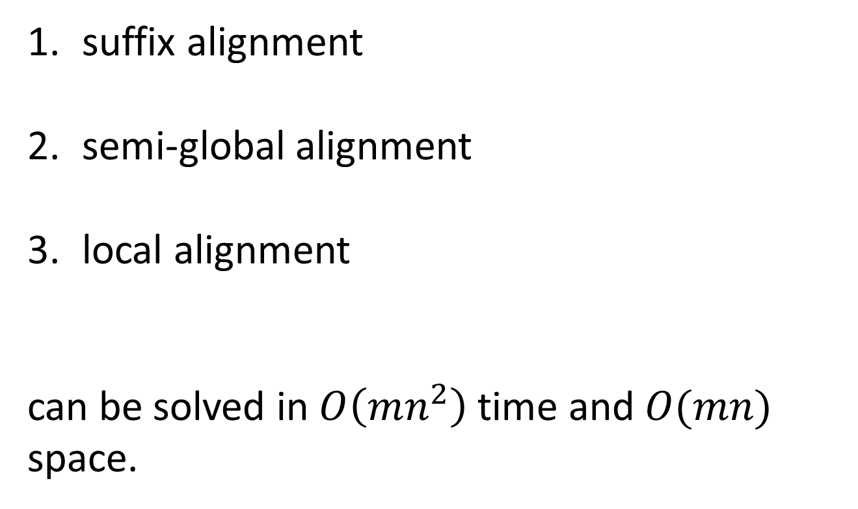
Other alignment problems
suffix alignment
semi-global alignment
local alignment
can be solved in $O\left(mn^{2}\right)$ time and $O(mn)$ space.

