Slide 1
A subquadratic algorithm for minimum palindromic factorization
Gabriele Fici , Travis Gagie , Juha Kärkkäinen , Dominik Kempa
Dipartimento di Matematica e Informatica, Università di Palermo, Italy Department of Computer Science, University of Helsinki, Finland
Journal of Discrete Algorithms
Volume 28, September 2014, Pages 41-48
Presenter: Ting-Wei Liang
Date:2018/11/20

Slide 2
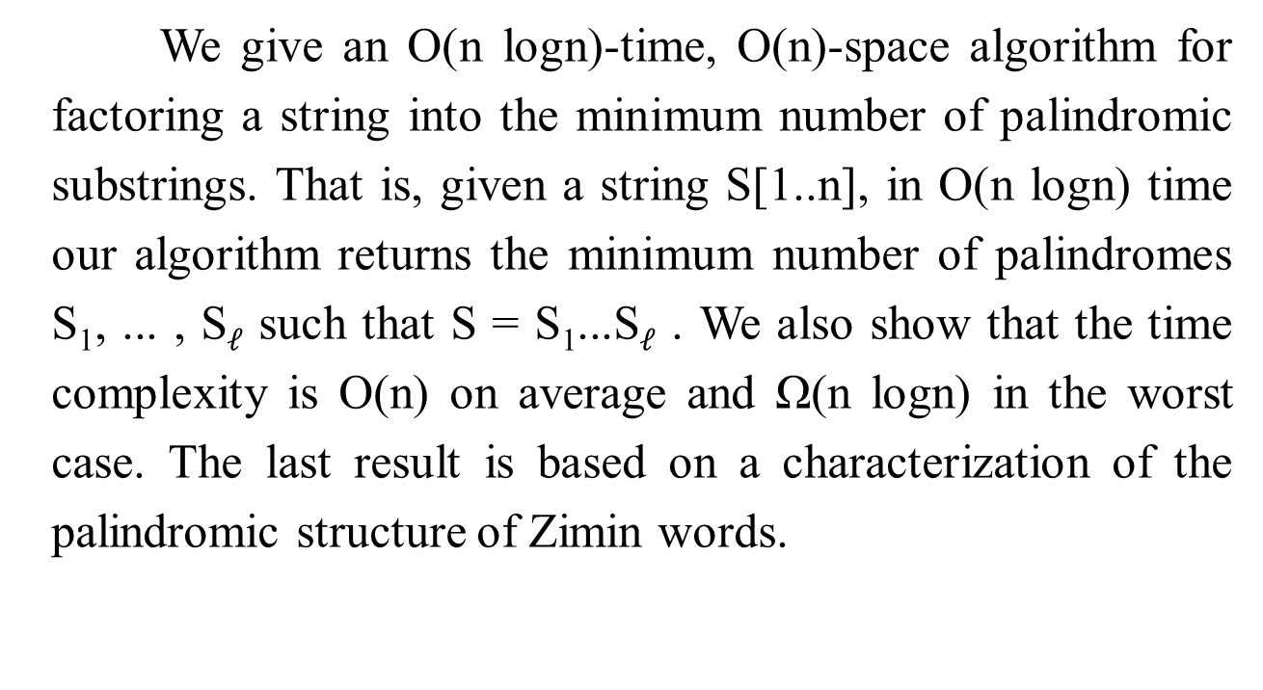
Abstract
We give an O(n logn)-time, O(n)-space algorithm for factoring a string into the minimum number of palindromic substrings. That is, given a string S[1..n], in O(n logn) time our algorithm returns the minimum number of palindromes S₁, ... , S$ℓ$ such that S = S₁...S$ℓ$ . We also show that the time complexity is O(n) on average and Ω(n logn) in the worst case. The last result is based on a characterization of the palindromic structure of Zimin words.

Slide 3
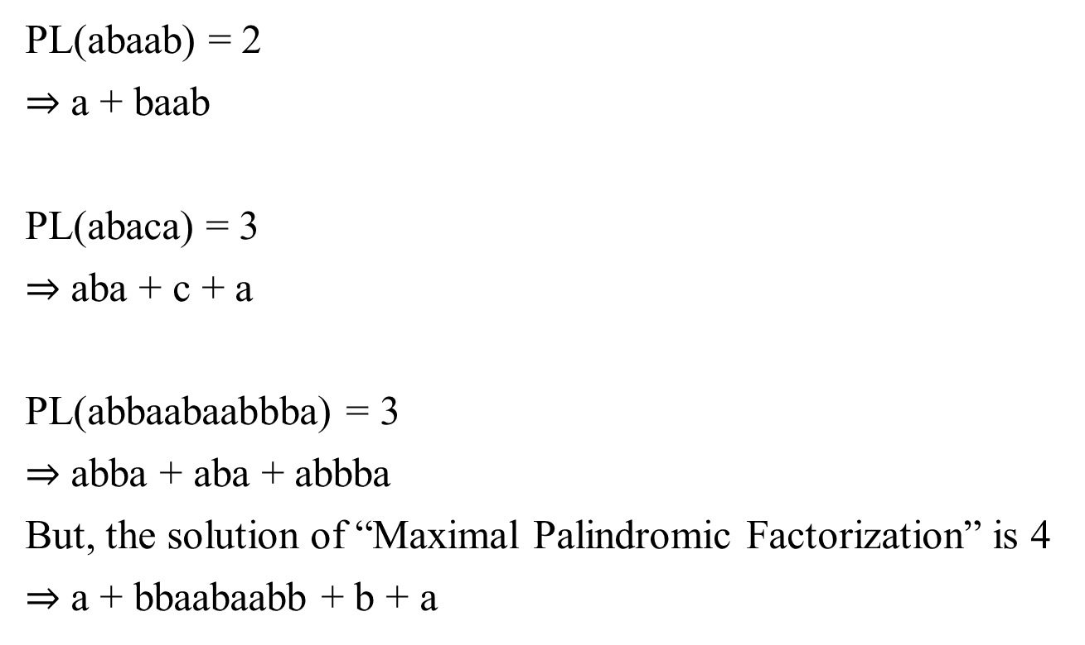
Minimum Palindromic Factorization (Palindromic Length)
PL(abaab) = 2
$⇒$ a + baab
PL(abaca) = 3
$⇒$ aba + c + a
PL(abbaabaabbba) = 3
$⇒$ abba + aba + abbba
But, the solution of “Maximal Palindromic Factorization” is 4
$⇒$ a + bbaabaabb + b + a

Slide 4


Simple Quadratic Algorithm
c | a | a | a | b | a | a | a | b | a | a | a | b | a | a | a
$$P_{j−1}$$
2
6
10
14
15
16
c | a | a | a | b | a | a | a | b | a | a | a | b | a | a | a | b
$$P_{j}$$
5
9
13
17

Slide 5
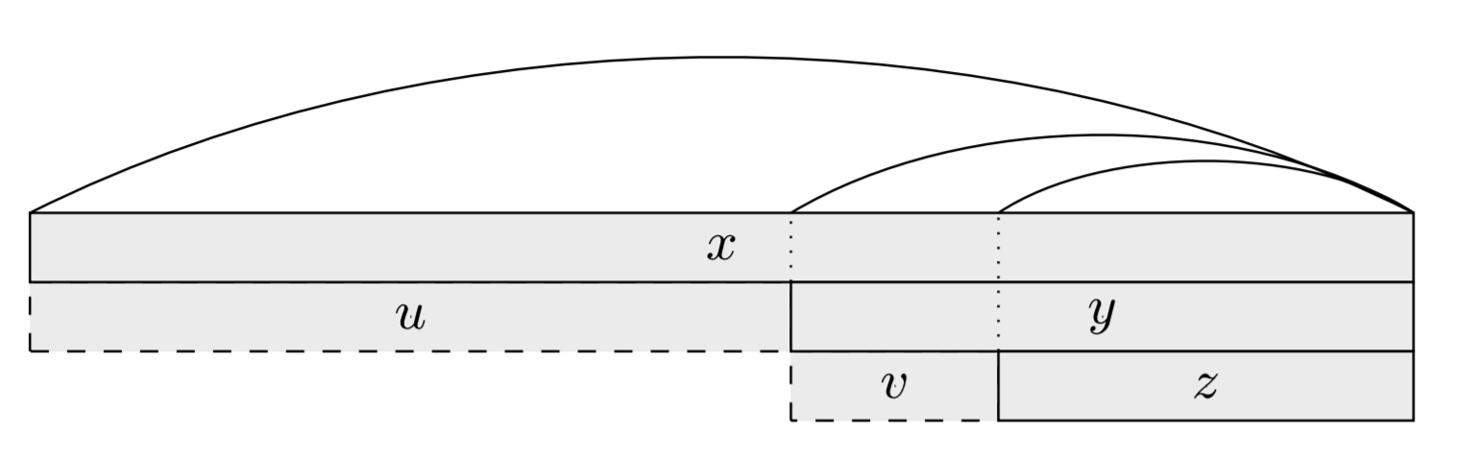


Period ($Δ$)
$$x,y,z are palindromes$$
$$u,v are periods of x and y if \left|x\right|≤2\left|y\right| and \left|y\right|≤2|z|$$
Ex : S = abbabbabba , is a palindrome
abbabba is the longest proper palindromic suffix of S.
Thus, abb is the smallest period of S.

Slide 6
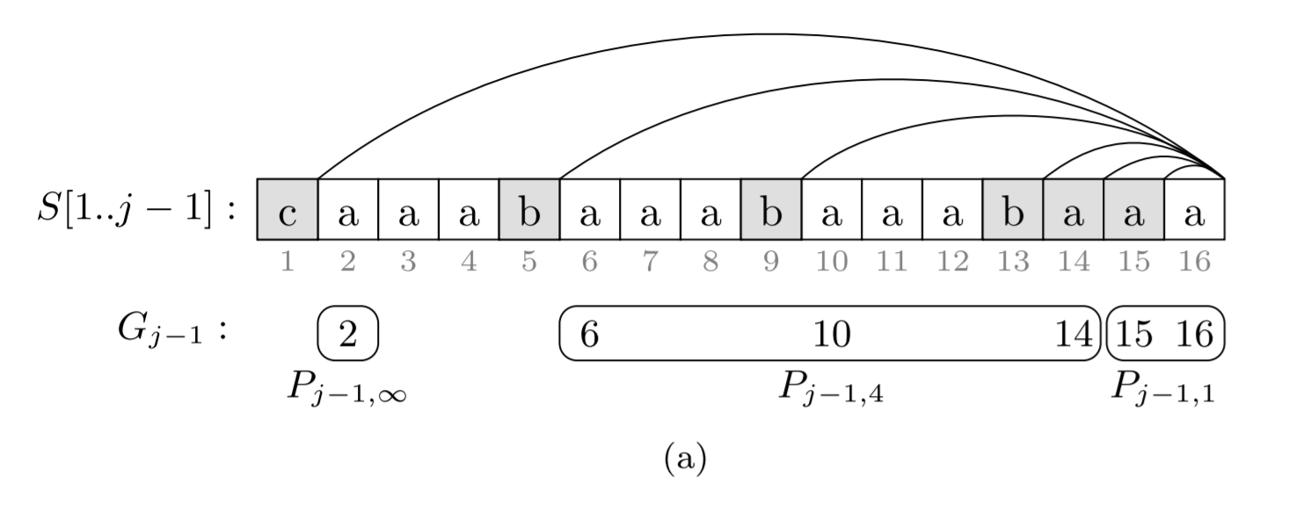

Grouping the suffix palindromes by periods
$$P_{j−1,∞}=(2,∞,1)$$
$$P_{j−1,4} =(6,4,3)$$
$$P_{j−1,1} =(15,1,2)$$

Slide 7
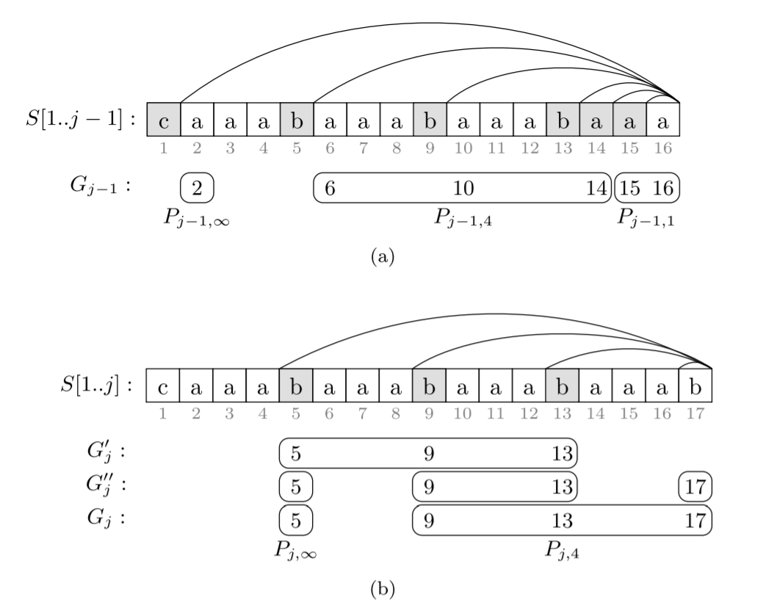

Update $G_{j}$

Slide 8
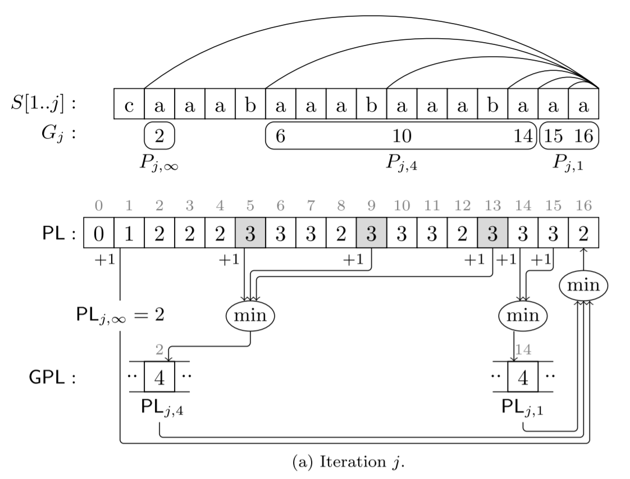
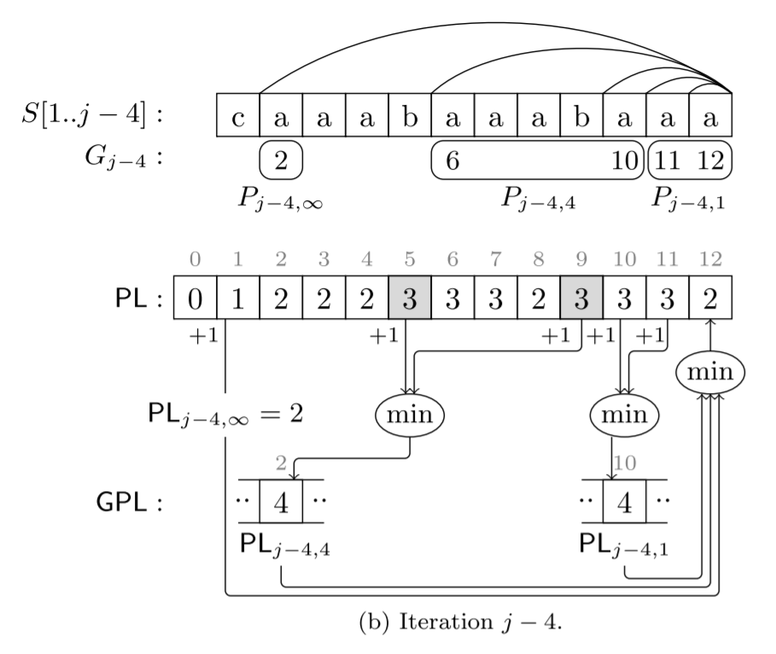

Slide 11

Time Complexity
Average case $O(n)$
Worst case $θ(nlogn)$

