Slide 1
Learning Optimal Warping Window Size of DTW for Time Series Classification
Qian Chen, Guyu Hu, Fanglin Gu, Peng Xiang
11th International Conference on Information Science, Signal Processing and their Applications (ISSPA), 2012, pages 1272 – 1277, Montreal, Canada
Speaker: Jheng-Yan Lyu
Date: 2018.11.27

Slide 2
Abstract (1/2)
The dynamic time warping (DTW) is a classic similarity measure which can handle the time warping issue in similarity computation of time series. And the DTW with constrained warping window is the most common and practical form of DTW. In this paper, the traditional learning method for optimal warping window of DTW is systematically analyzed. Then the time distance to measure the time deviation between two time series is introduced. Finally a new learning method for optimal warping window size based on DTW and time distance is proposed which can improve DTW classification accuracy with little additional computation.

Slide 3
Abstract (2/2)
Experimental data show that the optimal DTW with best warping window get better classification accuracy when the new learning method is employed. Additionally, the classification accuracy is better than that of ERP and LCSS, and is close to that of TWED.

Slide 4
Traditional Learning Method
To learn the best size of warping window, all the possible classification error rates will be iterated in traditional methods, and then select the best value which minimizes the classification errors estimated for the training data.

Slide 5

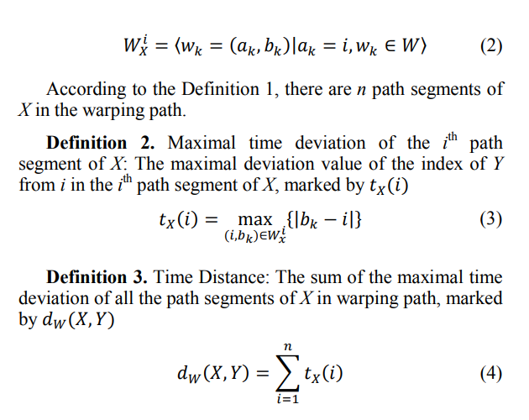
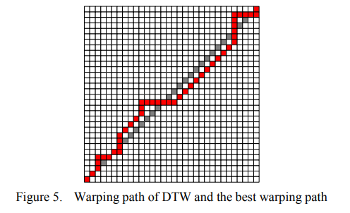
Time Distance between the Time Series

Slide 6
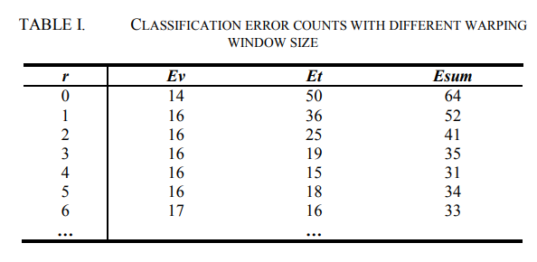
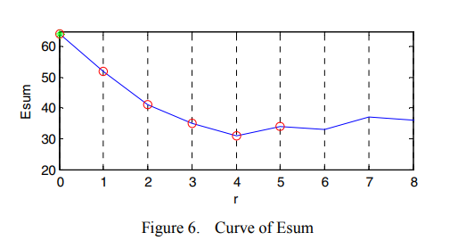
New Learning Method based on both Distances
Ev (the results of DTW distance)
Et (the results of time distance)
Esum is the sum of Ev and Et.
r=the size of warping window

Slide 7
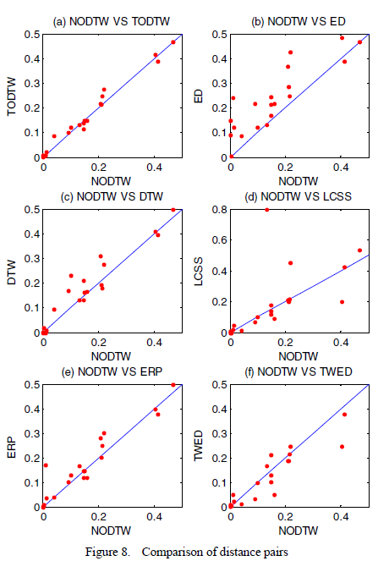
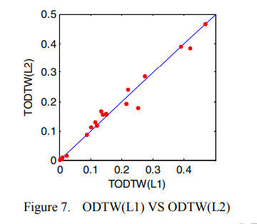
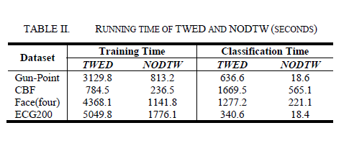
Experiment and Results
a

