Slide 1
A Neural Probabilistic Language Model
Yoshua Bengio , Réjean Ducharme, Pascal Vincent, Christian Jauvin
Journal of Machine Learning Research
3 (2003) 1137–1155
Presenter: Ke-Xin Zhu
Date: 2018/11/20

Slide 2
Abstract (1/2)
A goal of statistical language modeling is to learn the joint probability function of sequences of words in a language. This is intrinsically difficult because of the curse of dimensionality: a word sequence on which the model will be tested is likely to be different from all the word sequences seen during training. Traditional but very successful approaches based on n-grams obtain generalization by concatenating very short overlapping sequences seen in the training set. We propose to fight the curse of dimensionality by learning a distributed representation for words which allows each training sentence to inform the model about an exponential number of semantically neighboring sentences. The model learns simultaneously (1) a distributed representation for each word along with (2) the probability function for word sequences, expressed in terms of these representations.

Slide 3
Abstract (2/2)
Generalization is obtained because a sequence of words that has never been seen before gets high probability if it is made of words that are similar (in the sense of having a nearby representation) to words forming an already seen sentence. Training such large models (with millions of parameters) within a reasonable time is itself a significant challenge. We report on experiments using neural networks for the probability function, showing on two text corpora that the proposed approach significantly improves on state-of-the-art n-gram models, and that the proposed approach allows to take advantage of longer contexts.

Slide 4
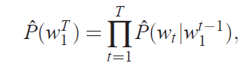

Statistical model of language
A statistical model of language can be represented by the conditional probability of the next word given all the previous ones, since:

Slide 5


n-gram models
The n-gram models construct tables of conditional probabilities for the next word, for each one of a large number of contexts, i.e.combinations of the last n−1 words:

Slide 6
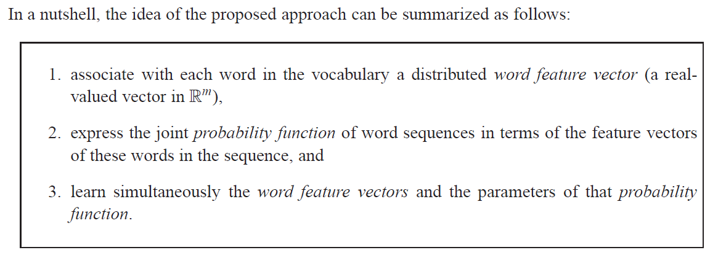
Fighting the Curse of Dimensionality with Distributed Representations
1. 為在詞表中的每一個詞分配一個分佈式的詞特徵向量；
2. 詞序列中出現的詞的特徵向量表示的詞序列的聯合概率函數；
3. 學習詞特徵向量和概率函數的參數。

Slide 7

using neural networks to model high-dimensional discrete distributions
1. 使用神經網絡對高維離散分佈建模：
2.條件概率函數：
3.基於詞向量的概率函數：
4.訓練目標-最大似然化：

Slide 8
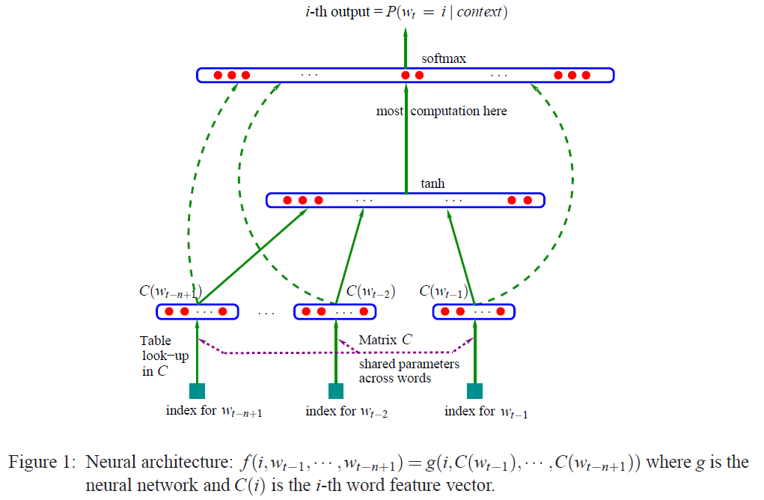
A Neural Model (1/2)

Slide 9








A Neural Model (2/2)
詞的概率：
隱含層：
詞向量：
自由參數：
隨機梯度上升：

Slide 10

Parallel Implementation
1. Data-Parallel Processing：each processor works on a different subset of the data.
2. Parameter-Parallel Processing: parallelize across the parameters, in particular the parameters of the output units

Slide 11
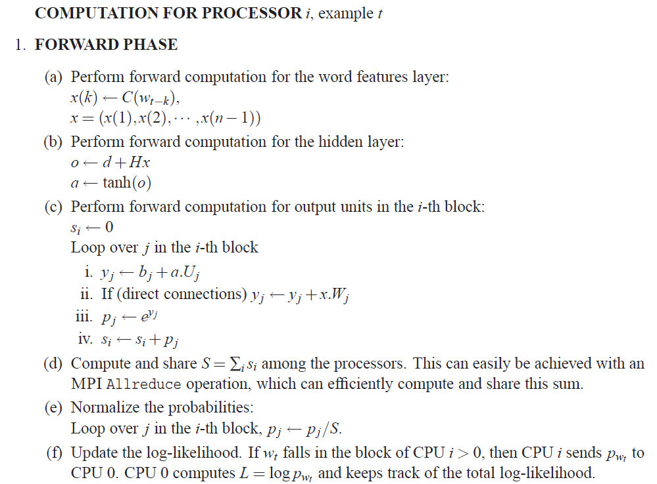
The implementation of this strategy (1/3)

Slide 12
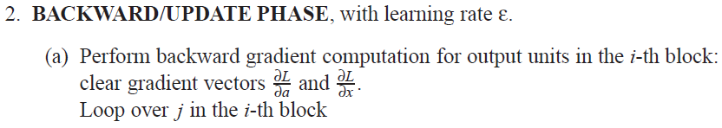
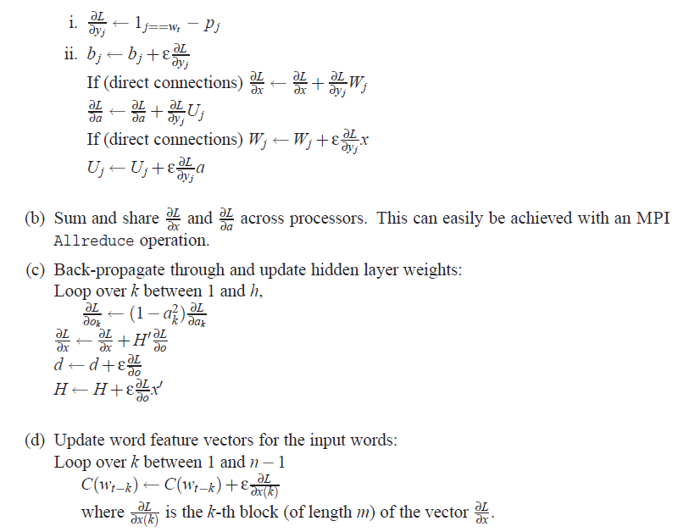
The implementation of this strategy (1/2)

Slide 13
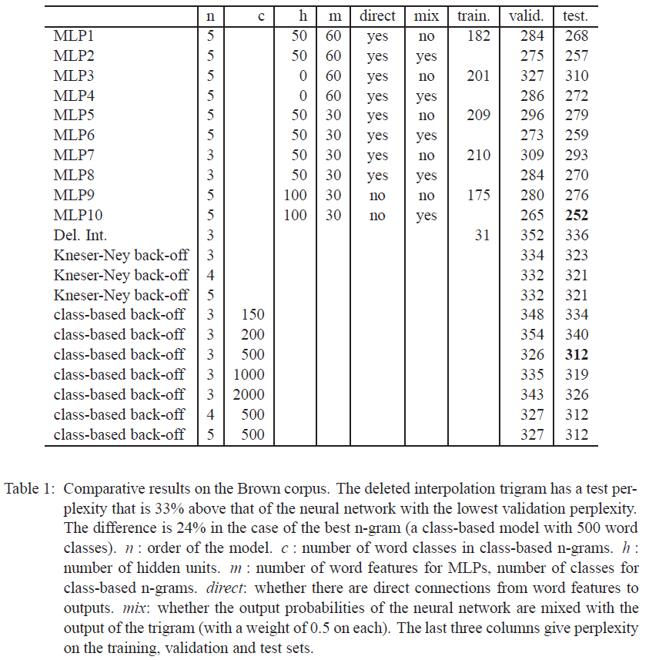
Results(1/2)

Slide 14
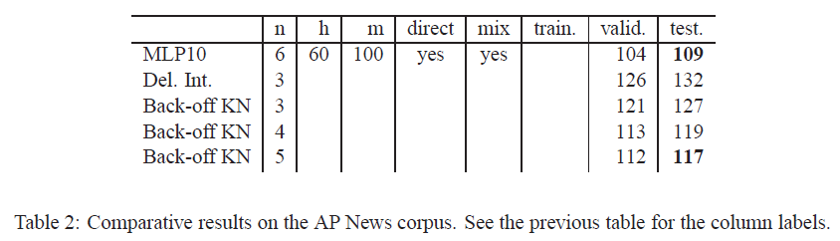

Results(2/2)

