Slide 1
Approximate string-matching with a single gap for sequence alignment
Tomas Flouri, Kunsoo Park, Kimon Frousios, Solon P. Pissis,
Costas S. Iliopoulos, German Tischler
Proceedings of the Second ACM International Conference on Bioinformatics and Computational Biology(BCB), Chicago, USA, July 31 - August 03, 2011
Speaker: Guan-Zhi Chen
Date: 2018.12.04
Notes:
Tomas Flouri 布拉格捷克理工大學
Kimon Frousios, Costas S. Iliopoulos, Solon P. Pissis 英國倫敦大學國王學院
Kunsoo Park 首爾大學
German Tischler 德國符茲堡大學

Slide 2
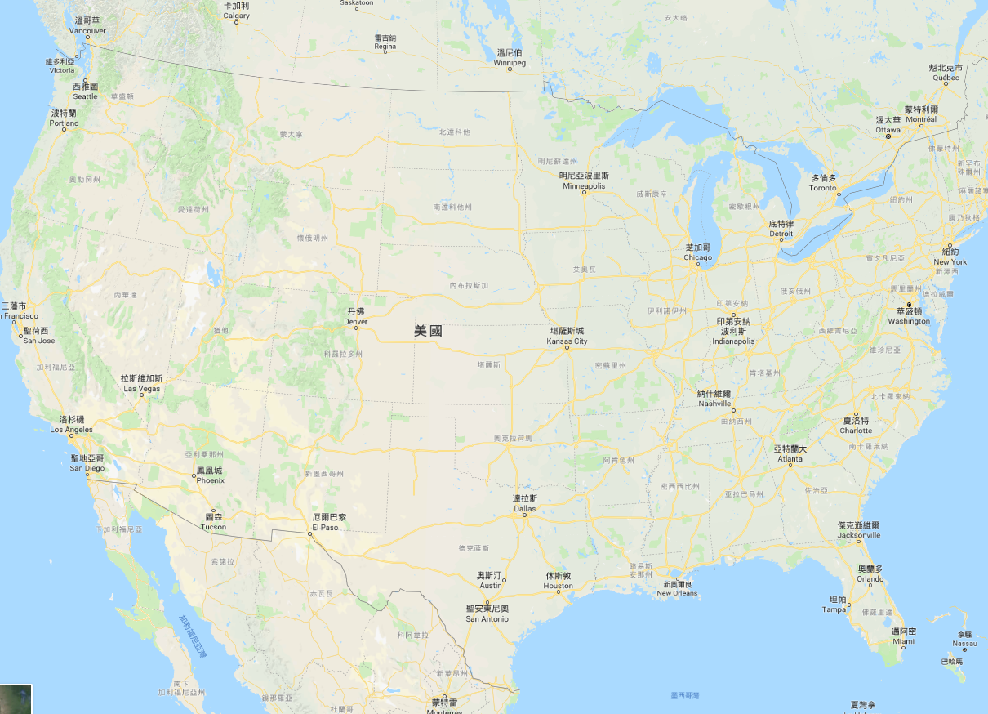
Notes:
Tomas Flouri 布拉格捷克理工大學
Kimon Frousios, Costas S. Iliopoulos, Solon P. Pissis 英國倫敦大學國王學院
Kunsoo Park 首爾大學
German Tischler 德國符茲堡大學

Slide 3
Abstract (1/2)
This paper deals with the approximate string-matching problem with Hamming distance and a single gap for sequence alignment. We consider an extension of the approximate string-matching problem with Hamming distance, by also allowing the existence of a single gap, either in the text, or in the pattern.

Slide 4
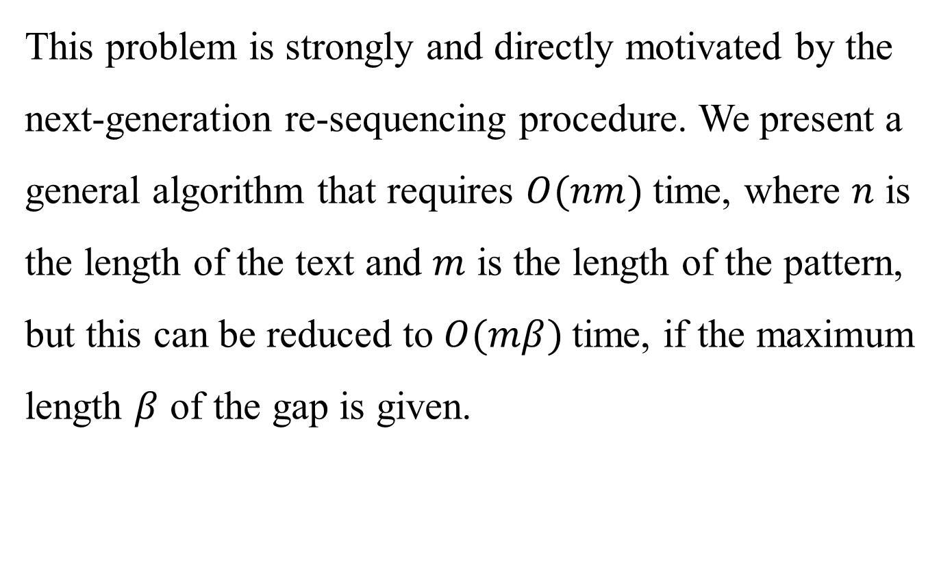
Abstract (2/2)
This problem is strongly and directly motivated by the next-generation re-sequencing procedure. We present a general algorithm that requires $O(nm)$time, where $n$ is the length of the text and $m$ is the length of the pattern, but this can be reduced to $O(mβ)$time, if the maximum length $β$ of the gap is given.

Slide 5



Definition (1/2)
Hamming distance:
number of different chars between two strings of the same length
$S$: | A | A | C | T | G
$T$: | A | C | T | T | G
$$δ_{H}\left(S,T\right)=2$$
2-mismatches
for single char:
$$δ_{H}\left(S[1],T[1]\right)=0$$
the same
$$δ_{H}\left(S[2],T[2]\right)=1$$
Notes:
delta

Slide 6

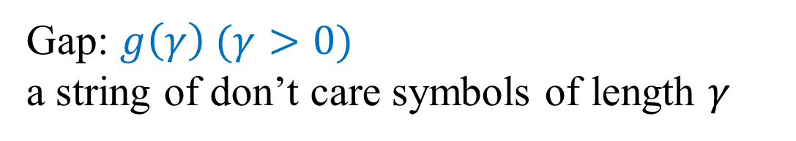



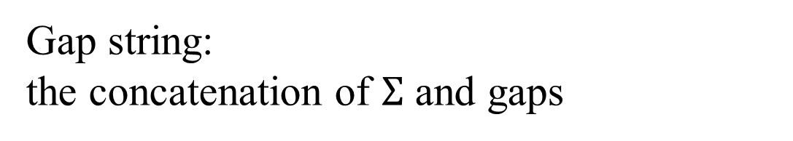
Definition (2/2)
Gap: $g\left(γ\right) (γ>0)$
a string of don’t care symbols of length $γ$
Gap string:
the concatenation of $Σ$ and gaps
$T$: | A | A | C | T | G | A | C | C | C
$P$: | A | C | T
$P′$: |  |  |  | * | * | * | * | * | *
< Gap string >
$$δ_{H}\left(T,P′\right)=2$$

Slide 7
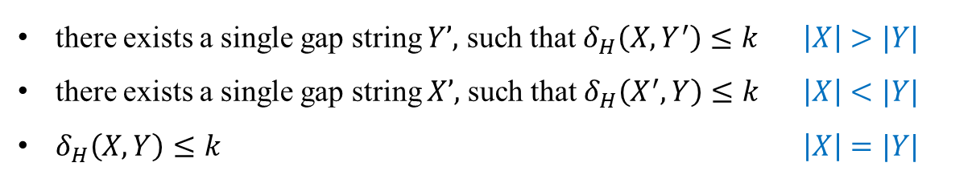




The problem and answer (1/4)
$T$: | A | G | G | T | C | A | T
$$len=n$$
$$X:$$ | G | G | G | T | A
$$len=m$$
Given $k$, find all positions of factors of $T \left(Y\right):$
there exists a single gap string $Y’,$ such that $δ_{H}\left(X,Y^{′}\right)≤k$ $\left|X\right|>|Y|$
there exists a single gap string $X’,$ such that $δ_{H}\left(X^{′},Y\right)≤k$ $\left|X\right|<|Y|$
$δ_{H}\left(X,Y\right)≤k$ $\left|X\right|=|Y|$

Slide 8
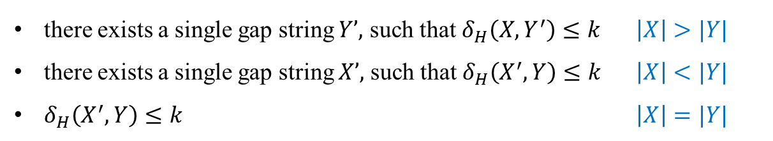




The problem and answer (2/4)
$T$: | A | G | G | T | C | A | T
$$len=n$$
$$X:$$ | G | G | G | T | A
$$len=m$$
Given $k$, find all positions of factors of $T \left(Y\right):$
there exists a single gap string $Y’,$ such that $δ_{H}\left(X,Y^{′}\right)≤k$ $\left|X\right|>|Y|$
there exists a single gap string $X’,$ such that $δ_{H}\left(X^{′},Y\right)≤k$ $\left|X\right|<|Y|$
$δ_{H}\left(X^{′},Y\right)≤k$ $\left|X\right|=|Y|$
$Y′$: | A | G | G | T | *
$δ_{H}\left(X,Y^{′}\right)$=1
$$X:$$ | G | G | G | T | A

Slide 9


The problem and answer (3/4)
$T$: | A | G | G | T | C | A | T
$$len=n$$
$$X:$$ | G | G | G | T | A
$$len=m$$
Given $k$, find all positions of factors of $T \left(Y\right):$
there exists a single gap string $Y’,$ such that $δ_{H}\left(X,Y^{′}\right)≤k$ $\left|X\right|>|Y|$
there exists a single gap string $X’,$ such that $δ_{H}\left(X^{′},Y\right)≤k$ $\left|X\right|<|Y|$
$δ_{H}\left(X^{′},Y\right)≤k$ $\left|X\right|=|Y|$
$Y$: | A | G | G | T | C
$δ_{H}\left(X,Y\right)$=1
$$X:$$ | G | G | G | T | A

Slide 10

The problem and answer (4/4)
$T$: | A | G | G | T | C | A | T
$$len=n$$
$$X:$$ | G | G | G | T | A
$$len=m$$
Given $k$, find all positions of factors of $T \left(Y\right):$
there exists a single gap string $Y’,$ such that $δ_{H}\left(X,Y^{′}\right)≤k$ $\left|X\right|>|Y|$
there exists a single gap string $X’,$ such that $δ_{H}\left(X^{′},Y\right)≤k$ $\left|X\right|<|Y|$
$δ_{H}\left(X^{′},Y\right)≤k$ $\left|X\right|=|Y|$
$Y$: | A | G | G | T | C | A
$δ_{H}\left(X′,Y\right)$=2
$$X′:$$ | G | G | G | T | A | *

Slide 11


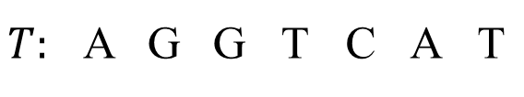

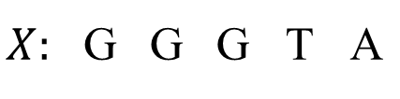


Their method
$$T:$$ | A | G | G | T | C | A | T
$$X:$$ | G | G | G | T | A
Taking $G\left[6, 4\right]$ for example:
$$(i>j)$$
$$G\left[i,j\right]=min⁡(δ_{H}\left(Y\left[i−j+1..i\right], X\left[1..j\right]\right), δ_{H}(Y\left[1..j\right],X[1..j]))$$
$Y$: | A | G | G | T | C | A
$δ_{H}\left(X′,Y\right)$ = 3
$$X′:$$ | * | * | G | G | G | T
$Y$: | A | G | G | T | C | A
$δ_{H}\left(X′,Y\right)$ = 1
$$X′:$$ | G | G | G | T | * | *
$G[6, 4]$ = min(3, 1) = 1

Slide 12
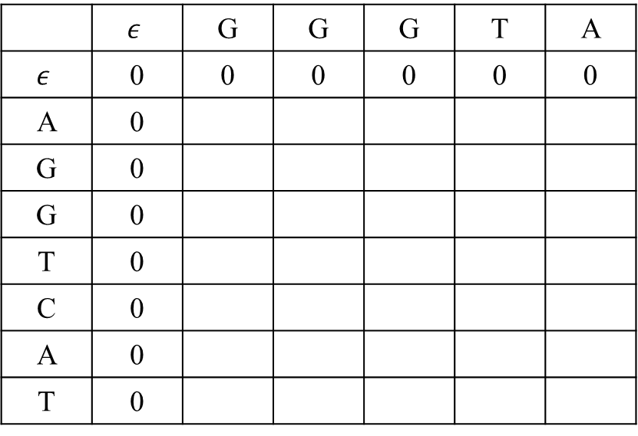
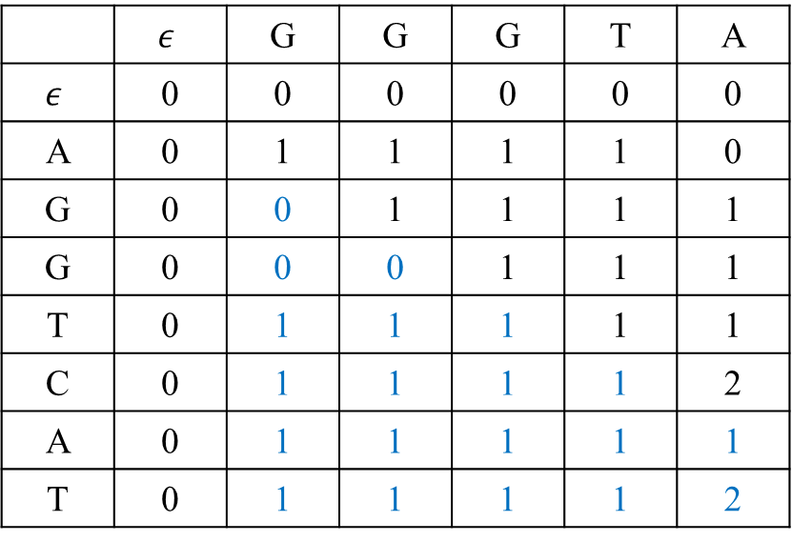
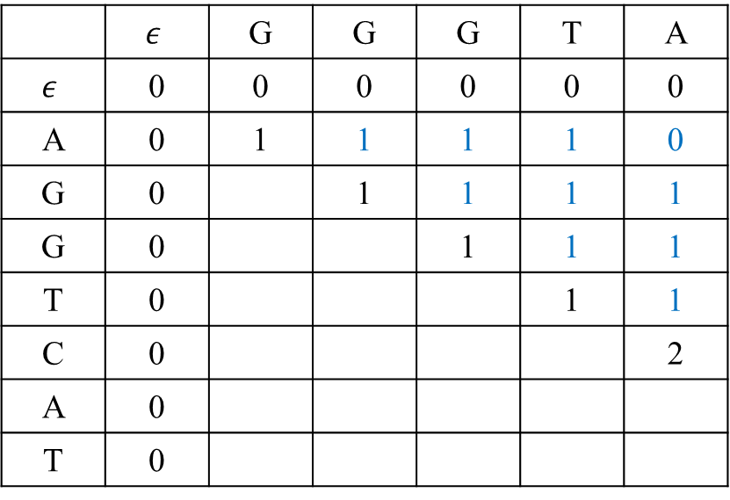
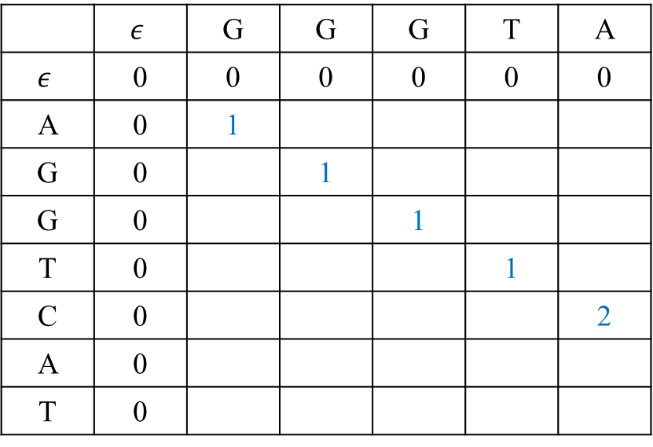
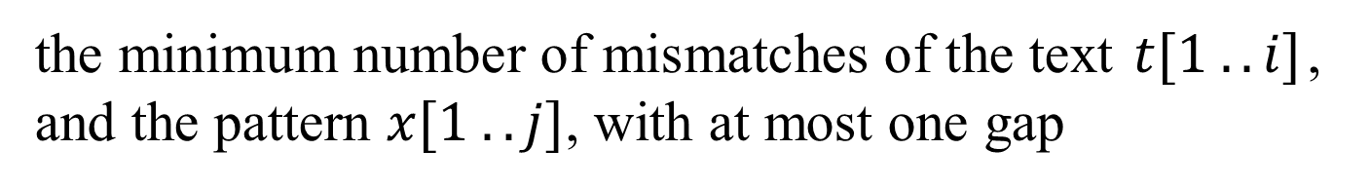
G matrix
the minimum number of mismatches of the text $t[1 . . i]$, and the pattern $x[1 . . j]$, with at most one gap
0 | 1 | 2 | 3 | 4 | 5
 | $$ε$$ | G | G | G | T | A
$$ε$$ | 0 | 0 | 0 | 0 | 0 | 0
A | 0 | 1
G | 0 |  | 1
G | 0 |  |  | 1
T | 0 |  |  |  | 1
C | 0 |  |  |  |  | 2
A | 0
T | 0
 | $$ε$$ | G | G | G | T | A
$$ε$$ | 0 | 0 | 0 | 0 | 0 | 0
A | 0 | 1 | 1 | 1 | 1 | 0
G | 0 |  | 1 | 1 | 1 | 1
G | 0 |  |  | 1 | 1 | 1
T | 0 |  |  |  | 1 | 1
C | 0 |  |  |  |  | 2
A | 0
T | 0
 | $$ε$$ | G | G | G | T | A
$$ε$$ | 0 | 0 | 0 | 0 | 0 | 0
A | 0 | 1 | 1 | 1 | 1 | 0
G | 0 | 0 | 1 | 1 | 1 | 1
G | 0 | 0 | 0 | 1 | 1 | 1
T | 0 | 1 | 1 | 1 | 1 | 1
C | 0 | 1 | 1 | 1 | 1 | 2
A | 0 | 1 | 1 | 1 | 1 | 1
T | 0 | 1 | 1 | 1 | 1 | 2
 | $$ε$$ | G | G | G | T | A
$$ε$$ | 0 | 0 | 0 | 0 | 0 | 0
A | 0
G | 0
G | 0
T | 0
C | 0
A | 0
T | 0
0
1
2
3
4
5
6
7
$$G\left[i,j\right]=min\left\{G\left[i−1,j−1\right]+δ_{H}\left(t\left[i\right],x\left[j\right]\right),G\left[i,i\right]\right\}, i<j$$
$$G\left[i,j\right]=min\left\{G\left[i−1,j−1\right]+δ_{H}\left(t\left[i\right],x\left[j\right]\right),G\left[j,j\right]\right\}, i>j$$
$G\left[i,j\right]=G\left[i−1,j−1\right]+δ_{H}\left(t\left[i\right],x\left[j\right]\right)$ $, i=j$

Slide 13
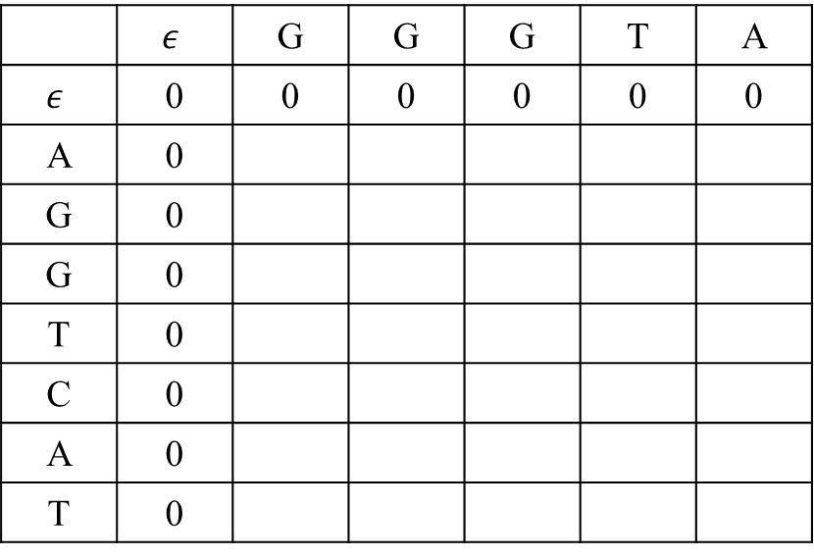
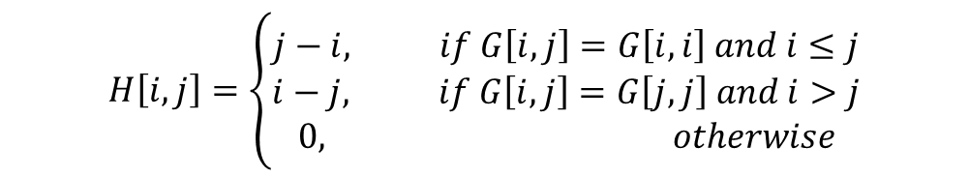
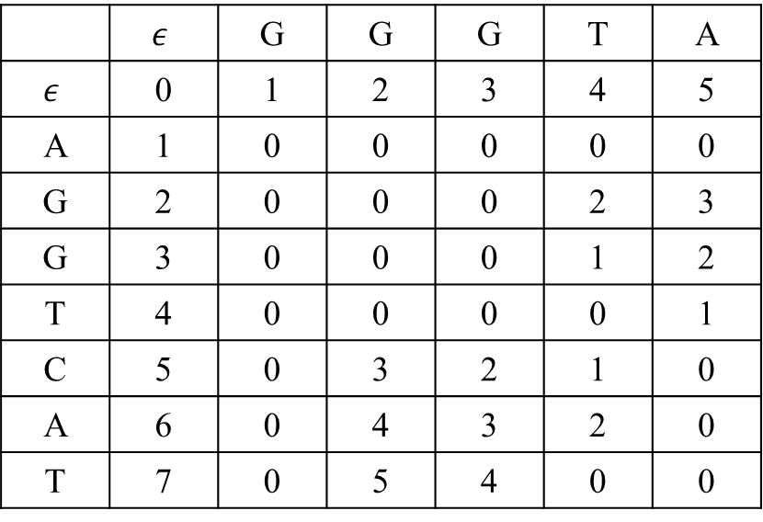
H matrix
the location of the gap
$$H\left[i,j\right]=\left\{\begin{aligned}j−i, if G\left[i, j\right]=G\left[i, i\right] and i≤j \\ i−j, if G\left[i, j\right]=G\left[j, j\right] and i>j \\ 0, otherwise\end{aligned}\right.$$
0 | 1 | 2 | 3 | 4 | 5
 | $$ε$$ | G | G | G | T | A
$$ε$$ | 0 | 1 | 2 | 3 | 4 | 5
A | 1 | 0 | 0 | 0 | 0 | 0
G | 2 | 0 | 0 | 0 | 2 | 3
G | 3 | 0 | 0 | 0 | 1 | 2
T | 4 | 0 | 0 | 0 | 0 | 1
C | 5 | 0 | 3 | 2 | 1 | 0
A | 6 | 0 | 4 | 3 | 2 | 0
T | 7 | 0 | 5 | 4 | 0 | 0
 | $$ε$$ | G | G | G | T | A
$$ε$$ | 0 | 0 | 0 | 0 | 0 | 0
A | 0
G | 0
G | 0
T | 0
C | 0
A | 0
T | 0
0
1
2
3
4
5
6
7

Slide 14
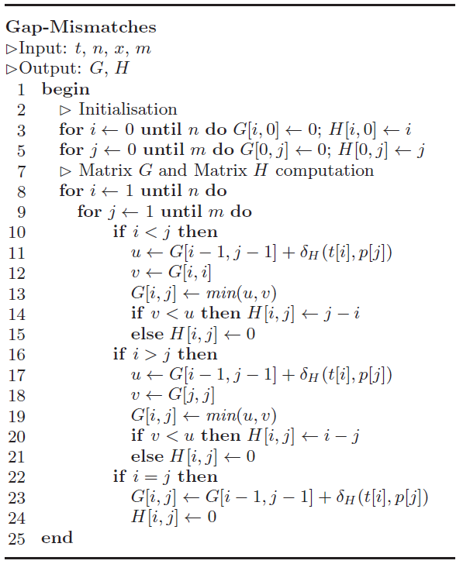
GAP-MISMATCHES algorithm

Slide 15
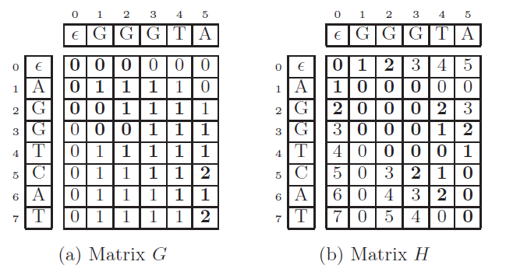

Speeding up
$$2β+1 width$$

Slide 16
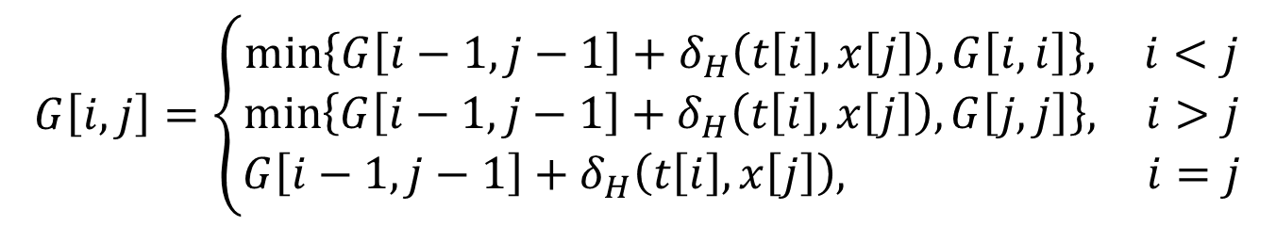
GAP-MISMATCHES algorithm (1/2)
$$G\left[i,j\right]=\left\{\begin{aligned}\min\left\{G\left[i−1,j−1\right]+δ_{H}\left(t\left[i\right],x\left[j\right]\right),G\left[i,i\right]\right\}, i<j \\ \min\left\{G\left[i−1,j−1\right]+δ_{H}\left(t\left[i\right],x\left[j\right]\right),G\left[j,j\right]\right\}, i>j \\ G\left[i−1,j−1\right]+δ_{H}\left(t\left[i\right],x\left[j\right]\right), i=j\end{aligned}\right.$$
$$G\left[i,0\right]=G\left[0,j\right]=0, for 0≤i≤n, 0≤j≤m$$

Slide 17
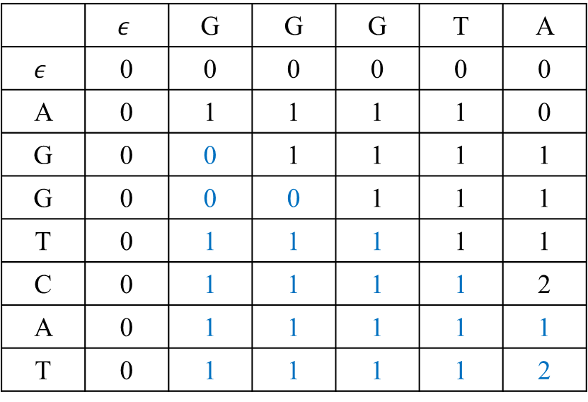
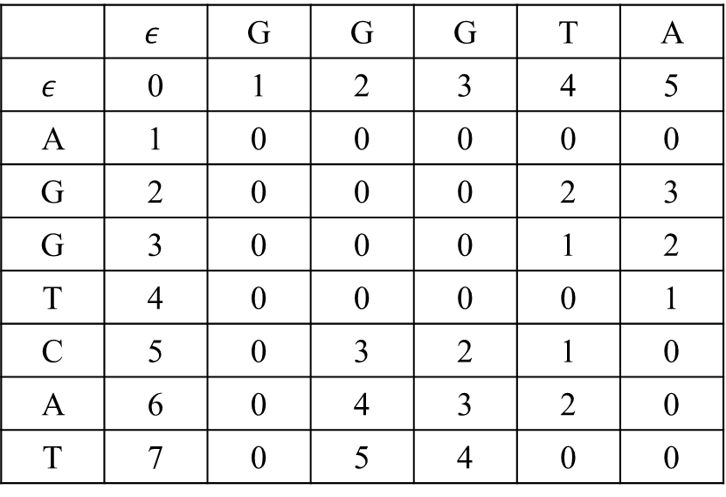
 | $$ε$$ | G | G | G | T | A
$$ε$$ | 0 | 0 | 0 | 0 | 0 | 0
A | 0 | 1 | 1 | 1 | 1 | 0
G | 0 | 0 | 1 | 1 | 1 | 1
G | 0 | 0 | 0 | 1 | 1 | 1
T | 0 | 1 | 1 | 1 | 1 | 1
C | 0 | 1 | 1 | 1 | 1 | 2
A | 0 | 1 | 1 | 1 | 1 | 1
T | 0 | 1 | 1 | 1 | 1 | 2
 | $$ε$$ | G | G | G | T | A
$$ε$$ | 0 | 1 | 2 | 3 | 4 | 5
A | 1 | 0 | 0 | 0 | 0 | 0
G | 2 | 0 | 0 | 0 | 2 | 3
G | 3 | 0 | 0 | 0 | 1 | 2
T | 4 | 0 | 0 | 0 | 0 | 1
C | 5 | 0 | 3 | 2 | 1 | 0
A | 6 | 0 | 4 | 3 | 2 | 0
T | 7 | 0 | 5 | 4 | 0 | 0

