Slide 1
The Monty Hall Problem, Reconsidered
Stephen Lucas, Jason Rosenhouse, Andrew Schepler
Mathematics Magazine, Vol. 82, No. 5 (2009), pp. 332-342
Presenter: Guan-Jie Chen
Date: Jun. 6, 2023

Slide 2
Abstract
The Monty Hall problem is one of the most frustrating brainteasers in all of mathematics. Despite its seemingly simple game-show format, most people, even those with mathematical training, find it very challenging. Part of the difficulty lies in the counter-intuitive nature of conditional probability. We offer an intuitive guide to focusing on what is important in the problem. We then show how to apply this new-found intuition to numerous, increasingly complicated, variations on the basic set-up.

Slide 3
Issue
Version 1. (Classic Monty) You are a player on a game show and are shown three identical doors. Behind one is a car, behind the other two are goats. Monty Hall, the host of the show, asks you to choose one of the doors. You do so, but you do not open your chosen door. Monty, who knows where the car is, now opens one of the doors. He chooses his door in accordance with the following rules:

Slide 4
Issue (cont.)
Monty always opens a door that conceals a goat.
Monty never opens the door you initially chose.
If Monty can open more than one door without violating rules one and two, then he chooses his door randomly.

Slide 5
Issue (cont.)
After Monty opens his door, he gives you the choice of sticking with your original choice or switching to the other unopened door. What should you do to maximize your chances of winning the car?

Slide 6
Confusion
Without switching
Winning probability = ⅓
Switching
Winning probability = ½

Slide 7
Confusion
Without switching
Winning probability = ⅓
Switching
Winning probability = ½ (Wrong)

Slide 8
Solution
If the player initially chooses door one
Without switching
Winning probability = ⅓

Slide 9
Solution (cont.)
If the player initially chooses door one
Switching
door 1 | door 2 | door 3 | winning probability
car |  |  | ⅓ * 0
 | car |  | ⅓ * 1
 |  | car | ⅓ * 1
Notes:
橘色是一開始選擇的door 1
藍色是主持人可能打開的門
三分之一是車分別在door 1 2 3的機率

Slide 10
Solution (cont.)
If the player initially chooses door one
Switching
Winning probability = ⅔
Notes:
因為在主持人在開門的時候已經受到我們的選擇影響

Slide 11
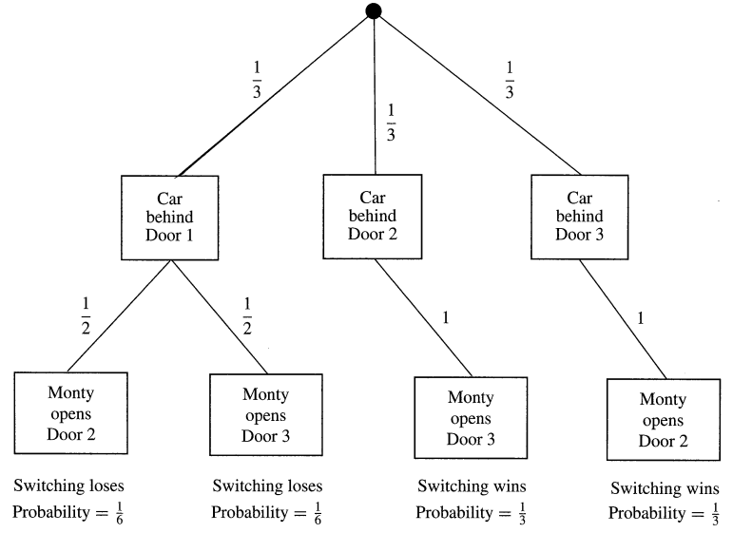
Solution (cont.)
Notes:
樹狀圖是選door 1＆都換的情況下
換個觀點 可以視為：
一開始如果選到有車的門 必輸
一開始如果選到沒車的門 必贏
所以 拿到車的機率＝一開始選到沒車的門的機率＝三分之二

Slide 12
Issue
Version 2. (High-Numbered Monty) As before, we have three identical doors concealing one car and two goats. The player chooses a door that remains un opened. Monty now opens a door he knows to conceal a goat. This time, however, we stipulate that Monty always opens the highest-numbered door available to him (keeping in mind that Monty will never open the door the player chose.) Will the player gain any advantage by switching doors?
Notes:
主持人只能打開藏有羊的最大數字門

Slide 13
Solution
If the player initially chooses door one
Switching
door 1 | door 2 | door 3 | winning probability
car |  |  | ⅓ * 0
 | car |  | ⅓ * 1
 |  | car | ⅓ * 1
Notes:
＃在一開始選擇門１的情況下
不換 一樣是三分之一
換：
本來可以打開黃色的門 但現在只能打開藍色的
如果開了門２，車一定在門３
所以如果主持人開了門３，此時換與不換的成功率相同

Slide 14
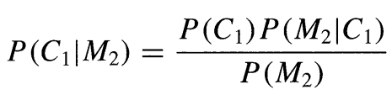
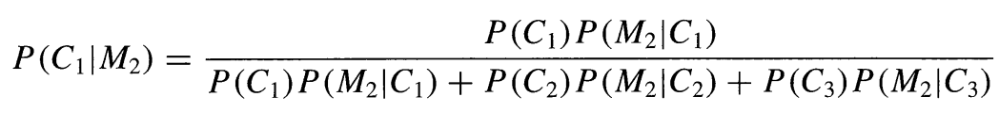
Bayes’ Theorem
C_{i} : the event that the car is behind door i
M_{j} : the event that Monty opens door j to reveal a goat
Notes:
P(M2) P(C1|M2) = P(C1) P(M2|C1) = P(C1 ⋂ M2)
這邊依舊是選擇門１的前提下

Slide 15
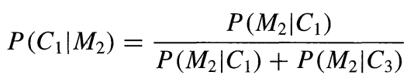
Bayes’ Theorem (cont.)
P(C₁) = P(C₂) = P(C₃) = ⅓
P(M₂ | C₂) = 0
Notes:
這邊依舊是選擇門１的前提下

Slide 16
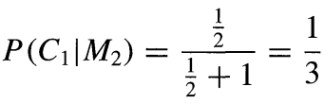
Bayes’ Theorem (cont.)
Classic
P(M₂ | C₁) = ½
P(M₂ | C₃) = 1
Notes:
這邊依舊是選擇門１的前提下
不換（門１）：三分之一
換門３：三分之二
換較優

Slide 17

Bayes’ Theorem (cont.)
High-numbered
P(M₂ | C₁) = 0
P(M₂ | C₃) = 1
Notes:
這邊依舊是選擇門１的前提下
換與不換都是二分之一

Slide 18
Issue
Version 3. (Random Monty) As always, assume that the player has initially chosen door one and Monty subsequently opened door two to reveal a goat. This time, however, you know that Monty chose his door randomly, subject only to the restriction that he not open the door the player chose. Should we switch?
Notes:
主持人打開任意一扇＂非＂我們一開始所選的門（也就是可能打開有車的門）

Slide 19
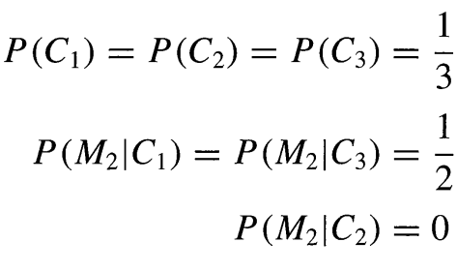
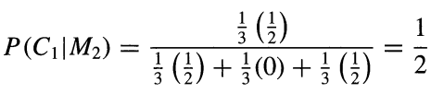
Solution
Notes:
結論：換與不換無所謂（在門２打開後是山羊的情況下）

Slide 20
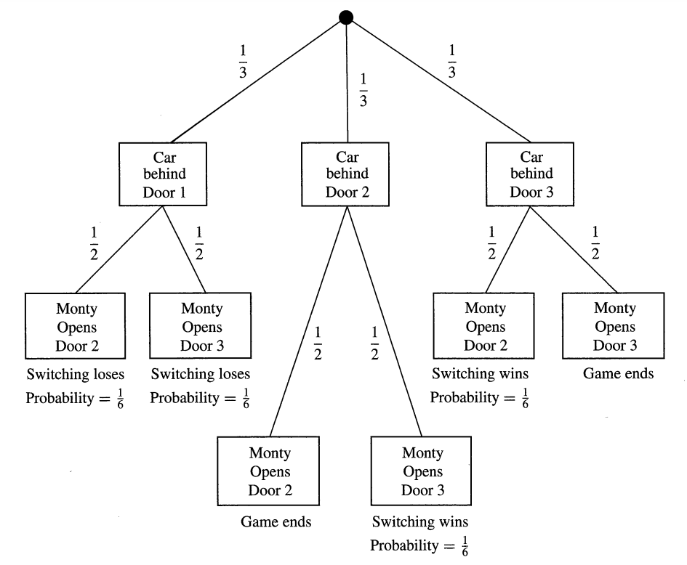
Solution (cont.)

Slide 21
Issue
Version 4. (Two-Player Monty) We begin with three identical doors con cealing two goats and one car. There are two players in the game. Each player chooses one of the doors, but does not open it. Each player knows there is another person in the game, but neither knows which door the other player selected. Monty now opens a door according to the following procedure.
Notes:
兩個玩家各選一扇門，他們不知道對方選什麼門

Slide 22
Issue (cont.)
If both players selected the same door, then everything proceeds as in the classical game. Monty opens a goat-concealing door, choosing randomly if he has a choice.
If the players selected different doors, then Monty opens the one remaining door, regardless of what is behind it.
Notes:
如果兩人選同一扇門，主持人可以打開任一扇藏有羊的門（不能打開他們一開始所選的門）
如果兩人選了不同門，主持人打開剩餘的那扇門

Slide 23
Issue (cont.)
We assume that both players select their initial doors randomly. If you are one of the players and you have just seen Monty open a goat-concealing door, should you switch?
Notes:
在我們一開始選擇門１，且主持人打開門２是羊的情況下，換不換

Slide 24
Solution
B chooses door 3 & goat is behind door 2: 1/3 * 1 * 2/3 = 2/9
B chooses door 1:
Car is behind door 1: 1/3 * 1/2 * 1/3 = 1/18
Car is behind door 3: 1/3 * 1 * 1/3 = 1/9
Notes:
考慮另一位玩家Ｂ選了什麼讓主持人打開門２
Ｂ選門３，主持人被迫打開門２，門２後面是羊的機率
Ｂ選門１
車在門１，主持人有二分之一的機率打開門２
車在門３，主持人被迫打開門２

Slide 25
Solution (cont.)
B’s choice
door 1 : door 3 = 4 : 3
Notes:
４／７的機率 Ｂ選門１
３／７的機率 Ｂ選門２

Slide 26
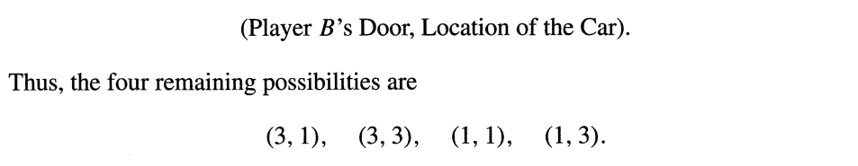


Solution (cont.)
Notes:
只要Ｂ選門３ 主持人就被迫打開門２
所以Ｐ（３，１）＝Ｐ（３，３）
若Ｂ選門１
－車在門１，主持人有二分之一的機率打開門２
－車在門３，主持人被迫打開門２ （１：２ 剛好分配掉剩下的３／７）

Slide 27
Solution (cont.)
Switching is a better choice.
Notes:
在我們一開始選了門１，主持人打開門２且是羊的情況下
在門１的機率是３／７，在門３的機率是４／７

Slide 28
Issue
Version 5. (Progressive Monty) This time there are n identical doors, concealing one car and n - 1 goats. The player chooses a door, but does not open it. Monty now opens a goat-concealing door, choosing randomly from among his options. The player is now given the choice of sticking or switching. The player makes his choice, but again does not open his chosen door. Monty opens another goat-concealing door.
Notes:
ｎ個相同門，門後有ｎ－１隻羊＆１台車
主持人打開一扇藏有羊的門（不包含我們所選的門），我們可以選擇換或不換

Slide 29
Issue (cont.)
The player is again given the opportunity to stick or switch. This continues until Monty has opened n - 2 doors. The player makes his final selection, and wins whatever is be hind his door. What strategy will maximize his chances of winning the car?
Notes:
不停執行這個流程，直到剩下２扇門

Slide 30

Solution
１ ２ ３ ４ ５

Slide 31
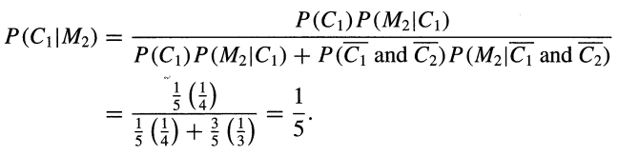
Solution (cont.)

Slide 32

Solution (cont.)
１ Ｘ ３ ４ ５

Slide 33
Solution (cont.)
１ Ｘ ３ ４ ５

Slide 34
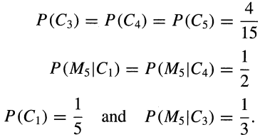
Solution (cont.)
Notes:
第二列
第一個
因為選３ 只能開４ｏｒ５
第二個
因為選３ 只能開１ｏｒ５

Slide 35

Solution (cont.)
Notes:
有Ｐ（Ｍ５）就能算後面的

Slide 36

Solution (cont.)
１ Ｘ ３ ４ Ｘ
Notes:
代入貝式定理
Ｐ（Ｃ１｜Ｍ５）
Ｐ（Ｃ３｜Ｍ５）
Ｐ（Ｃ４｜Ｍ５）

Slide 37
Solution (cont.)
１ Ｘ ３ ４ ５
Notes:
＃回到前一步

Slide 38

Solution (cont.)
Ｘ Ｘ ３ ４ ５
Notes:
為什麼門３機率低
效果如同４門（１３４５）經典，我們選了門３，開了門１是羊，所以門３（即不換）還是維持著４門時的機率，門４門５（換）
為什麼當蒙提打開第一扇門時，第三扇門的機率下降呢？這一點比較難解釋，但我們的計算結果提供了一種正確的思考方式。如果在我們轉換到第三扇門時，所有四扇門的機率是均等的，那麼我們實際上就是在玩四門經典蒙提遊戲。在這種情況下，我們選擇的門在蒙提打開一扇門後會保持其初始機率。
我們為當前情況計算的機率向量與在玩四門經典蒙提遊戲時所得到的機率向量是相同的。這表明，通過消除第一扇門，蒙提基本上抹去了遊戲的先前歷史。我們現在面對的是在我們選擇之時均等的三扇門，這些門是四門經典蒙提遊戲中的一部分。事實上，第一扇門與其他門的機率不同並不以相關的方式區分我們的情況。
因此，當蒙提打開第一扇門時，它並未提供任何關於第三扇門的新信息。我們重新評估第三扇門的機率是基於我們最初選擇時的均等機率，而不是過去遊戲中第一扇門的機率。

Slide 39
Summary
Monty打開門時，除了你現在所選的門，其餘門的勝率上升
如果當前選擇不同的門具有相同的勝率，在Monty打開一扇門後，你在Monty開門前所選的門勝率不會改變
Notes:
如果不具有相同的勝率，意味著車在不同門的機率不對等，進而影響到主持人開此門的機率（因為主持人不能打開有車的門）
然而，為什麼其他門具有相等的概率是重要的呢？答案是蒙蒂不打開一道門並不是我們能夠獲得信息的唯一來源。事件「蒙蒂打開X號門」的概率在一定程度上取決於「X號門後藏著汽車」的概率。具體而言，如果一道門更有可能藏著汽車，那麼蒙蒂打開那道門的概率就越低。再次回到我們的案例研究，我們在三號門至五號門具有相等概率並且整體上很有可能藏著汽車的情況下選擇了三號門。蒙蒂打開五號門後，他消除了這個集合中的一個元素。這個結果並不動搖我們對汽車更有可能在三號門至五號門之間而不是在包含一號門的任何三道門集合中的信心。因此，我們將上調我們選擇的門的概率。

Slide 40
Solution (cont.)
Ｘ Ｘ ３ ４ ５

Slide 41

Solution (cont.)
Ｘ Ｘ Ｘ ４ ５
Notes:
即 機率相同時 變為ｃｌａｓｓｉｃ

Slide 42
Solution (cont.)
Ｘ Ｘ ３ ４ ５

Slide 43

Solution (cont.)
Ｘ Ｘ ３ ４ Ｘ

Slide 44
Strategy
SLM (Switch at the Last Minute) with n doors
We stick with our initial choice until only two doors remain.
(the chosen one, the last remained) = (1 / n, (n - 1) / n)
Winning probability = (n - 1) / n

Slide 45
Thanks for your patience

