Slide 1
All Simulations Are Not Equal: Simulation Reweighing for Imperfect Information Games
Qucheng Gong and Yuandong Tian
International Conference on Learning Representations(ICLR), Millennium Hall, Addis Ababa ETHIOPIA, April 26-30, 2020.
Presenter: Yun-An Chen
Date: 2023/06/06

Slide 2
Abstract(1/2)
Imperfect information games are challenging benchmarks for artificial intelligent systems. To reason and plan under uncertainty is a key towards general AI. Traditionally, large amounts of simulations are used in imperfect information games, and they sometimes perform sub-optimally due to large state and action spaces. In this work, we propose a simulation reweighing mechanism using neural networks. It performs backwards verification to public previous actions and assign proper belief weights to the simulations from the information set of the current observation, using an incomplete state solver network (ISSN).

Slide 3
Abstract(2/2)
We use simulation reweighing in the playing phase of the game contract bridge, and show that it outperforms previous state-of-the-art Monte Carlo simulation based methods, and achieves better play per decision.

Slide 4
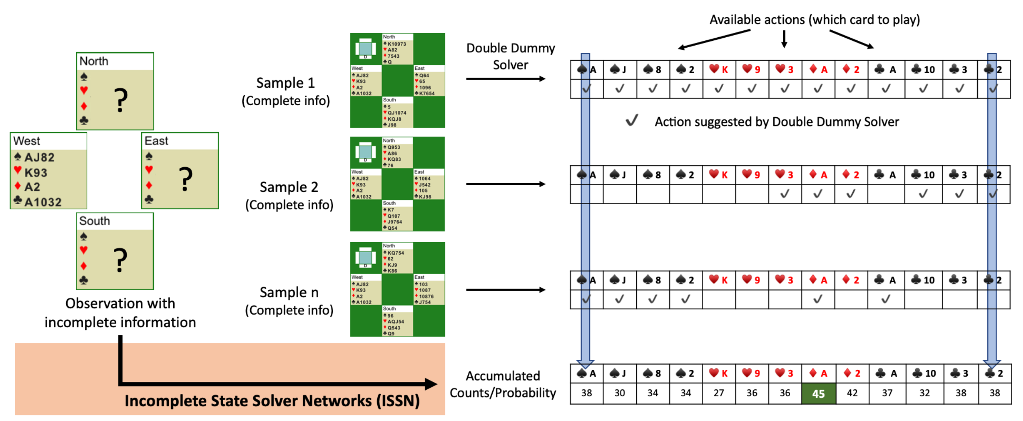
Incomplete State Solver Network (ISSN)

Slide 5
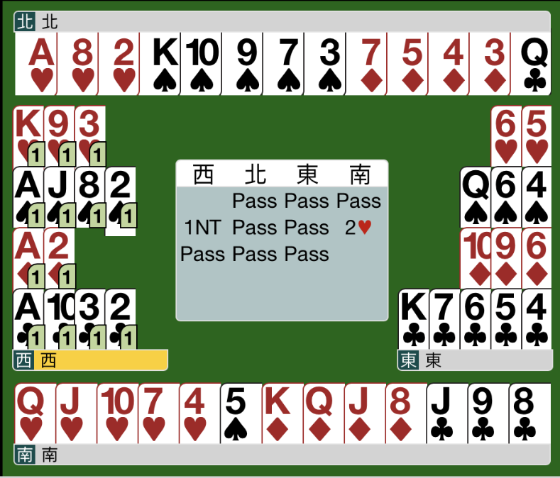

Slide 6
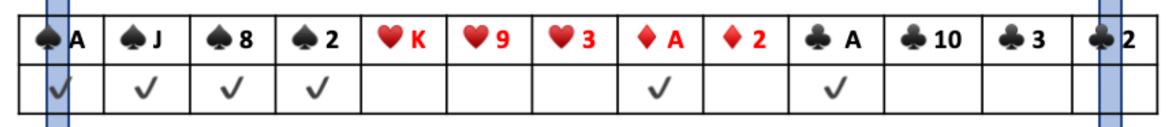
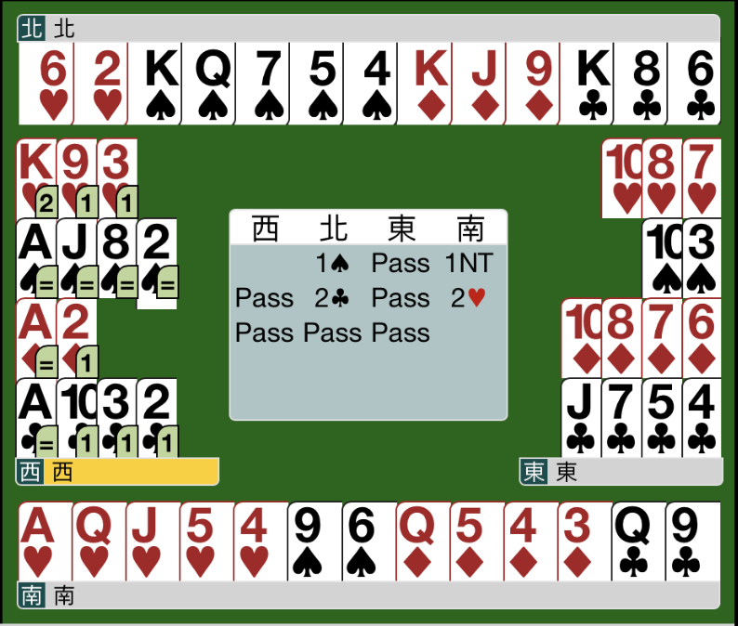

Slide 7
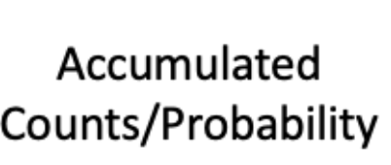

Slide 8
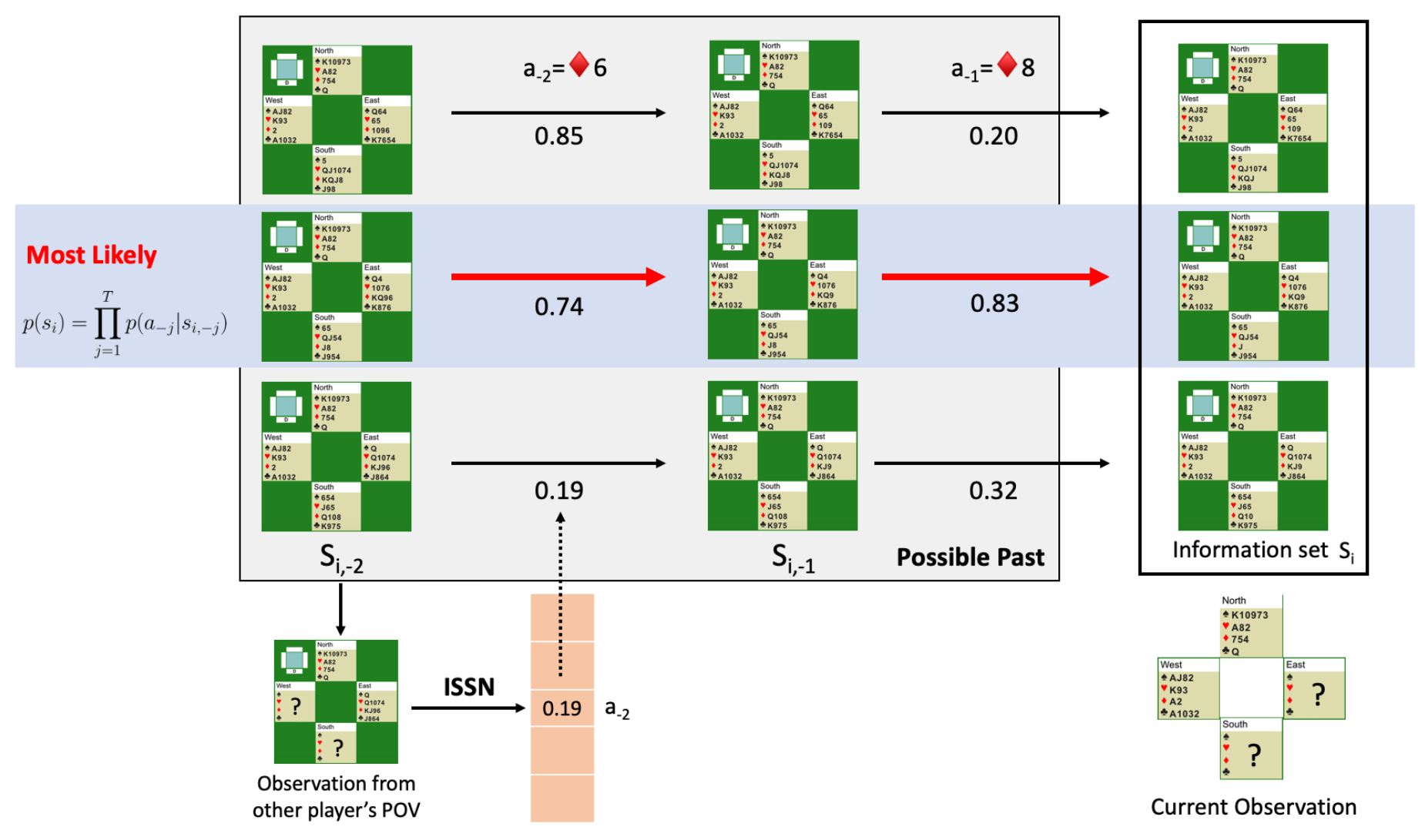
Sampled states reweigh

Slide 9
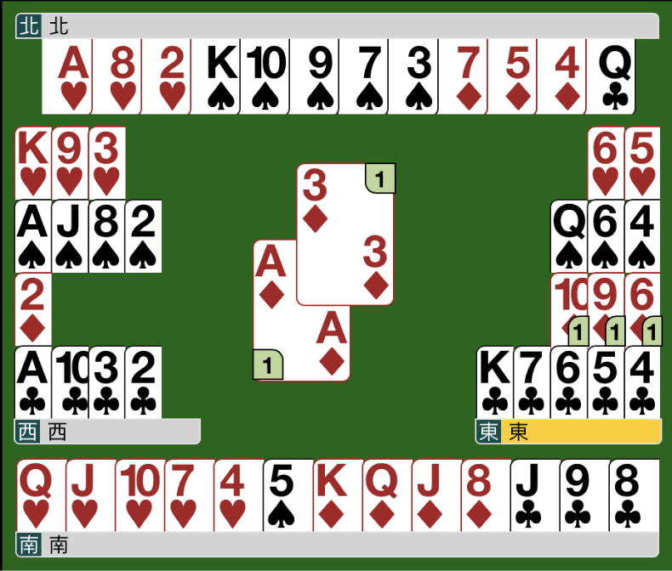
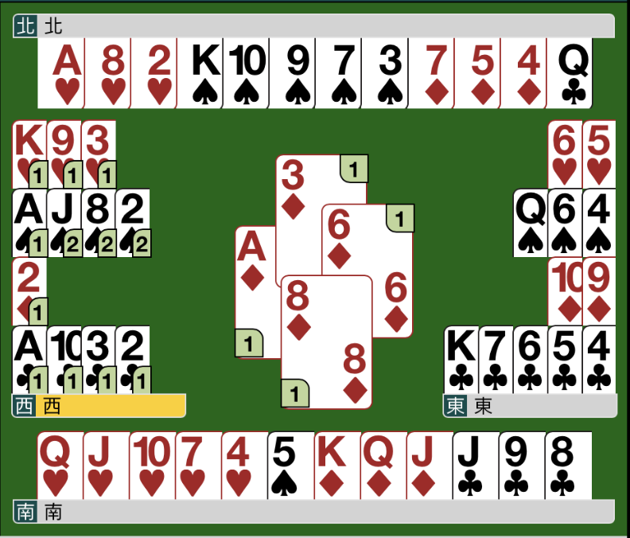

Sampled states reweigh

Slide 10
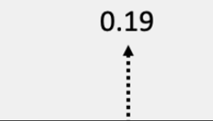

Slide 11

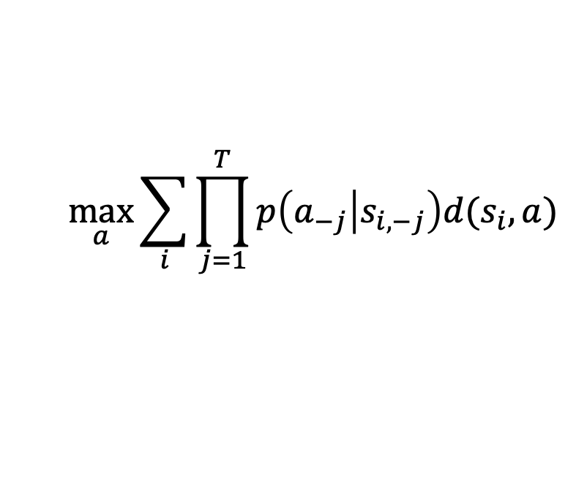
$$\max_{a}{\sum_{i}{\prod_{j=1}^{T}{p\left(a_{−j} | s_{i, −j}\right)d(s_{i},a)}}}$$

Slide 12
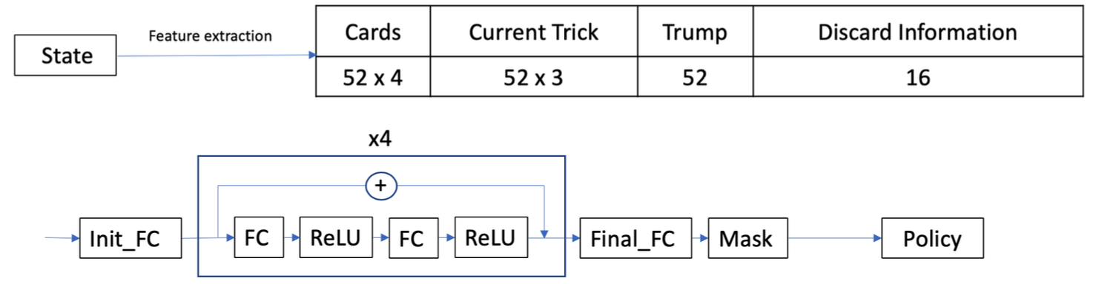
Network
Input: 432 neurons
Hidden layers: 8 * 100 neurons
Output: 52 possibilities

Slide 13
Problem Setup
Dataset: 84000 hands and 2.4 million positions.
90% training set and 10% testing set.
Double Dummy Solver on all 2.4 million positions as ground truth.
For each position, we run 50 simulations to compute the baselines and serve as training target of the pretrained network.

Slide 14
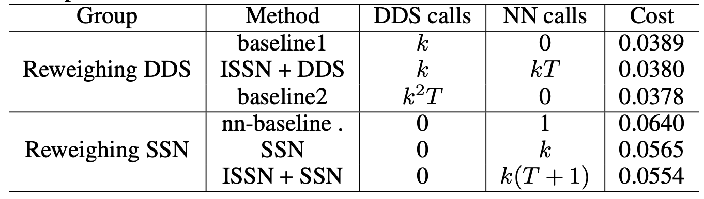
Experiment results
Baseline 1: DDS simulation results
Baseline 2: k simulations and for each simulation run k simulations
nn-baseline: ISSN only
Cost: trick loss per state

Slide 15
