Slide 1
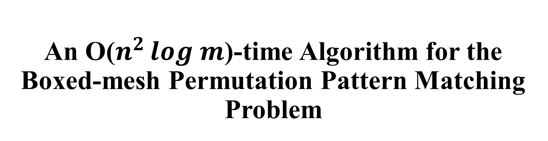
An O($n^{2 }log m$)-time Algorithm for the Boxed-mesh Permutation Pattern Matching Problem
Sukhyeun Cho, Joong Chae Na, Jeong Seop Sim,
Theoretical Computer Science(2018), pp. 35-43
Presenter: Wen-Wen Liao
Date: Aug. 8, 2023
Notes:
特拉維夫市以色列

Slide 2
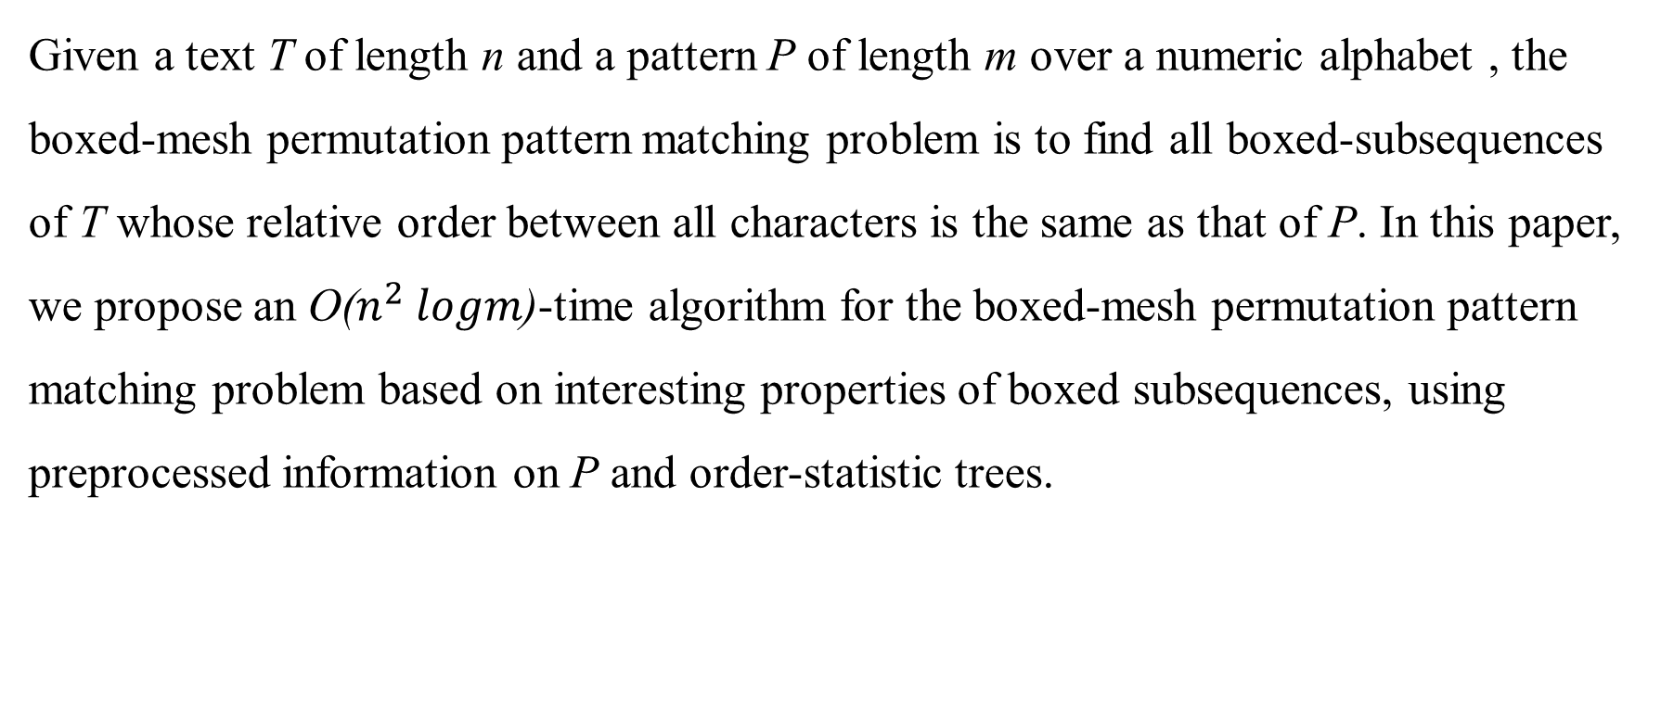
Abstract
Given a text T of length n and a pattern P of length m over a numeric alphabet , the boxed-mesh permutation pattern matching problem is to find all boxed-subsequences of T whose relative order between all characters is the same as that of P. In this paper, we propose an O($n^{2} logm$)-time algorithm for the boxed-mesh permutation pattern matching problem based on interesting properties of boxed subsequences, using preprocessed information on P and order-statistic trees.

Slide 3
Permutation matching problem
P = (5, 3, 4, 8, 9, 6, 7)
T = (10, 6, 2, 7, 15, 16, 12, 19, 13, 11, 3)
T’ = (10, 6, 7, 15, 16, 12, 13)
T’’ = (10, 2, 7, 15, 16, 12, 13)
→NP-hard

Slide 4
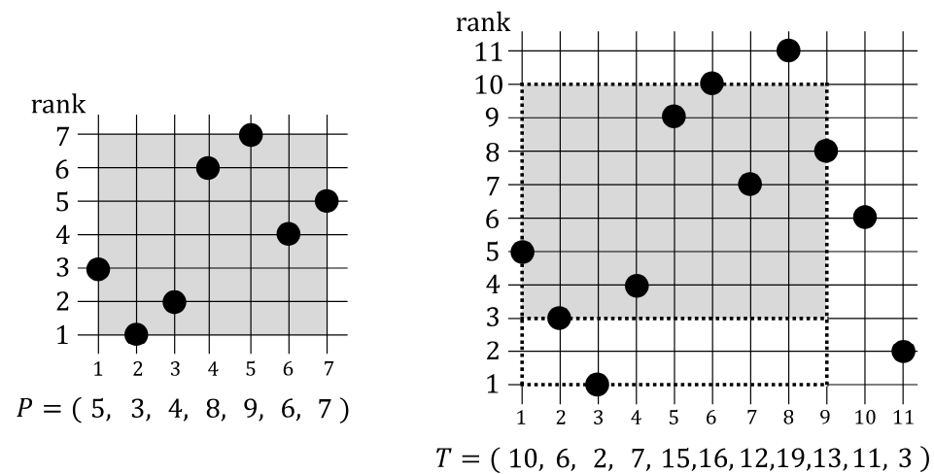
Boxed-mesh permutation pattern matching (BPPM)
P = (5, 3, 4, 8, 9, 6, 7)
rank(P) = (3, 1, 2, 6, 7, 4, 5)
T = (10, 6, 2, 7, 15, 16, 12, 19, 13, 11, 3)
rank(T) = (5, 3, 1, 4, 9, 10, 7, 11, 8, 6, 2)
Notes:
字符串匹配問題，它要求在一個序列中查找所有的子序列，這些子序列必須滿足一定的順序關係，並且在序列中的位置必須被限制在一個矩形框內

Slide 5
Boxed-mesh permutation pattern matching (BPPM)
P = (5, 3, 4, 8, 9, 6, 7)
T’ = (10, 6, 7, 15, 16, 12, 13)
→T’ is a boxed subsequence of T
Notes:
字符串匹配問題，它要求在一個序列中查找所有的子序列，這些子序列必須滿足一定的順序關係，並且在序列中的位置必須被限制在一個矩形框內

Slide 6
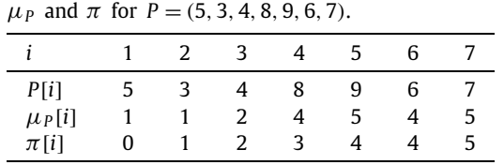
Boxed-mesh permutation pattern matching (BPPM)
P = (5, 3, 4, 8, 9, 6, 7)
T’ = (10, 6, 7, 15, 16, 12, 13)
→T’ ≈ P

Slide 7
Full-width boxed (f-boxed)
T’ = (T[1], T[2], T[4], T[7]) = (10, 6, 7, 12)
Full-width boxed: All the characters c of x such that min(x’) ≤ c ≤ max(x’)
full-width boxed
not full-width boxed

Slide 8
Full-width boxed (f-boxed)
T’ = (T[1], T[2], T[4], T[7]) = (10, 6, 7, 12)
Lower boundary
lb(T’, T [1..9]) = 2
Upper boundary
ub(T’, T [1..9]) = 13

Slide 9
Pivotal subsequence
P = (5, 3, 4, 8, 9, 6, 7)
T’ = (T[1], T[2], T[4], T[7]) = (10, 6, 7, 12)
C1. x includes the first character of x,
C2. x is an f-boxed subsequence of x, and
C3. x is order-isomorphic to the prefix P[1..|x|] of P ,
i.e., x ≈ P[1..|x|]
→ T’ is a pivotal subsequence
Notes:
關鍵子序列

Slide 10


Algorithm
P = (5, 3, 4, 8, 9, 6, 7)
T = (10, 6, 2, 7, 15, 16, 12, 19, 13, 11, 3)
The set of all the pivotal subsequences
$Z_{9}$ = {(10), (10, 7), (10, 6, 7), (10, 6, 7, 12), (10, 6, 7, 12, 13),
(10, 6, 7, 15, 16, 12, 13)}
$$lz_{9}$$

Slide 11

Algorithm
P = (5, 3, 4, 8, 9, 6, 7)
T = (10, 6, 2, 7, 15, 16, 12, 19, 13, 11, 3)
Example
z = $lz_{6}$= (10, 6, 7, 15, 16)
< 19 < $B_{ub}$ and r = Rank(T[8], z) =
Rank(19, z) = 7 is equal to μ[|z| + 1] = μ[6] = 4
→ (10, 6, 7, 15, 16, 12) is pivotal subsequences of T[1..7]

Slide 12

Algorithm
P = (5, 3, 4, 8, 9, 6, 7)
T = (10, 6, 2, 7, 15, 16, 12, 19, 13, 11, 3)
Example
z = $lz_{7}$= (10, 6, 7, 15, 16, 12)
$B_{lb}$ = 2, $B_{ub}$ = ∞
$∵$ T[8] = 19 > max(z) = 16
Since T[8] is not included in $lz_{8}$
→ update $B_{ub}$ = ub($lz_{8}$, T [1..8]) = min(∞, 19) = 19

Slide 13

Algorithm
P = (5, 3, 4, 8, 9, 6, 7)
T = (10, 6, 2, 7, 15, 16, 12, 19, 13, 11, 3)
Example
z = $lz_{8}$= (10, 6, 7, 15, 16, 12)
$B_{lb}$ = 2, $B_{ub}$ = 19
$B_{lb}$ < 13 < $B_{ub}$ and r = Rank(T[9], z) =
Rank(19, z) = 5 is equal to μ[|z| + 1] = μ[7] = 5
(10, 6, 7, 15, 16, 12, 13) is not pivotal subsequences of T[1..9]
→ delete largest characters (15, 16)
→ update $B_{ub}$ = 15

Slide 14
Algorithm
P = (5, 3, 4, 8, 9, 6, 7)
T = (10, 6, 2, 7, 15, 16, 12, 19, 13, 11, 3)
The set of all the pivotal subsequences
$Z_{9}$ = {(10), (10, 7), (10, 6, 7), (10, 6, 7, 12), (10, 6, 7, 12, 13),
(10, 6, 7, 15, 16, 12, 13)}
$$lz_{9}$$

Slide 15
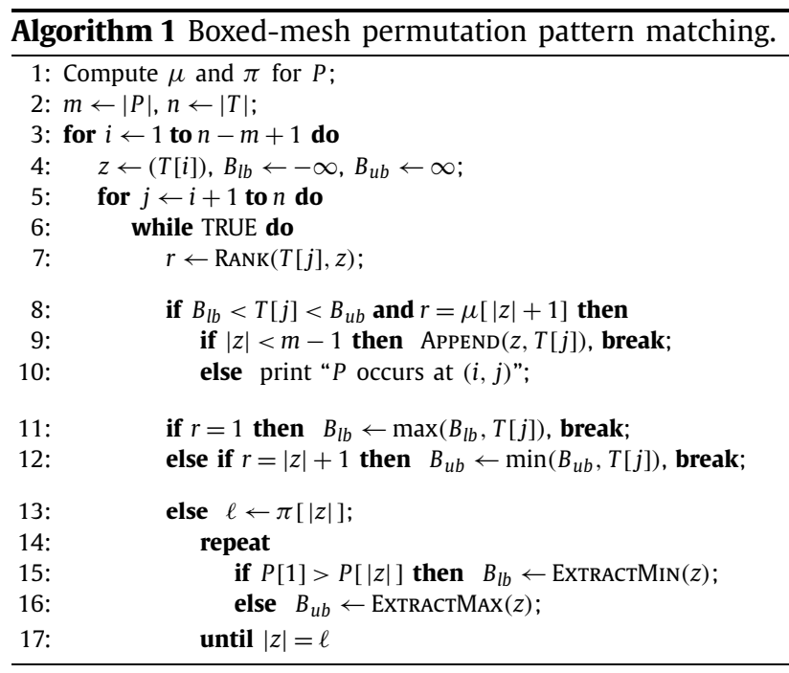

Conclusion
Time complexity: $O(n^{2} logm)$

Slide 16

Algorithm
P = (5, 3, 4, 8, 9, 6, 7)
T = (10, 6, 2, 7, 15, 16, 12, 19, 13, 11, 3)
$P6 =$ {(5), (5, 4), (5, 3, 4), (5, 3, 4, 6), (5, 3, 4, 8, 9, 6)}

