Slide 1
Computing Longest (Common) Lyndon Subsequences
Hideo Bannai, Tomohiro I, Tomasz Kociumaka, Dominik Köppl, Simon J. Puglisi
33rd International Workshop, IWOCA 2022, Trier, Germany, June 7–9, 2022
Presenter: Hsin-Chang Yu
Date: Aug. 8, 2023

Slide 2
Abstract
Given a string T with length n whose characters are drawn from an ordered alphabet of size σ, its longest Lyndon subsequence is a longest subsequence of T that is a Lyndon word. We propose algorithms for finding such a subsequence in O(n³) time with O(n) space, or online in O(n³σ) space and time. Our first result can be extended to find the longest common Lyndon subsequence of two strings of length n in O(n⁴σ) time using O(n³) space.

Slide 3
Lydon
A string is called Lyndon if it is lexicographically smaller (≺) than all its proper suffixes
Lyndon: a, ab, aab
not Lyndon: aba, abab

Slide 4
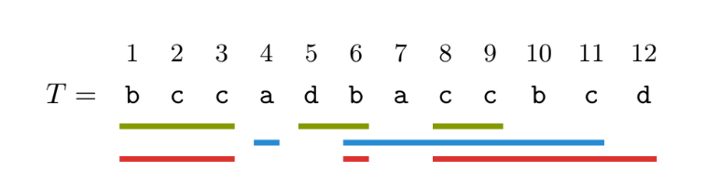
Lyndon subsequences
T[1..9]: bccdcc
T[1..11]: abaccbc
T[1..12]: bbcbccbcd

Slide 5
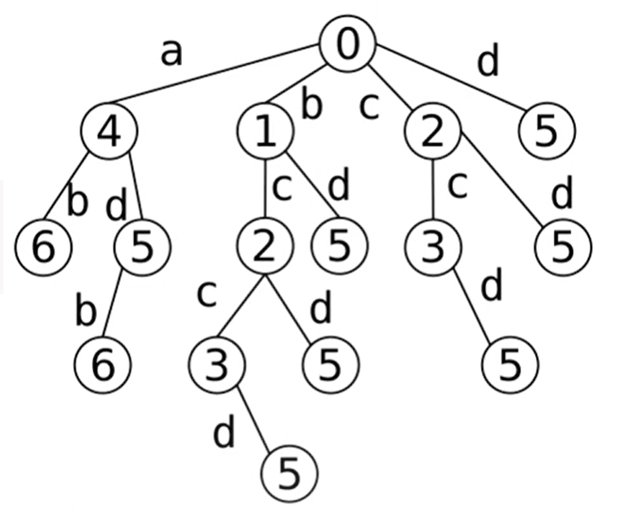
Trie of Lyndon subsequences
label c(v) of node v = end of leftmost occurrence of string read from root to v
c(parent(v)) < c(v)
T=b c c a d b a

Slide 6
Trie of Lyndon subsequences
leaves are Lyndon subsequences
deepest leaf is longest Lyndon subsequence
T=b c c a d b a
Notes:
but we dont build
which lead to lyndon subsequences?

Slide 7
Pre-Lyndon / Immature
a sring is called pre-Lyndon if it is a prefix of Lyndon string
a string is immature if it is pre-Lyndon but not Lyndon

Slide 8
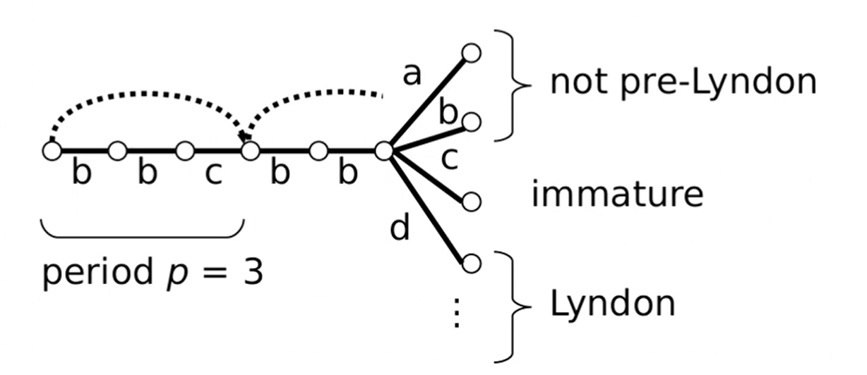
Pre-Lyndon / Immature
Notes:
Given a string S of length n, an integer p ∈ [1..n] is a period of S if S[i] = S[i + p] for all i ∈ [1..n − p].
S[|S| − p + 1] = c

Slide 9
Pre-Lyndon / Immature
W pre-Lyndon, c character, p period of W
c = W[|W| − p + 1] ⇔ Wc immature
c > W[|W| − p + 1] ⇔ Wc Lyndon

Slide 10
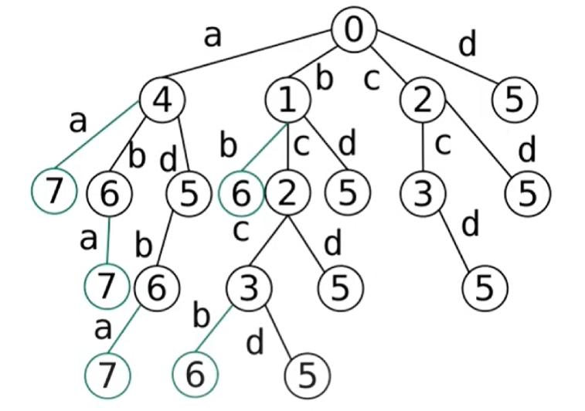
Trie of Pre-Lyndon subsequences
T=b c c a d b a

Slide 11
Stack
S = [4,6,7]
T=b c c a d b a
Notes:
implicitly represent trie by a stack S simulating a depth-first search(DFS)

Slide 12
Stack + Period
S = [(4,1),(6,2)]
compare T[S[|S| − p + 1]] with in-going edge of v
T=b c c a d b a

Slide 13
Improvement
if we visit a node u whose subsequence is lexicographically larger than a longer subsequence of an already visited node v, we prune u

Slide 14
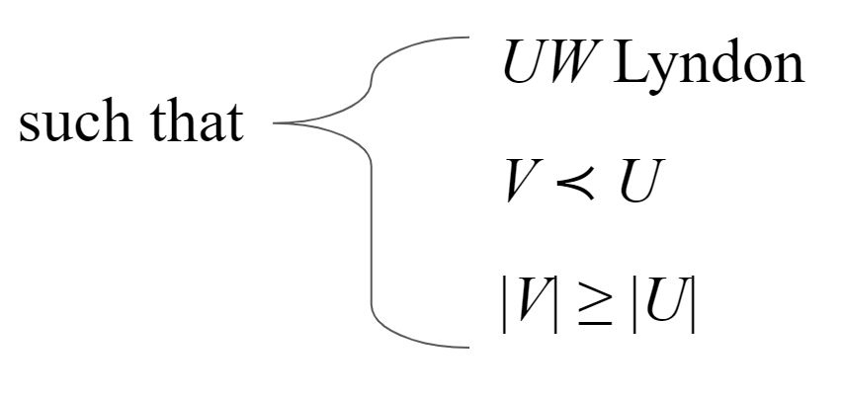
Lemma
V Lyndon
U,W ∈ Σ∗
⇒ VW Lyndon and VW ≺ UW

Slide 15
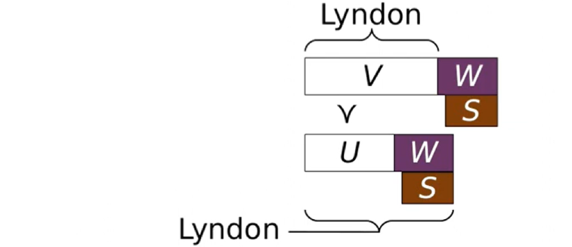
Lemma
V Lyndon
U,W ∈ Σ∗
⇒ VW Lyndon and VW ≺ UW
take suffix S of VW
1.|S| ≤ |W|
Notes:
S > UW > VW

Slide 16
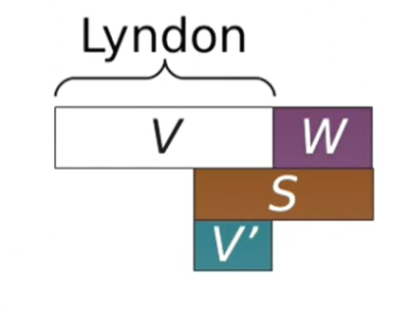
Lemma
V Lyndon
U,W ∈ Σ∗
⇒ VW Lyndon and VW ≺ UW
take suffix S of VW
2.|S| > |W|
Notes:
S > V’ > VW

Slide 17
Algorithmic Execition
initial state: S = Ø
L = ∞ ∞ ∞ ∞ ∞ ∞ ∞
T=b c c a d b a
Notes:
maintain dynamic array L[1..n]:
L[]: smallest text position i for which we know

Slide 18
Algorithmic Execition
S = (4,1) (6,2)
a
ab
L = 4 6 ∞ ∞ ∞ ∞ ∞
T=b c c a d b a

Slide 19
Algorithmic Execition
S = (4,1) (5,2) (6,3)
ad
adb
L = 4 5 6 ∞ ∞ ∞ ∞
T=b c c a d b a

Slide 20
Algorithmic Execition
S = (1,1) (2,2) (3,3) (5,4)
b
bc
bcc
bccd
L = 1 2 3 5 ∞ ∞ ∞
T=b c c a d b a

Slide 21
Algorithmic Execition
S = (1,1) (2,2) (5,3)
find subsequence bcd at node u but L[|bcd|] = 3 < 5 ⇒ prune u
L = 1 2 3 5 ∞ ∞ ∞
T=b c c a d b a

Slide 22
Time Complexity / Space
time: O(n³σ)
space: O(nσ)

Slide 23
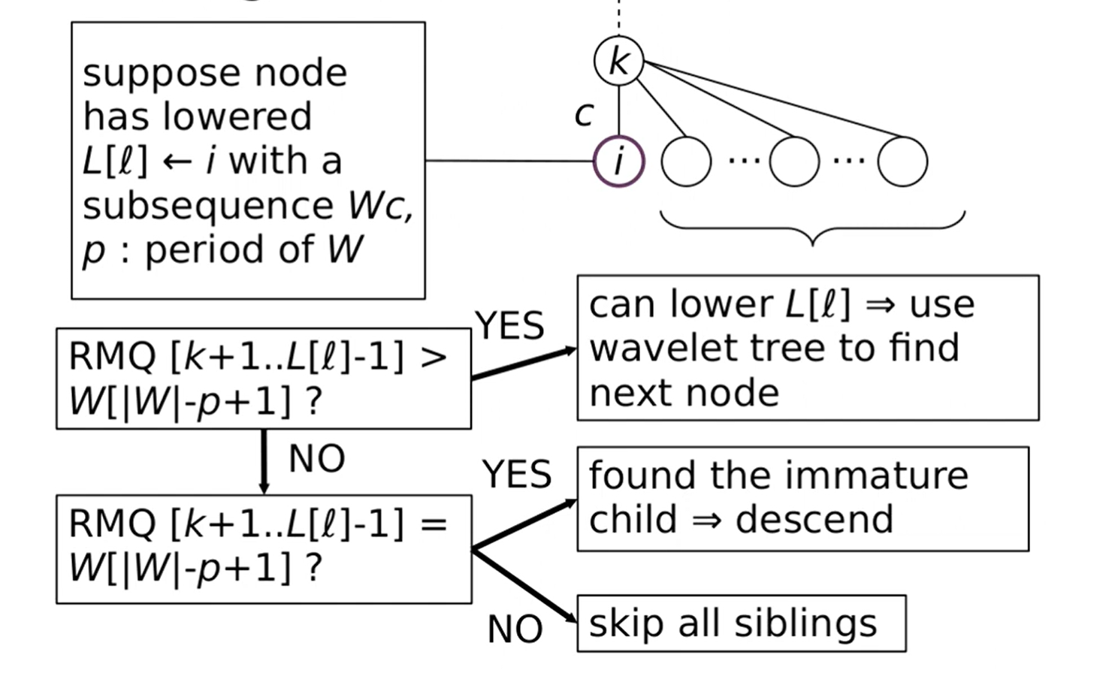

Slide 24
Time Complexity (cont.)
total time: O(n³ + n²lgσ) = O(n³)
space: O(n)

