Slide 1
Intelligent Predictive String Search Algorithm
Dipendra Gurung, Udit Kr. Chakraborty , Pratikshya Sharma
7th International Conference on Communication, Computing and Virtualization 2016, Mumbai, India.
Presenter: Zhi-Cheng Shen
Date: Aug. 08, 2023

Slide 2
Abstract 1
Text processing has moved beyond merely word processing and desktop publishing softwares, which currently form a miniscule part of its application. With the advent of the internet and the huge amount of text processing associated with information mining, string search algorithms have gained importance. In this paper a new string searching algorithm is presented that uses intelligent predictions based on text features to search for a string in a text. The proposed algorithm has been developed after analyzing the existing algorithms such as KMP, Boyer-Moore and Horspool. One unique feature of this algorithm is that unlike the existing algorithms, it does not require pre-processing the pattern to be searched.

Slide 3
Abstract 2
As a result it does not incur the overhead required in pre-processing the pattern. The algorithm searches through a given text to find the first occurrence of a pattern. It does not involve complex computations and uses simple rules during a match or mismatch of a pattern character. Based on the variety of applications coming up in areas of data and information mining, sentiment analysis, DNA pattern matching etc, this simple, elegant and intelligent algorithm will find its application.

Slide 4
Boyer Moore Algorithm
T = This is an alemple eleaple
P = eleaple

Slide 5
Boyer Moore Algorithm
T | T | h | i | s |  | i | s |  | a | n |  | a | l | e | m | p | l | e |  | e | l | e | a | p | l | e
P | e | l | e | a | p | l | e

Slide 6
Boyer Moore Algorithm
T | T | h | i | s |  | i | s |  | a | n |  | a | l | e | m | p | l | e |  | e | l | e | a | p | l | e
P |  |  |  |  |  |  |  | e | l | e | a | p | l | e

Slide 7
Boyer Moore Algorithm
T | T | h | i | s |  | i | s |  | a | n |  | a | l | e | m | p | l | e |  | e | l | e | a | p | l | e
P |  |  |  |  |  |  |  |  |  |  |  | e | l | e | a | p | l | e

Slide 8
Boyer Moore Algorithm
T | T | h | i | s |  | i | s |  | a | n |  | a | l | e | m | p | l | e |  | e | l | e | a | p | l | e
P |  |  |  |  |  |  |  |  |  |  |  |  |  |  |  |  |  | e | l | e | a | p | l | e

Slide 9
Boyer Moore Algorithm
T | T | h | i | s |  | i | s |  | a | n |  | a | l | e | m | p | l | e |  | e | l | e | a | p | l | e
P |  |  |  |  |  |  |  |  |  |  |  |  |  |  |  |  |  |  |  | e | l | e | a | p | l | e

Slide 10
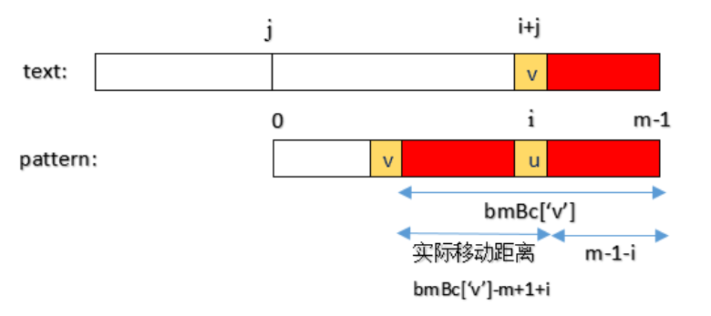
移動距離

Slide 11
Bad character
0 | 1 | 2 | 3 | 4 | 5 | 6
e | l | e | a | p | l | e
bmbc[]
e | l | a | p | *
4 | 1 | 3 | 2 | 7

Slide 12
suffix
P = eleaple
Suff[6] = strlen = 7
Suff[5] = 0
Suff[4] = 0
Suff[3] = 0
Suff[2] = 2
Suff[1] = 0
Suff[0] = 1

Slide 13
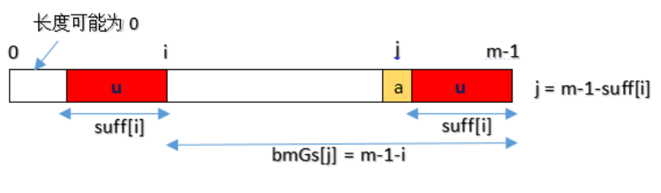
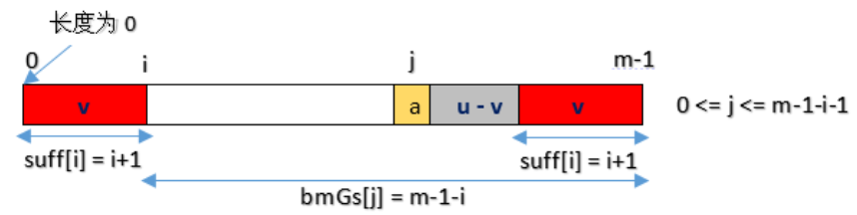
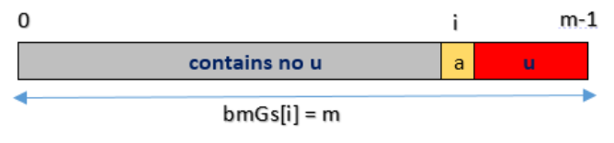
Good suffix
Case 1
Case 2
Case 3

Slide 14
Bmgs[]
P = eleaple
Suff[6] = 7 bmgs[5] = 6 bmgs[3] = 6
Suff[5] = 0 bmgs[6] = 5 bmgs[2] = 6
Suff[4] = 0 bmgs[4] = 4 bmgs[1] = 6
Suff[3] = 0 bmgs[6] = 3 bmgs[0] = 6
Suff[2] = 2 bmgs[6] = 2 case 2
Suff[1] = 0 bmgs[6] = 1
Suff[0] = 1 case 1

Slide 15
Time complexity
Preprocessing: O(m+δ)
Run time complexity:
best: O(n/m)
worst:O(n*m)

Slide 16
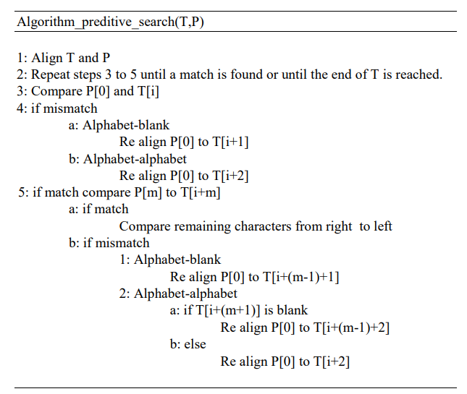
The Proposed Algorithm

Slide 17
The Proposed Algorithm
T | c | a | t | y |  | i | s |  | c | u | t | e
P | c | u | t | e

Slide 18
The Proposed Algorithm
T | c | a | t | y |  | i | s |  | c | u | t | e
P |  |  |  |  |  | c | u | t | e

Slide 19
The Proposed Algorithm
T | c | a | t | y |  | i | s |  | c | u | t | e
P |  |  |  |  |  |  |  | c | u | t | e

Slide 20
The Proposed Algorithm
T | c | a | t | y |  | i | s |  | c | u | t | e
P |  |  |  |  |  |  |  |  | c | u | t | e

Slide 21
Thanks~

